Slide 1
An Introduction to Computing and Problem Solving
Chapter 1
© 2016 Pearson Education, Ltd. All rights reserved.

Slide 2
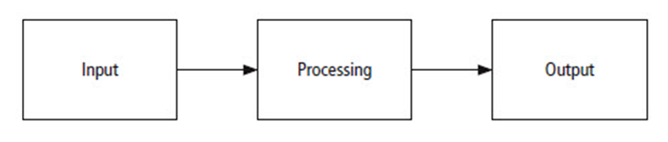
Program Development Cycle
FIGURE 1.1 The problem solving process.
© 2016 Pearson Education, Ltd. All rights reserved.

Slide 3
Program Planning
Analyze: Define the problem.
Design: Plan the solution to the problem.
Code: Translate the algorithm into a programming language.
Test and correct: Locate and remove any errors in the program.
Complete the documentation: Organize all the material that describes the program.
© 2016 Pearson Education, Ltd. All rights reserved.

Slide 4
Programming Tools
Algorithms
Flowcharts
Pseudocode
Hierarchy charts
© 2016 Pearson Education, Ltd. All rights reserved.

Slide 5
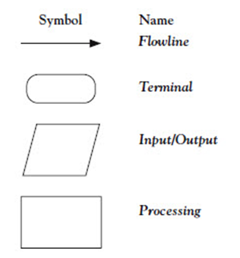
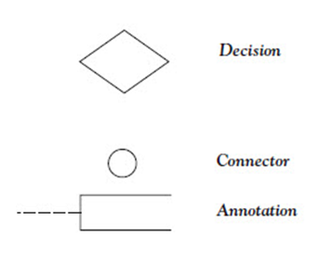
Flowcharts
© 2016 Pearson Education, Ltd. All rights reserved.

Slide 6
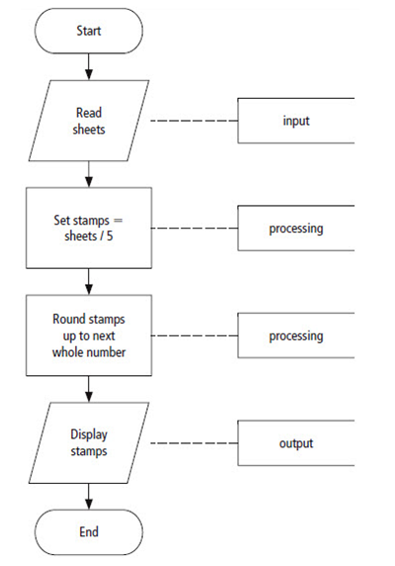
Example Flowchart
FIGURE 1.2 Flowchart for the postage-stamp problem.
© 2016 Pearson Education, Ltd. All rights reserved.

Slide 7
Pseudocode
Abbreviated plain English version of actual computer code
Symbols used in flowcharts replaced by English-like statements
Allows programmer to focus on steps required to solve problem
© 2016 Pearson Education, Ltd. All rights reserved.

Slide 8
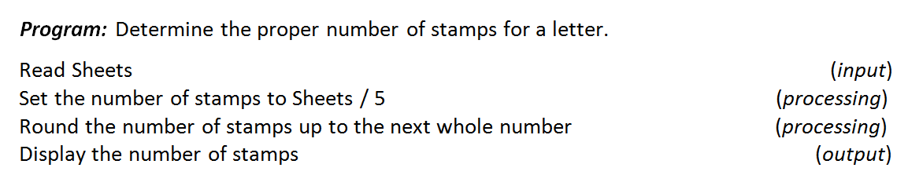
Example Pseudocode
FIGURE 1.3 Pseudocode for the postage stamp problem.
© 2016 Pearson Education, Ltd. All rights reserved.

Slide 9
Hierarchy Chart
Shows the overall program structure
Depict organization of program, omit specific processing logic
Describe what each part, or module, of the program does
Each module subdivided into a succession of submodules
© 2016 Pearson Education, Ltd. All rights reserved.

Slide 10
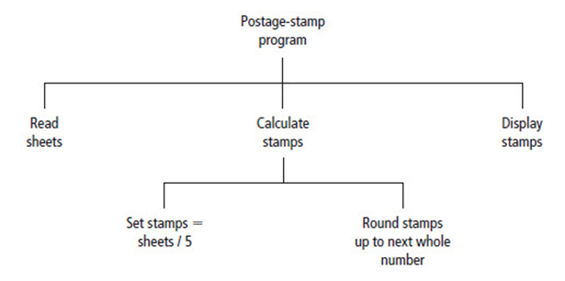
Example Hierarchy Chart
FIGURE 1.4 Hierarchy chart for the postage-stamp problem.
© 2016 Pearson Education, Ltd. All rights reserved.

Slide 11
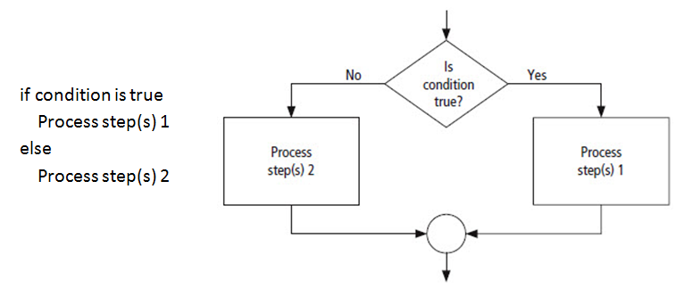
Decision Structure
FIGURE 1.5 Pseudocode and flowchart for a decision structure.
© 2016 Pearson Education, Ltd. All rights reserved.

Slide 12
Direction of Numbered
NYC Streets Algorithm
Problem: Given street number of one-way street in New York City, decide direction of street, either eastbound or westbound.
Discussion: There is a simple rule to tell the direction of a one-way street in New York City: Even-numbered streets run eastbound.
© 2016 Pearson Education, Ltd. All rights reserved.

Slide 13
Direction of Numbered
NYC Streets Algorithm
Input: Street number.
Processing: Decide if the street number is divisible by 2.
Output: “Eastbound” or “Westbound”.
© 2016 Pearson Education, Ltd. All rights reserved.

Slide 14
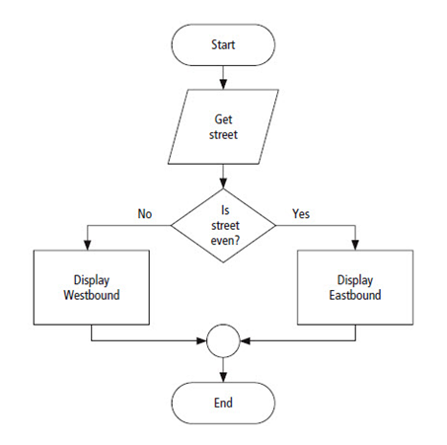
Direction of Streets Algorithm
FIGURE 1.6 Flowchart for the numbered
New York City streets problem.
© 2016 Pearson Education, Ltd. All rights reserved.

Slide 15
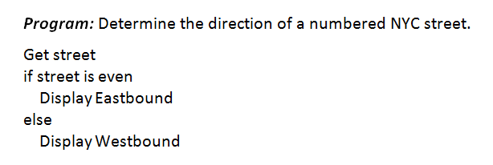
Direction of Streets Algorithm
FIGURE 1.7 Pseudocode for the numbered
New York City streets problem.
© 2016 Pearson Education, Ltd. All rights reserved.

Slide 16
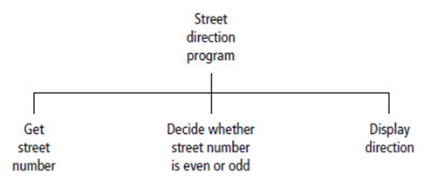
Direction of Streets Algorithm
FIGURE 1.8 Hierarchy chart for the numbered
New York City streets problem.
© 2016 Pearson Education, Ltd. All rights reserved.

Slide 17
Repetition Structure
A programming structure that executes instructions many times
  Repetition structure
  Looping structure
Need a test (or condition) to tell when the loop should end
  Check condition before each pass through loop
© 2016 Pearson Education, Ltd. All rights reserved.

Slide 18
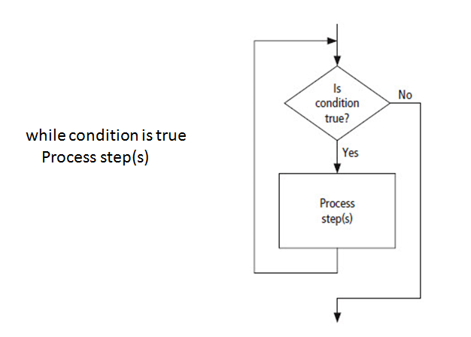
Direction of Streets Algorithm
FIGURE 1.9 Pseudocode and flowchart for a loop.
© 2016 Pearson Education, Ltd. All rights reserved.

Slide 19
Class Average Algorithm
Problem: Calculate and report the average grade for a class.
Discussion: Average grade equals sum of all grades divided by number of students.
  Need loop to read and then add (accumulate) grades for each student in class.
  Inside the loop, we also need to total (count) number of students in class.
© 2016 Pearson Education, Ltd. All rights reserved.

Slide 20
Class Average Algorithm
Input: Student grades.
Processing: Find the sum of the grades; count the number of students; calculate average grade = sum of grades / number of students.
Output: Average grade
© 2016 Pearson Education, Ltd. All rights reserved.

Slide 21
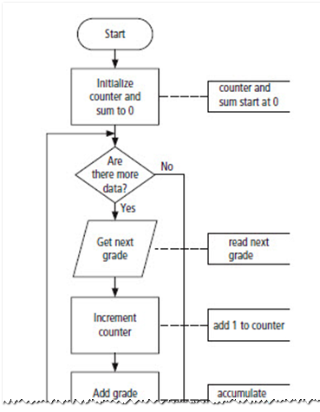
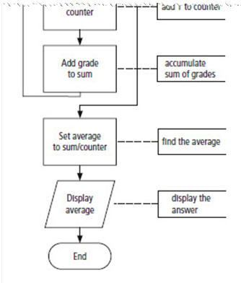
Class Average Algorithm
FIGURE 1.10 Flowchart for the class average problem.
© 2016 Pearson Education, Ltd. All rights reserved.

Slide 22
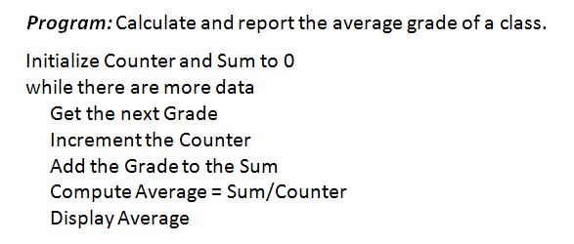
Class Average Algorithm
FIGURE 1.11 Pseudocode for the class average problem.
© 2016 Pearson Education, Ltd. All rights reserved.

Slide 23
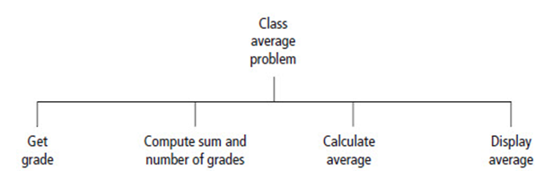
Class Average Algorithm
FIGURE 1.12 Hierarchy chart for the class average problem.
© 2016 Pearson Education, Ltd. All rights reserved.

Slide 24
End
Sections 1 - 3
Chapter 1
© 2016 Pearson Education, Ltd. All rights reserved.

