Slide 1
Core Objects, Variables, Input, and Output
Section 1
Chapter 2
© 2016 Pearson Education, Ltd. All rights reserved.

Slide 2
Numbers
Numbers are referred to as numeric literals
Two Types of numbers: ints and floats
  Whole number written without a decimal point called an int
  Number written with a decimal point called a float
© 2016 Pearson Education, Ltd. All rights reserved.

Slide 3
Numbers
Arithmetic Operators
  Addition, subtraction, multiplication, division, and exponentiation.
Result of a division is always a float
Result of the other operations is a float if …
  Either of the numbers is a float
  Otherwise is an int.
© 2016 Pearson Education, Ltd. All rights reserved.

Slide 4
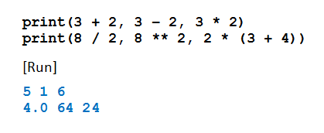
The print Function
Used to display numbers on the monitor
  If n is a number, print(n) displays number n.
  The print function can display the result of evaluated expressions
  A single print function can display several values
Example 1: Program
demonstrates
operations
© 2016 Pearson Education, Ltd. All rights reserved.

Slide 5
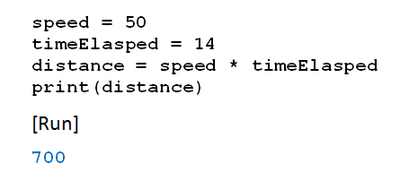
Variables
In mathematics problems, quantities are referred to by names
Names given to the values are called variables
Example 2: Program uses speed, time … calculates distance
© 2016 Pearson Education, Ltd. All rights reserved.

Slide 6
Variables
Assignment statements
Expression on right evaluated
  That value assigned to variable
© 2016 Pearson Education, Ltd. All rights reserved.

Slide 7
Variables
Variable names in Python
  Begin with letter or underscore _
  Can only consist of letters, numbers, underscores
Recommend using descriptive variable names
Convention will be
  Begin with lowercase
  Use cap for additional “word” in the name
  Example: rateOfChange
© 2016 Pearson Education, Ltd. All rights reserved.

Slide 8
Variables
Names in Python are case-sensitive
There are thirty-three words, called reserved words (or keywords)
  Have special meanings in Python
  Cannot be used as variable names
  See Appendix B
© 2016 Pearson Education, Ltd. All rights reserved.

Slide 9
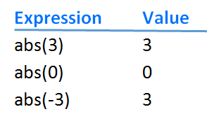
The abs Function
© 2016 Pearson Education, Ltd. All rights reserved.

Slide 10
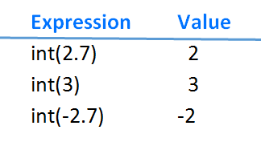
The int Function
© 2016 Pearson Education, Ltd. All rights reserved.

Slide 11
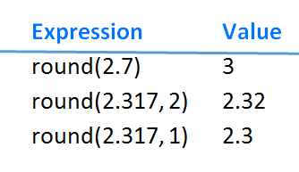
The round Function
© 2016 Pearson Education, Ltd. All rights reserved.

Slide 12
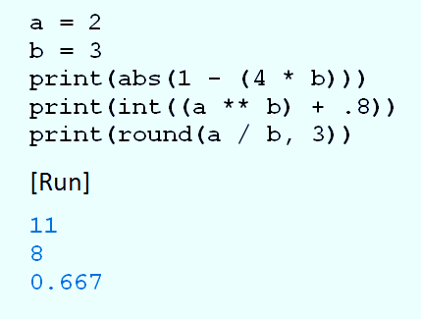
abs, int, and round Example
Example 3: Program evaluates functions, prints results
© 2016 Pearson Education, Ltd. All rights reserved.

Slide 13
Augmented Assignments
Remember: expression on right side of assignment statement evaluated before assignment is made
var = var + 1
Python has special operator to accomplish same thing
var += 1
© 2016 Pearson Education, Ltd. All rights reserved.

Slide 14
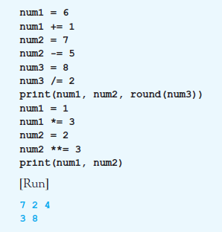
Augmented Assignments
Example 4:
Program illustrates
different
augmented
assignment
operators.
© 2016 Pearson Education, Ltd. All rights reserved.

Slide 15
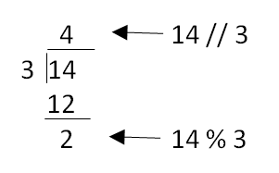
Two Other Integer Operators
Integer division operator
  Written //
Modulus operator
  Written %
© 2016 Pearson Education, Ltd. All rights reserved.

Slide 16
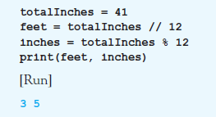
Two Other Integer Operators
Example 5: converts 41 inches to 3 feet,
5 inches:
© 2016 Pearson Education, Ltd. All rights reserved.

Slide 17
Parentheses, Order of Precedence
Parentheses used to clarify meaning of an expression
Order of precedence
  Terms inside parentheses (inner to outer)
  Exponentiation
  Multiplication, division (ordinary and integer), modulus
  Addition and subtraction
© 2016 Pearson Education, Ltd. All rights reserved.

Slide 18
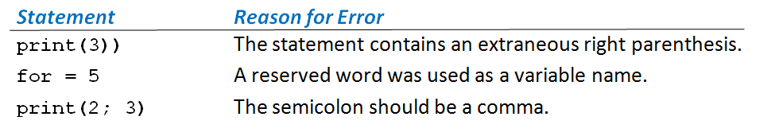
Syntax Errors
Grammatical and punctuation errors are called syntax errors.
Table 2.1 Three Syntax Errors
© 2016 Pearson Education, Ltd. All rights reserved.

Slide 19
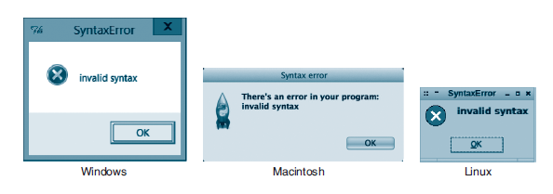
Syntax Errors
FIGURE 2.1 Syntax error message boxes.
© 2016 Pearson Education, Ltd. All rights reserved.

Slide 20
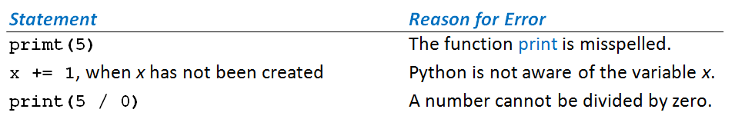
Runtime Errors
Errors discovered while program is running called runtime errors or exceptions
Table 2.2 Three Runtime Errors
© 2016 Pearson Education, Ltd. All rights reserved.

Slide 21
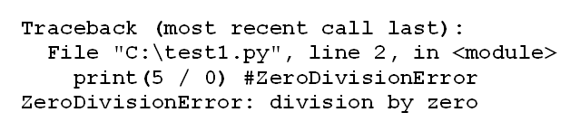
Runtime Errors
When Python encounters exception
  Terminates execution of program, displays message
FIGURE 2.2 An Error Message for an Exception Error
© 2016 Pearson Education, Ltd. All rights reserved.

Slide 22
Logic Error
Occurs when a program does not perform the way it was intended
Example
average = firstNum + secondNum / 2
Syntax correct, logic wrong: should be
average = (firstNum + secondNum) / 2
Logic errors are most difficult type of error to locate
© 2016 Pearson Education, Ltd. All rights reserved.

Slide 23

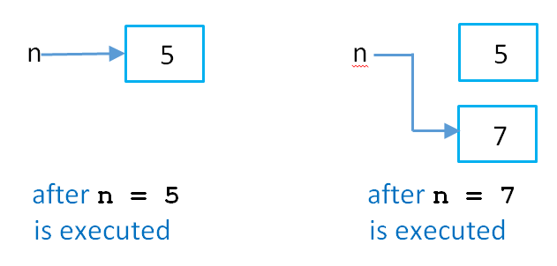
Numeric Objects in Memory
Consider this code:
This is
what
happens:
FIGURE 2.3 Numeric objects in memory.
© 2016 Pearson Education, Ltd. All rights reserved.

Slide 24
End
Section 1
Chapter 2
© 2016 Pearson Education, Ltd. All rights reserved.

