Slide 1
Output
Section 3
Chapter 2
© 2016 Pearson Education, Ltd. All rights reserved.

Slide 2
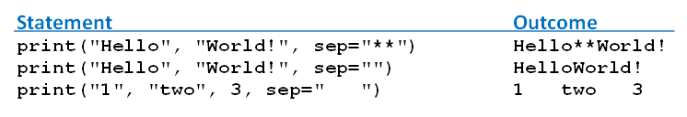
Optional print Argument sep
Consider statement
print(value0, value1, …, valueN)
Print function uses string consisting of one space character as separator
Optionally change the separator to any string we like with the sep argument
© 2016 Pearson Education, Ltd. All rights reserved.

Slide 3
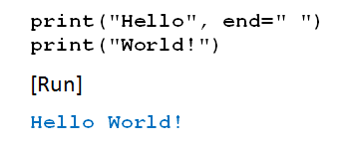
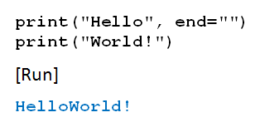
Optional print Argument end
Print statement ends by executing a newline operation.
Optionally change the ending operation with the end argument
© 2016 Pearson Education, Ltd. All rights reserved.

Slide 4
Escape Sequences
Short sequences placed in strings
  Instruct cursor or permit some special characters to be printed.
  First character is always a backslash (\).
\t induces a horizontal tab
\n induces a newline operation
© 2016 Pearson Education, Ltd. All rights reserved.

Slide 5
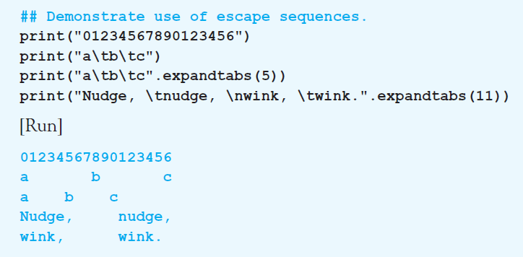
Escape Sequences
Example 1: Program demonstrates the use of the escape sequences \t and \n.
© 2016 Pearson Education, Ltd. All rights reserved.

Slide 6
Escape Sequences
Backslash also used to treat quotation marks as ordinary characters.
\” causes print function to display double quotation mark
\\ causes print function to display single backslash
© 2016 Pearson Education, Ltd. All rights reserved.

Slide 7
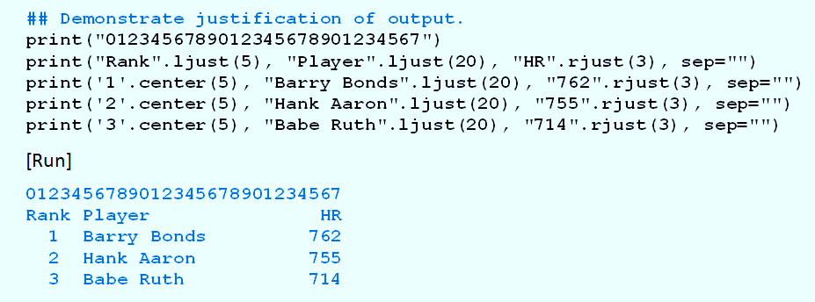
Justifying Output in a Field
Example 2: Program demonstrates methods ljust(n), rjust(n), and center(n)
© 2016 Pearson Education, Ltd. All rights reserved.

Slide 8
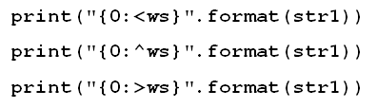
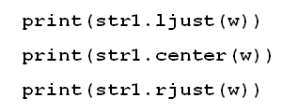
Justify Output with format
Given: str1 is a string and w is a field width
© 2016 Pearson Education, Ltd. All rights reserved.

Slide 9
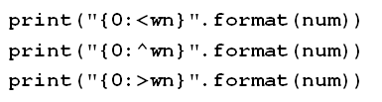
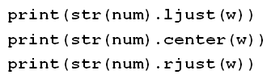
Justify Output with format
Given: num is a number and w is a field width
© 2016 Pearson Education, Ltd. All rights reserved.

Slide 10
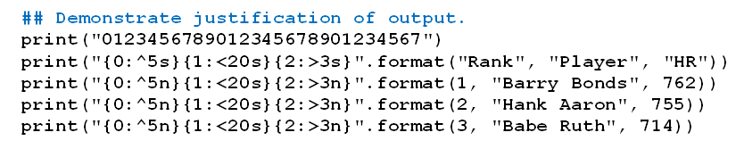
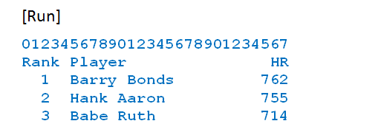
Justify Output with format
Example 3: Program illustrates formatting
© 2016 Pearson Education, Ltd. All rights reserved.

Slide 11
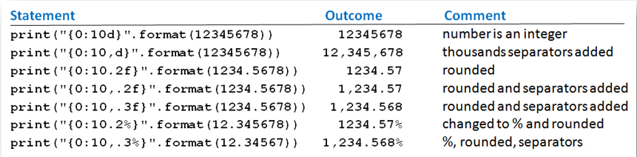
Justify Output with format
Table 2.4 Demonstrate number formatting.
© 2016 Pearson Education, Ltd. All rights reserved.

Slide 12
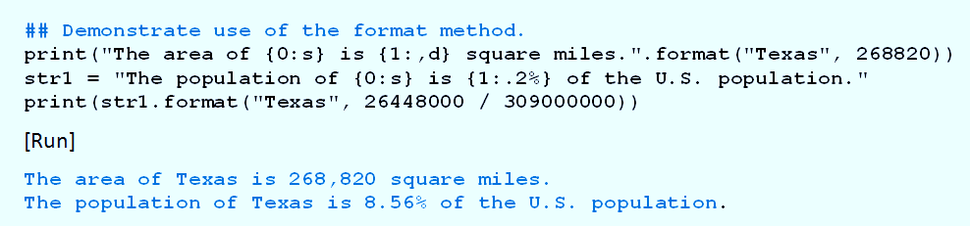
Justify Output with format
Example 4: Program formatting with curly brackets
© 2016 Pearson Education, Ltd. All rights reserved.

Slide 13
End
Section 3
Chapter 2
© 2016 Pearson Education, Ltd. All rights reserved.

