Slide 1
Decision Structures
Section 2
Chapter 3
© 2016 Pearson Education, Ltd. All rights reserved.

Slide 2
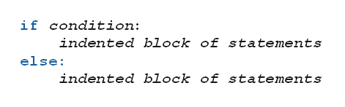
if-else Statements
Also known as branching structures
Allow program to decide on course of action
  Based on whether a certain condition is true or false.
Form:
© 2016 Pearson Education, Ltd. All rights reserved.

Slide 3
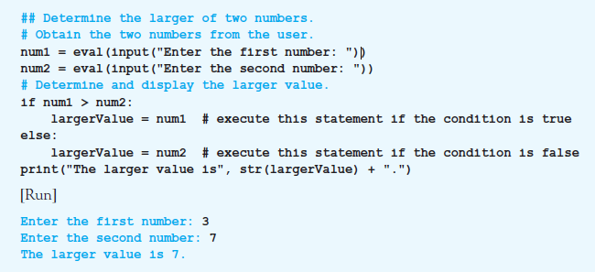
if-else Statements
Example 1: Program finds larger of two numbers input by user.
© 2016 Pearson Education, Ltd. All rights reserved.

Slide 4
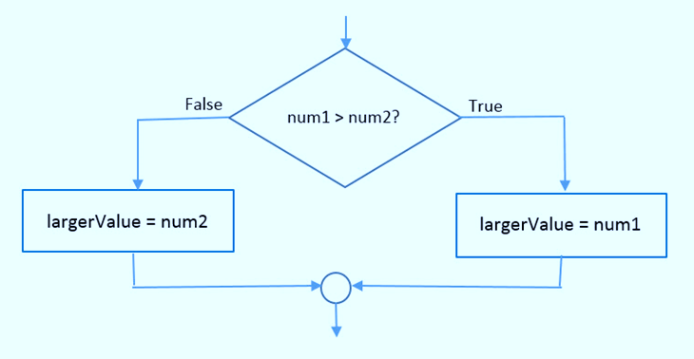
if-else Statements
FIGURE 3.1 Flowchart for the if-else statement in Example 1.
© 2016 Pearson Education, Ltd. All rights reserved.

Slide 5
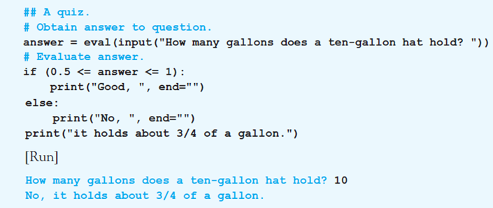
if-else Statements
Example 2: if-else statement in program has relational operators in its condition.
© 2016 Pearson Education, Ltd. All rights reserved.

Slide 6
if Statements
The else part of an if-else statement can be omitted
When the condition is false
  Execution continues with line after the if statement block
© 2016 Pearson Education, Ltd. All rights reserved.

Slide 7
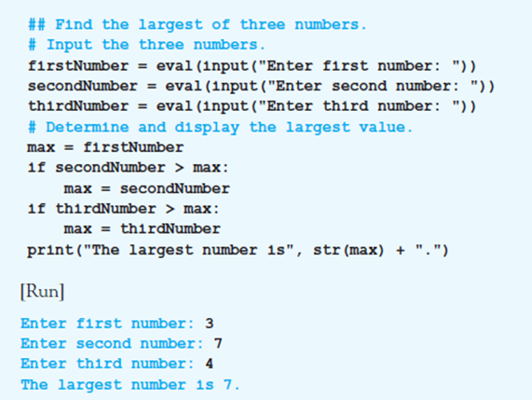
if Statements
Example 3: Program contains two if statements
© 2016 Pearson Education, Ltd. All rights reserved.

Slide 8
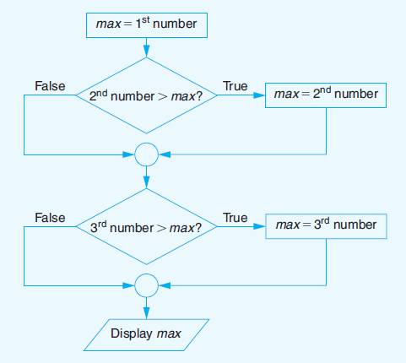
if Statements
FIGURE 3.2 Flowchart for Example 3.
© 2016 Pearson Education, Ltd. All rights reserved.

Slide 9
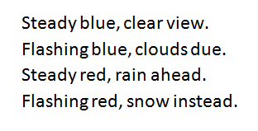
Nested if-else Statements
Indented blocks of if-else and if statements can contain other if-else and if statements
  The if-else statements are said to be nested
Consider the task of interpreting a beacon
  The color of the beacon light atop Boston’s old John Hancock building forecasts the weather
© 2016 Pearson Education, Ltd. All rights reserved.

Slide 10
Nested if-else Statements
Example 4: Program requests a color (Blue or Red) and a mode (Steady or Flashing) as input
  Then displays the weather forecast
© 2016 Pearson Education, Ltd. All rights reserved.

Slide 11
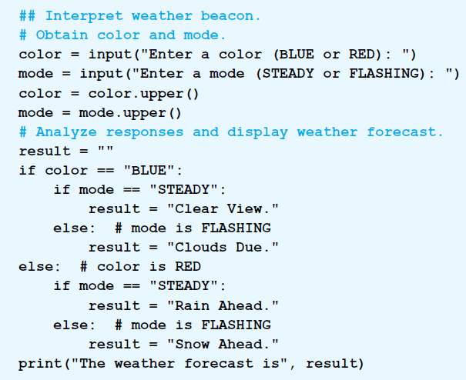
Nested if-else Statements
© 2016 Pearson Education, Ltd. All rights reserved.

Slide 12
Nested if-else Statements
Example 5: Program requests costs, revenue for company
  Displays “Break even”, profit, or loss
© 2016 Pearson Education, Ltd. All rights reserved.

Slide 13
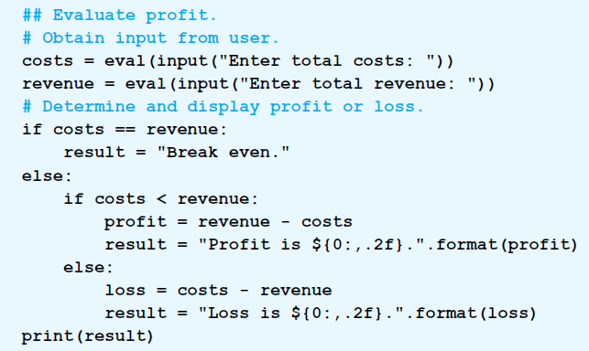
Nested if-else Statements
© 2016 Pearson Education, Ltd. All rights reserved.

Slide 14
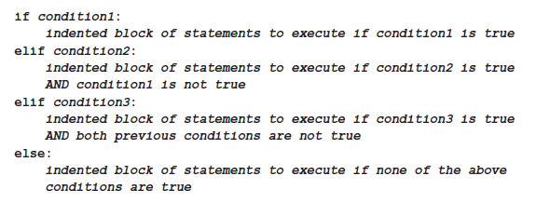
The elif Clause
Allows for more than two possible alternatives with inclusion of elif clauses.
© 2016 Pearson Education, Ltd. All rights reserved.

Slide 15
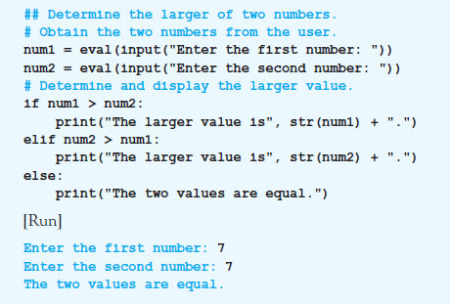
The elif Clause
Example 6: Program reports if the two numbers are equal.
© 2016 Pearson Education, Ltd. All rights reserved.

Slide 16
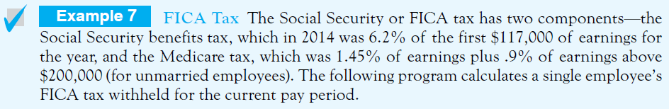
The elif Clause
Example 7: Program calculates a single employee’s FICA tax withheld.
© 2016 Pearson Education, Ltd. All rights reserved.

Slide 17
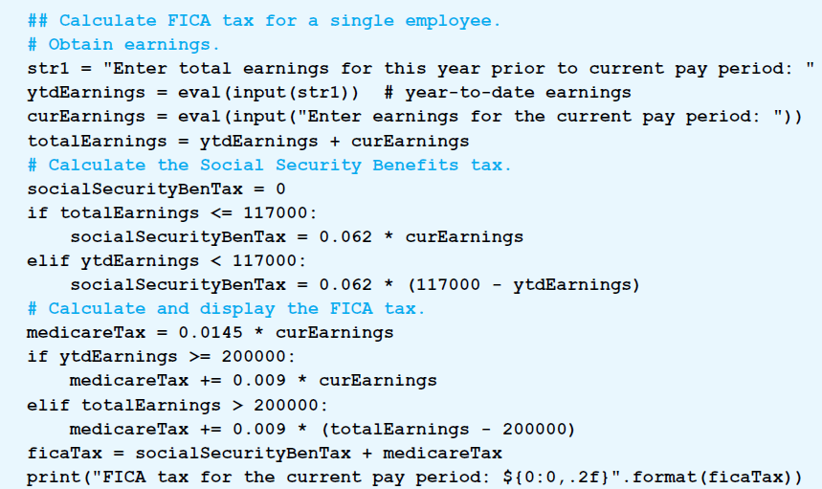
The elif Clause
© 2016 Pearson Education, Ltd. All rights reserved.

Slide 18
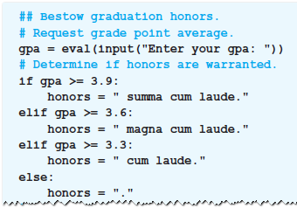
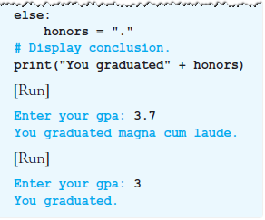
The elif Clause
Example 8: program assumes that the user will graduate and determines if they will graduate with honors.
© 2016 Pearson Education, Ltd. All rights reserved.

Slide 19
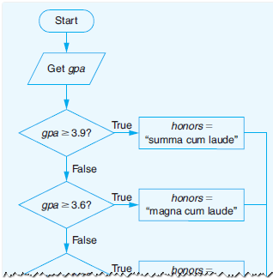
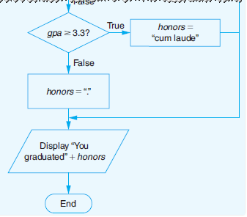
The elif Clause
Figure 3.3 Program and Flowchart for Example 8.
© 2016 Pearson Education, Ltd. All rights reserved.

Slide 20
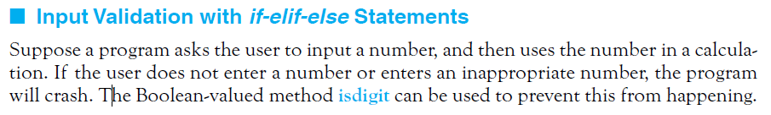
Input Validation with if-elif-else Statements
Example 9: Program uses the method isdigit to guard against improper input.
© 2016 Pearson Education, Ltd. All rights reserved.

Slide 21
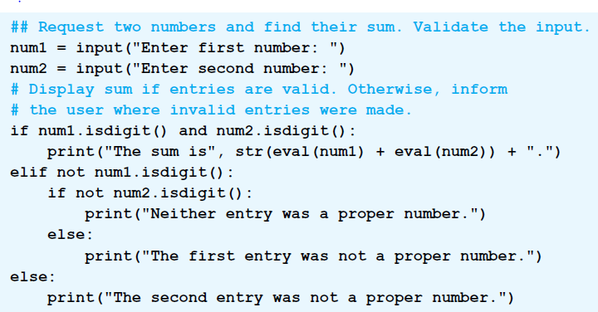
Input Validation with if-elif-else Statements
© 2016 Pearson Education, Ltd. All rights reserved.

Slide 22
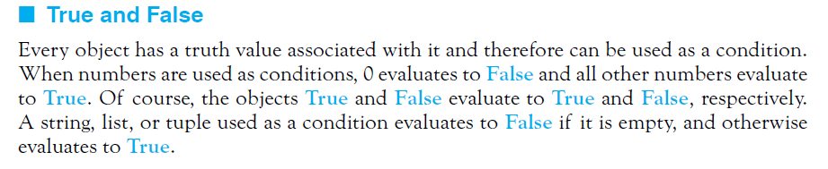
True and False
© 2016 Pearson Education, Ltd. All rights reserved.

Slide 23
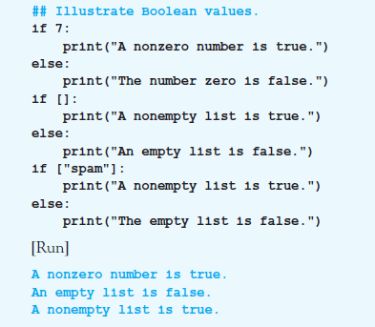
True and False
Example 10: Program illustrates truth values of objects
© 2016 Pearson Education, Ltd. All rights reserved.

Slide 24
End
Section 2
Chapter 3
© 2016 Pearson Education, Ltd. All rights reserved.

