Slide 1
Program Design
Section 3
Chapter 4
© 2016 Pearson Education, Ltd. All rights reserved.

Slide 2
Top-Down Design
To make a complicated problem more understandable
  Divide it into smaller, less complex subproblems.
  Called stepwise refinement
Top-down design and structured programming
  Techniques to enhance programming productivity
© 2016 Pearson Education, Ltd. All rights reserved.

Slide 3
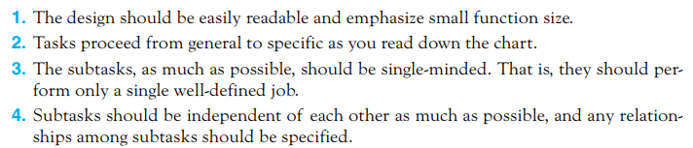
Top-Down Design
Criteria
© 2016 Pearson Education, Ltd. All rights reserved.

Slide 4
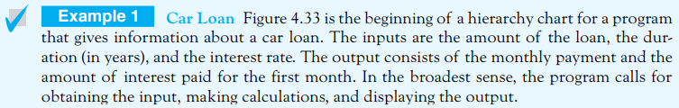
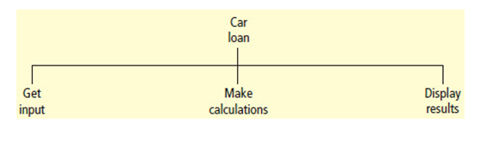
Top-Down Design
Figure 4.33 Beginning of a hierarchy chart for
the car loan program.
© 2016 Pearson Education, Ltd. All rights reserved.

Slide 5
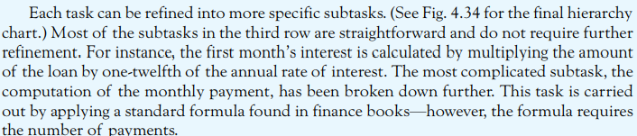
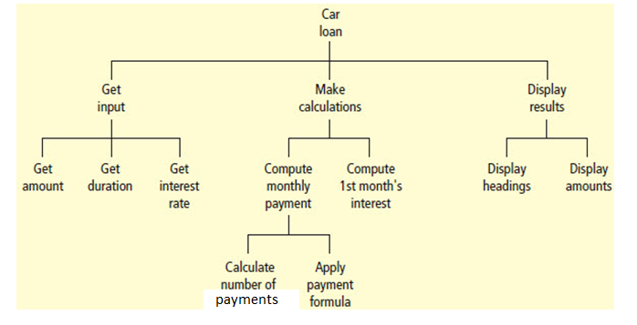
Top-Down Design
Figure 4.34 Hierarchy chart for the car loan program.
© 2016 Pearson Education, Ltd. All rights reserved.

Slide 6
Top-Down Design
Figure 4.34 Hierarchy chart for the car loan program.
© 2016 Pearson Education, Ltd. All rights reserved.

Slide 7
Structured Programming
Meets modern standards of program design
Use top-down design
Use only the three types of logical structures:
  Sequences – Statements executed one after the other
  Decisions – blocks of code executed based on test of some condition
  Loops – blocks of coded executed repeatedly based on some condition
© 2016 Pearson Education, Ltd. All rights reserved.

Slide 8
Advantages of Structured Programming
Easy to write
Easy to debug
Easy to understand
Easy to change
© 2016 Pearson Education, Ltd. All rights reserved.

Slide 9
Object-Oriented Programming
An object is an encapsulation of data and code that operates on the data
Objects
  Have properties
  Respond to methods
  Raise events
Object-oriented program viewed as collection of cooperating objects
© 2016 Pearson Education, Ltd. All rights reserved.

Slide 10
Object-Oriented Programming
Python is an object-oriented programming language;
  Every structure such as a list or a string is actually an object.
  We have been learning the building blocks of Python, later we’ll put them together using object-oriented techniques in Chapter 7.
© 2016 Pearson Education, Ltd. All rights reserved.

Slide 11
A Relevant Quote
From Dirk Gently’s Holistic Detective Agency
“… the more slow and dim-witted your pupil, the more you have to break things down into more and more simple ideas. And that’s really the essence of programming.”
© 2016 Pearson Education, Ltd. All rights reserved.

Slide 12
End
Section 3
Chapter 4
© 2016 Pearson Education, Ltd. All rights reserved.

