Slide 1
Processing Data, Part 1
Section 1
Chapter 5
© 2016 Pearson Education, Ltd. All rights reserved.

Slide 2
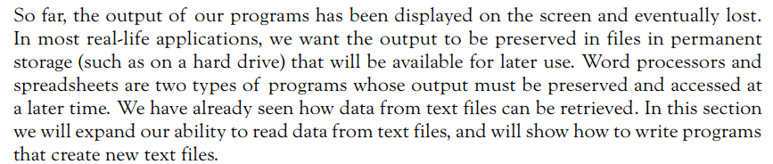
Processing Data
© 2016 Pearson Education, Ltd. All rights reserved.

Slide 3
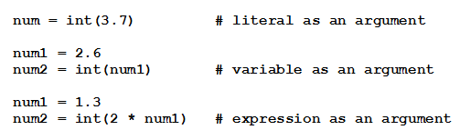
Built-in Functions
Output of functions is a single value
  Function is said to return its output
Items inside parentheses called arguments
Examples:
© 2016 Pearson Education, Ltd. All rights reserved.

Slide 4

Reading Text Files
Establish connection between the program and the file
  File is said to be opened for input
Read lines of file in a loop
© 2016 Pearson Education, Ltd. All rights reserved.

Slide 5
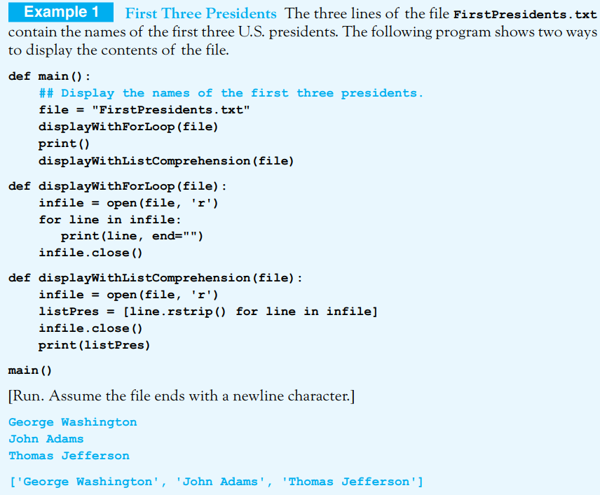
© 2016 Pearson Education, Ltd. All rights reserved.

Slide 6


Reading Text Files
Places entire contents of line (including the newline characters) into single string.
Current line is assigned to strVar and pointer advances to end of that line
  Method returns the empty string after all lines have been read

Slide 7
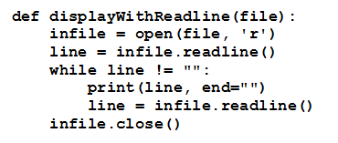
Reading Text Files
Given function displayWithReadline
© 2016 Pearson Education, Ltd. All rights reserved.

Slide 8
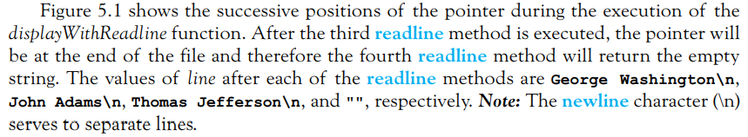
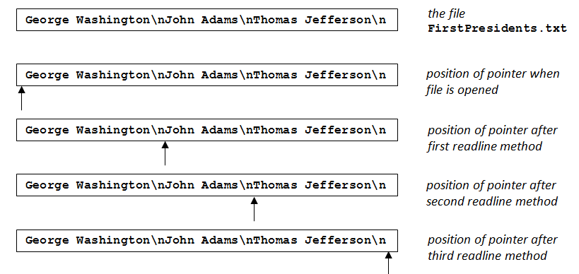
Reading Text Files
FIGURE 5.1 Pointer positions during the execution of the displayWithReadline function
© 2016 Pearson Education, Ltd. All rights reserved.

Slide 9


Creating Text Files
Creates a new text file with the specified name
  Said to be opened for writing
Adds the value of strVar as a line of the file
File must be closed to guarantee that all data has been physically transferred to the disk.
© 2016 Pearson Education, Ltd. All rights reserved.

Slide 10
Creating Text Files
Since memory access is much faster than disk access, Python sets aside a portion of memory called a buffer as a temporary holding place for data to be written to the disk. The contents of the buffer are written to the disk whenever the buffer is full or when the file is closed.
Therefore, after all write statements have been executed, the file must be closed to guarantee that all data has been physically transferred to the disk.
© 2016 Pearson Education, Ltd. All rights reserved.

Slide 11
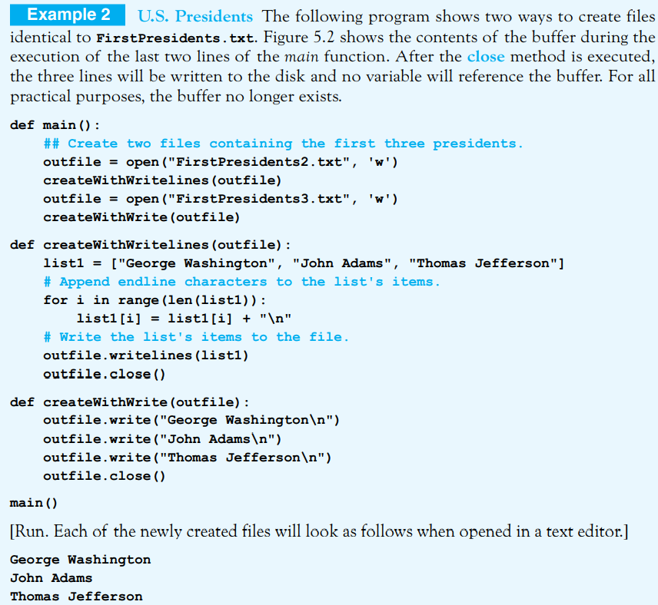

© 2016 Pearson Education, Ltd. All rights reserved.

Slide 12
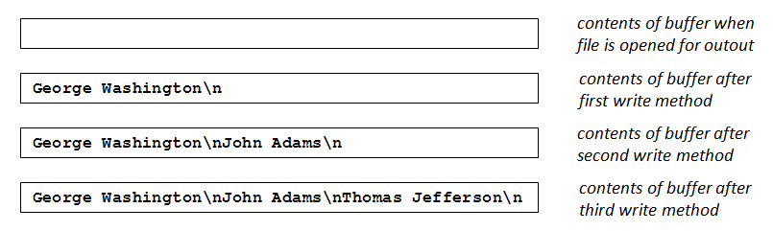
Creating Text Files
FIGURE 5.2 Contents of the buffer after execution of the second open statement and the createWithWrite function in Example 2
© 2016 Pearson Education, Ltd. All rights reserved.

Slide 13

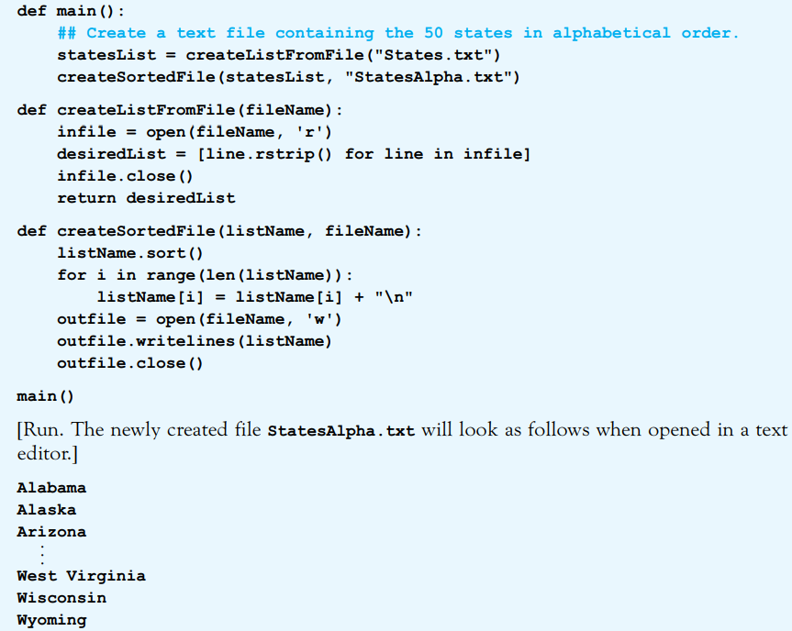
© 2016 Pearson Education, Ltd. All rights reserved.

Slide 14
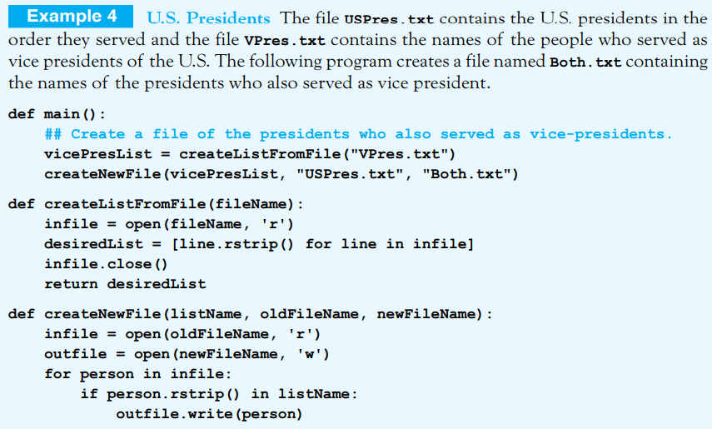
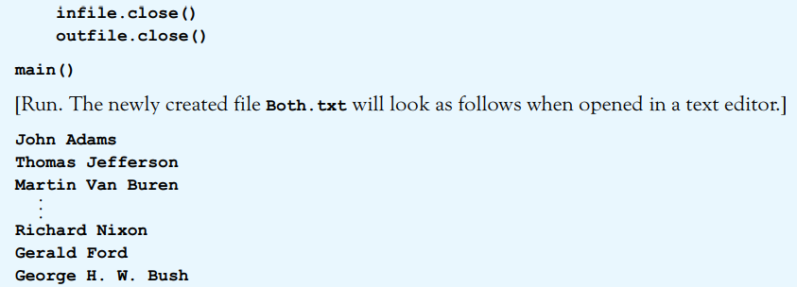
© 2016 Pearson Education, Ltd. All rights reserved.

Slide 15

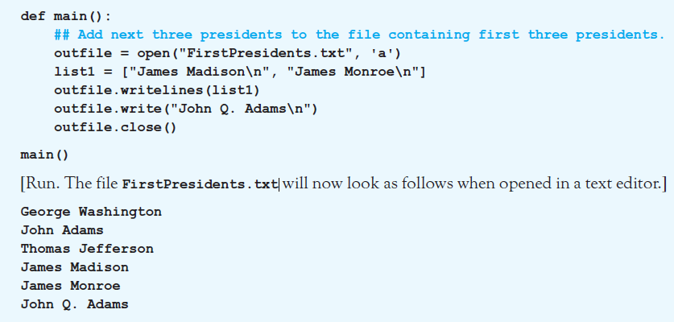
Adding Lines to an Existing Text File
Example 5: Program adds 3 more names to file. Uses open statement with ‘a’ parameter.
© 2016 Pearson Education, Ltd. All rights reserved.

Slide 16
Altering Items in a Text File
Altering, inserting, or deleting a line of a text file
  Cannot be made directly
New file must be created
  Read each item from the original file
  Record it, with changes, into new file
  Old file is then erased
  New file is renamed with name of the original
© 2016 Pearson Education, Ltd. All rights reserved.

Slide 17



Altering Items in a Text File
Functions needed for these tasks must be imported from standard library module os
To remove a file
To rename a file
© 2016 Pearson Education, Ltd. All rights reserved.

Slide 18
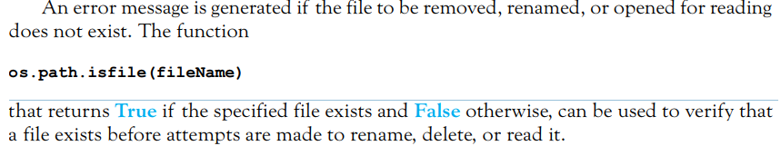
Altering Items in a Text File
© 2016 Pearson Education, Ltd. All rights reserved.

Slide 19
Sets
A list is an ordered collection of items
  Possibly with repetitions
  Delimited with [ ]
A set is an unordered collection of items
  No duplicates
  Delimited with { }
  Can contain numbers, strings, tuples, and Boolean values
  Cannot contain lists or other sets
© 2016 Pearson Education, Ltd. All rights reserved.

Slide 20
Sets
The main differences between sets and lists are that no items in a set can appear twice and the elements in a set have no order.
Since the elements have no order, they cannot be indexed and therefore slicing and list methods are meaningless.
When the set function is applied to a list or record, duplicate items only appear once in the set.

Slide 21
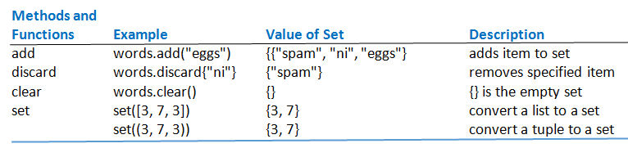
Sets
Table 5.1 Set methods (words = {"spam", "ni"})
© 2016 Pearson Education, Ltd. All rights reserved.

Slide 22
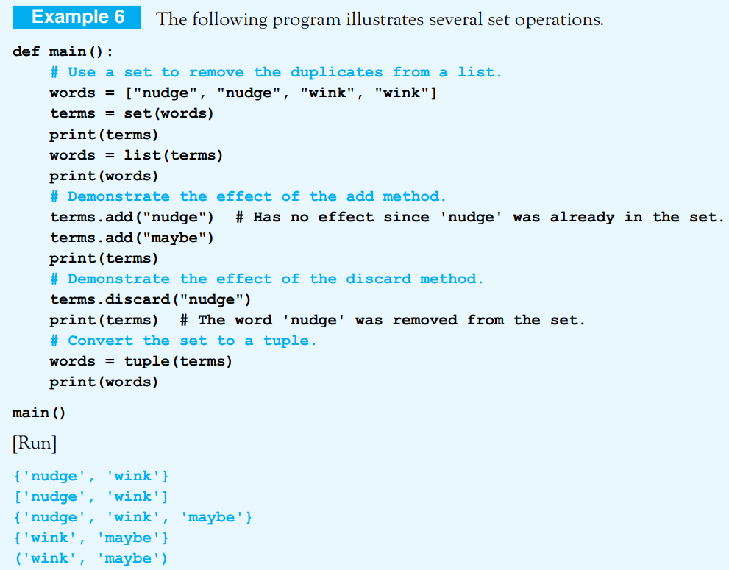
© 2016 Pearson Education, Ltd. All rights reserved.

Slide 23

Set Comprehension
Sets can be created with comprehension
This command creates the set {0, 1, 4, 9}.
© 2016 Pearson Education, Ltd. All rights reserved.

Slide 24
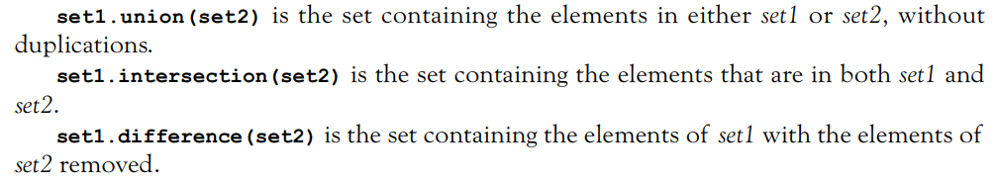
Set-theoretic Methods
Methods that create new sets from two existing sets
  Merge two sets
  Intersection of two sets
  Set difference
© 2016 Pearson Education, Ltd. All rights reserved.

Slide 25
Using Set-theoretic Methods with Files
Steps for extracting information from two related text files
Create two sets; each containing the contents of one of the two text files.
Apply a set operation such as union, intersection, or difference to the sets.
Write the resulting set into a new text file.
© 2016 Pearson Education, Ltd. All rights reserved.

Slide 26
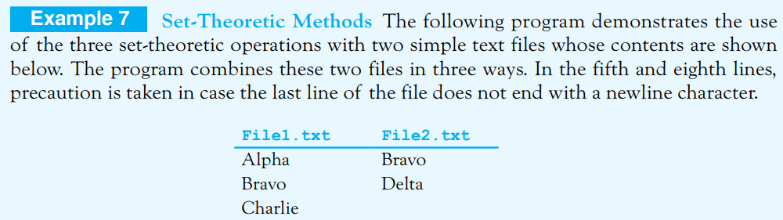
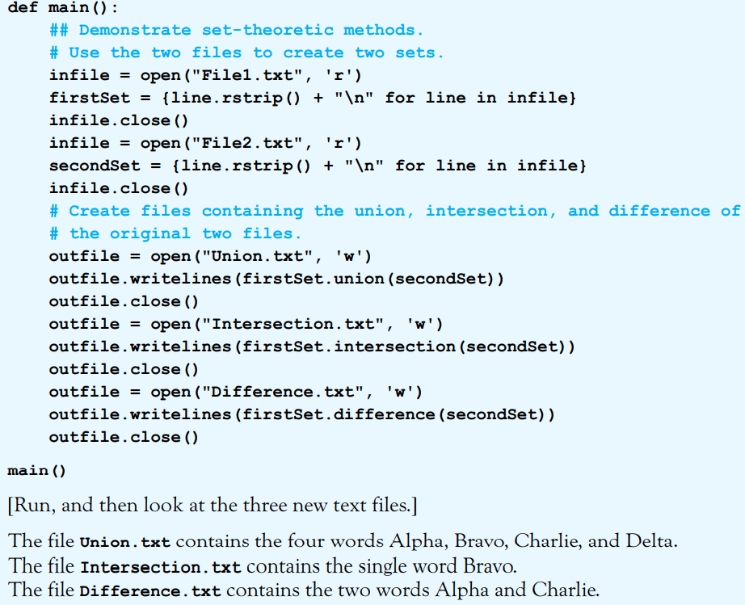
© 2016 Pearson Education, Ltd. All rights reserved.

Slide 27
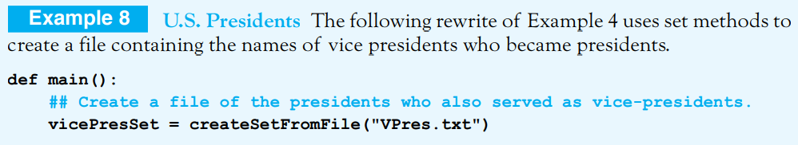
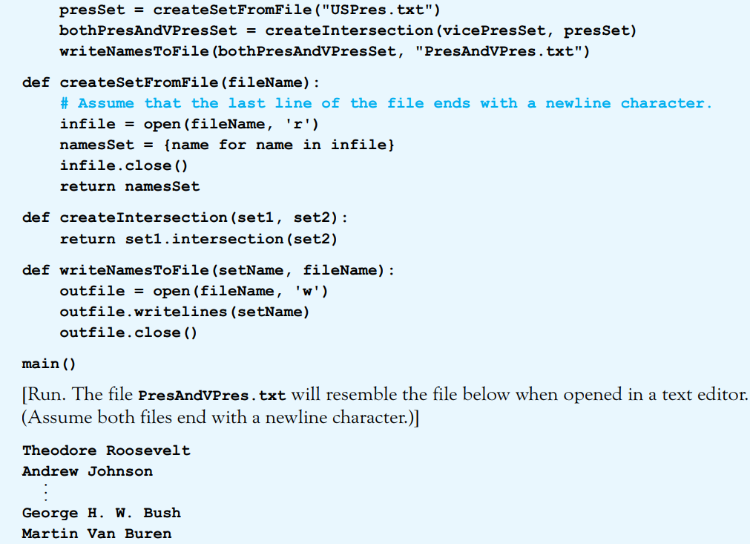
© 2016 Pearson Education, Ltd. All rights reserved.

Slide 28
End
Section 1
Chapter 5
© 2016 Pearson Education, Ltd. All rights reserved.

