Slide 1
Dictionaries
Section 3
Chapter 5
© 2016 Pearson Education, Ltd. All rights reserved.

Slide 2
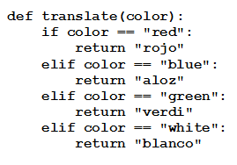
Dictionaries
Consider this function
  A mini English-Spanish
  dictionary
A function of this type is called a mapping
Python has an efficient and flexible mapping device, called a dictionary
  The value of translate["blue"] is "aloz"
© 2016 Pearson Education, Ltd. All rights reserved.

Slide 3
Dictionaries
Python dictionary is defined as
  A collection of comma separated pairs
  Of the form ”key:value”
  Enclosed in curly braces.
Value associated with key1 is given by the expression dictionaryName[key1].
The keys must be immutable objects, but the values can have any data types. The keys are unique, but the values needn’t be unique.
© 2016 Pearson Education, Ltd. All rights reserved.

Slide 4
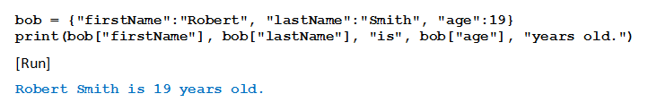
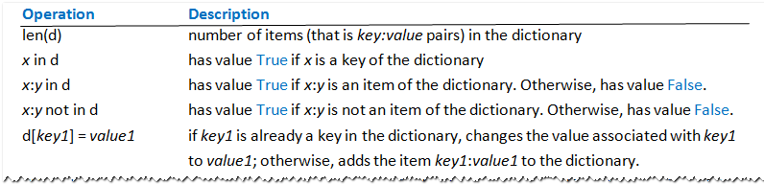
Dictionaries
Example
Table 5.4 Dictionary Operations
© 2016 Pearson Education, Ltd. All rights reserved.

Slide 5
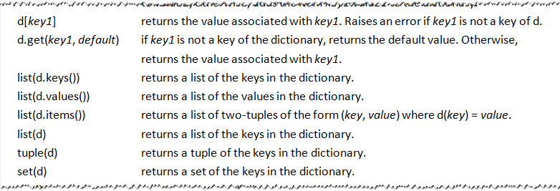
Dictionaries
Table 5.4 Dictionary Operations
© 2016 Pearson Education, Ltd. All rights reserved.

Slide 6
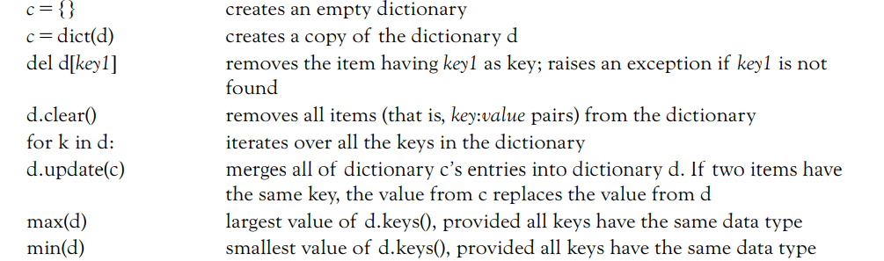
Dictionaries
Table 5.4 Dictionary Operations
© 2016 Pearson Education, Ltd. All rights reserved.

Slide 7

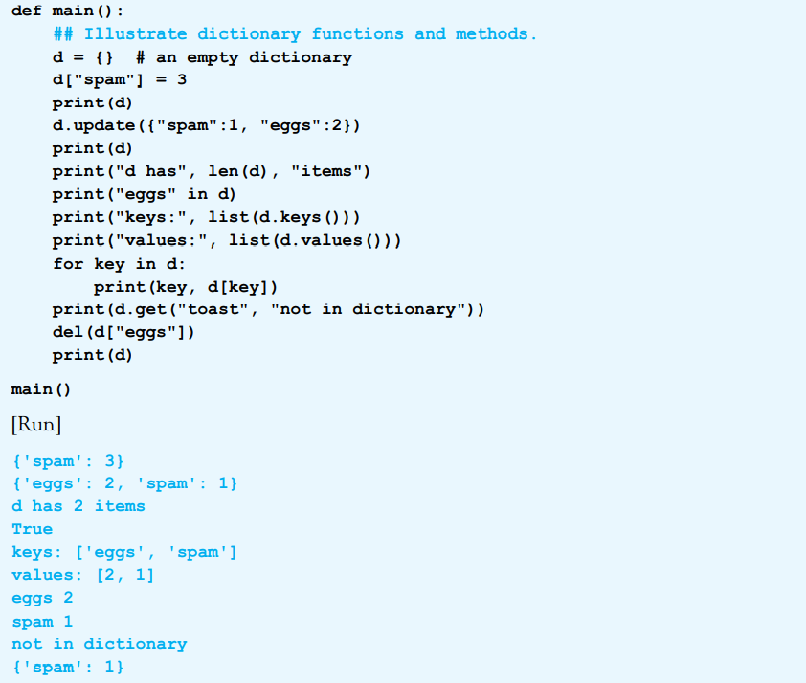
© 2016 Pearson Education, Ltd. All rights reserved.

Slide 8
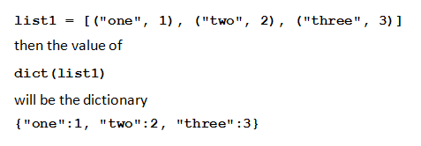
The dict Function
List of 2-item lists or 2-item tuples can be converted to a dictionary with dict function
Example
© 2016 Pearson Education, Ltd. All rights reserved.

Slide 9
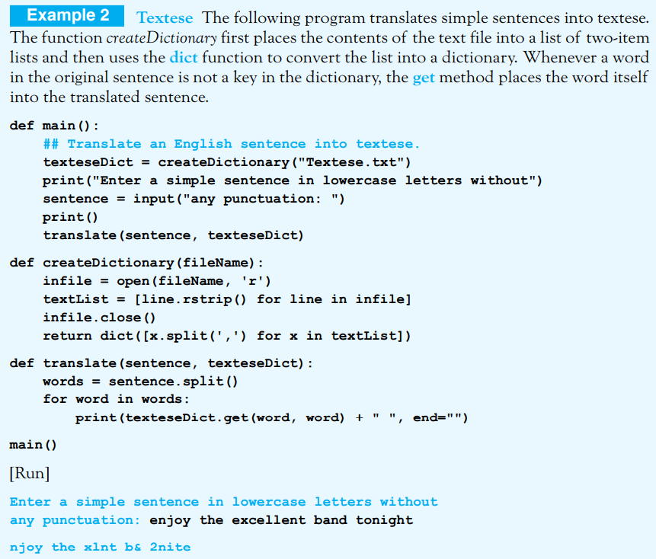
© 2016 Pearson Education, Ltd. All rights reserved.

Slide 10
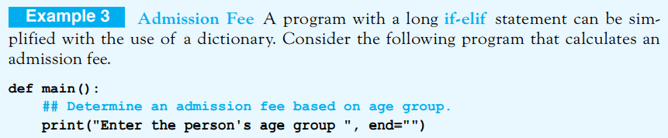
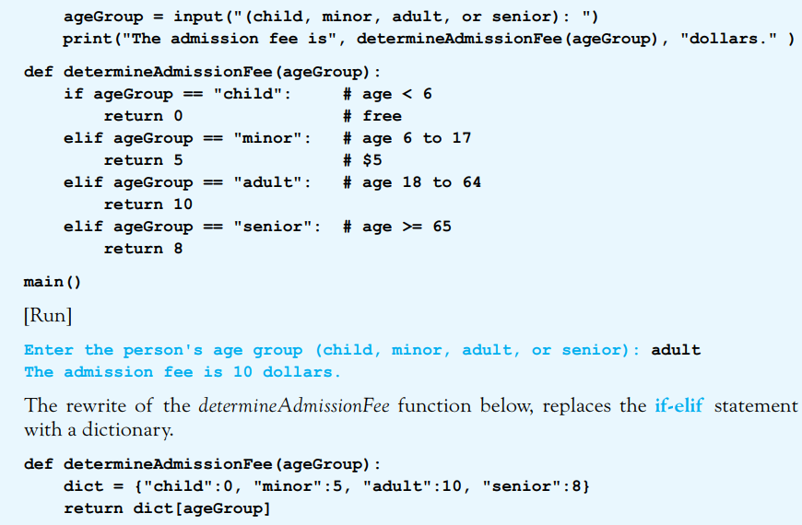
© 2016 Pearson Education, Ltd. All rights reserved.

Slide 11
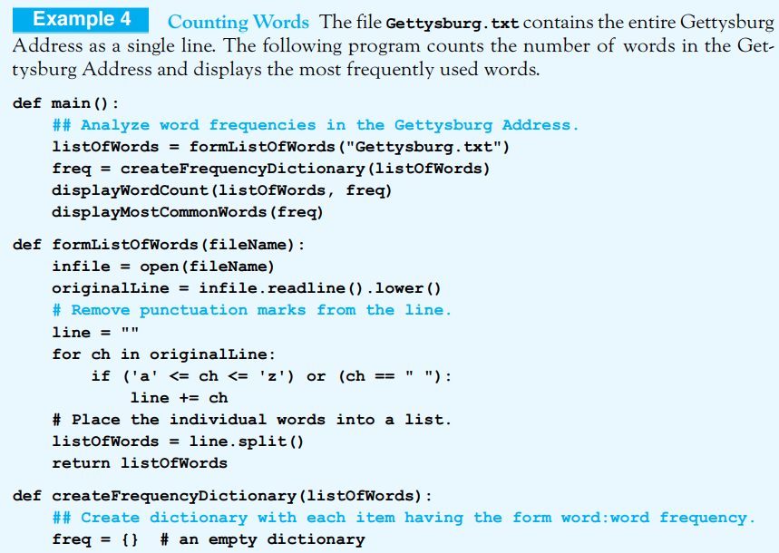
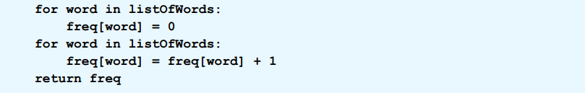
Default mode is ‘r’
© 2016 Pearson Education, Ltd. All rights reserved.

Slide 12
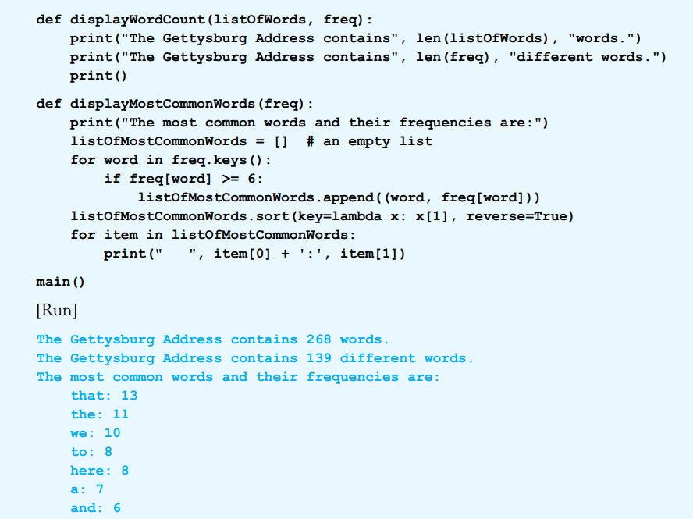
© 2016 Pearson Education, Ltd. All rights reserved.

Slide 13
Creating Dictionary from Binary File
Binary format (another file format)
  Stores data as sequence of bytes
  Can only be accessed by special readers
Methods that store dictionaries to, and retrieve dictionaries from binary files.
  Must be imported from a module named pickle
Note: We will use the extension “dat” for binary files that store dictionaries.
© 2016 Pearson Education, Ltd. All rights reserved.

Slide 14
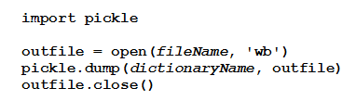
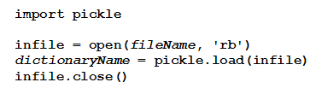
Creating Dictionary from Binary File
  Saves a dictionary as a binary file, 'wb' states that the file is to be opened for writing as a binary file:
  Creates a dictionary from a binary file, 'rb‘ states that the binary file is to be opened for reading:

Slide 15
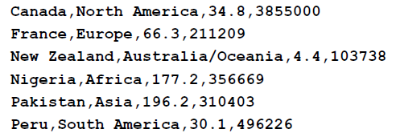
Dictionary-Valued Dictionaries
Dictionary’s values can be any type of object
  Including a dictionary
Consider the CSV file UN.txt
This data could be efficiently accessed if it was placed into the following dictionary:

Slide 16
Dictionary-Valued Dictionaries
Value of nations["Canada"] would be the dictionary
The value of nations["Canada"]["cont"] would be:
The value of nations["Canada"]["popl"] would be:
The value of nations["Canada"]["area"] would be:

Slide 17
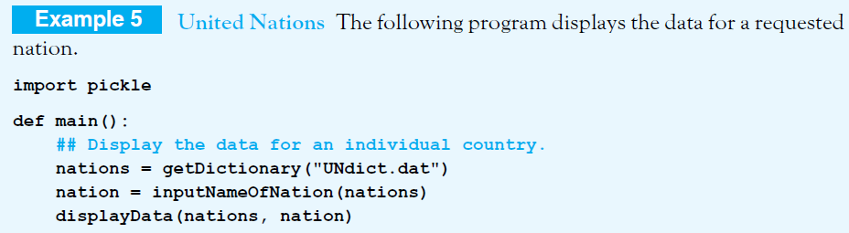
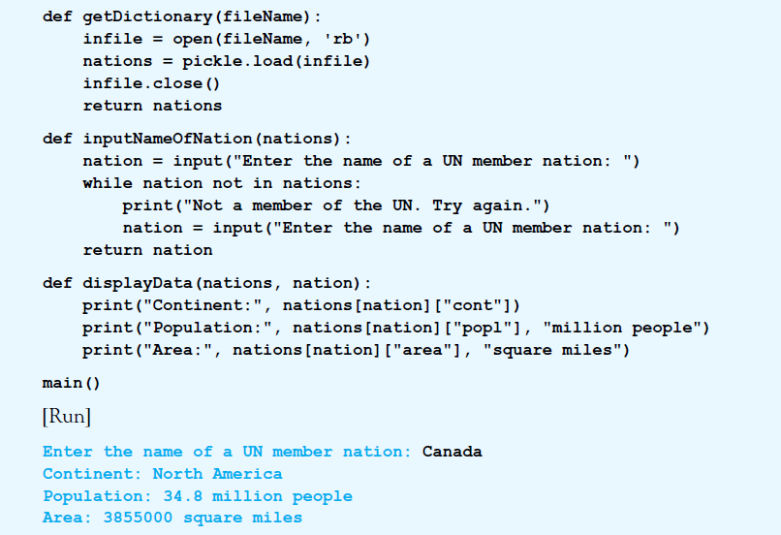
UNdict.dat. is created and saved as the binary file
© 2016 Pearson Education, Ltd. All rights reserved.

Slide 18
Extracting Ordered Data from a Dictionary
A dictionary is an unordered structure
  Does not have a sort method
However, items of dictionary can be placed into a list
  As 2-tuples
  In customized order
  Use function of the form
© 2016 Pearson Education, Ltd. All rights reserved.

Slide 19
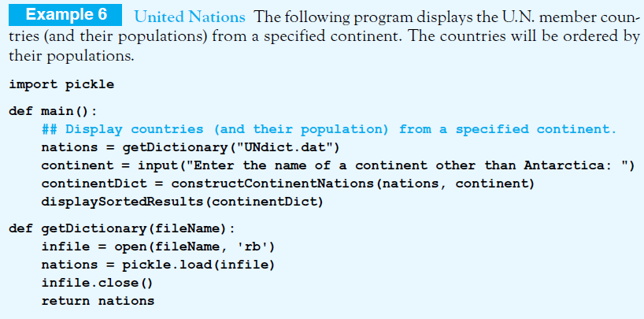
Extracting Ordered Data from a Dictionary
© 2016 Pearson Education, Ltd. All rights reserved.

Slide 20
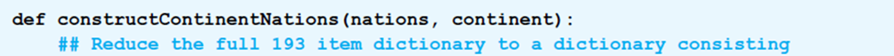
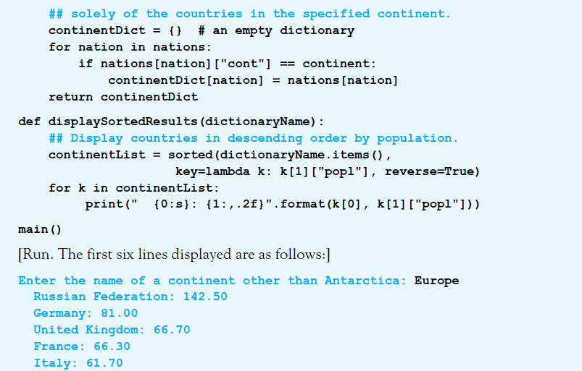

Slide 21
Using Dictionary with Tuples as Keys
Given: file USpresStatesDict.dat a dictionary giving names of presidents and home states
Each key is a tuple of form:
  (last name), first name(s)).
Two of the items in the dictionary are:
  ('Kennedy', 'John'):'Massachusetts'
  ('Reagan','Ronald'):'California'.
© 2016 Pearson Education, Ltd. All rights reserved.

Slide 22
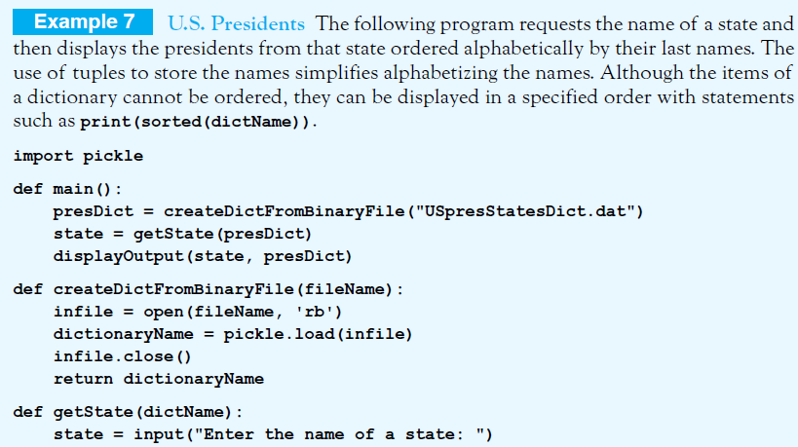
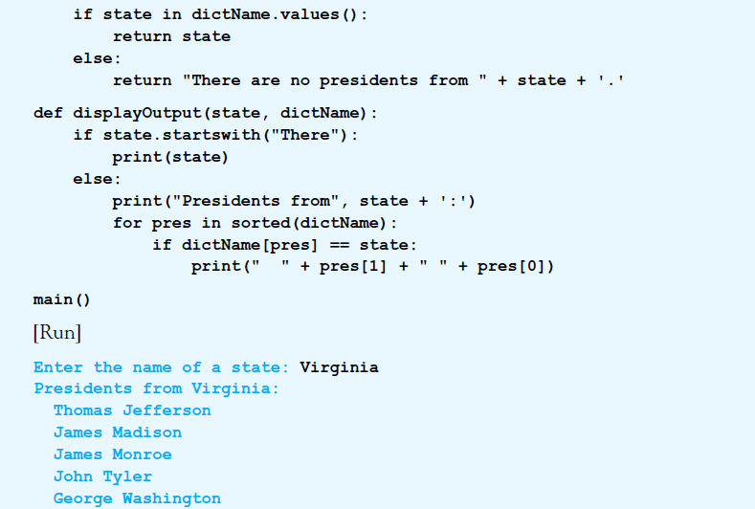
© 2016 Pearson Education, Ltd. All rights reserved.

Slide 23
© 2016 Pearson Education, Ltd. All rights reserved.

Slide 24

Dictionary Comprehension
Dictionaries can be created with dictionary comprehension.
  Example:
Dictionary comprehension can be used to extract a subset of a dictionary
© 2016 Pearson Education, Ltd. All rights reserved.

Slide 25

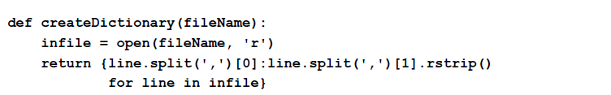
Dictionary Comprehension
The subset of presDict consisting of the presidents from New England states:
The createDictionary function can be written with dictionary comprehension:
© 2016 Pearson Education, Ltd. All rights reserved.

Slide 26
End
Section 3
Chapter 5
© 2016 Pearson Education, Ltd. All rights reserved.

