Slide 1
Selecting Random Values
Section 2
Chapter 6
© 2016 Pearson Education, Ltd. All rights reserved.

Slide 2
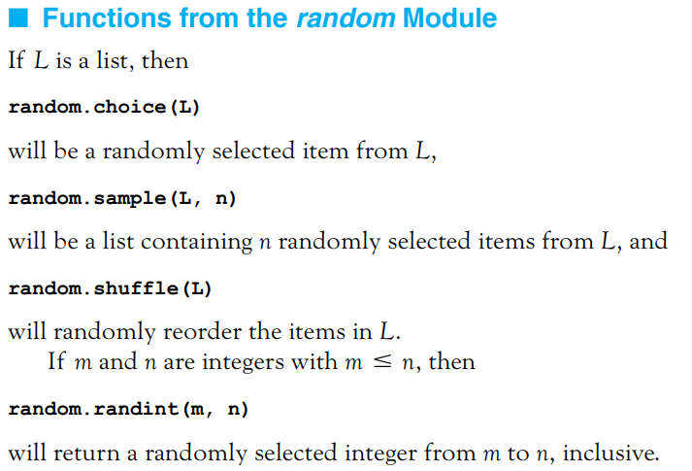
Functions from the random Module
Functions that randomly select items from a list and randomly reorder the items in a list.
© 2016 Pearson Education, Ltd. All rights reserved.

Slide 3
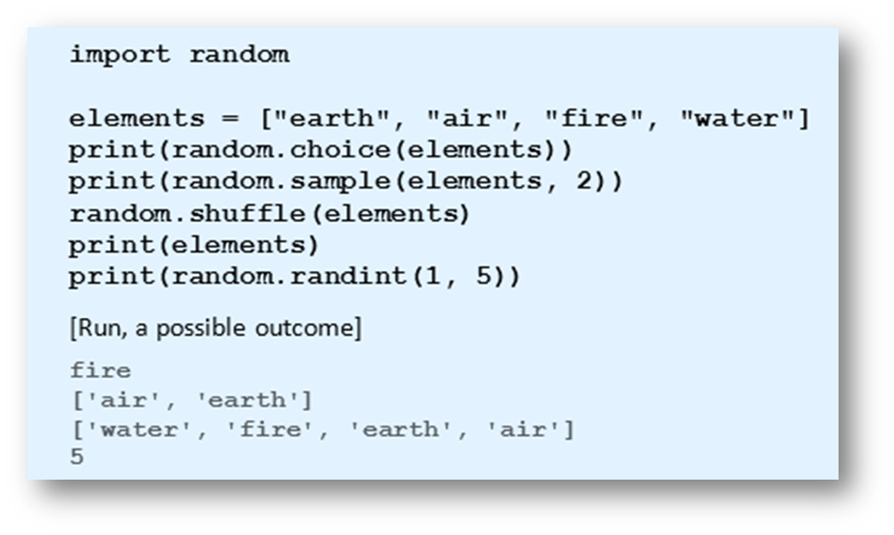
Functions from the random Module
Example 1: Program demonstrates functions from the random module.
© 2016 Pearson Education, Ltd. All rights reserved.

Slide 4
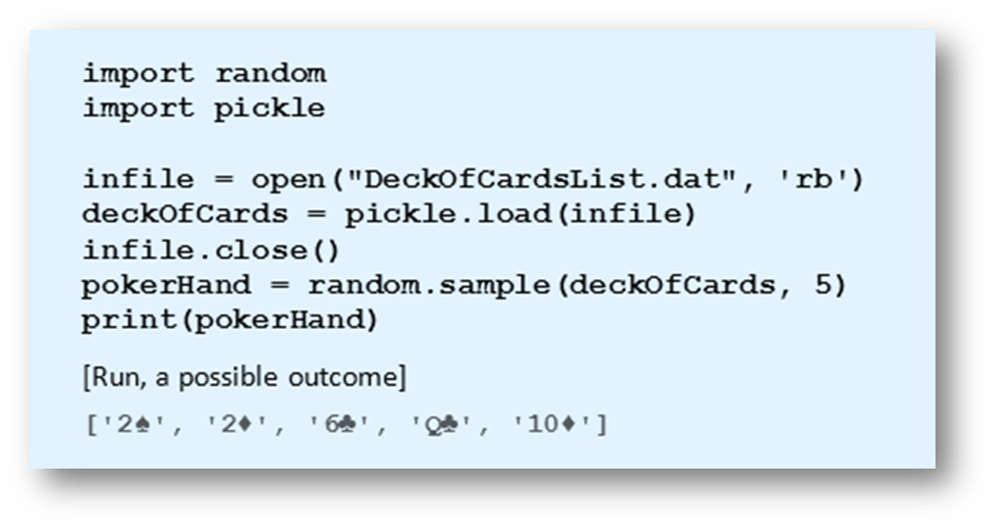
Games of Chance
Example 2: The file DeckOfCardsList.dat is a pickled binary file containing a list of the 52 cards in an ordinary deck of playing cards. Program randomly selects five cards from the deck.
© 2016 Pearson Education, Ltd. All rights reserved.

Slide 5
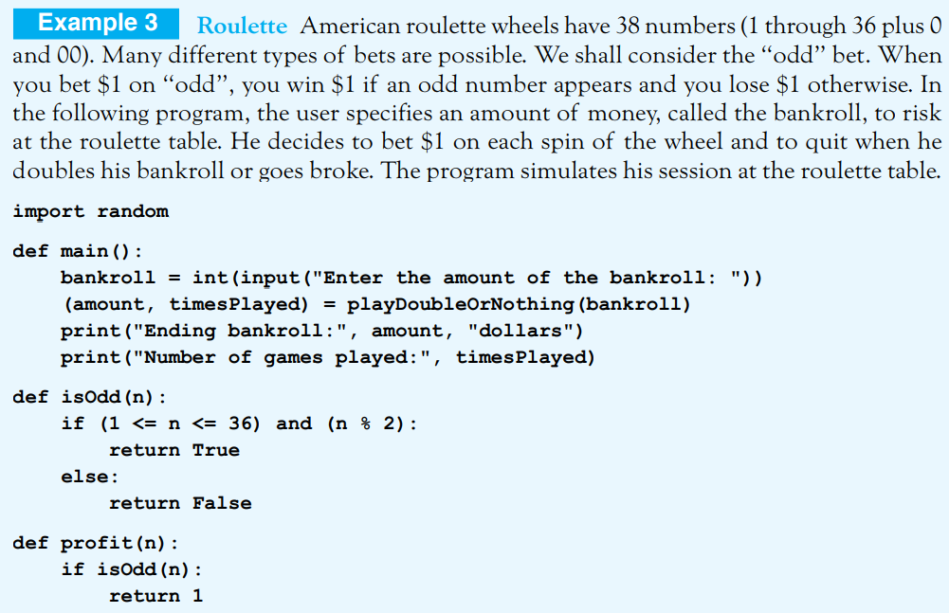
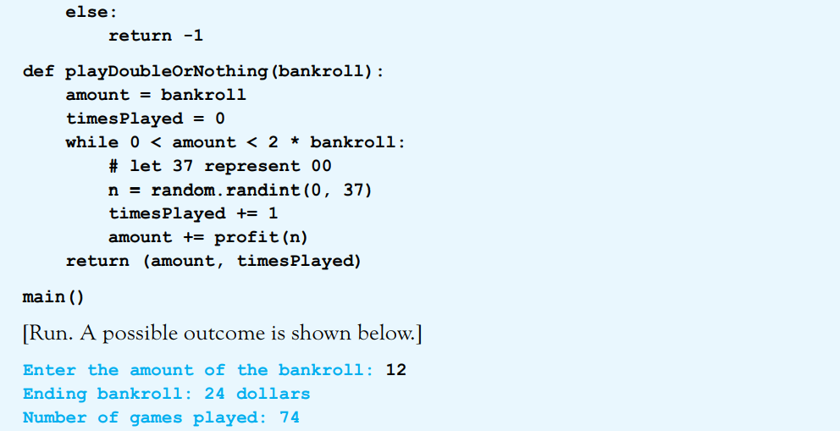
© 2016 Pearson Education, Ltd. All rights reserved.

Slide 6
In the next example, items are selected from a list of six items. However, some items are more likely to be selected than others. In this case, we must use an if-elif-else statement to do a truly random selection.
© 2016 Pearson Education, Ltd. All rights reserved.

Slide 7
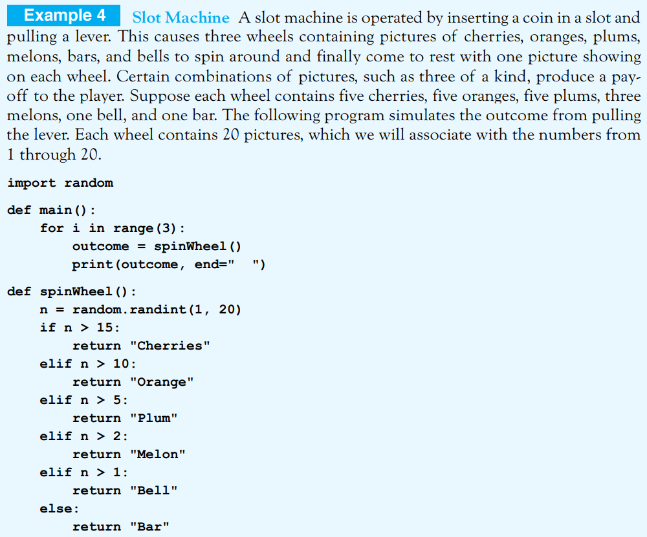
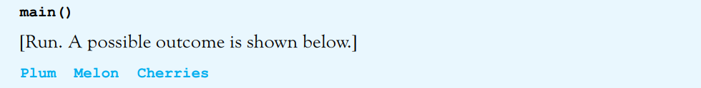

Slide 8
End
Section 2
Chapter 6
© 2016 Pearson Education, Ltd. All rights reserved.

