Slide 1
Object-Oriented Programming
Section 1
Chapter 7
© 2016 Pearson Education, Ltd. All rights reserved.

Slide 2
Classes and Objects
Programs grow in size, become more complex,
  Number of programmers working on same project increases
  A small change made by one programmer in one place may have unintended effects in other places.
Dependencies and interrelationships throughout code increases
© 2016 Pearson Education, Ltd. All rights reserved.

Slide 3
Classes and Objects
Partial solution to this problem is data hiding
  An important principle underlying object-oriented programming.
  Within a unit, as much implementation detail as possible is hidden
Programmer using an object is concerned only with
  Tasks that the object can perform
  Parameters used by these tasks
The details of the data structures and methods are hidden within the object

Slide 4
Built-in Classes
The word object is used in this lecture:
  “Hello World!” is an object of type str.
  [1, 2, 3] is an object of type list.
  We refer to a specific literal from one of these classes as an instance of the class
All strings are instances of the class str, and all lists are instances of the class list.
© 2016 Pearson Education, Ltd. All rights reserved.

Slide 5
Built-in Classes
Although each string holds its own value, all strings have the same methods. Similarly, all lists have the same methods.
We will refer to the data types str, int, float, list, tuple, dictionary, and set as built-in Python classes.
We will refer to a specific literal from one of these classes as an instance of the class.
© 2016 Pearson Education, Ltd. All rights reserved.

Slide 6
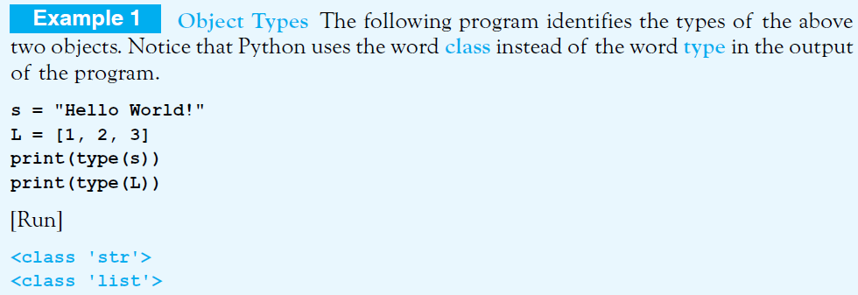
Built-in Classes
Example 1: Program identifies types of objects
  Note use of word “class” instead of “type”
  We refer to a specific literal from one of these classes as an instance of the class
© 2016 Pearson Education, Ltd. All rights reserved.

Slide 7

User-defined Classes
Python allows us to create our own classes, that is, data types.
Each class we define will
  Have a specified set of methods
Each object (instance) of the class
  Will have its own value(s)
Class definitions have the general form
© 2016 Pearson Education, Ltd. All rights reserved.

Slide 8
User-defined Classes
The class header consists of the reserved word class, followed by the name of the class, and a colon.
Class names must follow the same naming rules as variables. By convention, class names begin with an uppercase letter and use camel casing.
  writing phrases without spaces or punctuation,
  indicating the separation of words with a single capitalized letter

Slide 9
User-defined Classes
As an analogy, the difference between a class and an object is often compared to the difference between a cookie cutter and a cookie.
  A cookie cutter is a template that can be used to create cookies. You can’t eat a cookie cutter,
  But you can eat the cookies it creates.
A class is used to create objects that appear in programs.
© 2016 Pearson Education, Ltd. All rights reserved.

Slide 10
User-defined Classes
Methods defined much like ordinary functions,
  the main difference is that methods have self as their first parameter.
When an object (that is, an instance of the class) is created,
  each method’s self parameter references the object so the method knows which object to operate on.

Slide 11
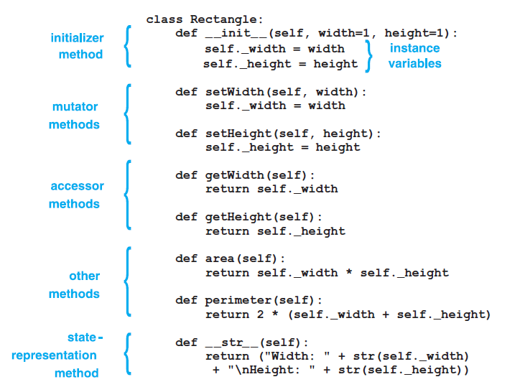
A typical class definition:

Slide 12
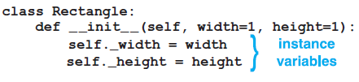

User-defined Classes
The Rectangle class has variables that store the values for the width and height of a rectangle.
  The first and last methods (_ _init_ _ and _ _str_ _) are special methods whose names have beginning and ending double underscores. (You should never name a method of your own in such a way.)
  The _ _init_ _ method (also known as the constructor) is automatically called when an object is created.

Slide 13
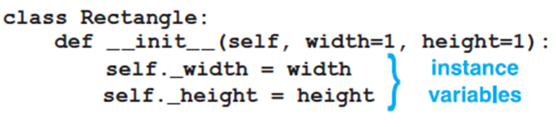
User-defined Classes
The _ _init_ _ method creates and assigns values to the instance variables _width and _height that store the values for the object.
Instance variables are also called the properties of the class, and the collections of values of the instance variables are called the state of the object.
© 2016 Pearson Education, Ltd. All rights reserved.

Slide 14

User-defined Classes
Unlike variables declared in other definitions, instance variables are visible everywhere in the class.
They can be accessed from every method in the class.
© 2016 Pearson Education, Ltd. All rights reserved.

Slide 15
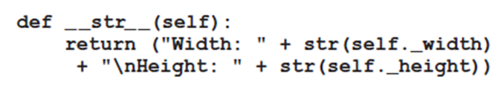
User-defined Classes
The _ _str_ _ method provides a customized way to represent the state of an object as a string.
  The mutator methods are used to assign new values to the instance variables,
  The accessor methods are used to retrieve the values of instance variables.
The other methods operate on objects just like the methods we have been using in previous chapters
© 2016 Pearson Education, Ltd. All rights reserved.

Slide 16
User-defined Classes
Classes are templates from which objects are created.
  The class specifies properties and methods that will be common to all objects (that are instances of that class)
Classes can be
  Typed directly into programs or,
  Stored in modules and brought into programs with an import statement

Slide 17
User-defined Classes
An object, which is an instance of a class, is created in a program with a statement of the form:
Or
This type of statement declares what type of object the variable will refer to, automatically calls the class’ initializer, causes the parameter self to reference the object, and passes its arguments to the other parameters of the initializer.

Slide 18
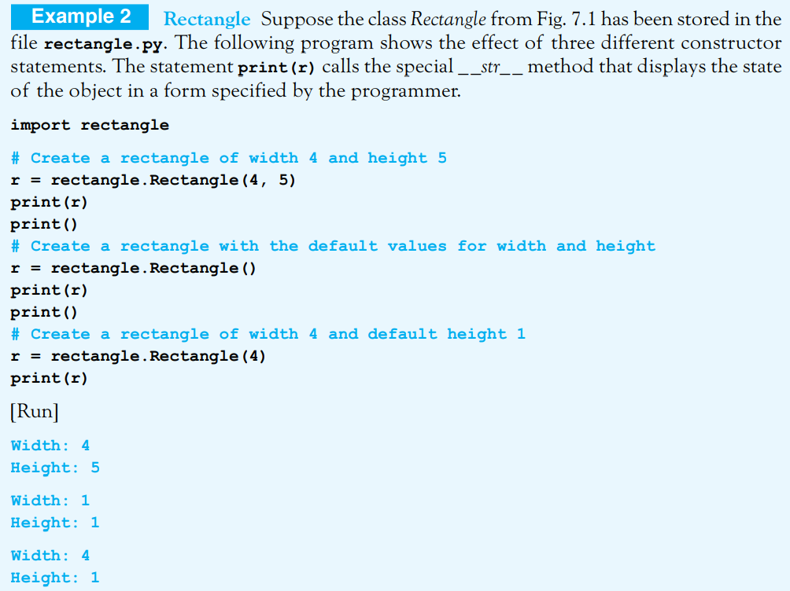
User-defined Classes
© 2016 Pearson Education, Ltd. All rights reserved.

Slide 19
User-defined Classes
In this Example, we used only two methods. The two special methods whose names began and ended with double underscores were called implicitly.
The method _ _init_ _ set the values of the instance variables and the _ _str_ _ method (along with the print function) reported the values of the instance variables.
These same tasks, along with the computation of the area and perimeter of the rectangle, can be carried out with the other methods of the Rectangle class.
The two mutator methods can be used to assign values to the instance variables, and the two accessor methods can be used to obtain the values of the instance variables.
The area and perimeter methods calculate the values indicated by their names.

Slide 20
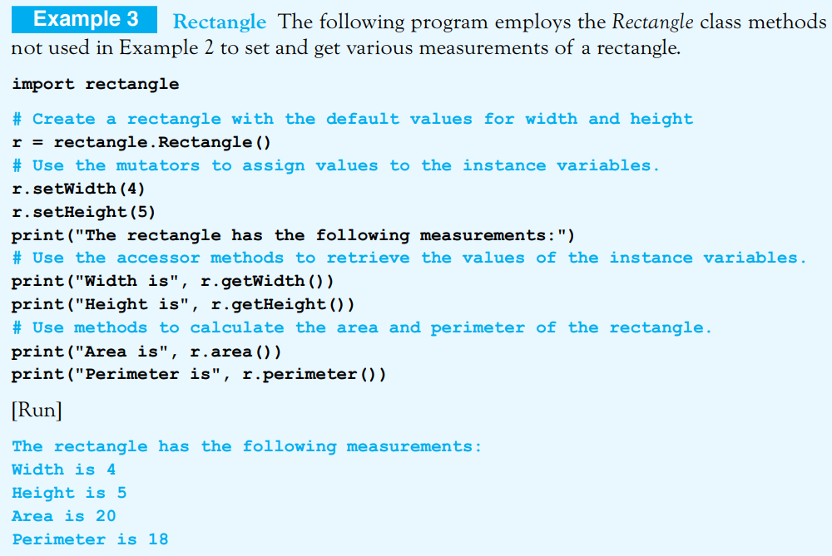
User-defined Classes

Slide 21
User-defined Classes
Instead of using the mutator methods in the fifth and sixth lines of the program, we could have replaced the two lines with the lines
r._width = 4
r._height = 5
Similarly, the accessor methods in the ninth and tenth lines could have been replaced with
print("Width is", r._width)
print("Height is", r._height)
However, such replacements are considered poor programming style. We have given instance variables names beginning with a single underscore to indicate to users of the class that these variables should not be directly accessed from outside of the class definition.
They should only be accessed from outside of the class definition via methods. One reason for only using methods to access instance variables is that validity-checking code can be inserted into the methods to make programs more robust. Also, one objective of object-oriented programming is to hide the implementation of methods from the users of the class.

Slide 22
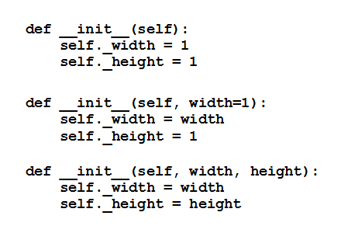
Other Forms of Initializer Method
The way we defined the initializer of the Rectangle class gives the greatest flexibility to the programmer.
However, there are 3 other ways the initializer could have been defined:
  With the third form of the initializer method, constructor statements must provide two arguments. Also, like the parameters in any other functions, the parameters having default values must come after those without default values.

Slide 23
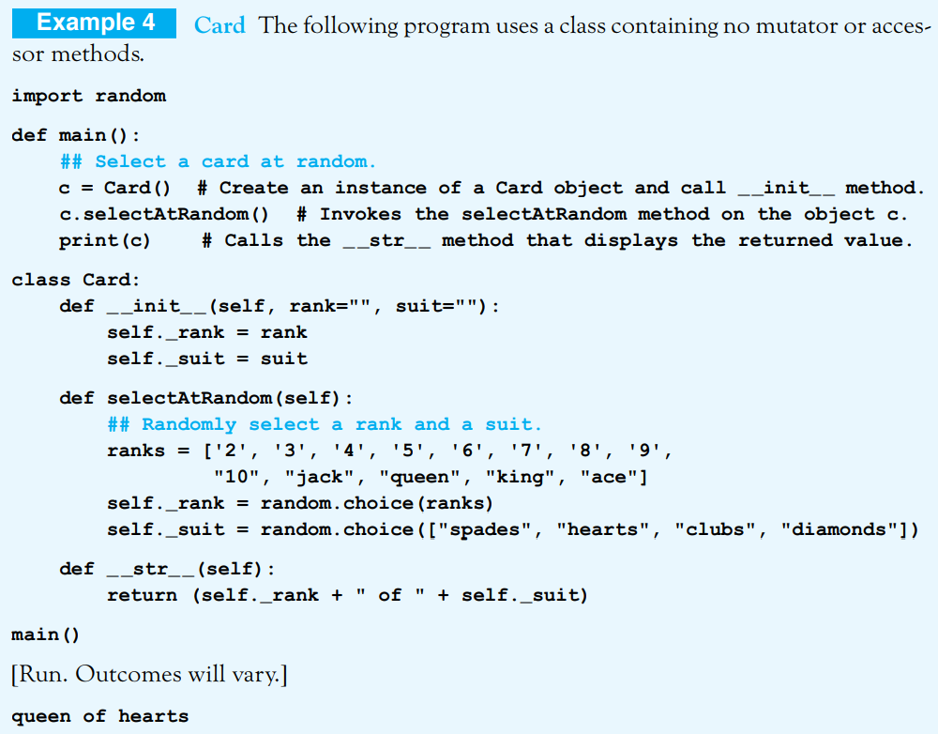
Class definitions can contain as many methods as desired. The following valid class definition contains no methods.
Class Trivial:
Pass

Slide 24

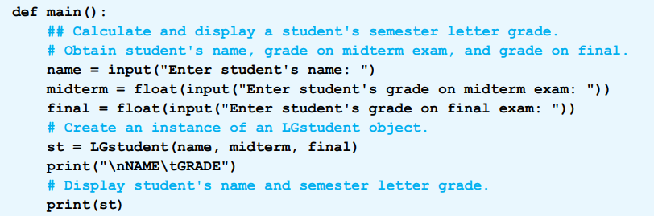
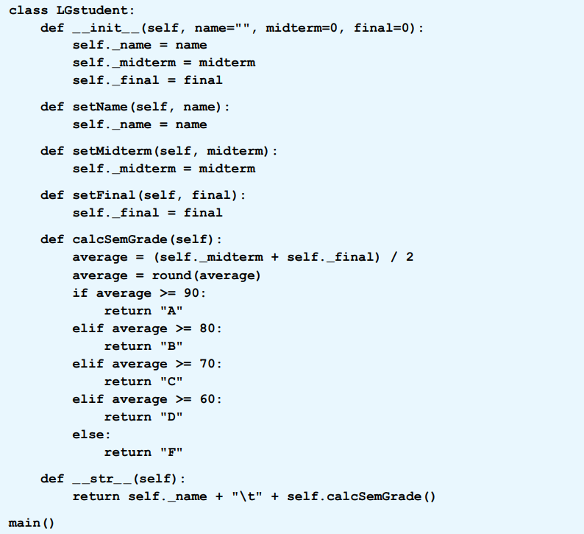
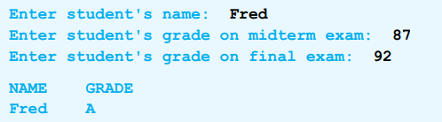

Slide 25
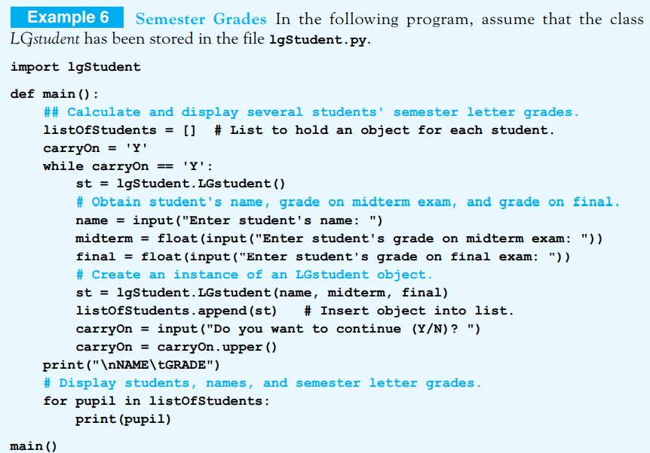
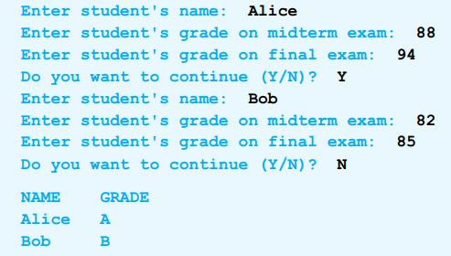
Lists of Objects
Items of a list can have any data type
  Including a user-defined class
This program uses a list where each item is an LGstudent object:

Slide 26
End
Section 1
Chapter 7
© 2016 Pearson Education, Ltd. All rights reserved.

