Slide 1
The Grid Geometry Manager
Section 2
Chapter 8
© 2016 Pearson Education, Ltd. All rights reserved.

Slide 2
Geometry Managers
Geometry managers are tools used to place widgets on the screen. There are three geometry managers available in tkinter:
grid, pack, and place
In this lecture we will use the grid geometry manager since it is the easiest to learn and produces the nicest layouts.
In this section we learn how to use the grid geometry manager.
We will combine the knowledge gained from the first two sections of this chapter to write complete GUI programs.
© 2016 Pearson Education, Ltd. All rights reserved.

Slide 3
Grids
A grid is an imaginary rectangle containing horizontal and vertical lines that subdivide it into rectangles called cells.
The first row of cells is referred to as row 0, the second row is referred to as row1, and so on. Similarly, the first column of cells is referred to as column 0, the second column of cells is referred to as column 1, and so on.
Each cell is identified by its row and column numbers. Figure 8.22 shows a grid having three rows and four columns, with each cell identified by its row and column number.
row 0, column 0 | row 0, column 1 | row 0, column 2 | row 0, column 3
row 1, column 0 | row 1, column 1 | row 1, column 2 | row 1, column 3
row 2, column 0 | row 2, column 1 | row 2, column 2 | row 2, column 3
FIGURE 8.22 A grid of 3 rows and 4 columns.

Slide 4
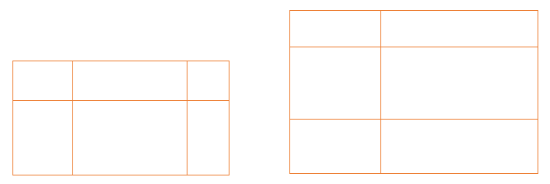
Grids
In previous Figure the horizontal and vertical lines are uniformly spaced. However, such is not the case for grids used in GUI programs. Figure 8.23 shows grids typical of those used in GUI programs.
FIGURE 8.23 Typical grids used in GUI programs.
© 2016 Pearson Education, Ltd. All rights reserved.

Slide 5
Grids
A graphical interface is created by placing widgets into a grid.
A widget can be inserted into an individual cell or can span a consecutive sequence of rows or columns.
Each row and column expands to fit the largest widget in that row and column. Padx and pady can be used to specify how much blank space should be put around a widget within its cell.
By default, widgets are centered within a cell. However, an attribute named sticky can be used to change the placement inside a cell and also to enlarge the widget so that it fills an entire cell.

Slide 6
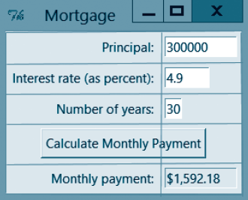
Grids
Below Figure shows the visual interface from Fig. 8.1 in the previous section.
The grid consists of five rows (row 0 through row 4) and two columns (column 0 and column 1).
Each Label and Entry widget is placed in a single cell. For instance, the Entry widget containing the number 30 has been placed in the cell in row 2, column 1.

Slide 7
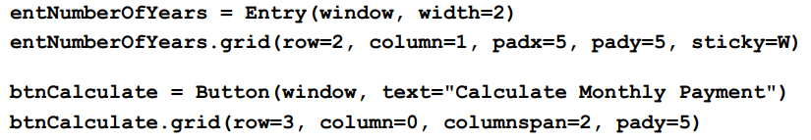
Grids
The button begins at the cell in row 3, column 0 and spans two columns. Those two widgets are declared and placed in the window with the lines of code below.
-The argument padx=5 places five pixels of space both to the left and to the right of the widget.
-The argument pady=5 places five pixels of space both above and below the widget.
-The argument sticky=W moves the Entry widget to the left side of its cell.
-The argument columnspan=2 specifies that the button should span two columns.

Slide 8
Grids
In general, below statement places the widget in the cell located at row m and column n:
Additional attributes, such as padx, pady, and sticky, can be placed into the grid method. Below statement places the widget beginning in the cell located at row m and column n, and spanning c columns. (If columnspan is replaced with rowspan, the widget will span c rows.):

Slide 9
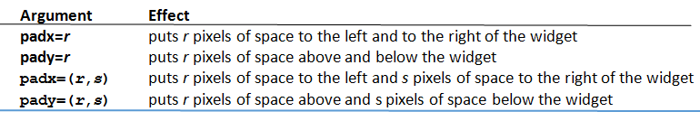
Grids
The arguments in Table 8.1 improve layouts by adding space to the sides of widgets.
Note: You don’t have to specify the number of rows and columns in the grid; the grid manager automatically determines them from the locations of the widgets that have been placed into the grid. Also, the width of each column and the height of each row are automatically adjusted to accommodate the widths, heights and paddings of the widgets they contain.
Table 8.1 Padding Arguments

Slide 10
The sticky Attribute
Below statement causes the widget (along with its padding) to attach to the
North (that is: top) side of the cell,
South (that is: bottom) side of the cell,
East (that is: right) side of the cell, or
West (that is: left) side of its cell
where letter is N, S, E, or W
© 2016 Pearson Education, Ltd. All rights reserved.

Slide 11
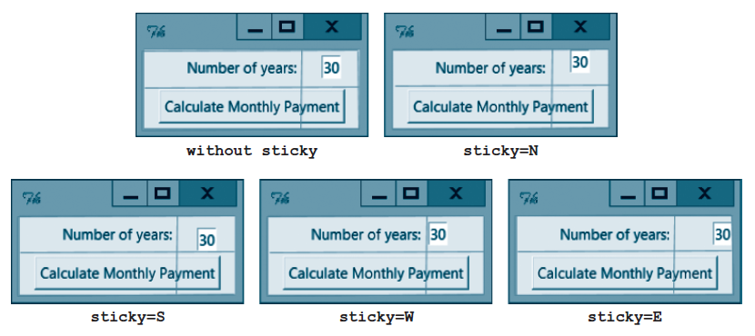
The sticky Attribute
The Entry widget containing the number 30 was declared with the statement:
entNumberOfYears = Entry(window, width=2)
In the top-left window, the widget was placed into the grid with the statement:
entNumberOfYears.grid(row=0, column=1)
Notice that the widget appears in the center of its cell—its default location. In the remaining windows, the sticky attribute was used to change the location of the widget within its cell.
In the top-right window, the widget was placed into the grid with the statement:
entNumberOfYears.grid(row=0, column=1, sticky=N)
The remaining three windows were created by setting the value of sticky to S, W, and E, respectively.

Slide 12
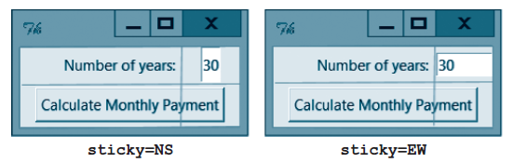
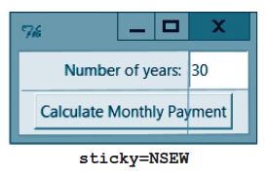
The sticky Attribute
The value assigned to the sticky attribute also can consist of two letters chosen from N, S, E, and W or can even consist of all four of the letters.
The argument sticky=NS causes the widget to attach to both the North and South sides of its cell. This can only happen if the widget is stretched vertically.
Similarly, the argument sticky=EW stretches the widget horizontally, and the argument sticky=NSEW stretches the widget both vertically and horizontally so that it fills the entire cell.

Slide 13
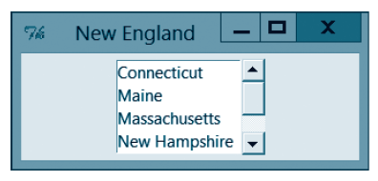
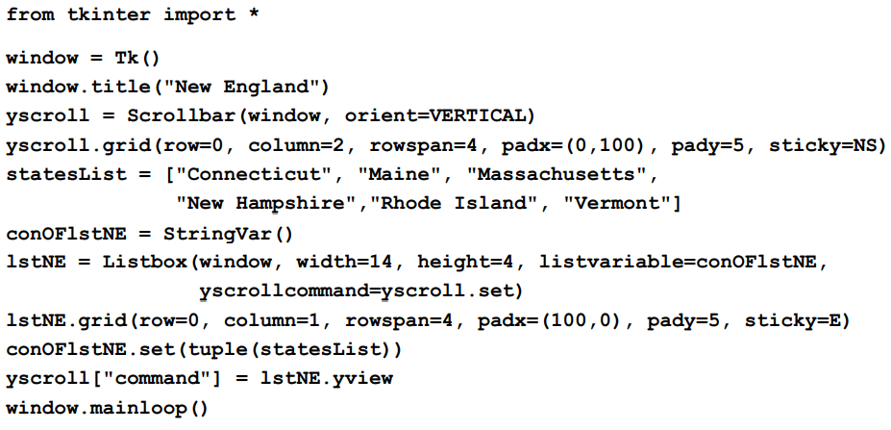
Attaching Vertical Scrollbar to List Box
Figure below shows a list box with a vertical scroll bar attached to its right side.
The items in the list box scroll when the user clicks on one of the scroll bar’s arrows or drags the small raised-looking rectangle located between the two arrows. The following code is used, where the names of the two widgets are lstNE and yscroll.

Slide 14
Attaching Vertical Scrollbar to List Box
The scroll bar must be declared before the list box.
The argument yscrollcommand=yscroll.set must be inserted into the list box’s constructor.
The statement yscroll["command"] = lstNE.yview must be added to the program.
The last two steps attach the scroll bar to the list box.
To create the interface below, the list box and the scroll bar were placed in adjacent cells and given the same rowspan values.
In addition, sticky was used to guarantee they are touching and that the scroll bar fills its cells vertically.
The arguments padx=(100,0) and padx=(0,100) put some space to the left of the list box and to the right of the scroll bar without separating them.

Slide 15
Designing the Screen Layout
Guidelines:
Input from the user can be obtained by having the user type the information into an Entry widget or click on an item in a list box. A label should be placed to the left of each Entry widget to specify the type of information that should be typed into the Entry widget. Often labels are placed above list boxes to describe their contents.
The output of a program is usually displayed either in a ReadOnly Entry widget or in a list box. If the output consists of a large number of items displayed in a list box, a vertical scroll bar should be connected to the list box.
© 2016 Pearson Education, Ltd. All rights reserved.

Slide 16
Designing the Screen Layout
Guidelines:
3- Often, but not necessarily, buttons span more than one column.
4- By default, list boxes hold 10 items.
5- Some programmers make a rough sketch of the screen layout on a piece of paper and then draw grid lines to guide them in deciding where to place each of the widgets. If the grid lines look awkward, the programmers make adjustments to the layout.
6- After the first draft of the program is run, the programmer usually will want to change the layout by adding padding and sticky arguments into the grid methods of the widgets. This process is typically repeated many times.
© 2016 Pearson Education, Ltd. All rights reserved.

Slide 17
End
Section 2
Chapter 8
© 2016 Pearson Education, Ltd. All rights reserved.

