Slide 1

Identification of Single Cell Phytoplankton Species
GTU CSE 495 – FINAL PRESENTATION
MEHMET AVNI CELIK
PROJECT ADVISOR: BURCU YILMAZ
JANUARY 2023
PROJECT TRAILER VIDEO:
Image Classification of Single Cell Marine Creatures: Phytoplanktons

Slide 2
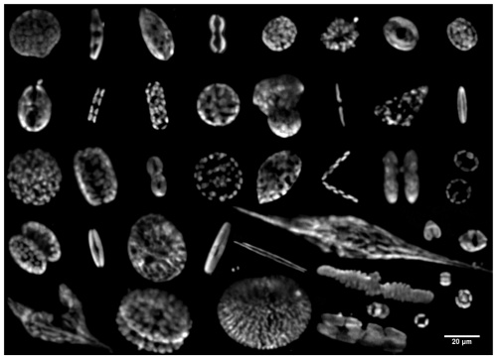
Identification of Phytoplanktons
Project Schema and Definition
Phytoplanktons are single cell microscopic marine creatures.
They are one of the most important resources of the seas, important in various fields such as food, agriculture, medicine and pharmacy.
There are more than 20.000 species of Phytoplanktons.
Imagery of phytoplankton with different morphologies obtained from natural coastal water samples.⁽¹⁾

Slide 3
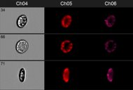

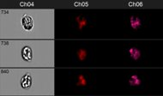
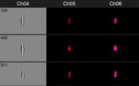
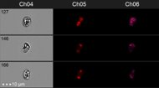

Project Design Plan I
ROS-23
ROS-6
ROS-13
EXE-1a
ROS-12
ROS-9

Slide 4
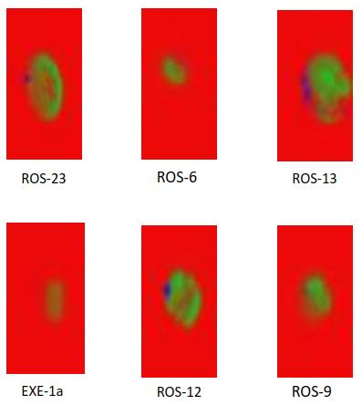
Project Design Plan II
Since each cell has 3 divergent grayscale channels, a relationship is researched between them.
Channels belongs to the same cell are combined and RGB images are created as shown in the figure.
Models are trained individually for each kind of datasets.

Slide 5
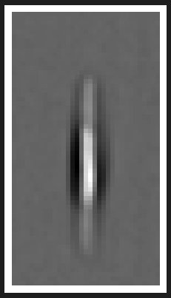
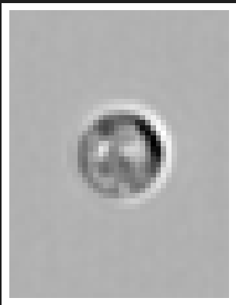
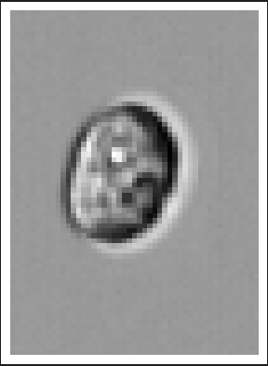
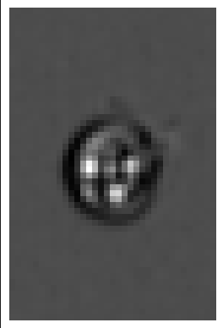
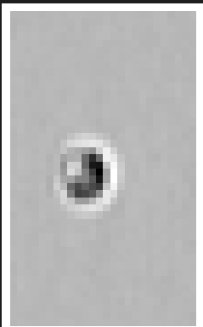
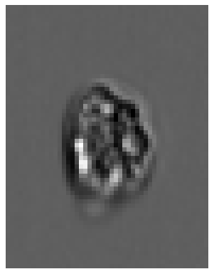
EXE1-a_m4
ROS-12_m4
ROS-23_m2
ROS-9 _m4
ROS-6 _m3
ROS-13_m4

Slide 6

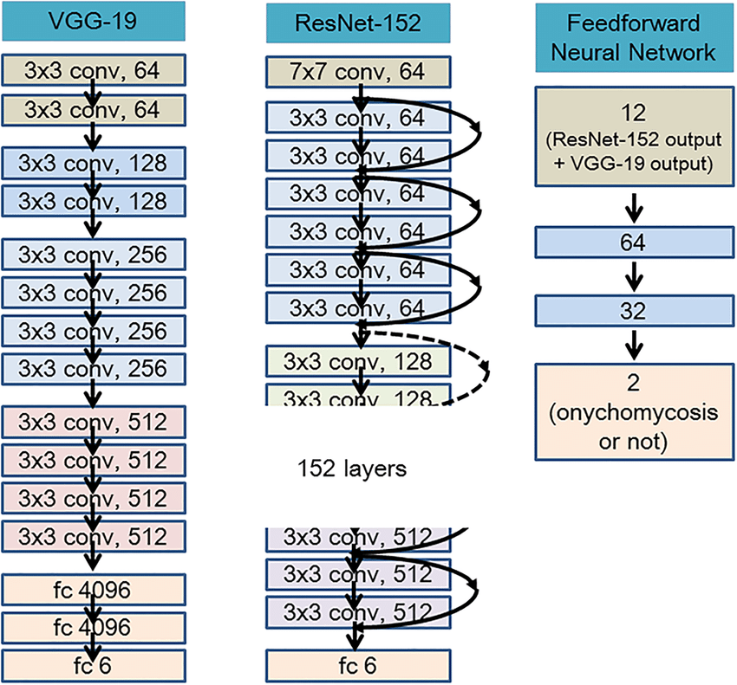


Approach and Technologies Used
Project Requirements I
Mostly Keras,OpenCV, NumPy and Rasterio libraries are used, since those are the most convenient libraries for image processing and segmentation.
AlexNet, GoogleNet, DenseNet, VGGNet and Resnet are some of the popular models for image processing.
It is decided to use ResNet and VGG16 in this project for the reasons mentioned later.
Compared architecture of VGG-19 ResNet-152-FNN⁽²⁾

Slide 7
Training the Models
Models
ResNet: -> ResNet-50 is a 50-layer convolutional neural network which overcomes the vanishing gradient problem,causes the value of gradient decreases significantly during backpropagation. -> ResNet-50 model exhibits the best accuracy for the task of image classificasstionwith a test data accuracy 97.33% -> ResNet-50 model in this project is pre-trained with ‘imagenet’ dataset.
VGG16: ->VGG16 model has one of the best accuracy in the ‘imagenet’ dataset following ResNet50. VGG16 model in this project is pre-trained with ‘imagenet’ dataset.

Slide 8
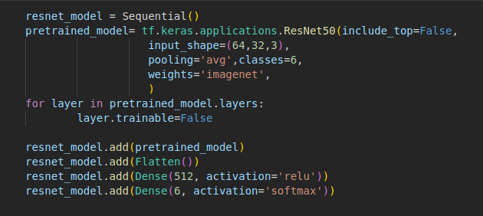
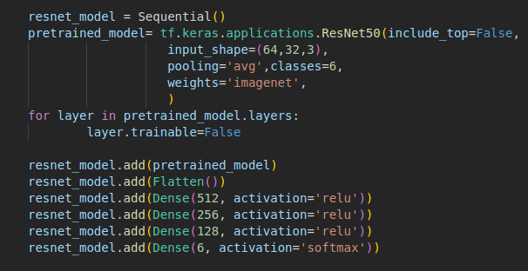
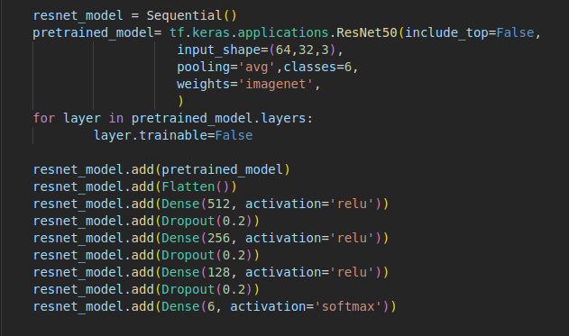
ResNet-50
ResNet-50
Pretrained ResNet-50 model is studied to the dataset with different approaches and different results are obtained by applying fine tuning.
Some different fine-tuning methods are used, yet 3 of them will be shown here due to the time restriction.
Model 1: Less Dense Layer
Model 2: More Dense Layer
Model 3: More Dense Layer with Dropout Layer

Slide 9
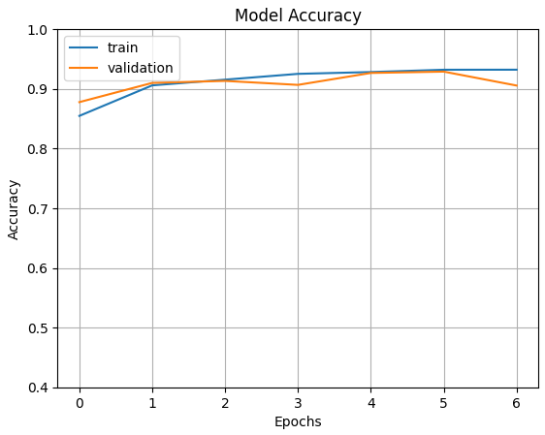
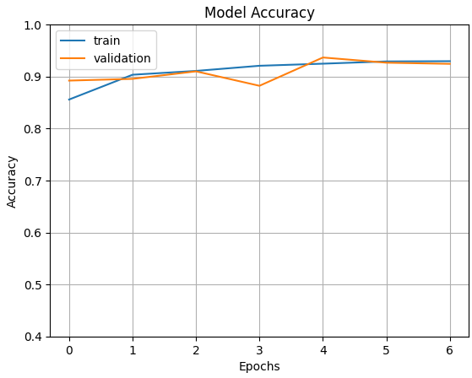
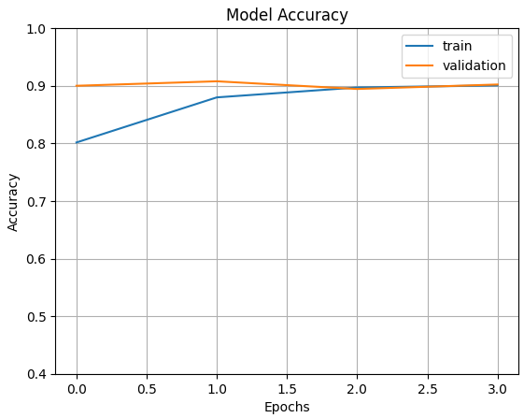
Results and Fine Tuning Effect on Channel4 Model Accuracy
ResNet-50
Model 1:
Model 2:
Model 3:
Train Set Accuracy: 0.9402
Validation Accuracy: 0.9056
Loss:0,28
Train Set Accuracy: 0.9357
Validation Accuracy: 0.9244
Train Set Accuracy: 0.9147
Validation Accuracy: 0.9022
Experiment shows that Dropout layer causes decrease in the accuracy, yet prevents overfitting.

Slide 10
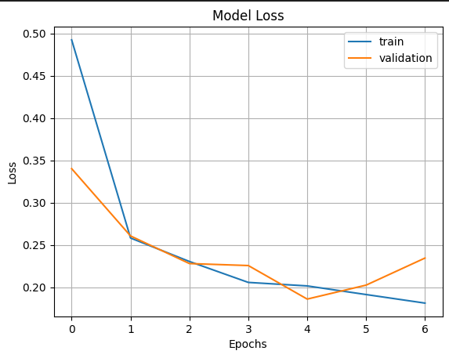
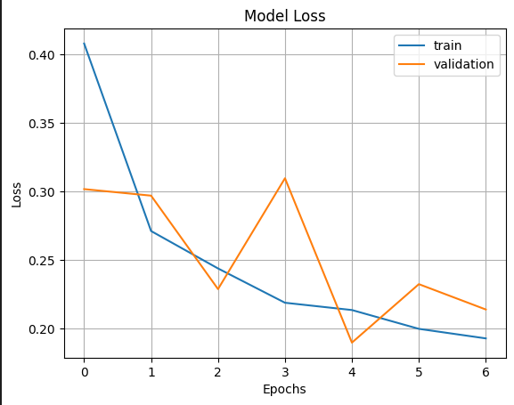
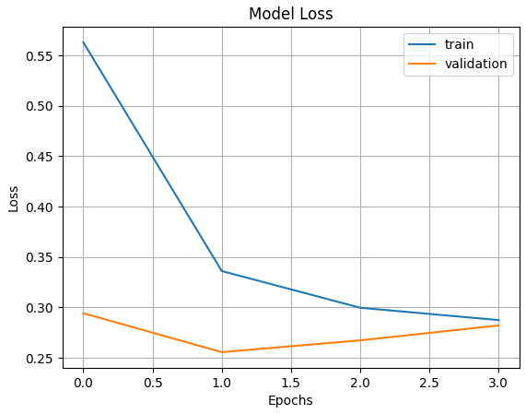
Results and Fine Tuning Effect on Channel4 Model Loss
ResNet-50
Model 1:
Model 2:
Model 3:
Train Loss: 0.1814
Val Loss: 0.2346
Train Loss: 0.1930
Val Loss: 0.2141
Train Loss: 0.2875
Val Loss: 0.2822
Experiment shows that Dropout layer causes increase in the loss, yet prevents overfitting.

Slide 11
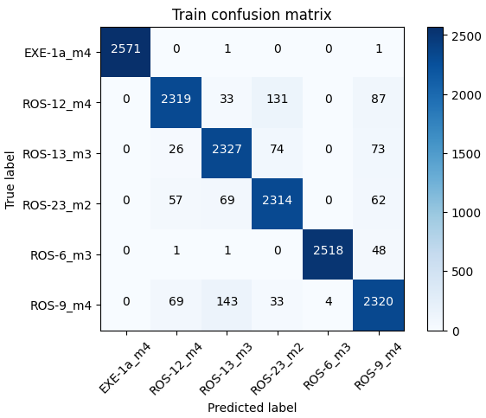
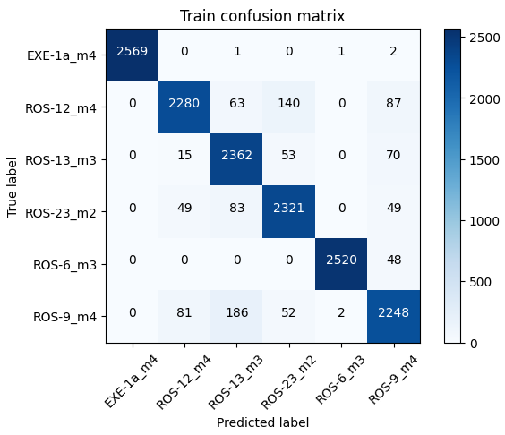
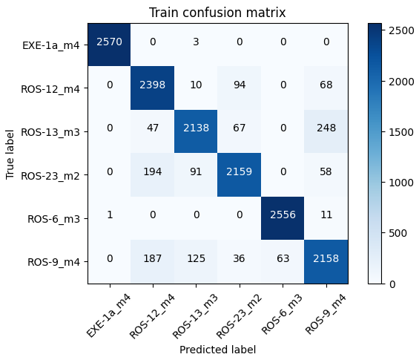

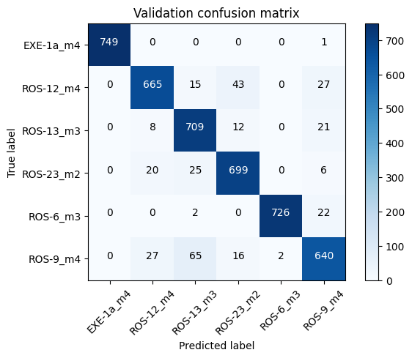
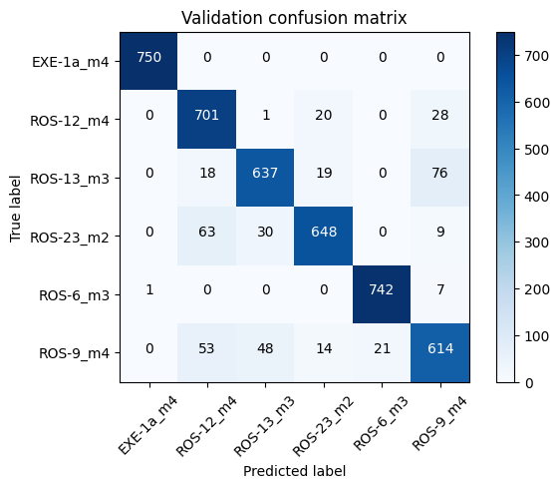
Confusion Matrix Results of Ch4
ResNet-50
Model 1:
Model 2:
Model 3:

Slide 12
The following pages will include only one version of the models due to time restriction.
Many Fine-tuning methods are applied and version-3 of the shown model is selected for the report as a result of preventing overfitting.
Models are trained with 10 epoch, yet Early-Stopping callback halts in the proper position by monitoring validation loss.

Slide 13
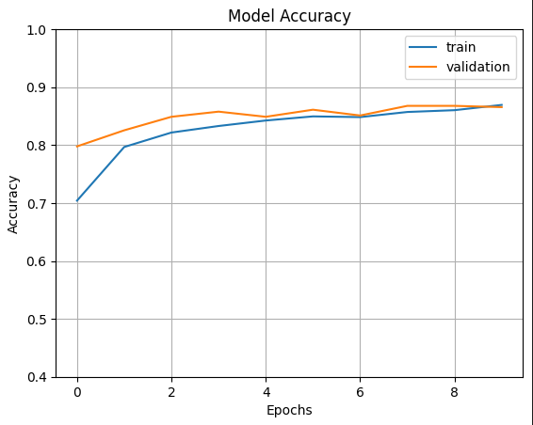
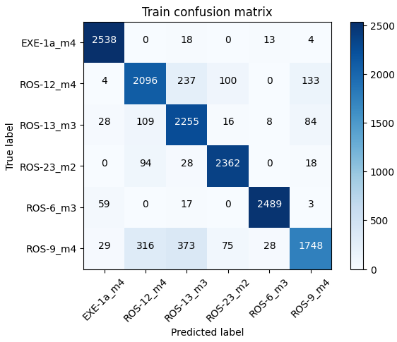
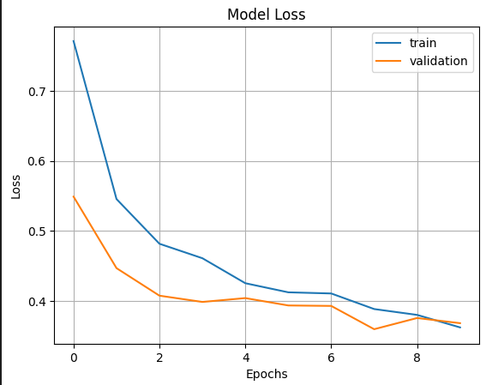
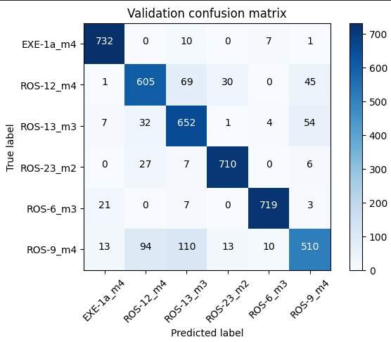
Accuracy,Loss and
Confusion Matrices of Channel 5
ResNet-50
Train Set Accuracy: 0.8826
Validation Accuracy: 0.8656

Slide 14
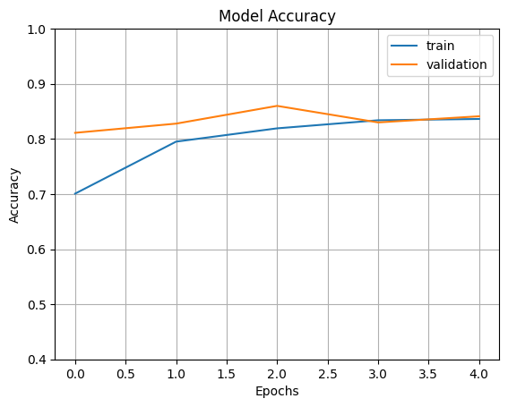
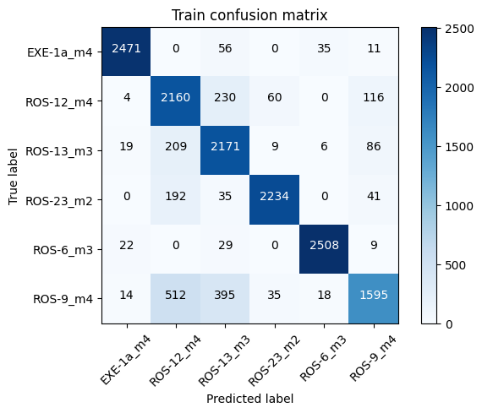
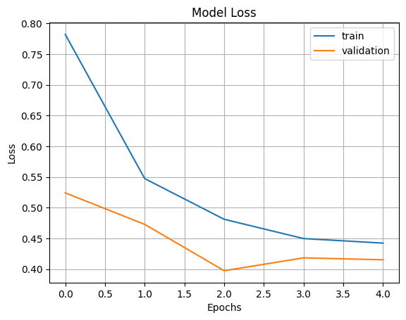
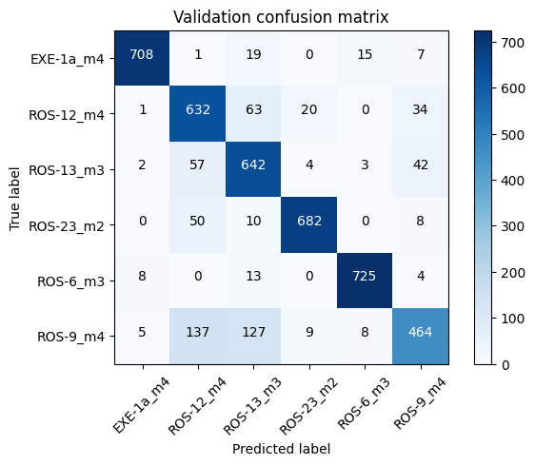
Accuracy,Loss and
Confusion Matrices of Channel 6
ResNet-50
Train Set Accuracy: 0.8363
Validation Accuracy: 0.8411

Slide 15
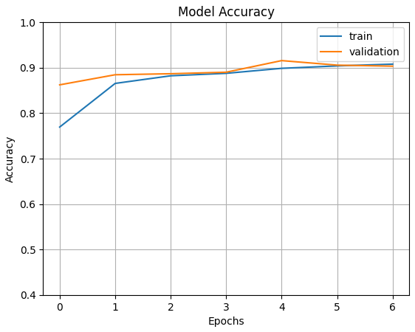
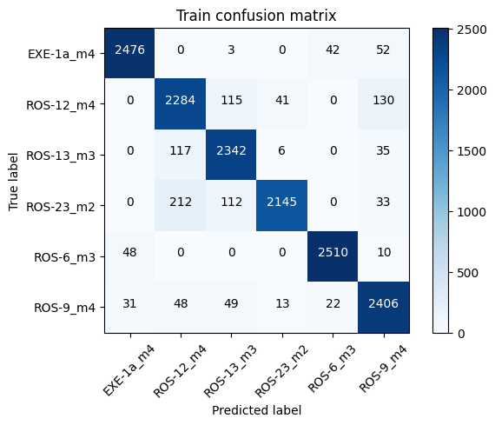
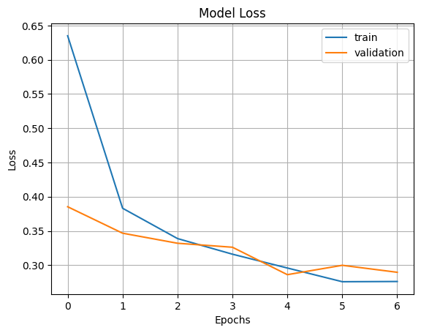
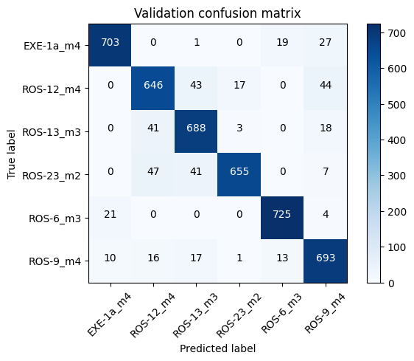
Accuracy,Loss and
Confusion Matrices of RGB
ResNet-50
Train Set Accuracy: 0.9078
Validation Accuracy: 0.9033

Slide 16
ResNet-50 Results
ResNet-50
The graphs and result values shows that the validation accuracies are ranked as shown below:
RGB > Ch4 > Ch5 > Ch6
90.33 > 90.22 > 86.56 > 84.11

Slide 17
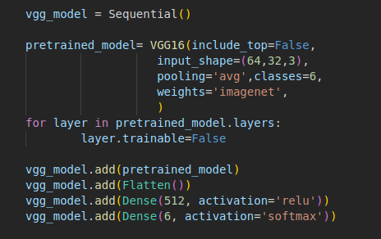
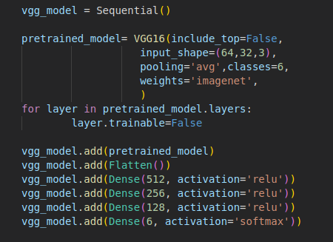
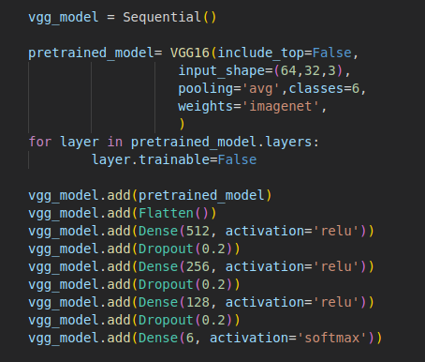
VGG16
VGG16
Pretrained VGG16 model is studied to the dataset with different approaches and different results are obtained by applying fine tuning.
Some different fine-tuning methods are used, yet 3 of them will be shown here due to the time restriction.
Model 1: Less Dense Layer
Model 2: More Dense Layer
Model 3: More Dense Layer with Dropout Layer

Slide 18
The following pages will include only one version of the models due to time restriction.
Many Fine-tuning methods are applied and version-3 of the shown model is selected for the report as a result of preventing overfitting.
Models are trained with 10 epoch, yet Early-Stopping callback halts in the proper position by monitoring validation loss.

Slide 19
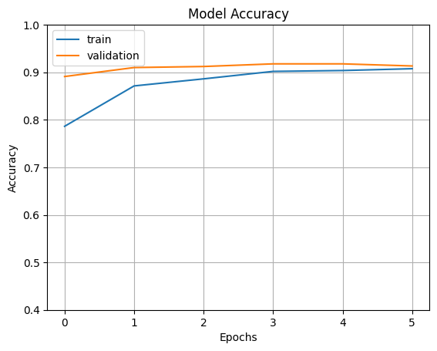

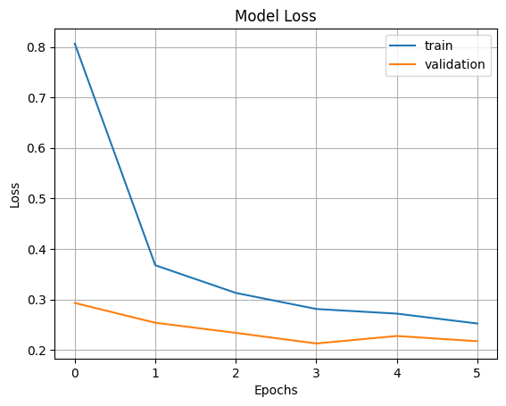

Accuracy,Loss and
Confusion Matrices of Channel 4
VGG16
Train Set Accuracy: 0.9076
Validation Accuracy: 0.9133
Results shows that the validation accuracy is higher than the train accuracy.
Possible reasons:
->Underfitting
->Dataset is not adequate
->Layer amount is not adequate

Slide 20
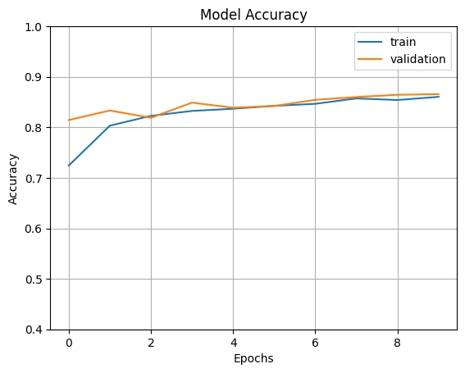
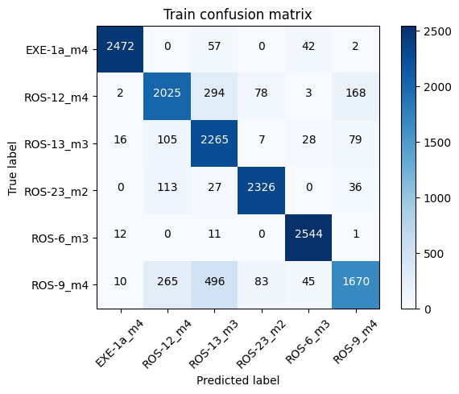
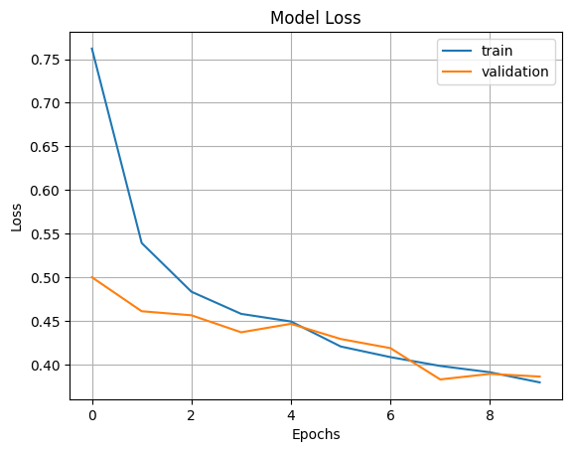
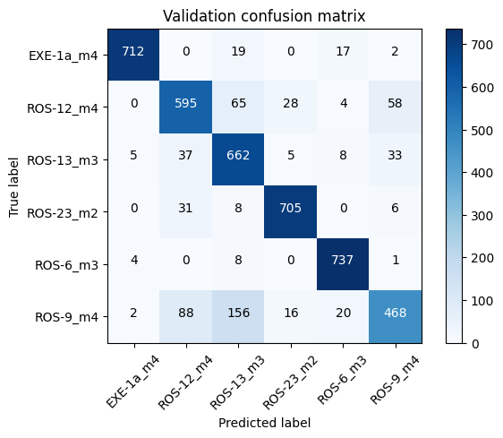
Accuracy,Loss and
Confusion Matrices of Channel 5
VGG16
Train Set Accuracy: 0.8604
Validation Accuracy: 0.8656

Slide 21
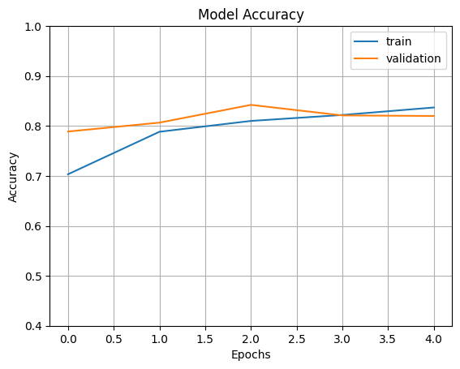
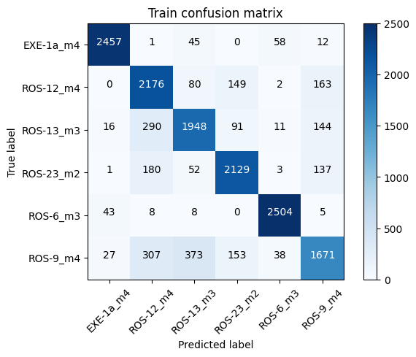


Accuracy,Loss and
Confusion Matrices of Channel 6
VGG16
Train Set Accuracy: 0.8370
Validation Accuracy: 0.8200

Slide 22




Accuracy,Loss and
Confusion Matrices of RGB
VGG16
Train Set Accuracy: 0.8816
Validation Accuracy: 0.8744

Slide 23
VGG16 Results
VGG16
The graphs and result values shows that the validation accuracies are ranked as shown below:
Ch4 > RGB > Ch5 > Ch6
91.33 > 88.16 > 86.56 > 82.00

Slide 24
Conclusion and Discussion
Conclusion
Obtained results show that:
Processed dataset increased the accuracy and provide improved results.
ResNet-50 model produces better outcomes than VGG16 model.
The dataset is not adequate for VGG16 as it is with ResNet-50.

Slide 25

Success Criterias
Success Criteria
The success criterias for this study is determined as:
Accuracy goal: >= 80% with ResNet with independent channels (achieved with 90.22%, 86.56%, 84.11%)
Accuracy goal >= 80% with ResNet by using 3 channels together (achieved with 90.33%)
The response times goal: <= 2 seconds (achieved)
Extra:
VGG16 model is studied same as ResNet-50 and differences are observed.
A graphical user interface is designed for more user friendly application.

Slide 26
References
References
Jianglai Wu and Robert K. Y. Chan, "A fast fluorescence imaging flow cytometer for phytoplankton analysis," Opt. Express 21, 23921-23926 (2013)
Deep neural networks show an equivalent and often superior performance to dermatologists in onychomycosis diagnosis: Automatic construction of onychomycosis datasets by region-based convolutional deep neural network - Scientific Figure on ResearchGate. Available from: https://www.researchgate.net/figure/The-representation-of-model-architecture-image-for-ResNet-152-VGG-19-and-two-layered_fig2_322621180 [accessed 25 Oct, 2022]
C. Zhang et al., "ResNet or DenseNet? Introducing Dense Shortcuts to ResNet," 2021 IEEE Winter Conference on Applications of Computer Vision (WACV), 2021, pp. 3549-3558, doi: 10.1109/WACV48630.2021.00359
S. Sharma and K. Guleria, "Deep Learning Models for Image Classification: Comparison and Applications," 2022 2nd International Conference on Advance Computing and Innovative Technologies in Engineering (ICACITE), 2022, pp. 1733-1738, doi: 10.1109/ICACITE53722.2022.9823516.
Paul Rees, ‘’Deepometry, a framework for applying supervised and weakly supervised deep learning to imaging cytometry’’
S. Mascarenhas and M. Agarwal, "A comparison between VGG16, VGG19 and ResNet50 architecture frameworks for Image Classification," 2021 International Conference on Disruptive Technologies for Multi-Disciplinary Research and Applications (CENTCON), Bengaluru, India, 2021, pp. 96-99, doi: 10.1109/CENTCON52345.2021.9687944.

Slide 27
Thank You for Your Time…

