Slide 1
Placeholder 34
Placeholder 36
Placeholder 37
Chief complaint :
Placeholder 300
‘Placeholder 35’

Slide 2
Anamnesis
No health problem
No bad habit

Slide 3
Symmetrical face
&
Competent lips

Slide 4
smiling line
Placeholder 109

Slide 5
Placeholder 105

Slide 6
Maxillary transverse deficiency
Overjet : mm
Overbite: mm
Placeholder 110
Placeholder 111
Placeholder 112
Placeholder 113

Slide 7
Placeholder 101

Slide 8
Placeholder 103

Slide 9
Placeholder 140
Placeholder 141
Placeholder 142
Placeholder 144
Placeholder 143

Slide 10
Hays Nance
Bolton Analysis
 | Right | Left | Total
Maxilla
Mandible
Placeholder 120
Placeholder 122
Placeholder 121
Placeholder 123
Placeholder 125
Placeholder 124
 | Bolton (6) | Bolton (12)
Maxilla
Mandible
Placeholder 126
Placeholder 127
Placeholder 128
Placeholder 129

Slide 11
SAGITTAL | Rate | Normal
SNA |  | 82° ± 2
SNB |  | 80° ± 2
ANB |  | 2° ± 2
N-A |  | 0 ± 3
N-Pog |  | -4 ± 5
Wits |  | -1 ± 3
Placeholder 1
Placeholder 2
Placeholder 3
Placeholder 4
Placeholder 5
Placeholder 6
Placeholder 38
Placeholder 39
Placeholder 80

Slide 12
VERTICAL | Rate | Normal
Y Axis angle |  | 59° ± 6
SN-GoMe |  | 32° ± 7
SN-PP |  | 7° ± 2
Mx-Md Angle |  | 25° ± 6
FMA |  | 25° ± 5
N-Me |  | 114.4 ± 5
S-Go |  | 74.4 ± 4
S-Go/N-Me |  | 65 ± 4
Placeholder 7
Placeholder 8
Placeholder 9
Placeholder 10
Placeholder 11
Placeholder 12
Placeholder 13
Placeholder 14
Placeholder 40

Slide 13
JAW DIMENSION | Rate | Normal
ANS-Me
Ef.Middle Face (Co-A)
Ef.Mand. (Co-Gn)
Anterior Cranial Base (S-N) |  | 73.2 ± 3
Corpus Length (Go-Me) |  | 78.1 ± 5.5
Placeholder 85
Placeholder 15
Placeholder 86
Placeholder 16
Placeholder 87
Placeholder 17
Placeholder 18
Placeholder 19
Effective middle face dimension is
Effective mandible dimension is
Lower anterior facial height is
Placeholder 90
Placeholder 91
Placeholder 92

Slide 14
Upper incisor | Rate | Normal
U1-SN |  | 102° ± 5
U1-PP |  | 110° ± 5
U1-NA |  | 4 mm ± 3
U1/NA |  | 22° ± 6
U1/OP |  | 57.8 ± 3
Placeholder 20
Placeholder 21
Placeholder 22
Placeholder 23
Placeholder 24
Lower incisor | Rate | Normal
L1-Apog |  | 2.7 mm ± 1
IMPA |  | 90° ± 5
L1-NB |  | 4 mm ± 2
L1/NB |  | 25° ± 6
L1/OP |  | 64 ± 4
Placeholder 25
Placeholder 26
Placeholder 27
Placeholder 28
Placeholder 29
1-1 angle |  | 130° ± 6
Placeholder 30
Placeholder 98
Placeholder 99
Placeholder 41

Slide 15
Soft Tissue | Rate | Normal
Nasolabial Angle |  | 104° ± 8
E-Upper lip |  | -4 ± 2
E-Lower lip |  | -2 ± 2
Placeholder 31
Placeholder 32
Placeholder 33
Placeholder 95
Nasolabial angle is
Upper lip is
Lower lip is
Placeholder 96
Placeholder 97

Slide 18
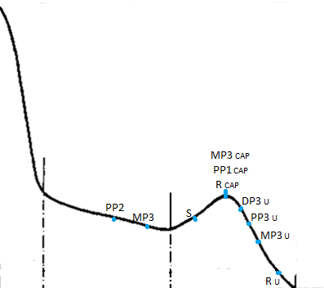
Placeholder 130

Slide 19
Diagnosis & Problem List
Dentally Class II relationship
Crowding
Placeholder 38
Placeholder 40
Placeholder 98
Placeholder 99

Slide 20
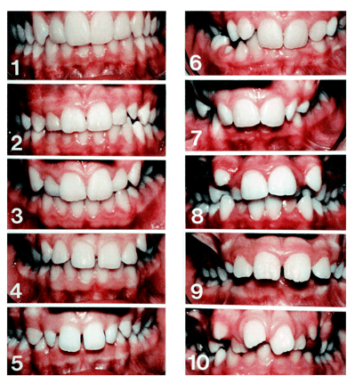
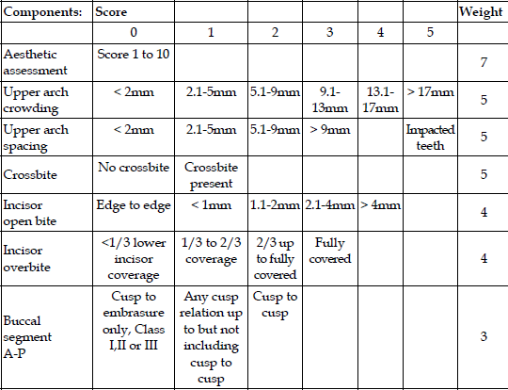
 | Pretreatment Score | Weighting
Aesthetic Component |  | 7
Upper Arch Crowding |  | 5
Crossbite |  | 5
Overbite |  | 4
Buccal A-P Relationship |  | 3
Weighted Score | 52

Slide 21
Placeholder 37

Slide 23
My Treatment Objectives
Alignment of teeth
Establishment of dentally Class I relationship on both sides
Correction of midline discrepancy
upper & lower incisor inclinations
crossbites
OJ & OB

Slide 24
Ideal Treatment Plan
?

Slide 25
Suggested Treatment Plan
?

