Slide 1
AIRP: AI-based domain-specific business solutions for SMEs
Mehmet Eyupoglu
2022719066
SWE523 – MANAGING SOFTWARE DEVELOPMENT

Slide 2
Table of contents
01
02
03
04
01
Problem Statement
Problem statement and motivation explained
Solution
02
Techniques, tools will be shared to explain the solution
Innovative Aspects
What is new ?
Market Research
Competitors & existing solutions
Financials
05
Costs, national economic contributions etc.

Slide 3
Problem Statement
01
What led me to find a solution

Slide 4
Problem
SMEs make up the 98% of most of the national economies. However, they are limited in terms of financial & human resources to keep the organization neat
Data-driven management is rare in SMEs due to lack of data collecting capacity/ability
Of-the-shelf ERPs are usually too generic or not for SMEs
Mobile access is not a common practice in traditional ERPs

Slide 5
Solution
02
Techniques, tools, etc

Slide 6
Solution
Built-in data collection solutions (forms etc.)
Domain specific solutions that address the majority of the issues in a specific industry
Instant access to data through mobile solutions
AI technology exploitation to boost autonomous company management

Slide 7
Innovative Aspects
03
What is new?

Slide 8
Innovative Aspects
Domain specific solutions addressing certain industry
Data collection is facilitated with AI
Company specific data is processed with AI
AI acts as assistant to management

Slide 9
Market Research
04
Competitors & existing solutions

Slide 10
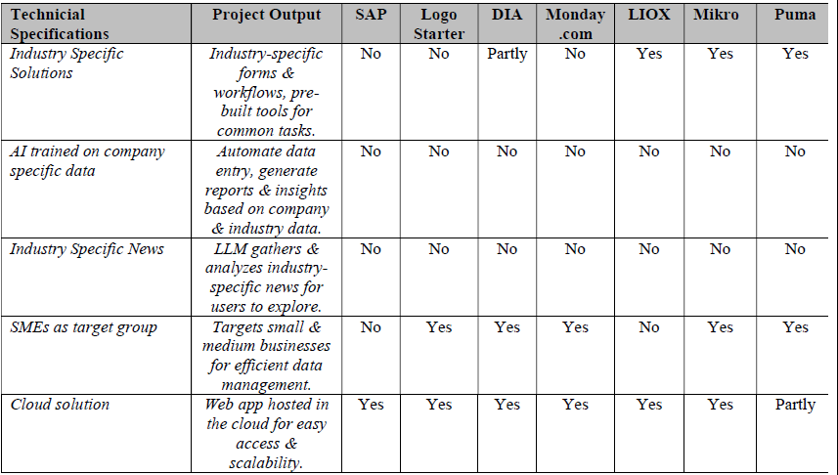
Market Research

Slide 11
Financials
05
Costs, national economic contributions

Slide 12
Financials (Costs)
Work packages (6) with 4 personnel cost ₺ 2.532.750,00
Travel expenses cost ₺ 132.500,00
Software & equipment cost ₺ 397.520,00
Total Cost ₺ 3.062.770,00

Slide 13
Financials (National Economic Contribution)
₺ 4.000.000,00 of domestic sales are expected within the next 12 months that follow the first sale
ROI is expected to be no more than 18 months
Within the five years, ₺ 500.000.000,00 of savings are expected in the SMEs that use AIRP.
Around 40 direct (within our prospective company in the next 5 years) employment are expected
Around 200.000 indirect employment is expected

Slide 14
Thanks!
Do you have any questions?
mehmet.eyupoglu@std.bogazici.edu.tr
+90 553 173 19 91

