Slide 1
Creating the Work Breakdown Structure

Slide 2
Why?
If you've got a project charter and an excited customer, why go to the trouble to build a work breakdown structure?

Slide 3
What is WBS?
“... a hierarchical list of work activities required to complete a project.”
“... is a description of the work to be performed, broken down into its key components, to the lowest level.”

Slide 4
Work breakdowns
can be viewed as
a tree diagram
indentions

Slide 5
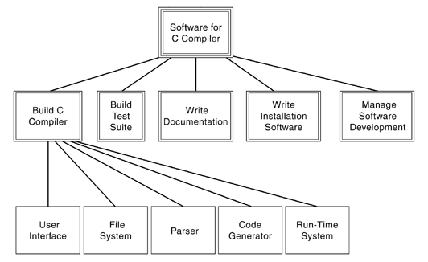
Tree View

Slide 6
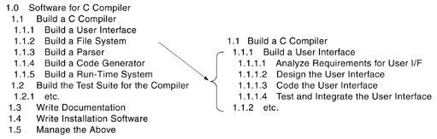
Indentions

Slide 7
WBS is organized...
As major work products and deliverables.
Organize WBS:
around deliverables and
the actions to produce those deliverables
Avoid unnecessary work from being done on the project.
Gold Plating?
Work that does not drive toward a deliverable. (Avoid!)

Slide 8
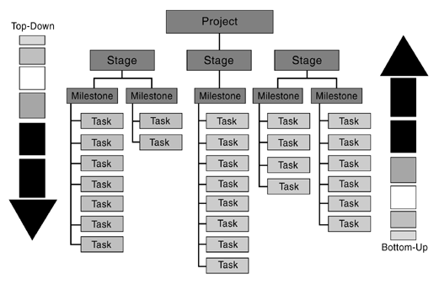
WBS can be created...
as top-down
as bottom-up!

Slide 9
While breaking down
... until when?
done by “one unit of resource”
“Do not plan in any more detail than you can manage!”
... if no WBS?
BIG BANG!

Slide 10
Strategy
You should stop when you have a sufficient description of the activity!
Use teams as subgroups rather than individuals.
Not deeper than 3 or 4 levels!
Not a large tree!

Slide 11
What is milestone?
It must have a deliverable!
Not so close... Not so far...
Stated as “something done” or “something completed”

Slide 12
What is work package?
It is the lowest level...
Contents:
Description of the work product expected software element to be produced;
The staffing requirements who or how many people will do this activity;
Names of responsible individual(s) who is responsible for seeing that it is completed;
The scheduled start and end dates when the activity is expected to start and to end;
The budget assigned (dollars, hours, or other unit) the effort estimate for the activity;
The acceptance criteria for the work defect level or other quality measure.

Slide 13
Building a WBS for software
Identify the work concerning the software product (separate from hardware and work processes).
Find any higher system WBS (separate the software from other systems and components).
Determine the software WBS architecture (how to organize this software product and project).
Populate the software WBS architecture (identify all the parts and activities to produce them).
Determine cost categories for software (prepare for estimation activities).

Slide 14
Identify the Work Concerning Software
Go through the available documentation
SOW (best item to start with)
Specifications, concept of operation
Requirements documents of many kinds
Design documents
Standards (internal and external)
Customer conversations
Test criteria or expectations
List all items that might impact the cost
Include the what and where of each item

Slide 15
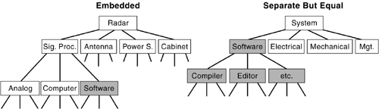
Find Any Higher System WBS
Determine whether there is a WBS for any higher system (higher project or program) and how the software fits in.

Slide 16
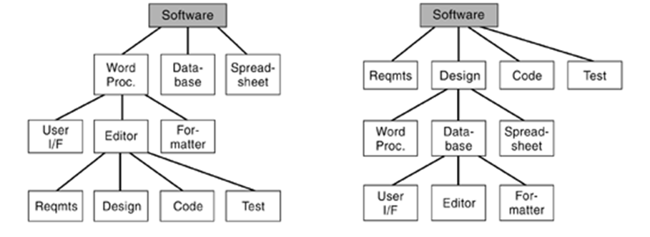
Determine the Software WBS Architecture

Slide 17
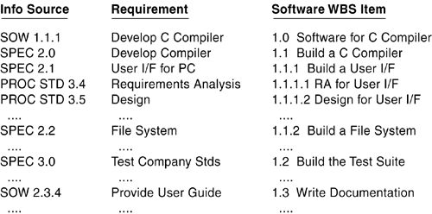
Populate the Software WBS
Cross-Reference Matrix

Slide 18
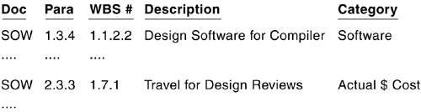
Determine Cost Categories for Software
When necessary to track unit-level costs in a WBS
Determines how the cost will be estimated
Capital equipment: currency,
Effort: hours, weeks, or months of labor,
Overhead items: proportional add-on (a percentage).

Slide 19
Questions?

