Slide 1
Shaply Vahid Akram

Slide 2
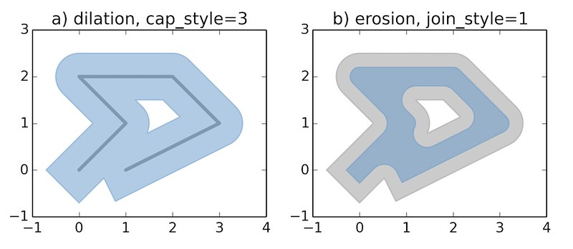
Shaply
Shapely is a BSD-licensed Python package for manipulation and analysis of planar geometric objects

Slide 3
Mathplot
Matplotlib is a Python 2D plotting library which produces publication quality figures in a variety of hardcopy formats and interactive environments across platforms.
import shapely
import matplotlib.pyplot as plt
from shapely.geometry.point import Point
from shapely.geometry import LineString
from shapely.geometry import box
import matplotlib as mpl
import random
import math

Slide 4
Point, Circle, Box
pnt = Point(5,9);
f=box(0,0,dx, dy)
cu=pnt.buffer(10);
cu.intersection(f)
cu.difference (f)
cu.union(nextc)
polygon.contains(pnt)

Slide 5
LineString, Polygon
Line=LineString([(1, 2), (4, 5), (6, 7)]);
poly = Polygon([(2.2, 4.2), (7.2, -25.1), (9.26, -2.456)])
world_centroid = p.centroid # Get the area of the Polygon
world_area = p.area # Get the bounds of the Polygon
world_bbox = p.bounds # Get the exterior of the Polygon
world_ext = p.exterior # Get the length of the exterior
world_ext_length = world_ext.length

Slide 6
Plotting
c.exterior.coords.xy;
plt.figure()
plt.fill(x,y,edgecolor='black', linewidth=0.1)
plt.show()
l=LineString([(1, 2), (4, 5), (6, 7)]);
x,y=l.coords.xy;
plt.figure()
plt.plot(x,y, marker = 'o')
plt.show()

Slide 7
Some Math
random.uniform(x, y)
math.ceil(x)
math.floor(x)
math.sin(x)
math.cos(x)
round(x)

