Slide 1
Fuzzy BMS with PV

Slide 2
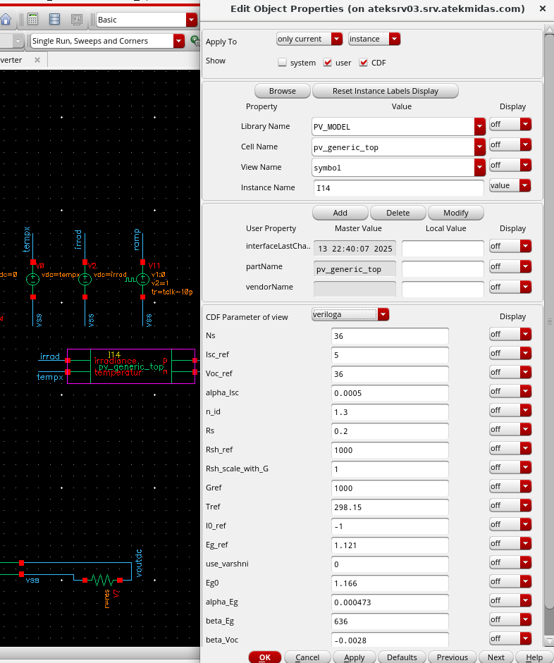
PV Model:
Same parameters with matlab and manufacturer informations.

Slide 3
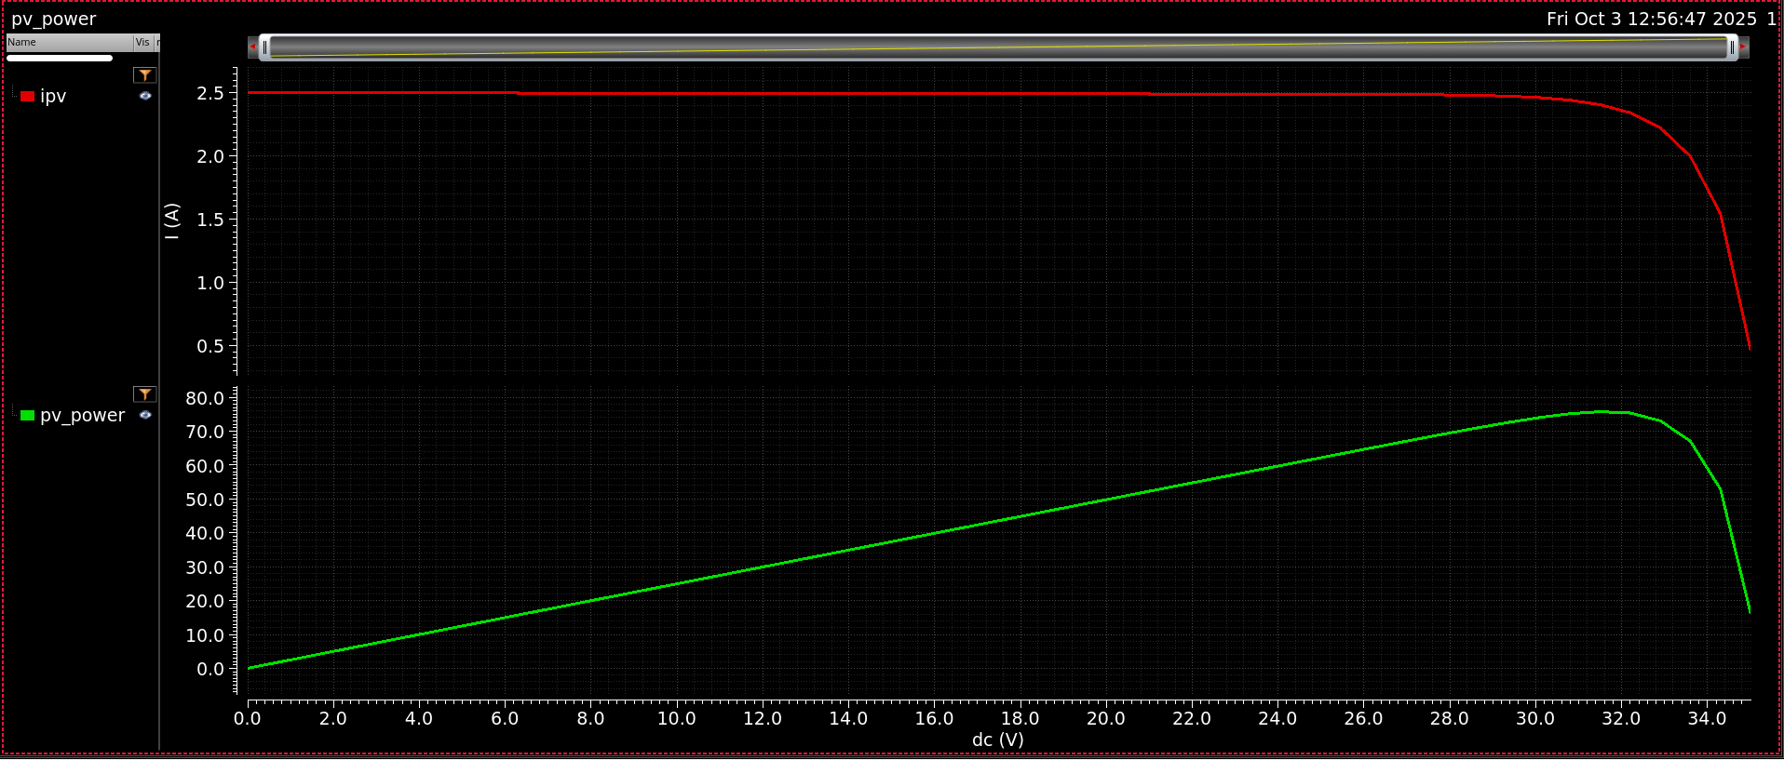
I-V curve

Slide 4
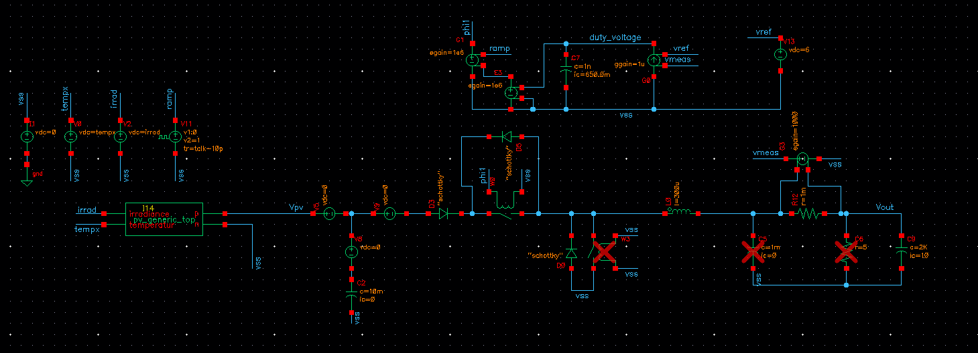
Analog Loop Setup:

Slide 5
Analog Loop Setup:
Error Amp
Current Sense
Battery

Slide 6
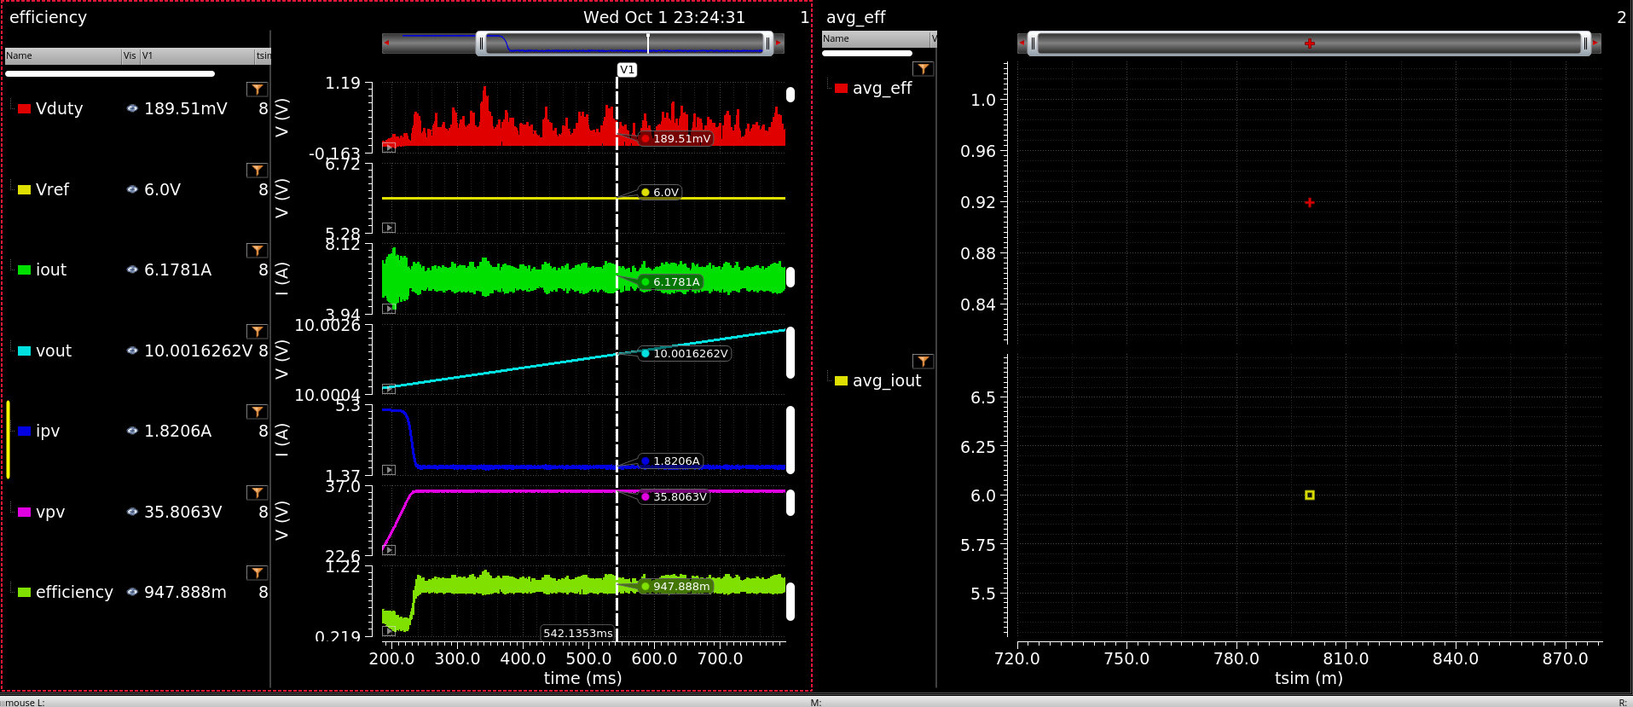
Sim

Slide 7
Conclusions:
Convergent PV model is created.
Analog loop around buck converter with PV is verified.

Slide 8
Roadmap
System verilog block for fuzzy should be built.
Required Analog Blocks are listed
ADC (8-10B low rate)
Current Sense Unit
Gate Driver
AUXilary block
New friends can optimize models while I proceed with system verilog and other block's spec creation.

