Slide 1
MPPT with Fuzzy Logic

Slide 2
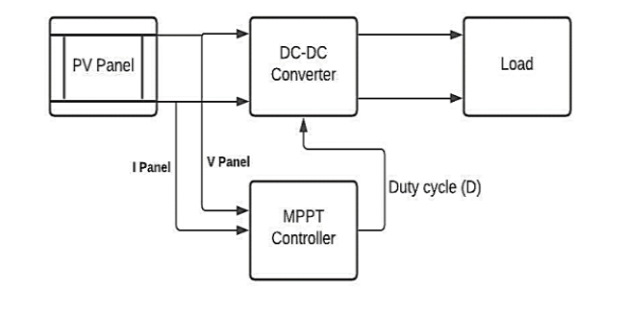
System:
https://ieeexplore.ieee.org/stamp/stamp.jsp?tp=&arnumber=9768650

Slide 3
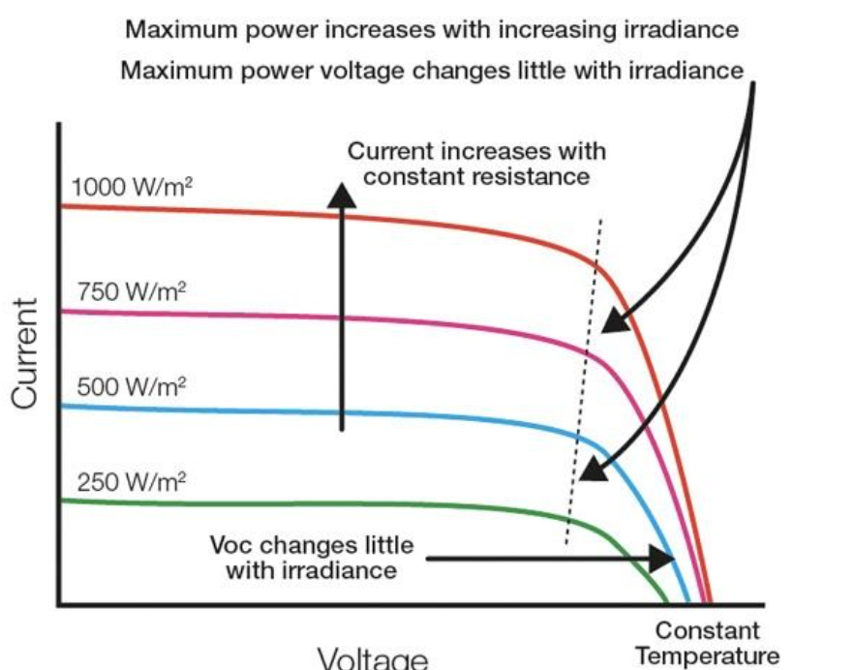
Photovoltaic IV characteristics
Due to point maximizes the power there should be DC-DC converter to make kind of impedance match.
https://arka360.com/ros/factors-affect-photovoltaic-performance/

Slide 4

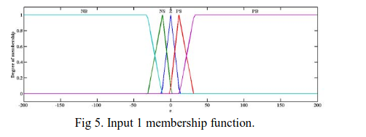
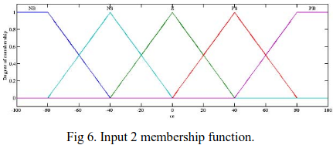
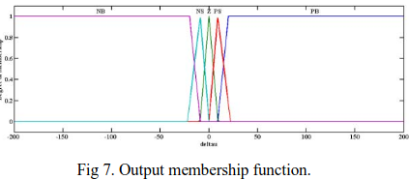
System Membership Functions:
System will include two input.
Inputs are as follows:
System has one output which is Duty Cycle of PWM driving DC-DC converter
P: power of PV output
V: Voltage of PV output
I: Current of PV output
Membership functions:
https://ieeexplore.ieee.org/stamp/stamp.jsp?tp=&arnumber=8012756

Slide 5
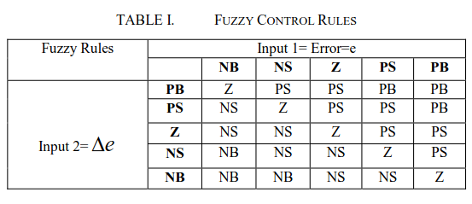
Inference system rule set:
https://ieeexplore.ieee.org/stamp/stamp.jsp?tp=&arnumber=8012756

Slide 6
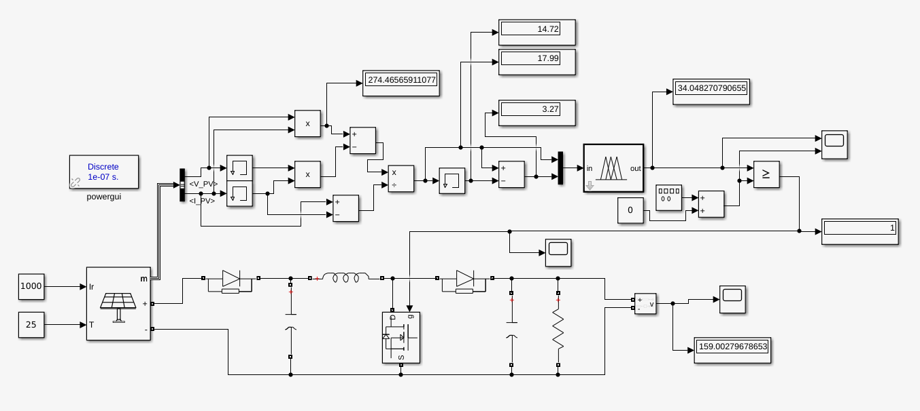
Simulink setup and simulation:
Component parameters of boost converter is arbitrarily chosen.
L: 900uH
C:1mF R:10ohm

Slide 7
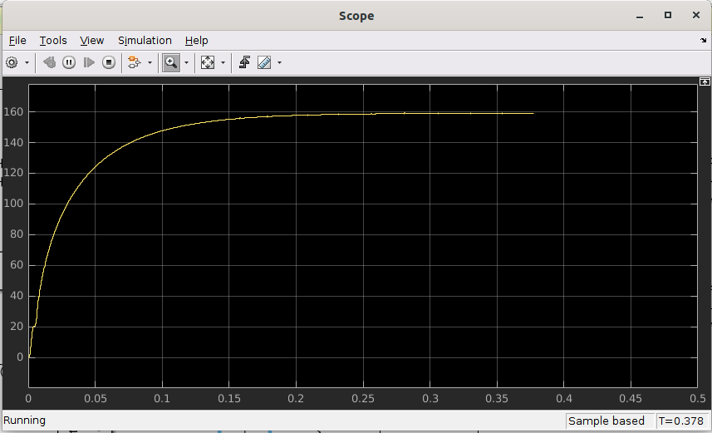
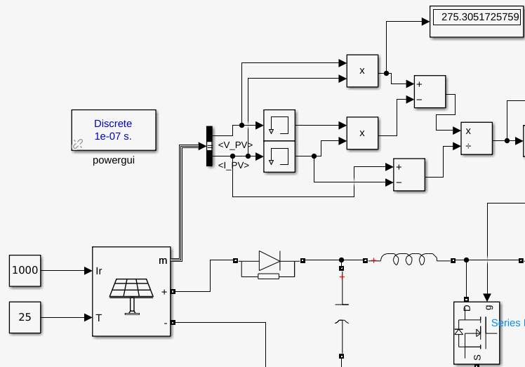


Simulation Result
Output voltage
Steady state Power
Max power offered by PV is 280W

