Slide 1
Literature Search & Efficiency

Slide 2
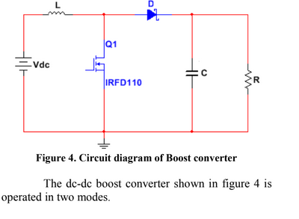
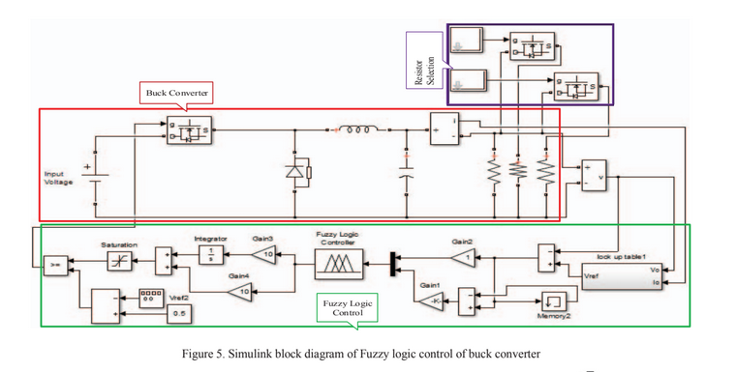
Papers and switch models
Modelling and Simulation of Solar Photovoltaic array for Battery charging Application using Matlab-Simulink
P.Sathya, G.Aarthi
Fuzzy Logic Control of Buck Converter for Photo Voltaic Emulator Mohammad Tauquir Iqbal, Mohd Tariq, Md Shafquat Ullah Khan
Left one mention the switch they used but many other like the right one didn't mention about anything.

Slide 3
What is required from previous meeting?
Make sure operation is CCM?
For efficiency purposes remove diode and non-idealities.
Increase time resolution

Slide 4
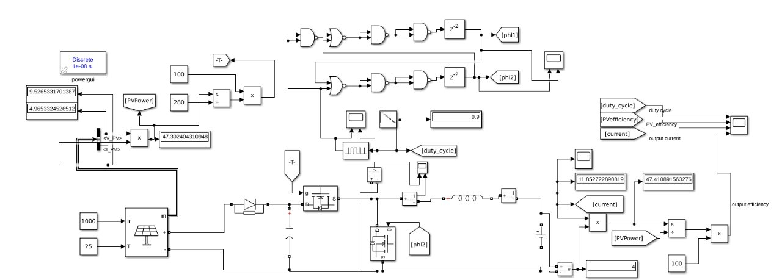
Setup:
Nonoverlapping clock delay is around 2us, PWM frequency is 25kHz.

Slide 5
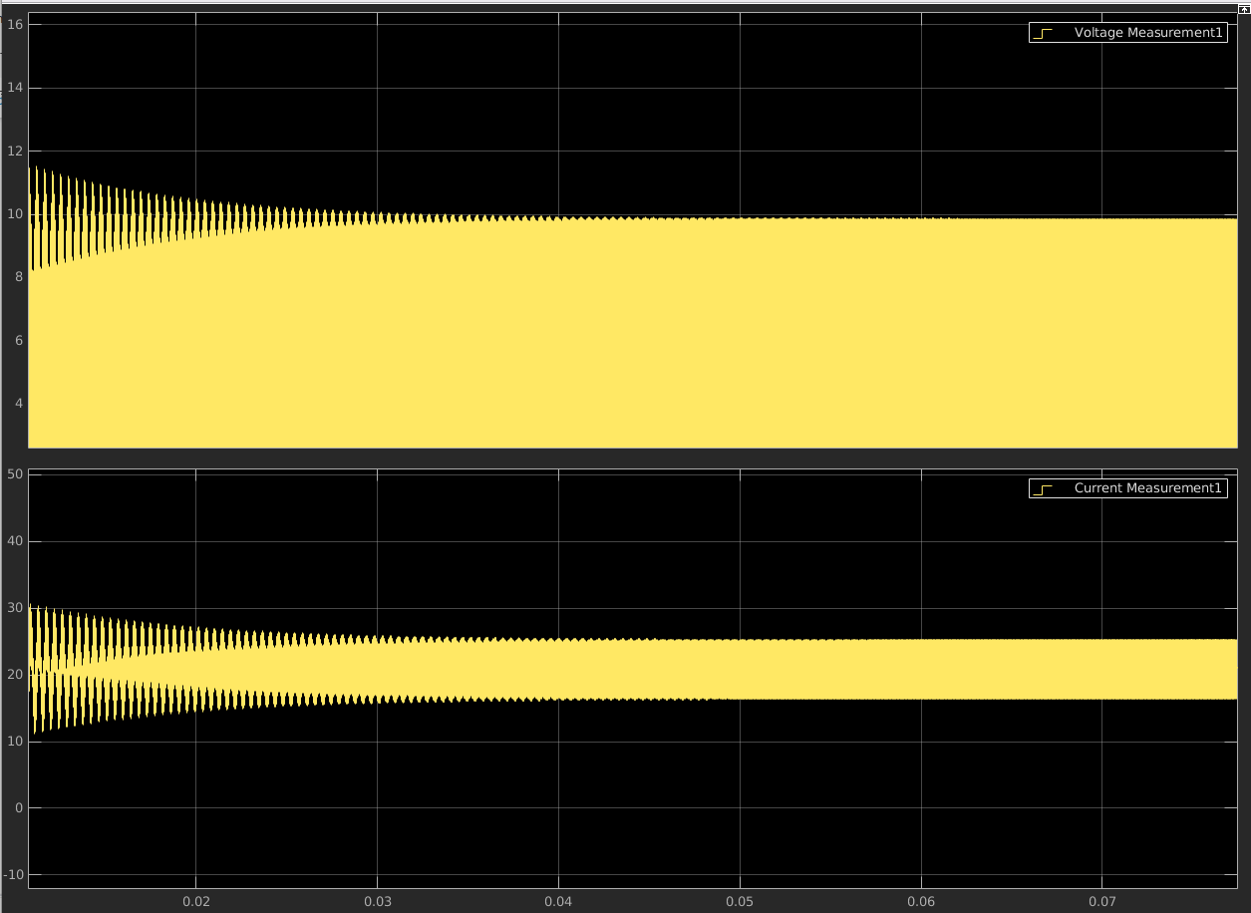
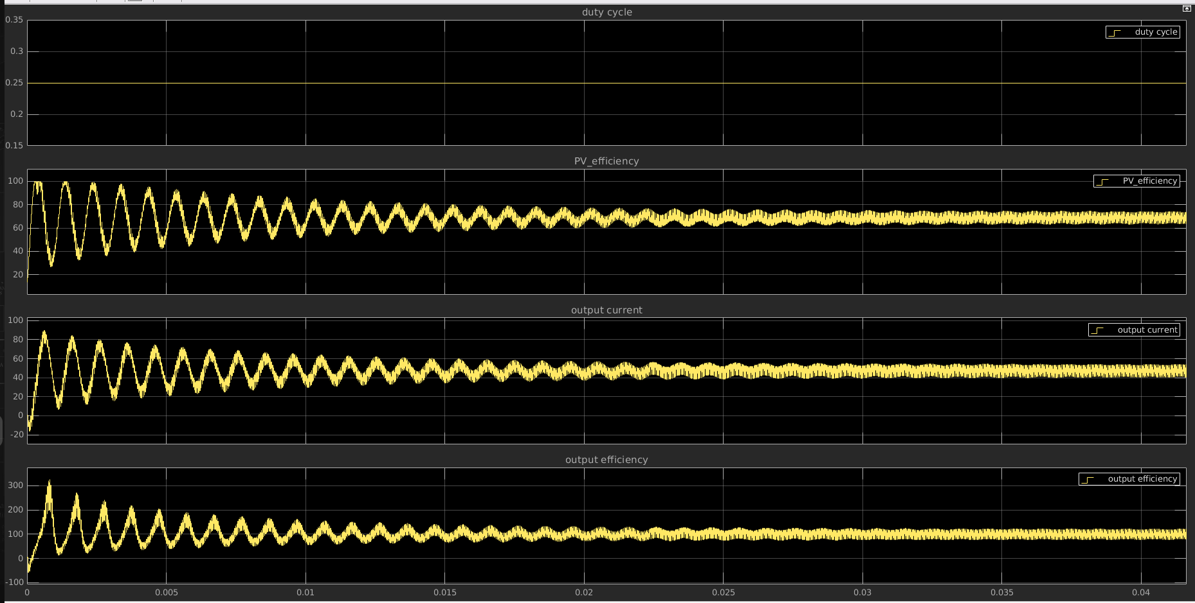
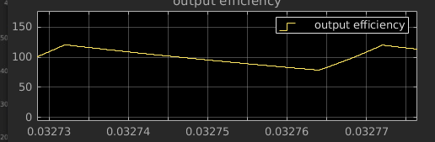
Mode of operation:
Previously mode of operation is not clear, so component values changed a little
Parallel Cap -> 100e-6F
Series Inductor -> 10e-6H
Voltage and Inductor Current @D=0.5
Output efficiency
@D=0.9 and 0.25 gives same results too.

Slide 6
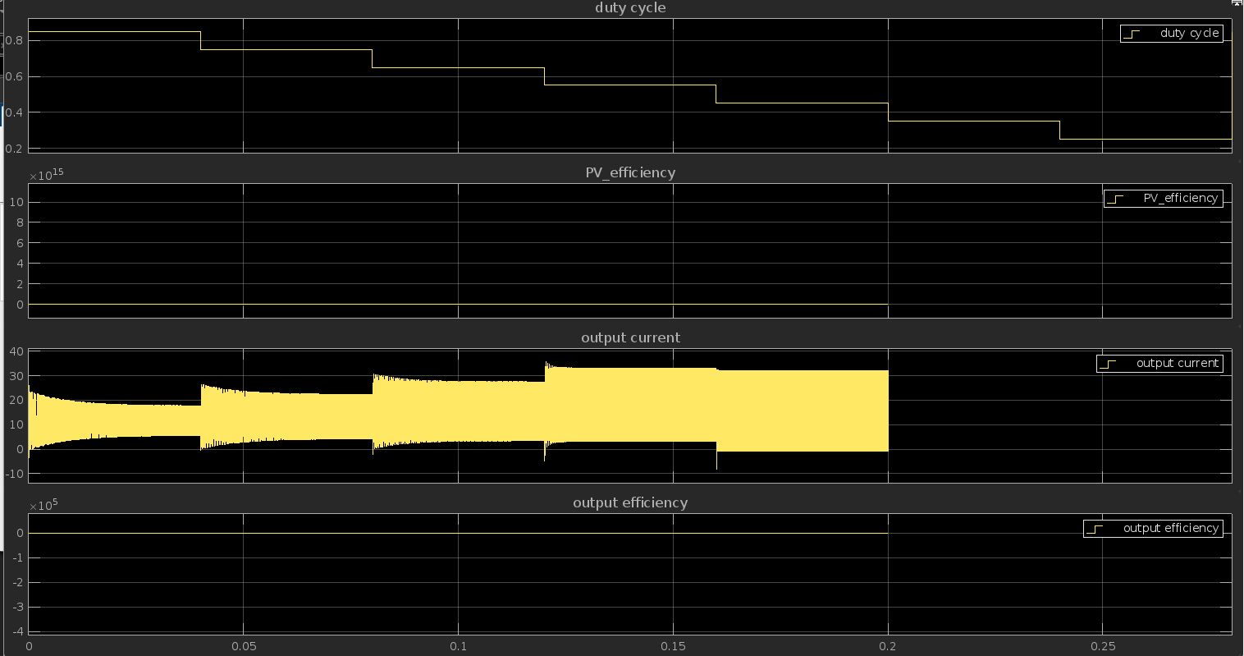
Duty Cycle Sweep:
Output connected to 15V direct DC supply.
After some point sweep gives not a number error.

Slide 7
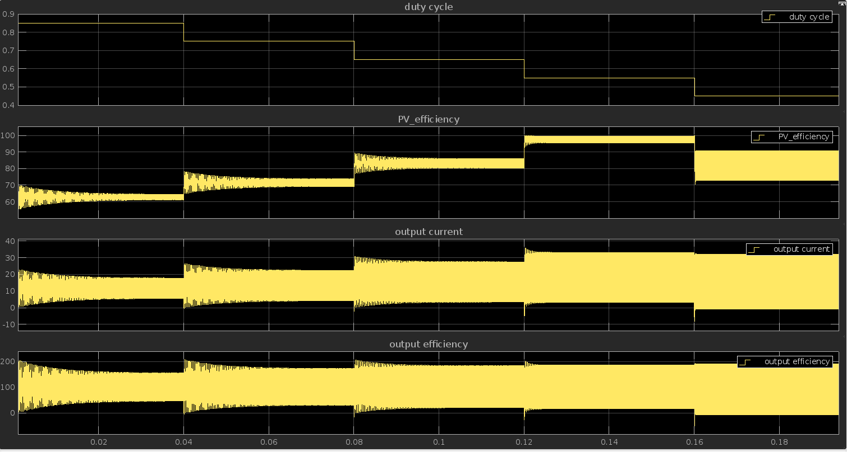
Closer look at high efficiency point:
Max output current is achieved at high efficiency region as expected.
But is this data reliable or not according to above slide?

Slide 8
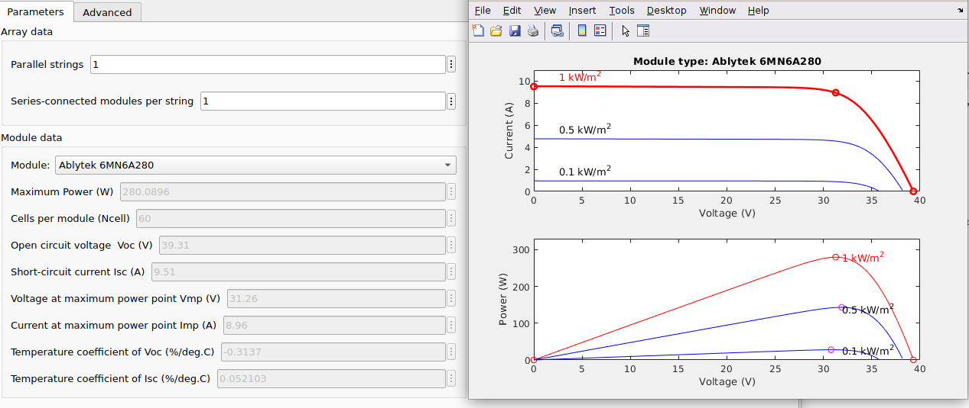
What could be possible cause?
We try to fix the output at 15V, max power point voltage is taken at 30V, when duty cycle is around 0.5V we get maximum. Maybe we have a state which has no solution in terms of PV?

