Slide 1
Problems when modelling PV buck converter in verilogA
Issue arises from the problem, simple setup in next slide will summarize the problem.

Slide 2
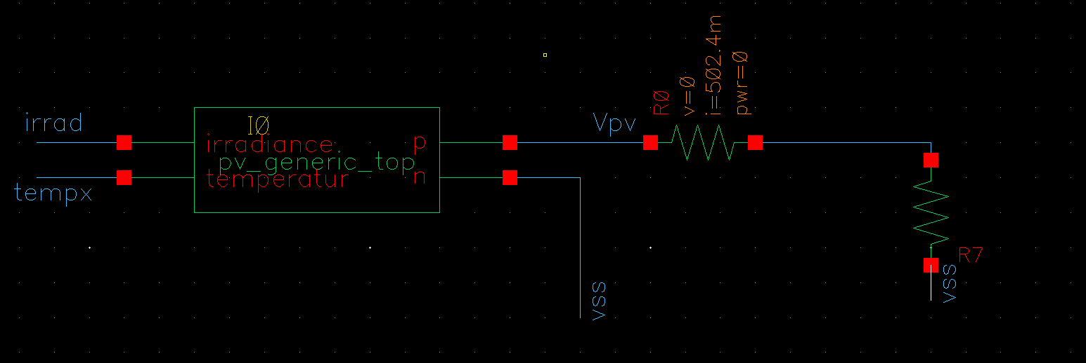
Setup:

Slide 3
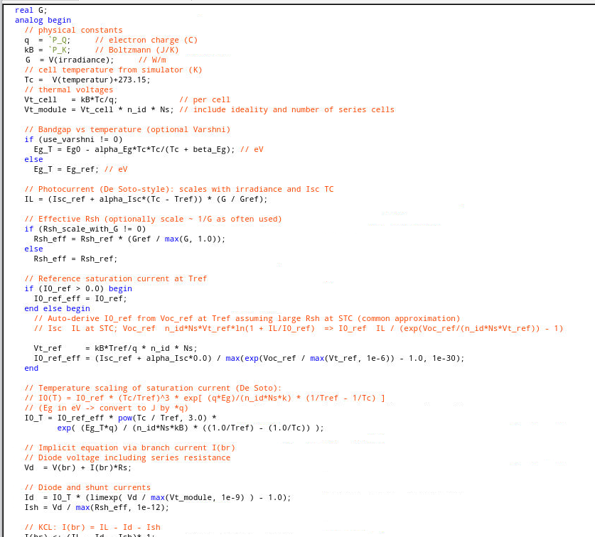
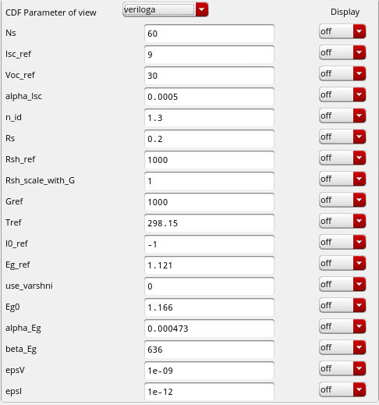
Model and Params (still under improvement):
https://pvpmc.sandia.gov/modeling-guide/2-dc-module-iv/single-diode-equivalent-circuit-models/de-soto-five-parameter-module-model/

Slide 4
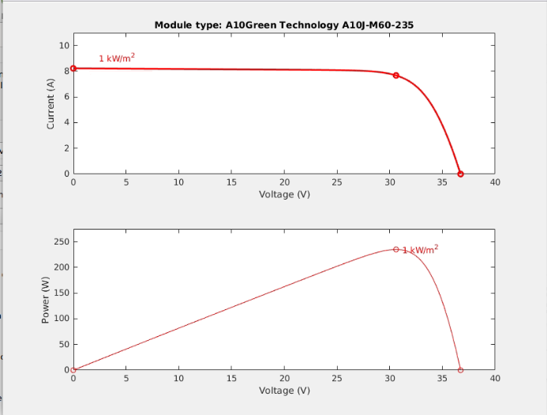
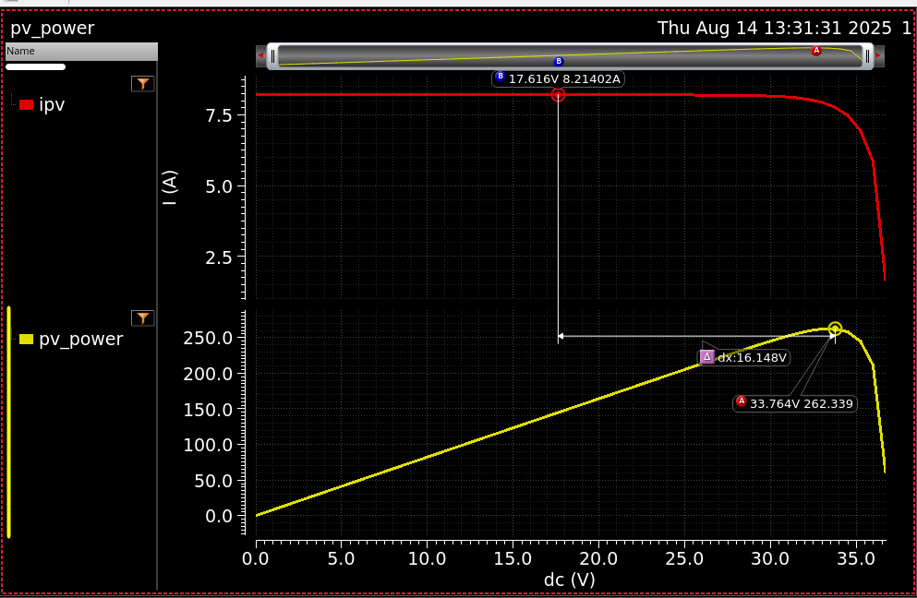
Isc & Voc

Slide 5
Future Work:
Currently models tried to be matched with matlab models.
Also Buck converter is created with this model but, meaningfull results are not seen yet

Slide 6
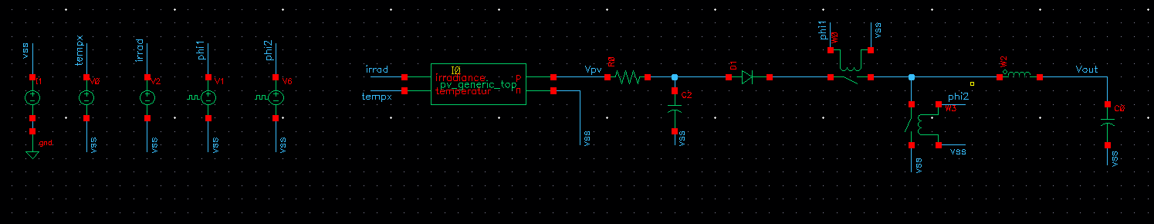
Problem:

Slide 7
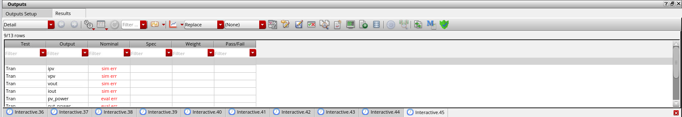
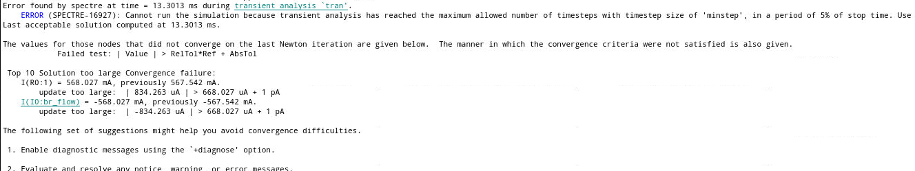
Logs

