Slide 1
Fuzzy BMS with PV

Slide 2
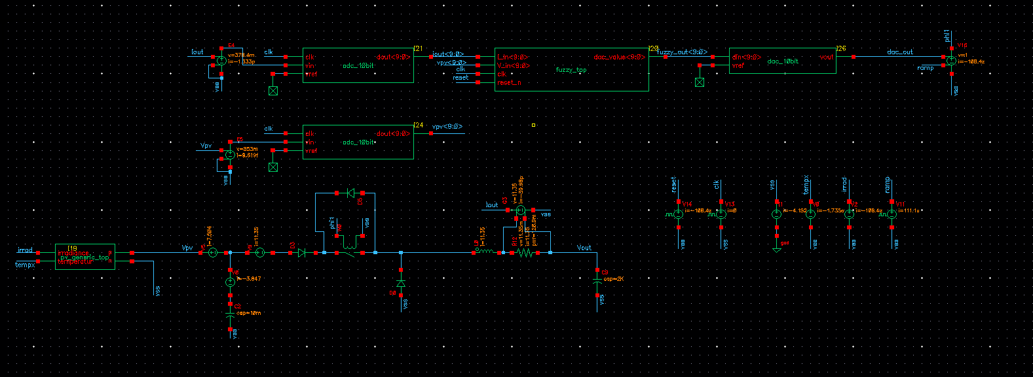
System:
ADC veriloga
Fuzzy HDL
DAC veriloga
PV
Buck

Slide 3
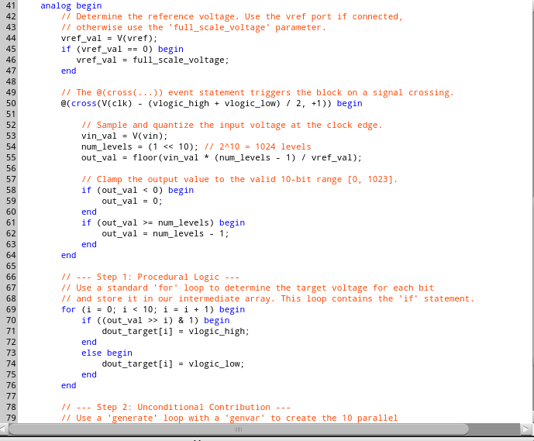
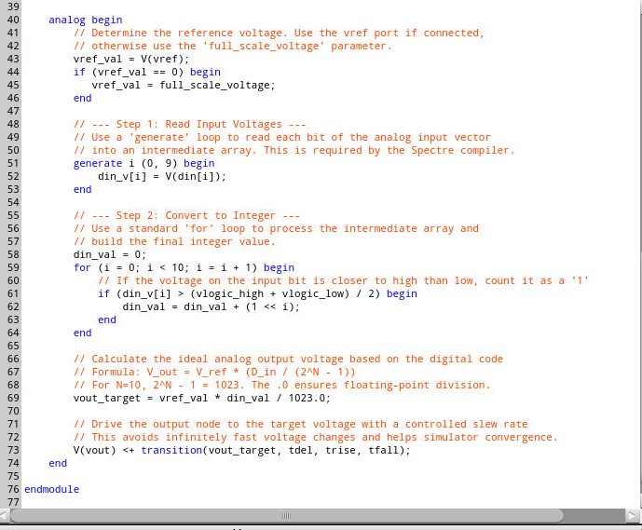
ADC and DACS
Both are 10bit, Ref expected as 1V
Fclk of adc is on the order of kHz but should be increased.

Slide 4
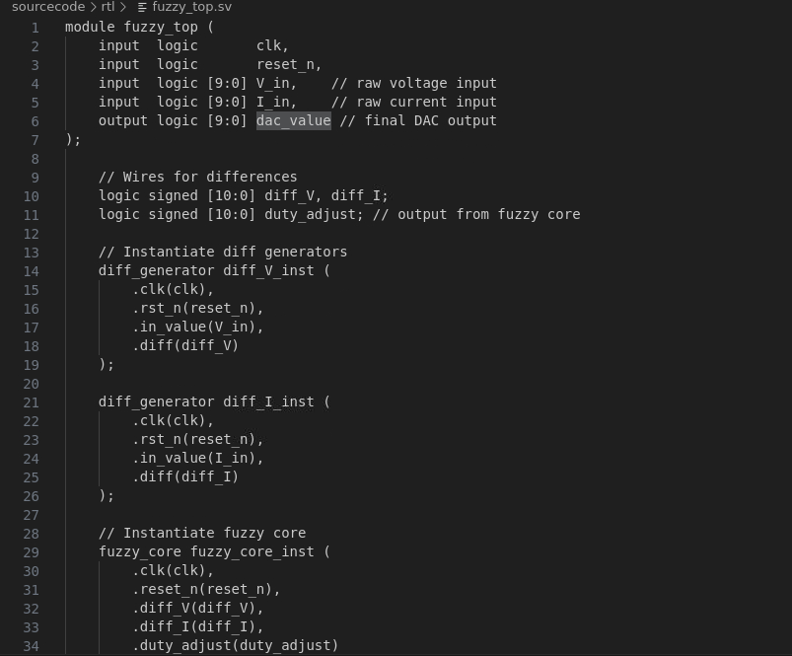
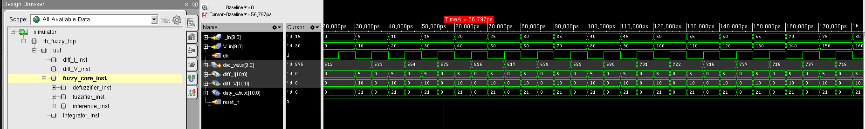
Fuzzy
Pure synthesizable hdl code checked against matlab model.
Deviation is around %1 from matlab.

Slide 5
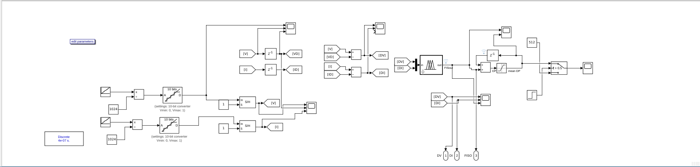
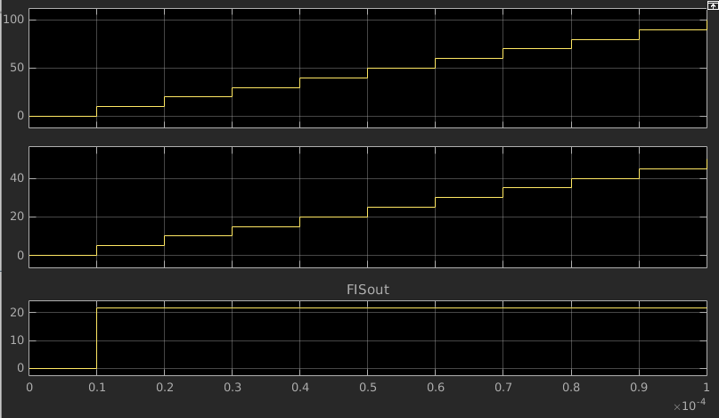
Matlab
Same 21 output under same input conditions with before plot.

Slide 6
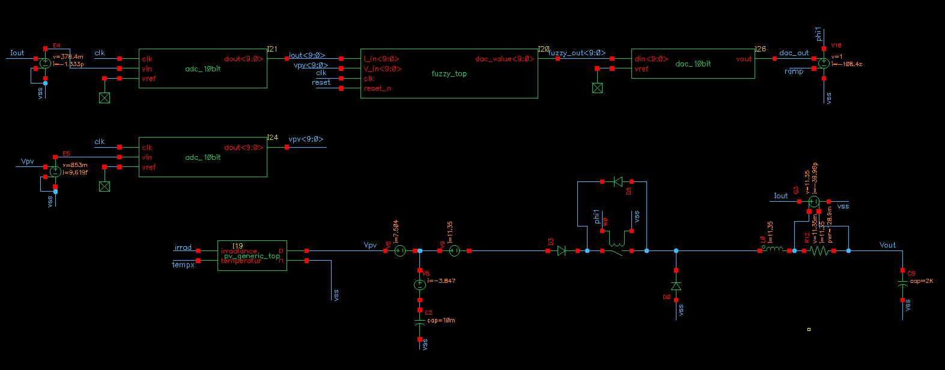

Slide 7
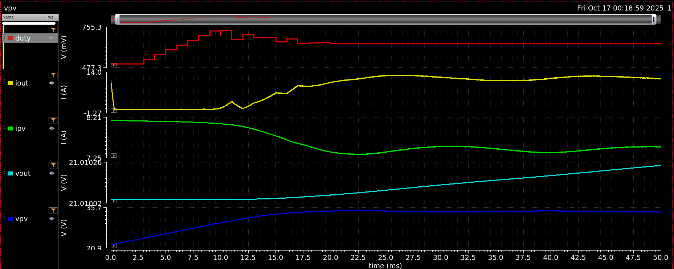
Buck Converter efficiency : ~96.5
PV efficiency: ~99

Slide 8
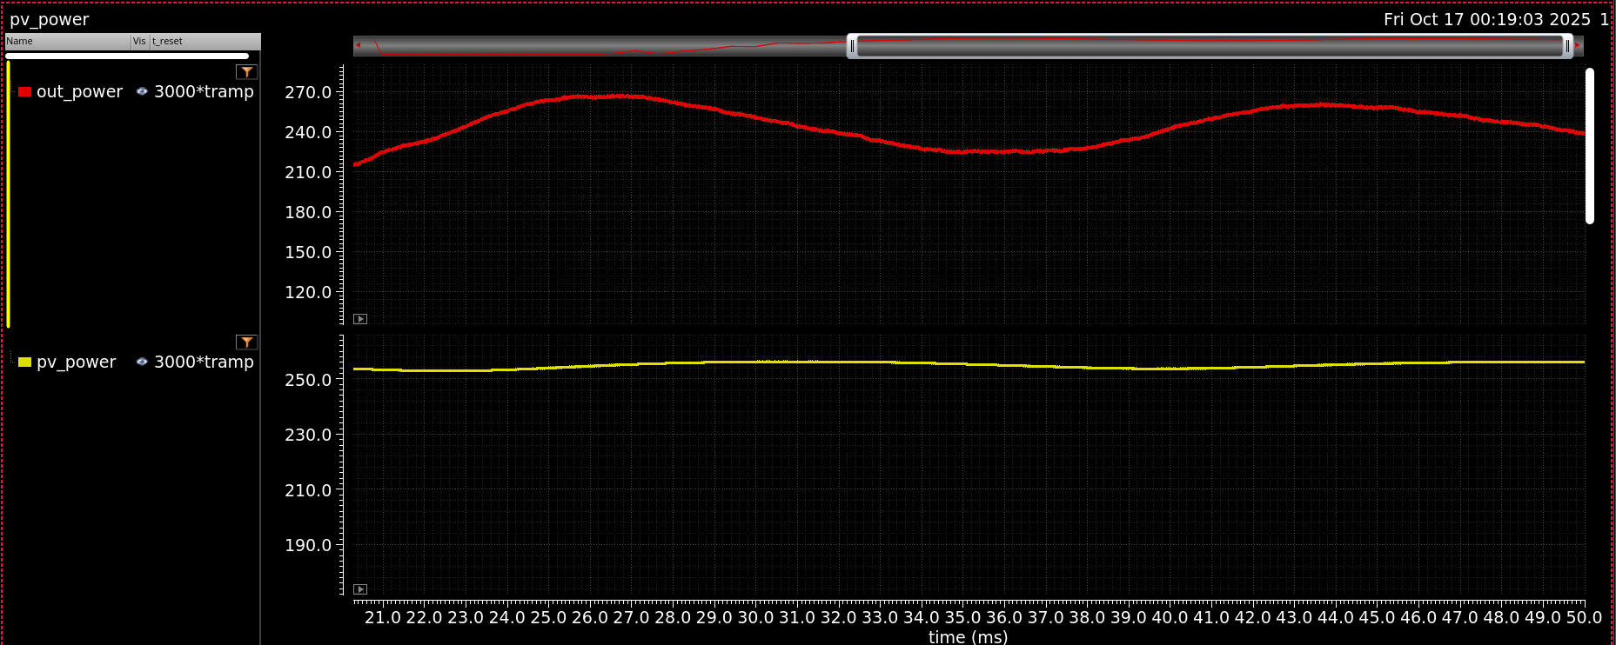

Slide 9
Roadmap
Required Analog Blocks are listed
ADC (10B low rate)
Current Sense Unit
Gate Driver
AUXilary block
New friends can optimize models while I proceed with system verilog and other block's spec creation.
Should we wait PDK ????

