Slide 1
Output Current & Duty Cycle

Slide 2
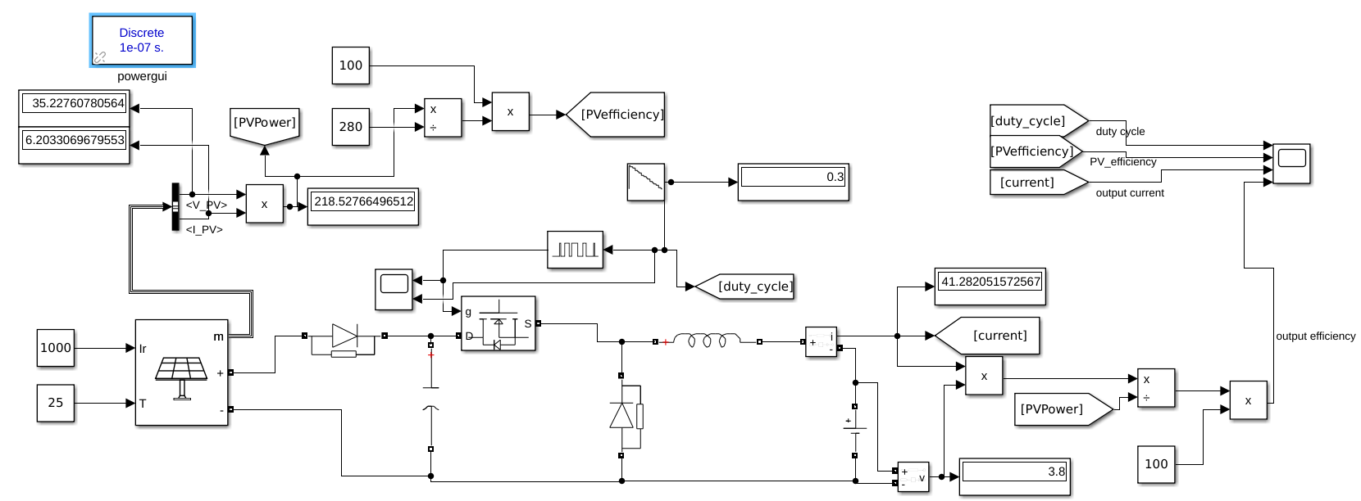
Setup:

Slide 3
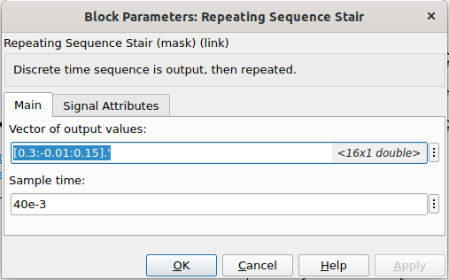
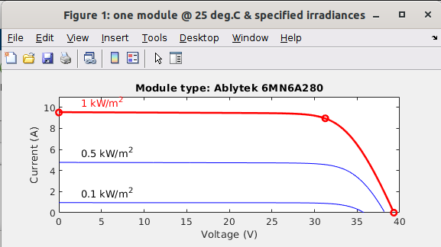
Duty Cycle:
Below 0.15 duty cycle it gives error and displays show NaN outputs.
Above case probably related to model of PV, because output voltage fixed at 3.8 whenever we decrease duty cycle input voltage try to increase but model is defined for some range.

Slide 4
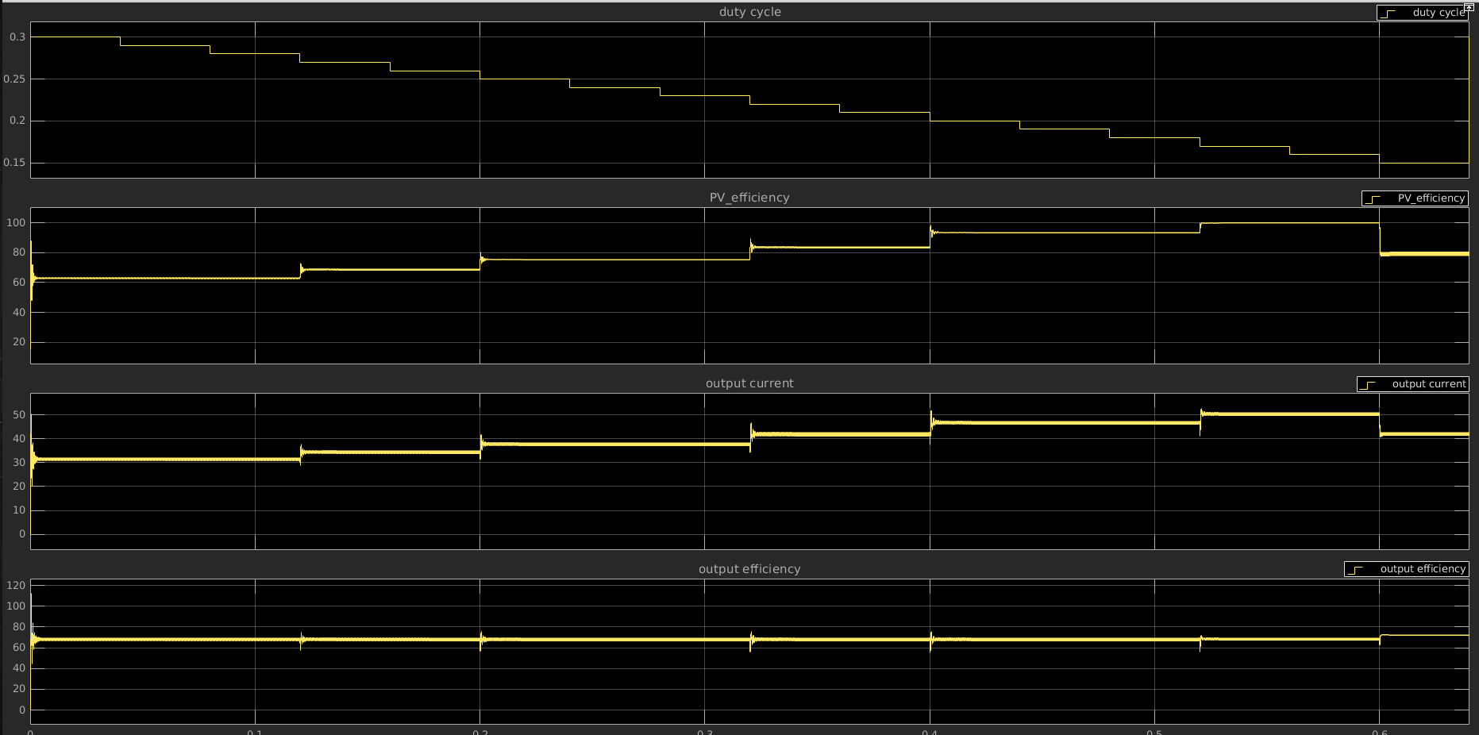
Simulation Output:

