Slide 1
Problems when modelling PV buck converter in verilogA
Issue arises from the problem, simple setup in next slide will summarize the problem.

Slide 2
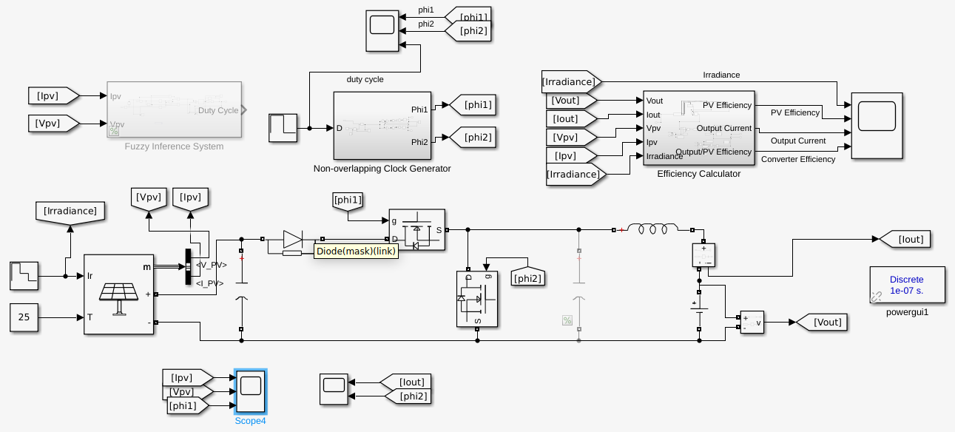
Setup:
100uH
10mF
10V
Component values inserted in red text. Duty cycle is swept between 0.8 to 0.35

Slide 3
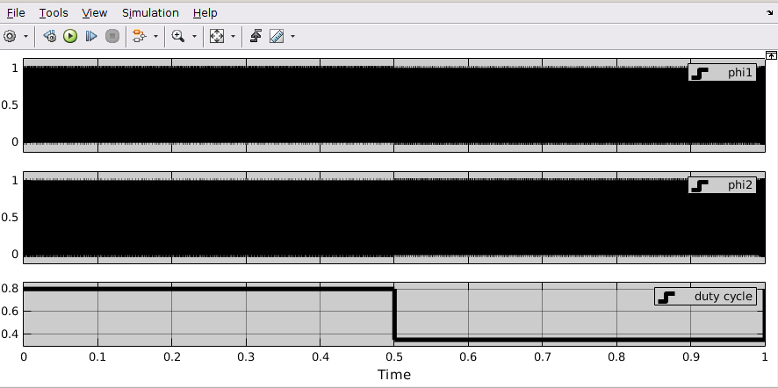
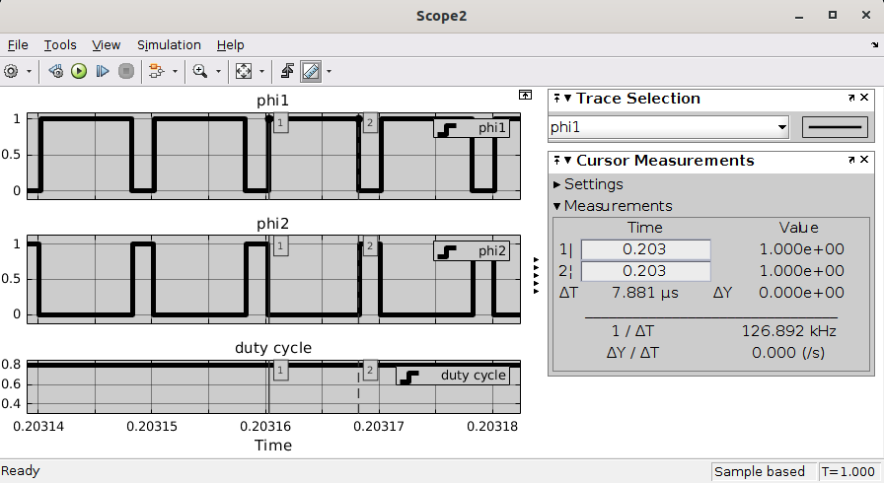
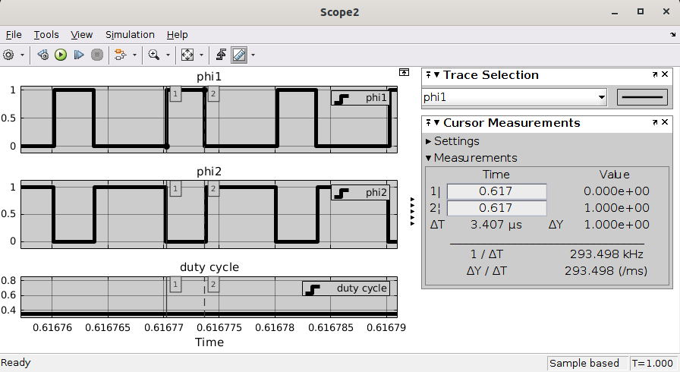
Clocks:
Duty cycle is swept between 0.8 to 0.35
100ns given for nonoverlapping time.

Slide 4
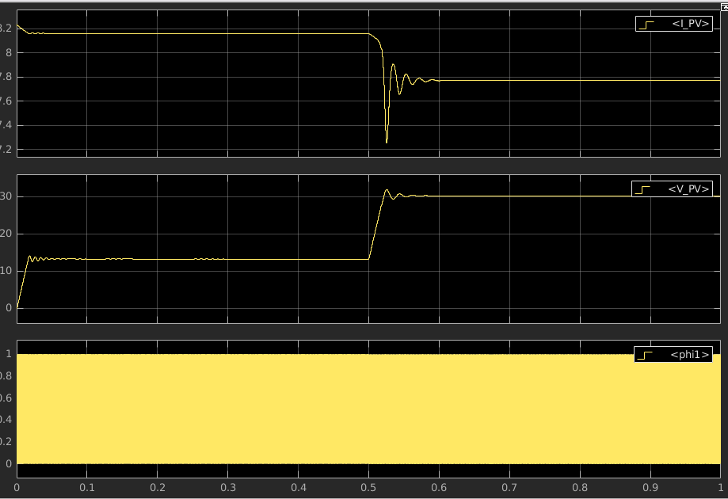
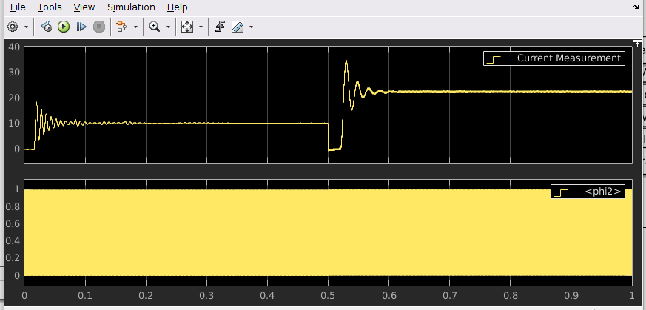
Current Measurement -> Iout
As seen on previous slide at 0.5s duty cycle is changing and settling almost take 100ms.

Slide 5
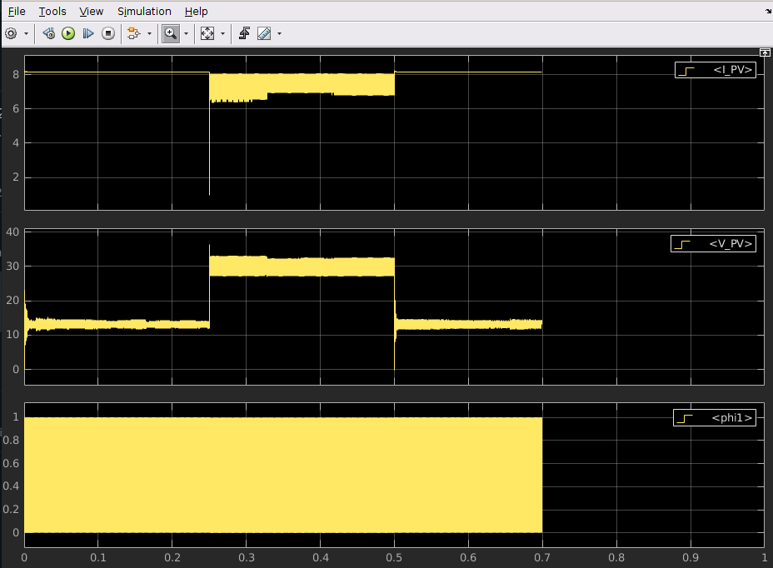
This much settling can be solved by lowering capacitance at input of PV 10uF, load ind as 10uH.
When we change those values its ripples are quite high and affect the determination point.

Slide 6
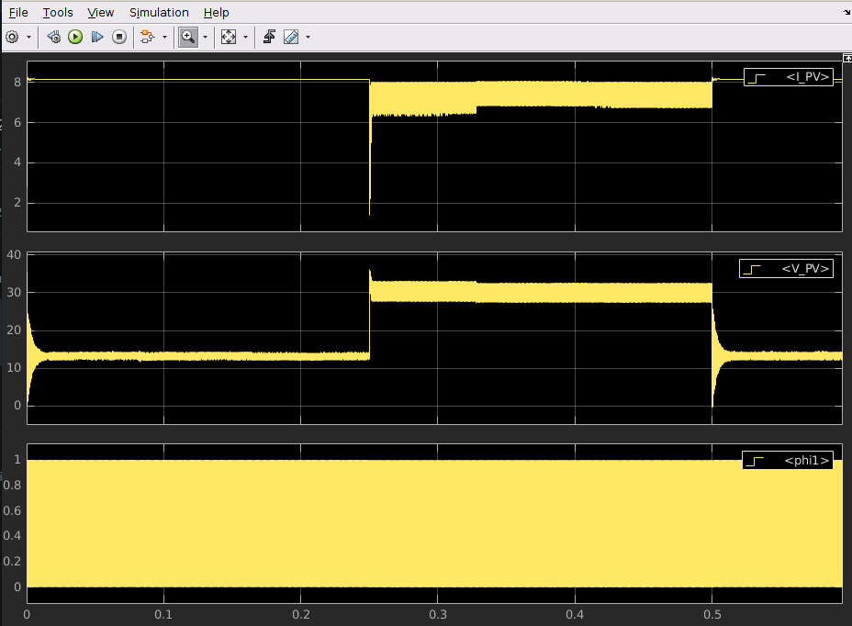
This much settling can be solved by lowering capacitance at input of PV 10uF, load ind as 100uH.

Slide 7
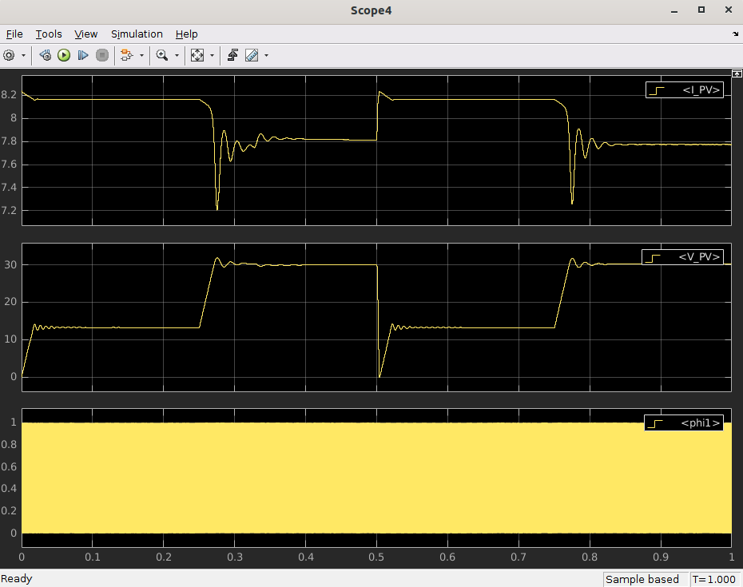
Capacitance at input of PV 10mF, load ind as 100uH.

Slide 8
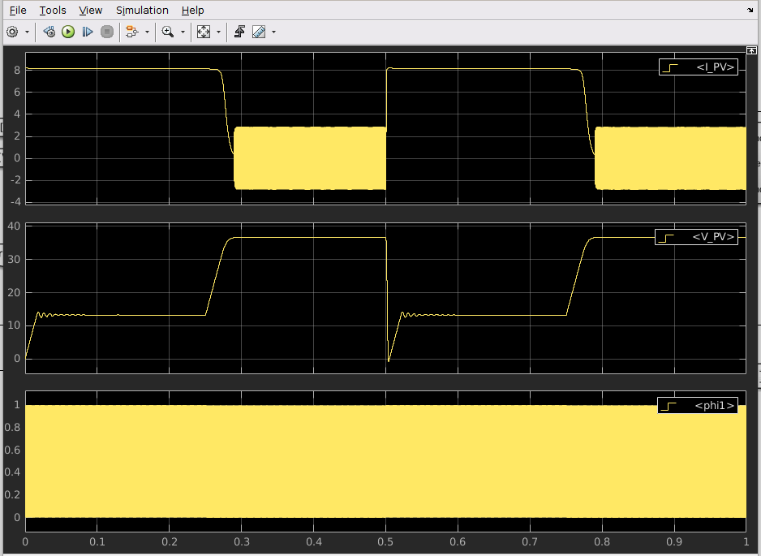
But although capacitance at input of PV 10mF, load ind as 100uH. When sweep duty cycle from 0.8 to 0.15
Here we are again :), Undefined model region cause weird things happening

Slide 9
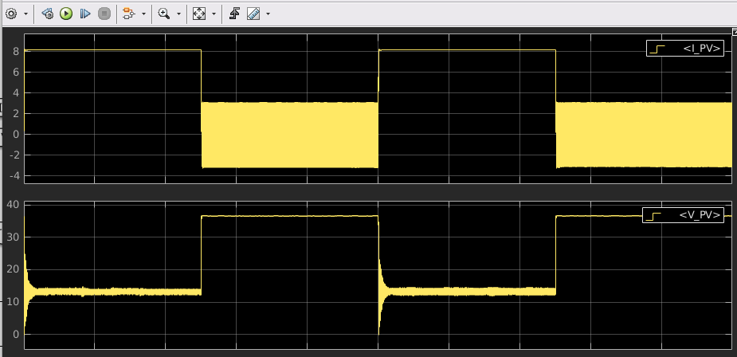
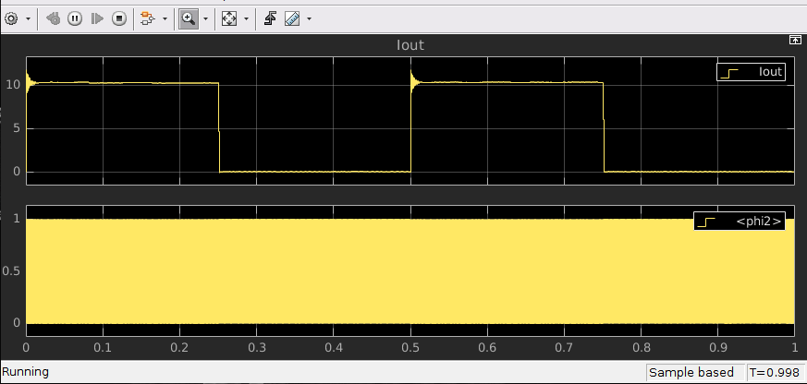
Is it good idea to check output current
I increased load inductance to 1mH, cap is 10uF

Slide 10
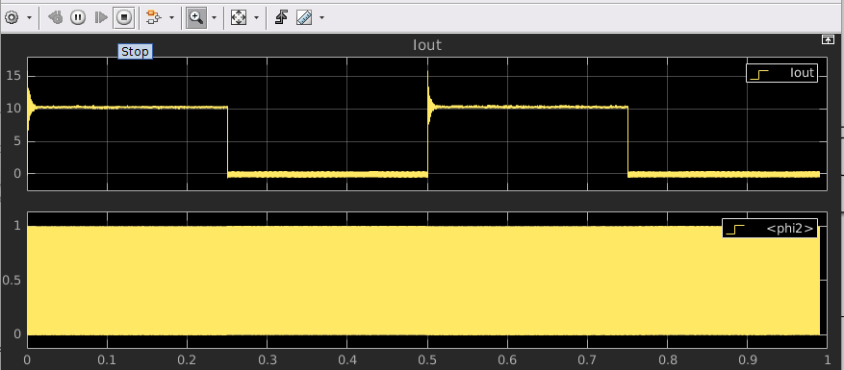
I increased load inductance to 100uH, cap is 10uF

Slide 11
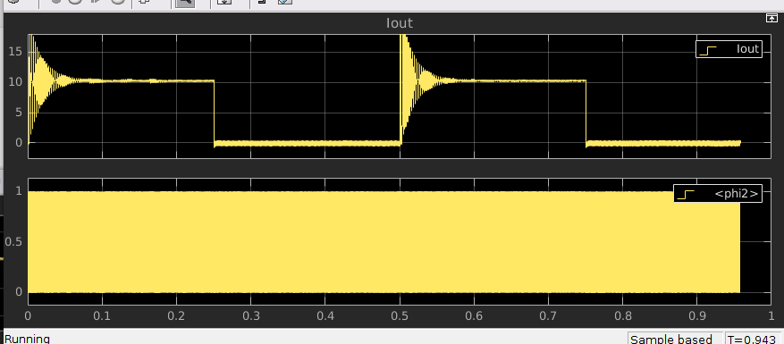
I increased load inductance to 100uH, cap is 1mF

Slide 12
Main question
That much ripple causes wrong states and machine stuck at that points at some points

