Slide 1
Data Structures – Week #5
Trees (Ağaçlar)

Slide 2
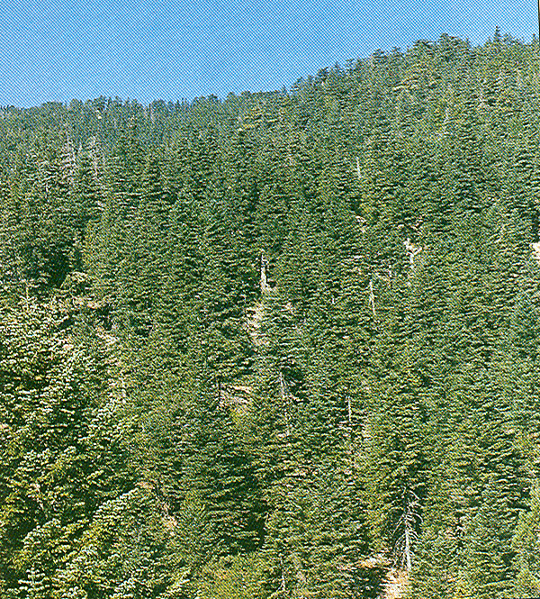
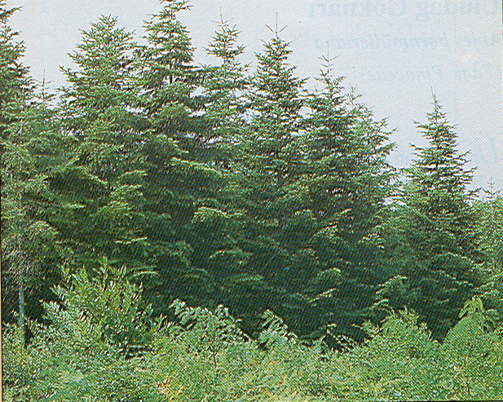
Trees (Ağaçlar)
Toros Göknarı
Avrupa Göknarı

Slide 3
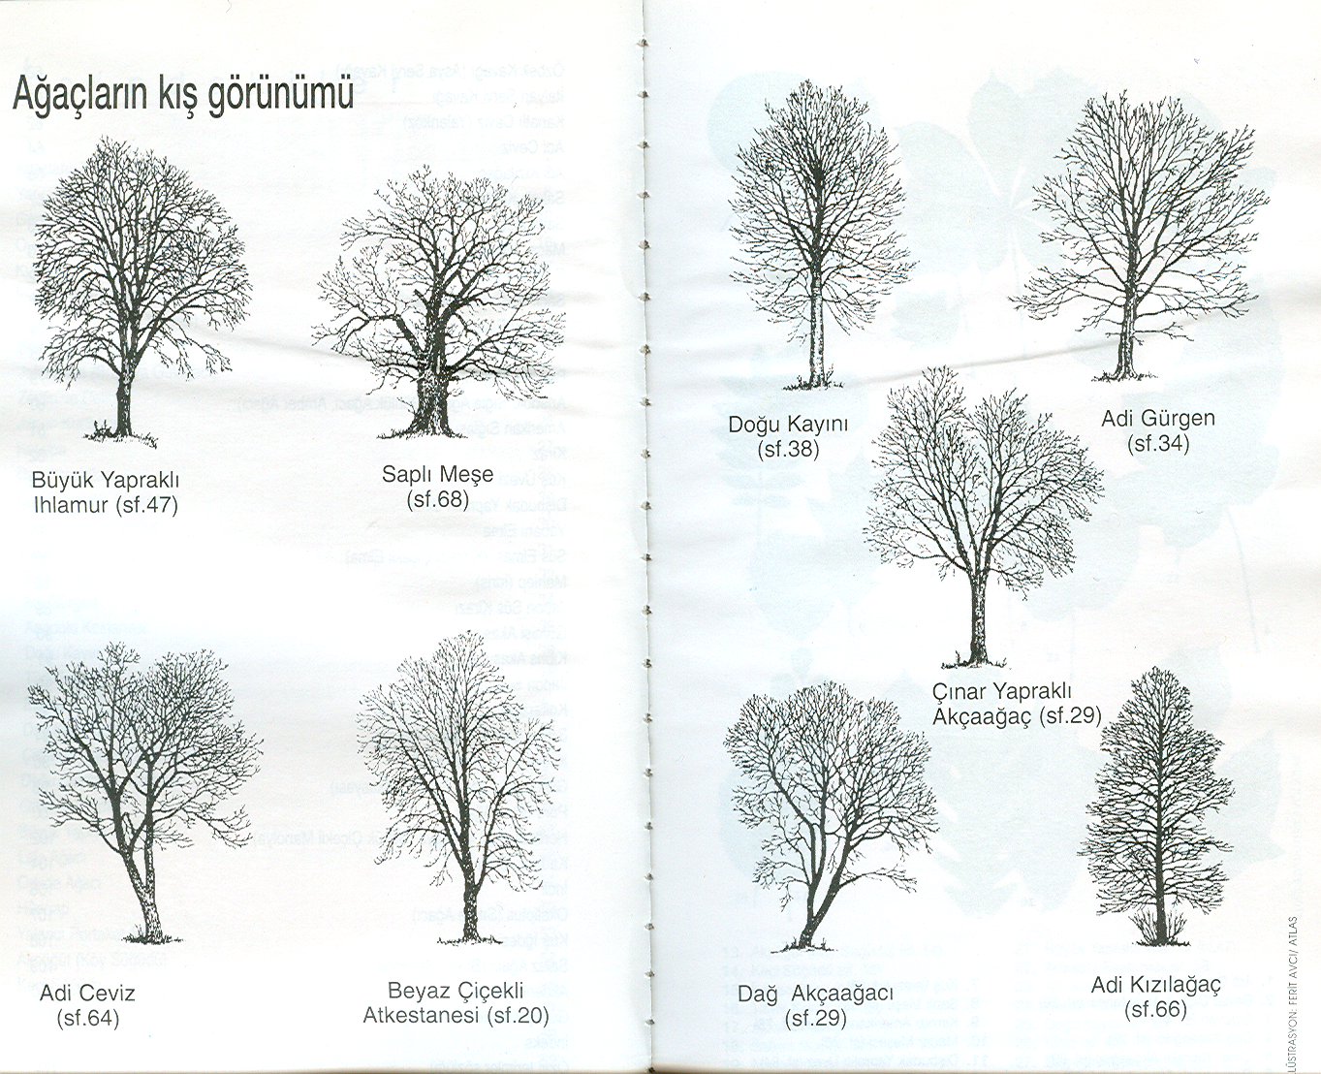
Trees (Ağaçlar)

Slide 4
Outline
Trees
Definitions
Implementation of Trees
Binary Trees
Tree Traversals & Expression Trees
Binary Search Trees

Slide 5
Definition of a Tree
Definition:
A tree is a collection of nodes (vertices) where the collection may be empty. Otherwise, the collection consists of a distinguished node r, called the root, and zero or more non-empty (sub)trees T₁, …, T_{k}, each of whose roots are connected by a directed edge to r.

Slide 6
More definitions
In-degree of a vertex is the number of edges arriving at that vertex.
Out-degree of a vertex is the number of edges leaving that vertex.
Nodes with out-degree=0 (no children) are called the leaves of the tree.
Root is the only node in the tree with in-degree=0.
The child C of a node A is the node that is connected to A by a single edge. Then, A is the parent of C.
Grandparent and grandchild relations can be defined in the same manner.
Nodes with the same parent are called siblings.

Slide 7
More definitions
A path from a node n₁ to n_{k} is defined as a sequence of nodes n₁,…, n_{k} such that n_{i} is the parent of n_{i+1} for 1≤i<k.
The length of this path is the number of edges on the path, i.e., k-1.
There is exactly one path from the root to each node.
The depth of any node n_{i} is the length of the unique path from the root to n_{i}.
The depth of root is 0.
The height of any node n_{i} is the length of the longest path from n_{i} to a leaf.

Slide 8
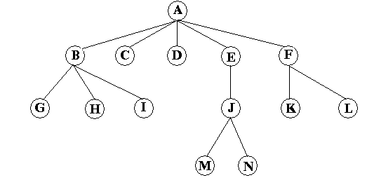




A General Tree Example
Root
A
Children of A
B, C, D, E, F.
Leaves of the tree
C, D, G, H, I, K, L, M, and N.
Siblings of G
H and I.

Slide 9
Remarks
The height of all leaves are 0.
The height of a tree is the height of its root.
The height of the above tree is 3.
The height of C is 0.
If there is a path from n₁ to n₂, then n₁ is an
ancestor of n₂ and n₂ is a descendant of n₁ .

Slide 10
Implementation of Trees
One way to implement a tree would be to have a pointer in each node to each child, besides the data it holds. This is infeasible!
Q:Why?
A:The number of children of each node is variable, and hence, unknown.
Another option would be to keep the children in a linked list where the first node of the list is pointed to by the pointer in the parent node as a header.
A typical tree node declaration in C would be as follows:
struct TNode_type {
int data;
struct TNodetype *childptr, *siblingptr;
}

Slide 11
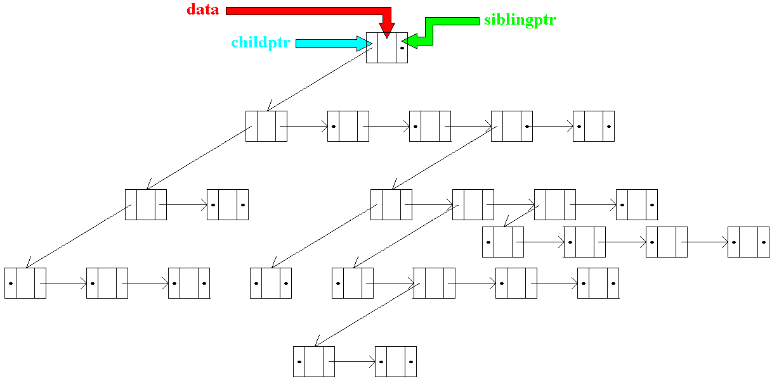
A General Tree Implementation

Slide 12
Binary Trees (BTs)
A binary tree is a tree of nodes with at most two children.
Declaration of a typical node in a binary tree
struct BTNodeType {
infoType *data;
struct BTNodeType *left;
struct BTNodeType *right;
}

Slide 13
A Binary Tree Example

Slide 14
Tree Traversals
A tree can be traversed recursively in three different ways:
in-order traversal (left-node-right or LNR)
First recursively visit the left subtree.
Next process the data in the current node.
Finally, recursively visit the right subtree.
pre-order traversal (node-left-right or NLR)
post-order traversal (left-right-node or LRN)

Slide 15
Recursive In-order (LNR) Traversal
void in-order(BTNodeType *p) {
if (p!=null){
in-order(p->left);
operate(p);
in-order(p->right);
}
}

Slide 16
Recursive Pre-order (NLR) Traversal
void pre-order(BTNodeType *p) {
if (p!=null){
operate(p);
pre-order(p->left);
pre-order(p->right);
}
}

Slide 17
Recursive Post-order (LRN) Traversal
void post-order(BTNodeType *p) {
if (p!=null){
post-order(p->left);
post-order(p->right);
operate(p);
}
}

Slide 18
Expression Trees
Prefix, postfix and infix formats of arithmetic expressions
Infix | Postfix | Prefix
A+B | AB+ | +AB
A/(B+C) | ABC+/ | /A+BC
A/B+C | AB/C+ | +/ABC
A-B*C+D/(E+F) | ABC*-DEF+/+ | +-A*BC/D+EF
A*((B+C)/(D-E)+F)-G/(H-I) | ABC+DE-/F+*GHI-/- | -*A+/+BC-DEF/G-HI

Slide 19
Construction of an Expression Tree from Postfix Expressions
Initialize an empty stack of subtrees
Repeat
Get token;
if token is an operand
Push it as a subtree
else
pop the last two subtrees and form & push a subtree such that root is the current operator and left and right operands are the former and latter subtrees, respectively
Until the end of arithmetic expression

Slide 20
Example to Construction of Expression Trees
Empty Stack of subtrees
ABC+DE-/F+*GHI-/-

Slide 21
Example to Construction of Expression Trees - 1
Stack of subtrees
A
ABC+DE-/F+*GHI-/-

Slide 22
Example to Construction of Expression Trees - 2
Stack of subtrees
A
B
ABC+DE-/F+*GHI-/-

Slide 23
Example to Construction of Expression Trees - 3
Stack of subtrees
A
B
C
ABC+DE-/F+*GHI-/-

Slide 24
Example to Construction of Expression Trees - 4
Stack of subtrees
A
+
B
C
ABC+DE-/F+*GHI-/-

Slide 25
Example to Construction of Expression Trees - 5
Stack of subtrees
A
+
D
B
C
ABC+DE-/F+*GHI-/-

Slide 26
Example to Construction of Expression Trees - 6
Stack of subtrees
A
+
D
E
B
C
ABC+DE-/F+*GHI-/-

Slide 27
Example to Construction of Expression Trees - 7
Stack of subtrees
A
+
-
B
C
D
E
ABC+DE-/F+*GHI-/-

Slide 28
Example to Construction of Expression Trees - 8
Stack of subtrees
/
A
+
-
B
C
D
E
ABC+DE-/F+*GHI-/-

Slide 29
Example to Construction of Expression Trees - 9
Stack of subtrees
/
A
F
+
-
B
C
D
E
ABC+DE-/F+*GHI-/-

Slide 30
Example to Construction of Expression Trees - 10
Stack of subtrees
+
A
/
F
+
-
B
C
D
E
ABC+DE-/F+*GHI-/-

Slide 31
Example to Construction of Expression Trees - 11
Stack of subtrees
*
A
+
/
F
+
-
ABC+DE-/F+*GHI-/-
B
C
D
E

Slide 32
Example to Construction of Expression Trees - 12
Stack of subtrees
G
*
A
+
/
F
+
-
ABC+DE-/F+*GHI-/-
B
C
D
E

Slide 33
Example to Construction of Expression Trees - 13
Stack of subtrees
G
H
*
A
+
/
F
+
-
ABC+DE-/F+*GHI-/-
B
C
D
E

Slide 34
Example to Construction of Expression Trees - 14
Stack of subtrees
G
H
I
*
A
+
/
F
+
-
ABC+DE-/F+*GHI-/-
B
C
D
E

Slide 35
Example to Construction of Expression Trees - 15
Stack of subtrees
G
*
-
A
+
/
F
H
I
+
-
ABC+DE-/F+*GHI-/-
B
C
D
E

Slide 36
Example to Construction of Expression Trees - 16
Stack of subtrees
*
/
A
+
G
-
/
F
+
-
H
I
ABC+DE-/F+*GHI-/-
B
C
D
E

Slide 37
Example to Construction of Expression Trees - 17
Stack of subtrees
-
*
/
A
+
G
-
/
F
+
-
H
I
ABC+DE-/F+*GHI-/-
B
C
D
E

Slide 38
Binary Search Trees (BSTs)
BSTs are binary trees with keys placed in each
node in such a manner that
the key of a node is
greater than all keys in its left sub-tree
and
less than all keys in its right sub-tree.
Here, we assume no replication of keys. For replicating keys,
the relations are modified as “greater than or equal to” or “less
than or equal to” depending on the application.

Slide 39
A Binary Search Tree Example
48
16
24
20
32
8
12
54
72
18
96
64
17
60
98
68
84
36
30
48

Slide 40
A Binary Search Tree Example
48
16
24
20
32
8
12
54
72
18
96
64
17
60
98
68
84
36
30
48
16

Slide 41
A Binary Search Tree Example
48
16
24
20
32
8
12
54
72
18
96
64
17
60
98
68
84
36
30
48
16
24

Slide 42
A Binary Search Tree Example
48
16
24
20
32
8
12
54
72
18
96
64
17
60
98
68
84
36
30
48
16
24
20

Slide 43
A Binary Search Tree Example
48
16
24
20
32
8
12
54
72
18
96
64
17
60
98
68
84
36
30
48
16
24
20
32

Slide 44
A Binary Search Tree Example
48
16
24
20
32
8
12
54
72
18
96
64
17
60
98
68
84
36
30
48
16
8
24
20
32

Slide 45
A Binary Search Tree Example
48
16
24
20
32
8
12
54
72
18
96
64
17
60
98
68
84
36
30
48
16
8
24
12
20
32

Slide 46
A Binary Search Tree Example
48
16
24
20
32
8
12
54
72
18
96
64
17
60
98
68
84
36
30
48
16
54
8
24
12
20
32

Slide 47
A Binary Search Tree Example
48
16
24
20
32
8
12
54
72
18
96
64
17
60
98
68
84
36
30
48
16
54
8
24
72
12
20
32

Slide 48
A Binary Search Tree Example
48
16
24
20
32
8
12
54
72
18
96
64
17
60
98
68
84
36
30
48
16
54
8
24
72
12
20
32
18

Slide 49
A Binary Search Tree Example
48
16
24
20
32
8
12
54
72
18
96
64
17
60
98
68
84
36
30
48
16
54
8
24
72
12
20
32
96
18

Slide 50
A Binary Search Tree Example
48
16
24
20
32
8
12
54
72
18
96
64
17
60
98
68
84
36
30
48
16
54
8
24
72
12
20
32
64
96
18

Slide 51
A Binary Search Tree Example
48
16
24
20
32
8
12
54
72
18
96
64
17
60
98
68
84
36
30
48
16
54
8
24
72
12
20
32
64
96
18
17

Slide 52
A Binary Search Tree Example
48
16
24
20
32
8
12
54
72
18
96
64
17
60
98
68
84
36
30
48
16
54
8
24
72
12
20
32
64
96
18
60
17

Slide 53
A Binary Search Tree Example
48
16
24
20
32
8
12
54
72
18
96
64
17
60
98
68
84
36
30
48
16
54
8
24
72
12
20
32
64
96
18
60
98
17

Slide 54
A Binary Search Tree Example
48
16
24
20
32
8
12
54
72
18
96
64
17
60
98
68
84
36
30
48
16
54
8
24
72
12
20
32
64
96
18
60
68
98
17

Slide 55
A Binary Search Tree Example
48
16
24
20
32
8
12
54
72
18
96
64
17
60
98
68
84
36
30
48
16
54
8
24
72
12
20
32
64
96
18
60
68
84
98
17

Slide 56
A Binary Search Tree Example
48
16
24
20
32
8
12
54
72
18
96
64
17
60
98
68
84
36
30
48
16
54
8
24
72
12
20
32
64
96
18
36
60
68
84
98
17

Slide 57
A Binary Search Tree Example
48
16
24
20
32
8
12
54
72
18
96
64
17
60
98
68
84
36
30
48
16
54
8
24
72
12
20
32
64
96
18
30
36
60
68
84
98
17

Slide 58
Recursive Find Function in BSTs
int find (BTNodeType *p, int key)
{ // we assume infotype in BTNodeType is int
if (p != NULL)
if (key < p->data) find(p->left, key);
else if (key > p->data) find(p->right, key);
else if (p->data == key) printf (p->data);
}

Slide 59
Analysis of Find - 1
We would like to calculate the search time, t(n), it takes to find a given key in a BST with n nodes (or to find it is not in the BST!). First let us answer the following question:
Question: What is the unit operation performed to accomplish the search?
Answer: The comparison of the key searched with the key stored in the tree node (i.e., if (key < p->data) or if (key > p->data) or if (key == p->data) ). At least one, at most three comparisons are made. key < p->data is always checked once. Hence we may assign 1 time unit to this condition.
Hence, what we need to do to find t(n) is to count, as a function of n, how many times the comparison (i.e. condition 1) is executed.

Slide 60
Analysis of Find - 2
Now, we have converted the problem into one as in the following:
what is the average number of comparisons (i.e., condition checks) performed to find a given key in a BST?
or
how many nodes, on average, are visited to find a given key or to find it is not in the BST?
or, in a higher level of detail,
what is the average depth of the node that stores the key we are looking for or, in case the key is not in the BST, what is the average depth of the leaf at the end of the path our search follows through?

Slide 61
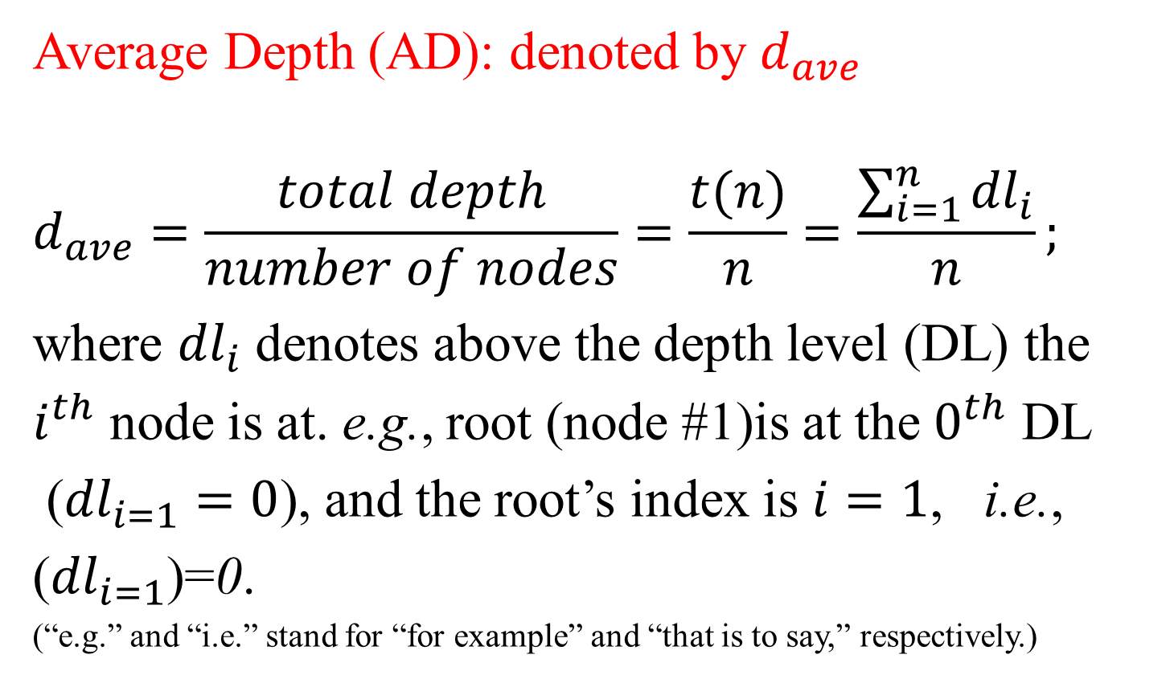
Analysis of Find – 2: Average Depth
Average Depth (AD): denoted by $d_{ave}$
$$d_{ave}=\frac{total depth}{number of nodes}=\frac{t(n)}{n}=\frac{\sum_{i=1}^{n}{{dl}_{i}}}{n};$$
where ${dl}_{i}$ denotes above the depth level (DL) the
$i^{th}$ node is at. e.g., root (node #1)is at the $0^{th}$ DL
(${dl}_{i=1}=0$), and the root’s index is $i=1$, i.e.,
(${dl}_{i=1}$)=0.
(“e.g.” and “i.e.” stand for “for example” and “that is to say,” respectively.)

Slide 62
Analysis of Find – 2: Average Depth
(!!!) Attention (!!!)
A BST or, in general, an ordered tree with k DLs has DL indices between 0 and k-1.

Slide 63
Analysis of Find – 2: Internal Path Length
Internal path length (IPL) or total depth (TD): Another concept closely related to total # of comparisons.
Definition:
IPL is the sum of the length of all paths that connect the nodes of a tree.
TD is the sum of depths of all nodes in the binary tree topology.

Slide 64




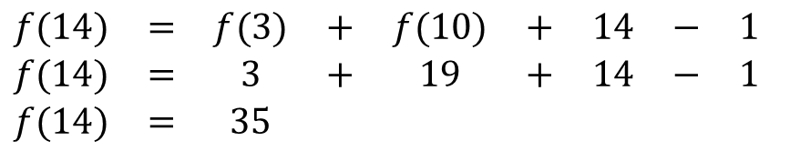



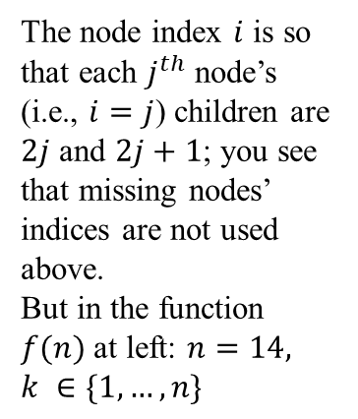



IPL f(n), AD t(n) and their relation: A 14-node BST example
$1$node 1comparison;
Depth Level # 0 or DL #0
$2$ nodes 2 comp.’s each;
DL #1; $i=2,3$
$3$ nodes 3 comp.’s each;
DL #2; $i=4,$6,7
f(k)
$5$ nodes 4 comp.’s each;
DL #3; $i=9$,12,…,15
$3$ nodes 5 comp.’s each;
DL #4; $i=$24,30,31
+________________
The node index $i$ is so that each $j^{th}$ node’s (i.e., $i=j$) children are $2j$ and $2j+1$; you see that missing nodes’ indices are not used above.
But in the function $f(n)$ at left: $n=14,$ $k ∈\{1,…,n\}$
$$t\left(n\right)=1∗1+2∗2+3∗3+$$
$$5∗4+3∗5=49$$
f(n-k-1)
f(n)
$$\begin{matrix}f(14) & = & f(3) & + & f(10) & + & 14 & − & 1 \\ f(14) & = & 3 & + & 19 & + & 14 & − & 1 \\ f(14) & = & 35 & & & & & & \end{matrix}$$
$$f\left(n\right)=f\left(k\right)+f\left(n−k−1\right)+n−1$$
Relation among IPL (i.e., total depth) and # of comparisons : $t(n)=f(n)+n$ $t(n)=f(n)+n\begin{matrix}\end{matrix}⇒\begin{matrix}\end{matrix}t(n)=35+14=49$

Slide 65
Analysis of Find - 3
Now, we turn back to formulating t(n):
We will do the formulation for three cases:
Average case
Worst case
Best case

Slide 66
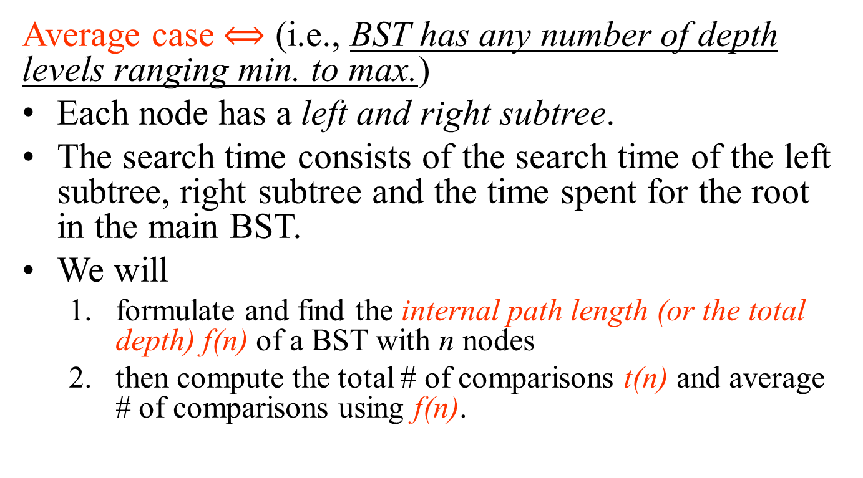
Analysis of Find: Average Case - 1
Average case $⟺$ (i.e., BST has any number of depth levels ranging min. to max.)
Each node has a left and right subtree.
The search time consists of the search time of the left subtree, right subtree and the time spent for the root in the main BST.
We will
formulate and find the internal path length (or the total depth) f(n) of a BST with n nodes
then compute the total # of comparisons t(n) and average # of comparisons using f(n).

Slide 67
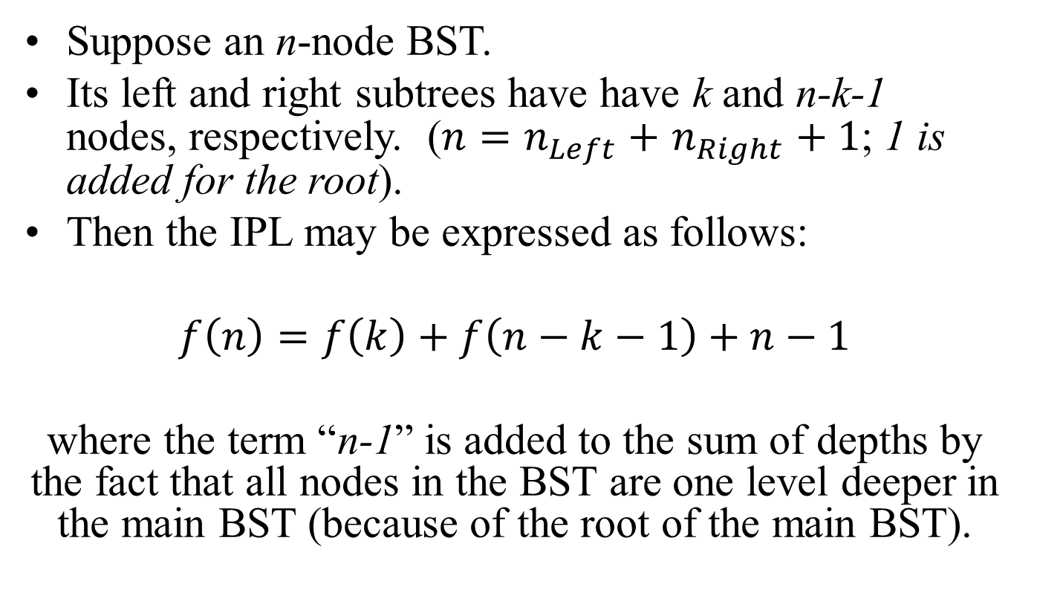
Average Case – Formulating IPL
Suppose an n-node BST.
Its left and right subtrees have have k and n-k-1 nodes, respectively. ($n=n_{Left}+$ $n_{Right}+1$; 1 is added for the root).
Then the IPL may be expressed as follows:
$f\left(n\right)=f\left(k\right)+f\left(n−k−1\right)+n−1$
where the term “n-1” is added to the sum of depths by the fact that all nodes in the BST are one level deeper in the main BST (because of the root of the main BST).

Slide 68
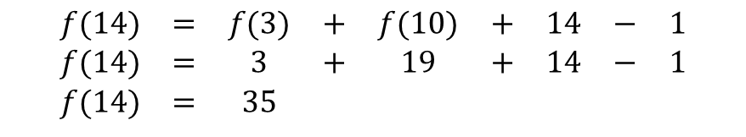
Average Case: Example tree with f(14)
f(k)
f(n-k-1)
f(n)
IPL=Total Depth:
$$\begin{matrix}f(14) & = & f(3) & + & f(10) & + & 14 & − & 1 \\ f(14) & = & 3 & + & 19 & + & 14 & − & 1 \\ f(14) & = & 35 & & & & & & \end{matrix}$$
Total # of comparisons:
$$t(n)=f(n)+n\begin{matrix}\end{matrix}⇒\begin{matrix}\end{matrix}t(n)=35+14=49$$

Slide 69
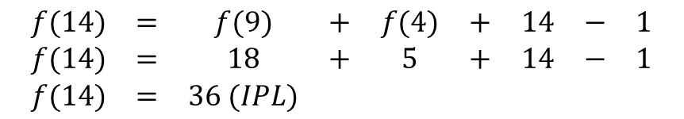
Average Case: Another Example
f(n-k-1)
f(k)
f(n)
IPL =Total Depth:
$$\begin{matrix}f(14) & = & f(9) & + & f(4) & + & 14 & − & 1 \\ f(14) & = & 18 & + & 5 & + & 14 & − & 1 \\ f(14) & = & 36 (IPL) & & & & & & \end{matrix}$$
Total # of comparisons :
$$t(n)=f(n)+n\begin{matrix}\end{matrix}⇒\begin{matrix}\end{matrix}t(n)=36+14=50$$

Slide 70
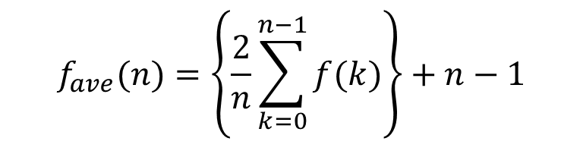
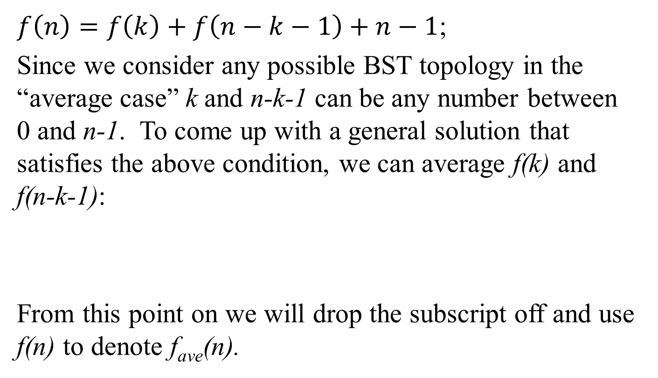
Average Case - 2
$f\left(n\right)=f\left(k\right)+f\left(n−k−1\right)+n−1$;
Since we consider any possible BST topology in the “average case” k and n-k-1 can be any number between 0 and n-1. To come up with a general solution that satisfies the above condition, we can average f(k) and f(n-k-1):
From this point on we will drop the subscript off and use f(n) to denote f_{ave}(n).
$$f_{ave}(n)=\left\{\frac{2}{n}\sum_{k=0}^{n−1}{f(k)}\right\}+n−1$$

Slide 71
Average Case - 3

Slide 72
Average Case - 4

Slide 73
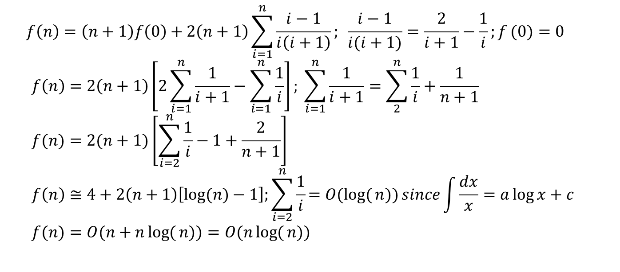
Average Case - 5
$$f\left(n\right)=\left(n+1\right)f\left(0\right)+2\left(n+1\right)\sum_{i=1}^{n}{\frac{i−1}{i\left(i+1\right)}};\begin{matrix}\end{matrix}\frac{i−1}{i(i+1)}=\frac{2}{i+1}−\frac{1}{i};{f}(0)=0 \\ f\left(n\right)=2\left(n+1\right)\left[2\sum_{i=1}^{n}{\frac{1}{i+1}−\sum_{i=1}^{n}{\frac{1}{i}}}\right]; \sum_{i=1}^{n}{\frac{1}{i+1}=\sum_{2}^{n}{\frac{1}{i}+\frac{1}{n+1}}} \\ f(n)=2(n+1)\left[\sum_{i=2}^{n}{\frac{1}{i}−1+\frac{2}{n+1}}\right] \\ f\left(n\right)≅4+2\left(n+1\right)\left[log⁡(n)−1\right];\sum_{i=2}^{n}{\frac{1}{i}=O(log{(}n))}since\int{\frac{dx}{x}}=a\log{x}+c \\ f(n)=O(n+n\log{(}n))=O(n\log{(}n))$$
To find the average (per node) number of comparisons, N_{ave}, we divide f(n) by the number
of nodes n: N_{ave}= f(n)/n⇒O(log n)

Slide 74
Analysis of Find: Worst Case - 1
Worst Case BST: (i.e., BST has a maximum number of depth levels)
The worst case BST is one with the deepest path. An n-node such BST is one with n depth levels.
Question: How many such n-node BSTs are there?
We will formulate and find the internal path length f(n) in a worst case n-node BST.
In such a BST one subtree of the root forms a linked list of n-1 nodes whereas the other subtree has no nodes. Then the depth may be expressed as follows:
f(n)=f(n-1)+n-1.

Slide 75
Worst Case - 2
Order of f(n): f(n)=O(n²)

Slide 76
Analysis of Find: Best Case - 1
Best Case BST: (i.e., BST has a minimum number of depth levels)
The best case BST is one with the least tree depth. An n-node such BST is one with depth levels.
Question: How many such n-node BSTs are there?
We will formulate and find the internal path length f(n) in a best case n-node BST.
In such a BST both subtrees of the root have the same number of nodes (i.e., n/2 nodes). Then the depth may be expressed as follows:
f(n)=2f(n/2)+n-1. (conditional recurrence!!!)

Slide 77
Best Case - 2
Order of f(n): f(n)=O(nlgn)

Slide 78
Non-recursive FindMin Function in BSTs
BTNodeType *findMin (BTNodeType *p)
{// returns a pointer to node with the minimum key in the BST.
// which one is the minimum key in a BST?
if (p != NULL)
while (p->left != NULL) p=p->left;
return p;
}

Slide 79
Recursive FindMax Function in BSTs
BTNodeType *findMax (BTNodeType *p)
{// returns a pointer to node with the maximum key in the BST
// which one is the maximum key in a BST?
if (p == NULL) return NULL;
if (p->right == NULL) return p;
return findMax(p->right);
}

Slide 80
Recursive Insert Function in BSTs
BTNodeType *insert (infotype * key, BTNodeType *p)
{// returns a pointer to new node with key inserted in the BST.
if (p == NULL) { //empty tree
p=malloc(sizeof(BTNodeType));
if (p == NULL) return OutofMemoryError; //no heap space left!!!
p->data=key;
p->left=p->right=NULL;
return p;
}
else if (key < p->data) //tree exists, key < root
p->left=insert(key,p->left);
else if (key > p->data) //tree exists, key > root
p->right=insert(key,p->right);
return p; //key found
}

Slide 81
Recursive Remove Function in BSTs
BTNodeType *Remove (infotype *key, BTNodeType *p)
{// returns a pointer to node replacing the node removed.
BTNodeType *TempPtr;
if (p == NULL) //empty tree
return errorMessage(“empty tree”);
if (key < p->data)
p->left=Remove(key,p->left);
else if (key > p->data)
p->right=Remove(key,p->right);
else //node with key found!!!
if (p->right && p->left) { //if node has two children
TmpPtr=findMin(p->right); //find smallest key of right subtree of node with key
p->data=TmpPtr->data; //replace removed data by smallest key of right subtree
p->right=Remove(p->data,p->right);
}
else { //if node has less than two children
TmpPtr=p;
if (p->left == NULL) p=p->right;
else if (p->right == NULL) p=p->left;
free(TmpPtr);
}
return p;
}

Slide 82
Removing a key at a node with a single child
An Example…

Slide 83
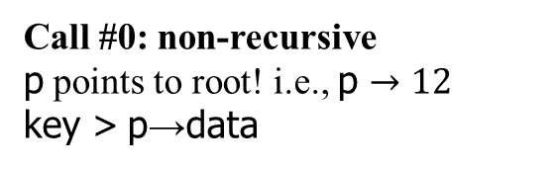
Removing a key of node with a single child
Remove 16 !!!
← p
12
BTNodeType *Remove (infotype *key, BTNodeType *p)
{// returns a pointer to node replacing the node removed.
BTNodeType *TempPtr;
if (p == NULL) return errorMessage(“empty tree”);
if (key < p->data)
p->left=Remove(key,p->left);
else if (key > p->data)
p->right=Remove(key,p->right);
else
if (p->right && p->left) {
TmpPtr=findMin(p->right);
p->data=TmpPtr->data;
p->right=Remove(p->data,p->right);
}
else {
TmpPtr=p;
if (p->left == NULL) p=p->right;
else if (p->right == NULL) p=p->left;
free(TmpPtr);
}
return p;
8
24
4
10
16
48
18
32
60
Call #0: non-recursive
p points to root! i.e., p $→12$
key > p→data
Red background: condition false
Green backgrnd: condition true

Slide 84
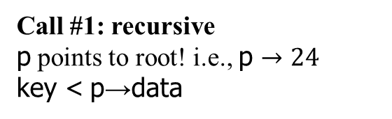
Removing a key of node with a single child
Remove 16 !!!
12
BTNodeType *Remove (infotype *key, BTNodeType *p)
{// returns a pointer to node replacing the node removed.
BTNodeType *TempPtr;
if (p == NULL) return errorMessage(“empty tree”);
if (key < p->data)
p->left=Remove(key,p->left);
else if (key > p->data)
p->right=Remove(key,p->right); Call #1 point !!!
else
if (p->right && p->left) {
TmpPtr=findMin(p->right);
p->data=TmpPtr->data;
p->right=Remove(p->data,p->right);
}
else {
TmpPtr=p;
if (p->left == NULL) p=p->right;
else if (p->right == NULL) p=p->left;
free(TmpPtr);
}
return p;
← p
8
24
4
10
16
48
18
32
60
Call #1: recursive
p points to root! i.e., p $→24$
key < p→data
Red background: condition false
Green backgrnd: condition true

Slide 85
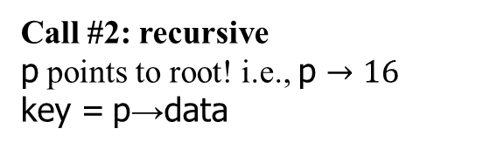
Removing a key of node with a single child
Remove 16 !!!
12
BTNodeType *Remove (infotype *key, BTNodeType *p)
{// returns a pointer to node replacing the node removed.
BTNodeType *TempPtr;
if (p == NULL) return errorMessage(“empty tree”);
if (key < p->data)
p->left=Remove(key,p->left); Call #2 point !!!
else if (key > p->data)
p->right=Remove(key,p->right);
else //key = p→data
if (p->right && p->left) { //double child node
TmpPtr=findMin(p->right);
p->data=TmpPtr->data;
p->right=Remove(p->data,p->right);
}
else { //single child node
TmpPtr=p;
if (p->left == NULL) p=p->right;
else if (p->right == NULL) p=p->left;
free(TmpPtr);
}
return p; //p → 18 returned
p ↓
8
24
4
10
16
p ↓
48
TmpPtr →
18
32
60
Call #2: recursive
p points to root! i.e., p $→16$
key = p→data
Red background: condition false
Green backgrnd: condition true

Slide 86
Removing a key of node with a single child
Remove 16 !!!
12
BTNodeType *Remove (infotype *key, BTNodeType *p)
{// returns a pointer to node replacing the node removed.
BTNodeType *TempPtr;
if (p == NULL) return errorMessage(“empty tree”);
if (key < p->data)
p->left=Remove(key,p->left; Call #2 point !!!
else if (key > p->data)
p->right=Remove(key,p->right);
else
if (p->right && p->left) {
TmpPtr=findMin(p->right);
p->data=TmpPtr->data;
p->right=Remove(p->data,p->right);
}
else { //single child node
TmpPtr=p;
if (p->left == NULL) p=p->right;
else if (p->right == NULL) p=p->left;
free(TmpPtr);
}
return p;
8
p →
24
4
10
18
48
32
60
Return from Call #2 back to Call #1 at the point of Call #2
Address of 18 returned to p→left with p pointing to 24.

Slide 87
Removing a key of node with a single child
Remove 16 !!!
← p
12
BTNodeType *Remove (infotype *key, BTNodeType *p)
{// returns a pointer to node replacing the node removed.
BTNodeType *TempPtr;
if (p == NULL) return errorMessage(“empty tree”);
if (key < p->data)
p->left=Remove(key,p->left);
else if (key > p->data)
p->right=Remove(key,p->right); Call #1 point !!!
else
if (p->right && p->left) {
TmpPtr=findMin(p->right);
p->data=TmpPtr->data;
p->right=Remove(p->data,p->right);
}
else {
TmpPtr=p;
if (p->left == NULL) p=p->right;
else if (p->right == NULL) p=p->left;
free(TmpPtr);
}
return p;
8
24
4
10
18
48
32
60
Return from Call #1 back to Call #0 at the point of Call #1
Address of 24 returned to p→right with p pointing to 12.

Slide 88
Removing a key at node with a single child
Remove 16 !!!
← p
12
BTNodeType *Remove (infotype *key, BTNodeType *p)
{// returns a pointer to node replacing the node removed.
BTNodeType *TempPtr;
if (p == NULL) return errorMessage(“empty tree”);
if (key < p->data)
p->left=Remove(key,p->left);
else if (key > p->data)
p->right=Remove(key,p->right);
else
if (p->right && p->left) {
TmpPtr=findMin(p->right);
p->data=TmpPtr->data;
p->right=Remove(p->data,p->right);
}
else {
TmpPtr=p;
if (p->left == NULL) p=p->right;
else if (p->right == NULL) p=p->left;
free(TmpPtr);
}
return p;
8
24
4
10
18
48
32
60
Return from Call #0
Address of 12 (i.e., modified BST) returned to the invoker function with 16 removed.

Slide 89
Removing a key at a node with two children
An Example…

Slide 90
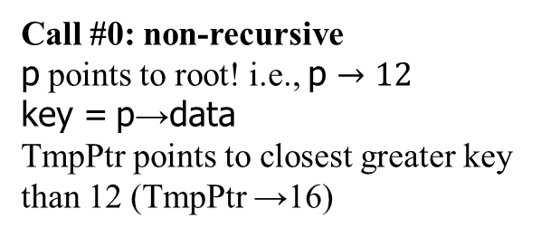
Removing a key at a node with two children
Remove 12 !!!
← p
12
BTNodeType *Remove (infotype *key, BTNodeType *p)
{// returns a pointer to node replacing the node removed.
BTNodeType *TempPtr;
if (p == NULL) return errorMessage(“empty tree”);
if (key < p->data)
p->left=Remove(key,p->left);
else if (key > p->data)
p->right=Remove(key,p->right);
else //key = p→data
if (p->right && p->left) { //double child node
TmpPtr=findMin(p->right);
p->data=TmpPtr->data;
p->right=Remove(p->data,p->right);
}
else {
TmpPtr=p;
if (p->left == NULL) p=p->right;
else if (p->right == NULL) p=p->left;
free(TmpPtr);
}
return p;
16
8
24
4
10
16
48
TmpPtr →
18
32
60
Call #0: non-recursive
p points to root! i.e., p $→12$
key = p→data
TmpPtr points to closest greater key than 12 (TmpPtr →16)
Red background: condition false
Green backgrnd: condition true

Slide 91
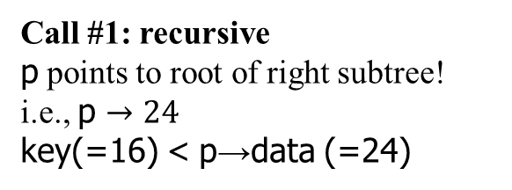
Removing a key at node with two children
Remove 12 !!!
16
BTNodeType *Remove (infotype *key, BTNodeType *p)
{// returns a pointer to node replacing the node removed.
BTNodeType *TempPtr;
if (p == NULL) return errorMessage(“empty tree”);
if (key < p->data)
p->left=Remove(key,p->left);
else if (key > p->data)
p->right=Remove(key,p->right);
else //key = p→data
if (p->right && p->left) { //double child node
TmpPtr=findMin(p->right);
p->data=TmpPtr->data;
p->right=Remove(p->data,p->right); Call #1 point !!!
}
else {
TmpPtr=p;
if (p->left == NULL) p=p->right;
else if (p->right == NULL) p=p->left;
free(TmpPtr);
}
return p;
p →
8
24
4
10
16
48
18
32
60
Call #1: recursive
p points to root of right subtree! i.e., p $→24$
key(=16) < p→data (=24)
Red background: condition false
Green backgrnd: condition true

Slide 92
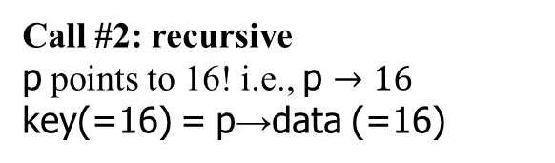
Removing a key at node with two children
Remove 12 !!!
16
BTNodeType *Remove (infotype *key, BTNodeType *p)
{// returns a pointer to node replacing the node removed.
BTNodeType *TempPtr;
if (p == NULL) return errorMessage(“empty tree”);
if (key < p->data)
p->left=Remove(key,p->left); Call #2 point !!!
else if (key > p->data)
p->right=Remove(key,p->right);
else //key = p→data
if (p->right && p->left) { //double child node
TmpPtr=findMin(p->right);
p->data=TmpPtr->data;
p->right=Remove(p->data,p->right);
}
else { //single child node
TmpPtr=p;
if (p->left == NULL) p=p->right;
else if (p->right == NULL) p=p->left;
free(TmpPtr);
}
return p;
8
TmpPtr
↓
24
4
10
16
48
p →
p →
18
32
60
Call #2: recursive
p points to 16! i.e., p $→16$
key(=16) = p→data (=16)
Red background: condition false
Green backgrnd: condition true

Slide 93
Removing a key at node with two children
Remove 12 !!!
16
BTNodeType *Remove (infotype *key, BTNodeType *p)
{// returns a pointer to node replacing the node removed.
BTNodeType *TempPtr;
if (p == NULL) return errorMessage(“empty tree”);
if (key < p->data)
p->left=Remove(key,p->left); Call #2 point !!!
else if (key > p->data)
p->right=Remove(key,p->right);
else //key = p→data
if (p->right && p->left) { //double child node
TmpPtr=findMin(p->right);
p->data=TmpPtr->data;
p->right=Remove(p->data,p->right);
}
else { //single child node
TmpPtr=p;
if (p->left == NULL) p=p->right;
else if (p->right == NULL) p=p->left;
free(TmpPtr);
}
return p;
p →
8
24
4
10
18
48
32
60
Return from Call #2 back to Call #1 at point of Call #2
Address of 18 returned to p→left with p pointing to 24.

Slide 94
Removing a key at node with two children
Remove 12 !!!
← p
16
BTNodeType *Remove (infotype *key, BTNodeType *p)
{// returns a pointer to node replacing the node removed.
BTNodeType *TempPtr;
if (p == NULL) return errorMessage(“empty tree”);
if (key < p->data)
p->left=Remove(key,p->left);
else if (key > p->data)
p->right=Remove(key,p->right);
else //key = p→data
if (p->right && p->left) { //double child node
TmpPtr=findMin(p->right);
p->data=TmpPtr->data;
p->right=Remove(p->data,p->right); Call #1 point !!!
}
else { //single child node
TmpPtr=p;
if (p->left == NULL) p=p->right;
else if (p->right == NULL) p=p->left;
free(TmpPtr);
}
return p;
8
24
4
10
18
48
32
60
Return from Call #1 back to Call #0 at the point of Call #1
Address of 24 returned to p→right with p pointing to 16 (12 gone!!!).

Slide 95
Removing a key at node with two children
Remove 12 !!!
← p
16
BTNodeType *Remove (infotype *key, BTNodeType *p)
{// returns a pointer to node replacing the node removed.
BTNodeType *TempPtr;
if (p == NULL) return errorMessage(“empty tree”);
if (key < p->data)
p->left=Remove(key,p->left);
else if (key > p->data)
p->right=Remove(key,p->right);
else //key = p→data
if (p->right && p->left) { //double child node
TmpPtr=findMin(p->right);
p->data=TmpPtr->data;
p->right=Remove(p->data,p->right);
}
else { //single child node
TmpPtr=p;
if (p->left == NULL) p=p->right;
else if (p->right == NULL) p=p->left;
free(TmpPtr);
}
return p;
8
24
4
10
18
48
32
60
Return from Call #0
Address of 16 (i.e., modified BST) returned to the invoker function with 12 removed.

Slide 96
Supplementary slides…

Slide 97
Calculation of Access Time
Access to some specific piece of data is achieved when the node this piece of data resides is found. To find this node, a search gets started from the root.
Data at each node is compared with the key that is searched for.
Counting up the number of comparisons for each node will render the access time.

Slide 98
Best/Average/Worst (B/A/W) Case Access Times of a specific BST
The best or fastest access time of a specific BST describes the access time to a node that can be attained with the smallest number of comparisons in this BST. Obviously this node is the root of this BST.
The average access time of a specific BST is total number of comparisons required to find all nodes divided by the number of nodes in this BST.
The worst case access time of a specific BST is the number of nodes on the longest path from the root to a leaf in this BST. It is equal to the height of this tree +1.
Important: !!! Please note that B/A/W topologies and B/A/W case access times are two different concepts!!!

Slide 99
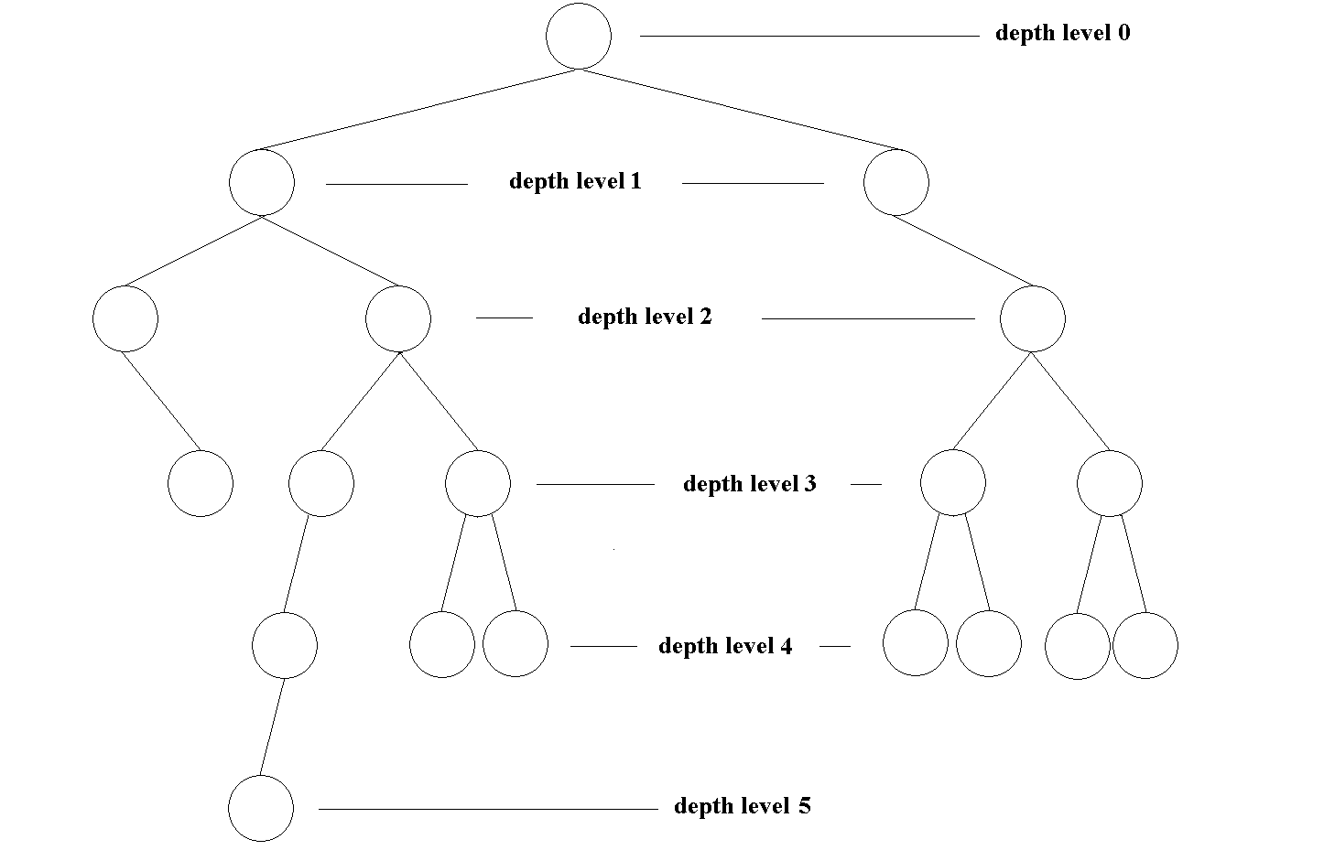
Calculation of Access Times
Depth level | # of Comparisons/ node | # of Comparisons/ level
0 | 1 | 1*1=1
1 | 2 | 2*2=4
2 | 3 | 3*3=9
3 | 4 | 4*5=20
4 | 5 | 5*7=35
5 | 6 | 6*1=6
Total | Nodes: 19 | 75
BST Access Times
Average | 75/19=3.94
Worst | 6
Best | 1

Slide 100
Best/Average/Worst BST Topologies
In the analysis of Find function we considered three different topology types:
Average case: this type includes all possible BST topologies from best to worst case topologies;
Best case: this type includes all BST topologies* that provide the shortest (best) total or average access time;
Worst case: this type includes all BST topologies* that provide the longest (worst) total or average access time which is simply a LL.
* Is there more than one best/worst topology? Look at next slide!

Slide 101
Best/Worst BST Topologies
A best (worst) BST topology is one with the best total or average access time.
Each topology with all depth levels filled up with the only possible exception of the last one is a best case topology.
Each different arrangement combination of leaves at the last depth level refers to a different BST topology that provides the same shortest total search time; hence a best case BST topology.
Examples are at the next slide.

Slide 102
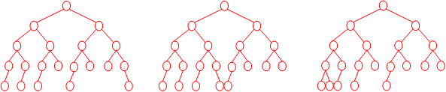
20-Node Best BST Topologies
We see three examples to such BST topologies…
Question: How many such BST topologies are there? Solution in the following slides…

Slide 103
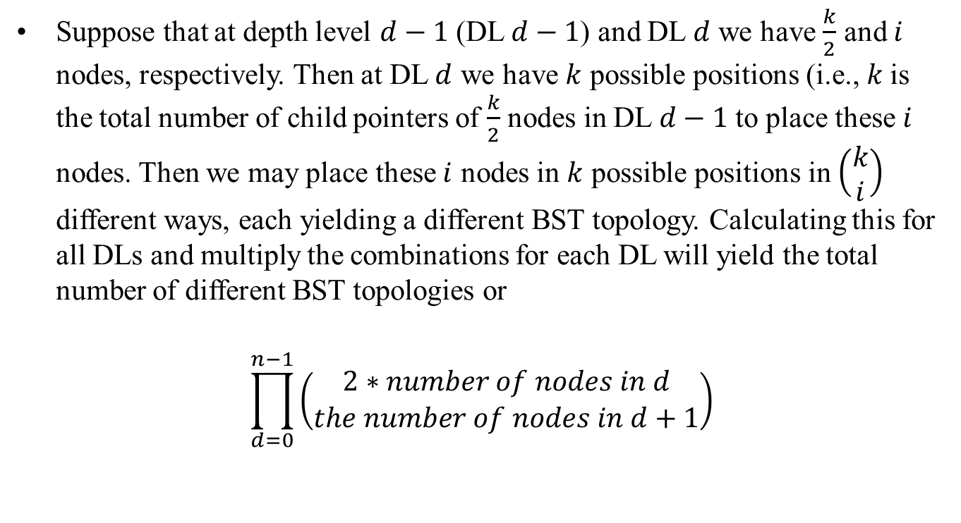
Solution
Suppose that at depth level $d−1$ (DL $d−1$) and DL $d$ we have $\frac{k}{2}$ and $i$ nodes, respectively. Then at DL $d$ we have $k$ possible positions (i.e., $k$is the total number of child pointers of $\frac{k}{2}$ nodes in DL $d−1$ to place these $i$ nodes. Then we may place these $i$ nodes in $k$ possible positions in $\left(\begin{matrix}k \\ i\end{matrix}\right)$ different ways, each yielding a different BST topology. Calculating this for all DLs and multiply the combinations for each DL will yield the total number of different BST topologies or
$$\prod_{d=0}^{n−1}{\left(\begin{matrix}2∗number of nodes in d \\ the number of nodes in d+1\end{matrix}\right)}$$

Slide 104
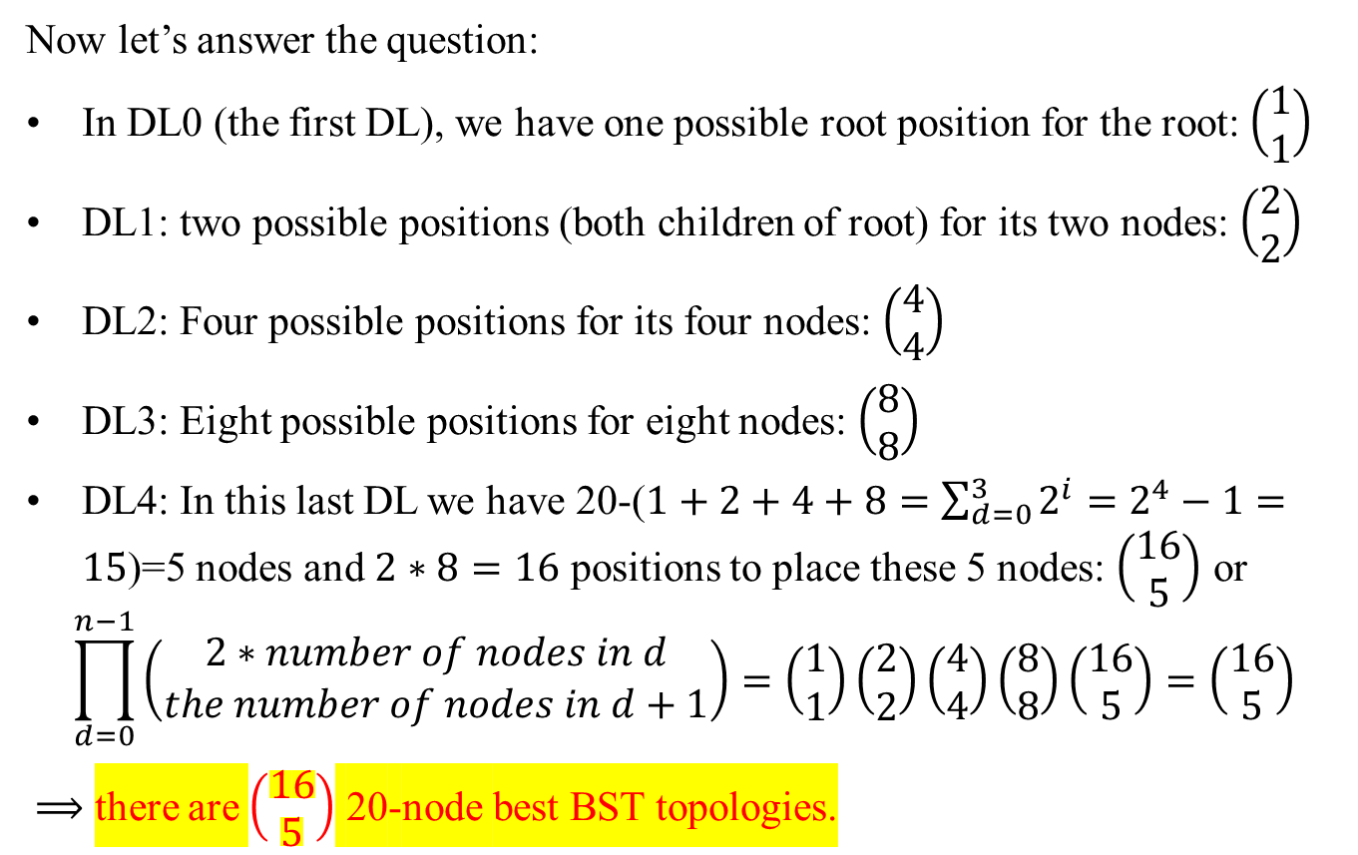
Solution
Now let’s answer the question:
In DL0 (the first DL), we have one possible root position for the root: $\left(\begin{matrix}1 \\ 1\end{matrix}\right)$
DL1: two possible positions (both children of root) for its two nodes: $\left(\begin{matrix}2 \\ 2\end{matrix}\right)$
DL2: Four possible positions for its four nodes: $\left(\begin{matrix}4 \\ 4\end{matrix}\right)$
DL3: Eight possible positions for eight nodes: $\left(\begin{matrix}8 \\ 8\end{matrix}\right)$
DL4: In this last DL we have 20-($1+2+4+8=\sum_{d=0}^{3}{2^{i}}=2^{4}−1=15$)=5 nodes and $2∗8=16$ positions to place these 5 nodes: $\left(\begin{matrix}16 \\ 5\end{matrix}\right)$ or
$$\prod_{d=0}^{n−1}{\left(\begin{matrix}2∗number of nodes in d \\ the number of nodes in d+1\end{matrix}\right)}=\left(\begin{matrix}1 \\ 1\end{matrix}\right)\left(\begin{matrix}2 \\ 2\end{matrix}\right)\left(\begin{matrix}4 \\ 4\end{matrix}\right)\left(\begin{matrix}8 \\ 8\end{matrix}\right)\left(\begin{matrix}16 \\ 5\end{matrix}\right)=\left(\begin{matrix}16 \\ 5\end{matrix}\right)$$
$⟹$ there are $\left(\begin{matrix}16 \\ 5\end{matrix}\right)$ 20-node best BST topologies.

Slide 105
n-Node Worst BST Topologies
We see three examples to such BST topologies…
Exercise: Find how many such BST topologies there are. Use the same technique as that to find the number of the best BST topologies…

