Slide 1
Data Structures – Week #2
Algorithm Analysis
&
Sparse Vectors/Matrices
&
Recursion

Slide 2
Outline
Performance of Algorithms
Performance Prediction (Order of Algorithms)
Examples
Exercises
Sparse Vectors/Matrices
Recursion
Recurrences

Slide 3
Algorithm Analysis

Slide 4
Performance of Algorithms
Algorithm: a finite sequence of instructions that the computer follows to solve a problem.
Algorithms solving the same problem may perform differently. Depending on resource requirements an algorithm may be feasible or not. To find out whether an algorithm is usable or relatively better than another one solving the same problem, its resource requirements should be determined.
The process of determining the resources of an algorithm is called algorithm analysis.
Two essential resources, hence, performance criteria of algorithms are
execution or running time
memory space used.

Slide 5
Performance Assessment - 1
Execution time (or memory space required) of an algorithm is hard to assess unless one knows
the intimate details of the computer architecture,
the operating system,
the compiler,
the quality of the program,
the current load of the system and
other factors.

Slide 6
Performance Assessment - 2
Two ways to assess performance of an algorithm
Execution time may be compared for a given algorithm using some special performance programs called benchmarks (denektaşları) and evaluated as such.
Growth rate of execution time (or memory space) of an algorithm with the growing input size may be found.

Slide 7
Performance Assessment - 3
Here, we define the execution time or the memory space used as a function of the input size.
By “input size” we mean
the number of elements to store in a data structure,
the number of records in a file etc…
the nodes in a LL or a tree or
the nodes as well as connections of a graph

Slide 8
Assessment Tools
We can use the concept the “growth rate or order of an algorithm” to assess both criteria. However, our main concern will be the execution time.
We use asymptotic notations to symbolize the asymptotic running time of an algorithm in terms of the input size.

Slide 9
Asymptotic Notations
We use asymptotic notations to symbolize the asymptotic running time of an algorithm in terms of the input size.
The following notations are frequently used in algorithm analysis:
O (Big Oh) Notation (asymptotic upper bound)
Ω (Omega) Notation (asymptotic lower bound)
Θ (Theta) Notation (asymptotic tight bound)
o (little Oh) Notation (upper bound that is not asymptotically tight)
ω (omega) Notation (lower bound that is not asymptotically tight)
Goal: To find a function that asymptotically limits the execution time or the memory space of an algorithm.

Slide 10
O-Notation (“Big Oh”) Asymptotic Upper Bound
Mathematically expressed, the “Big Oh” (O()) concept is as follows:
Let g: N → R* be an arbitrary function.
O(g(n)) = {f: N → R* | (∃c ∈ R⁺)(∃n₀ ∈ N)(∀n ≥ n₀) [f(n)≤ cg(n)]},
where R* is the set of nonnegative real numbers and R⁺ is the set of strictly positive real numbers (excluding 0).

Slide 11
O-Notation by words
Expressed by words; O(g(n)) is the set of all functions f(n) mapping (→) integers (N) to nonnegative real numbers (R*) such that (|) there exists a positive real constant c (∃c ∈ R⁺) and there exists an integer constant n₀ (∃n₀ ∈ N) such that for all values of n greater than or equal to the constant (∀n ≥ n₀), the function values of f(n) are less than or equal to the function values of g(n) multiplied by the constant c (f(n)≤ cg(n)).
In other words, O(g(n)) is the set of all functions f(n) bounded above by a positive real multiple of g(n), provided n is sufficiently large (greater than n₀). g(n) denotes the asymptotic upper bound for the running time f(n) of an algorithm.

Slide 12
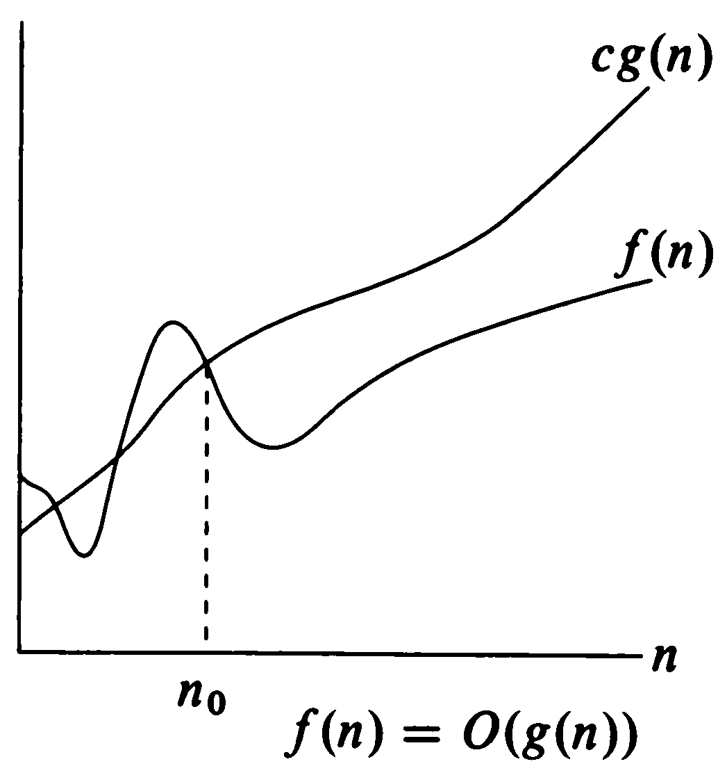
O-Notation (“Big Oh”) Asymptotic Upper Bound

Slide 13
Θ-Notation (“Theta”) Asymptotic Tight Bound
Mathematically expressed, the “Theta” (Θ()) concept is as follows:
Let g: N → R* be an arbitrary function.
Θ(g(n)) = {f: N → R* | (∃c₁,c₂ ∈ R⁺)(∃n₀ ∈ N)(∀n ≥ n₀)
[0 ≤ c₁g(n)≤ f(n)≤ c₂g(n)]},
where R* is the set of nonnegative real numbers and R⁺ is the set of strictly positive real numbers (excluding 0).

Slide 14
Θ-Notation by words
Expressed by words; A function f(n) belongs to the set Θ(g(n)) if there exist positive real constants c₁ and c₂ (∃c₁,c₂∈R⁺) such that it can be sandwiched between c₁g(n) and c₂g(n) ([0 ≤ c₁gn)≤ f(n)≤ c₂g(n)]), for sufficiently large n (∀n ≥ n₀).
In other words, Θ(g(n)) is the set of all functions f(n) tightly bounded below and above by a pair of positive real multiples of g(n), provided n is sufficiently large (greater than n₀). g(n) denotes the asymptotic tight bound for the running time f(n) of an algorithm.

Slide 15
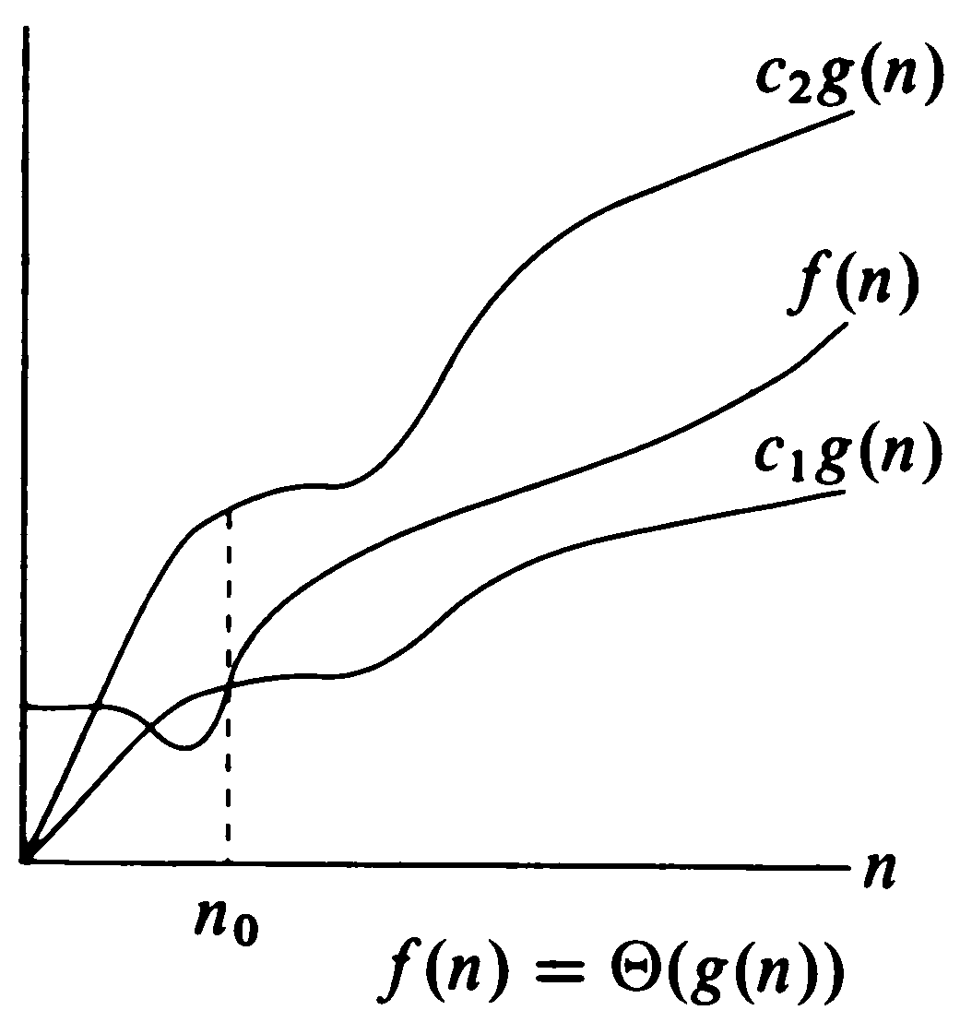
Θ-Notation (“Theta”) Asymptotic Tight Bound

Slide 16
Ω-Notation (“Big-Omega”) Asymptotic Lower Bound
Mathematically expressed, the “Omega” (Ω()) concept is as follows:
Let g: N → R* be an arbitrary function.
Ω(g(n)) = {f: N → R* | (∃c ∈ R⁺)(∃n₀ ∈ N)(∀n ≥ n₀)
[0 ≤ cg(n)≤ f(n)]},
where R* is the set of nonnegative real numbers and R⁺ is the set of strictly positive real numbers (excluding 0).

Slide 17
Ω-Notation by words
Expressed by words; A function f(n) belongs to the set Ω(g(n)) if there exists a positive real constant c (∃c∈R⁺) such that f(n) is greater than or equal to cg(n) ([0≤ cg(n)≤ f(n)]), for sufficiently large n (∀n ≥ n₀).
In other words, Ω(g(n)) is the set of all functions t(n) bounded below by a positive real multiple of g(n), provided n is sufficiently large (greater than n₀). g(n) denotes the asymptotic lower bound for the running time f(n) of an algorithm.

Slide 18
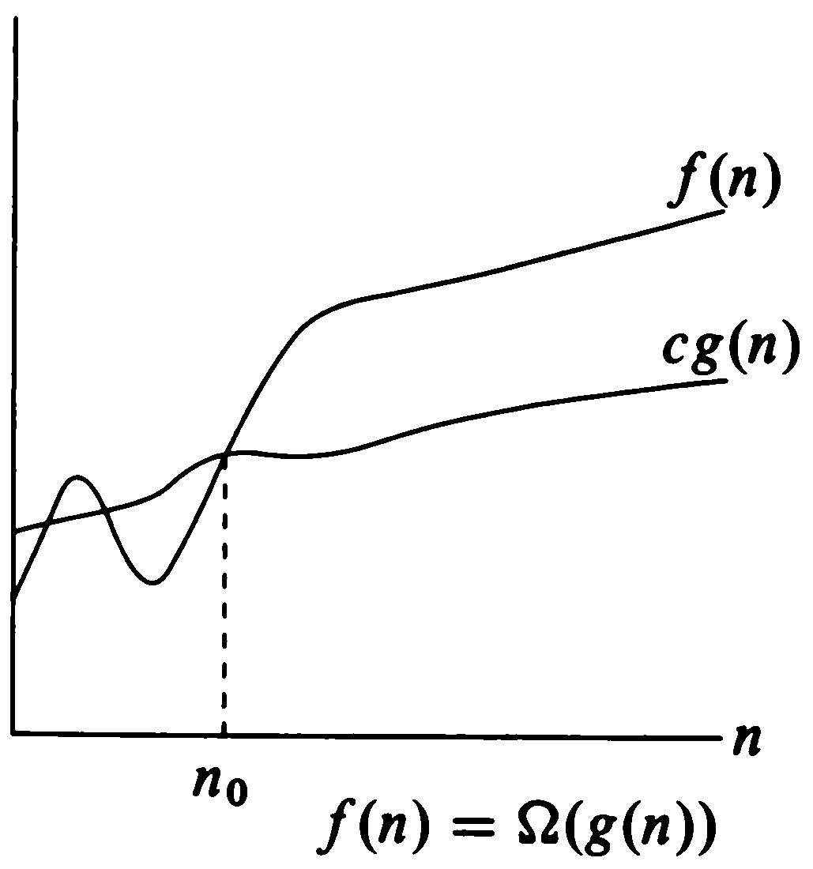
Ω-Notation (“Big-Omega”) Asymptotic Lower Bound

Slide 19
o-Notation (“Little Oh”) Upper bound NOT Asymptotically Tight
“o” notation does not reveal whether the function f(n) is a tight asymptotic upper bound for t(n) (t(n)≤ cf(n)).
“Little Oh” or o notation provides an upper bound that strictly is NOT asymptotically tight.
Mathematically expressed;
Let f: N → R* be an arbitrary function.
o(f(n)) = {t: N → R* | (∀c ∈ R⁺)(∃n₀ ∈ N)(∀n ≥ n₀) [t(n)< cf(n)]},
where R* is the set of nonnegative real numbers and R⁺ is the set of strictly positive real numbers (excluding 0).

Slide 20
ω-Notation (“Little-Omega”) Lower Bound NOT Asymptotically Tight
ω concept relates to Ω concept in analogy to the relation of “little-Oh” concept to “big-Oh” concept.
“Little Omega” or ω notation provides a lower bound that strictly is NOT asymptotically tight.
Mathematically expressed, the “Little Omega” (ω()) concept is as follows:
Let f: N → R* be an arbitrary function.
ω(f(n)) = {t: N → R* | (∀c ∈ R⁺)(∃n₀ ∈ N)(∀n ≥ n₀) [cf(n) < t(n)]},
where R* is the set of nonnegative real numbers and R⁺ is the set of strictly positive real numbers (excluding 0).

Slide 21
Asymptotic Notations Examples
t(n) ∈ O(f(n))
t(n) ∈ O(h(n))
t(n) ∈ Θ(f(n))
t(n) ∉ Θ(h(n))
t(n) ∉ Θ(g(n))
t(n) ∈ Ω(f(n))
t(n) ∈ Ω(g(n))
t(n) ∈ o(h(n))
t(n) ∉ o(f(n))
t(n) ∈ ω(g(n))
t(n) ∉ ω(f(n))
Upper bound not asymptotically tight
Asymptotic upper bound
Execution time of algorithm
Asymptotic lower bound
Lower bound not asymptotically tight

Slide 22
Execution time of various structures
Simple Statement
O(1), executed within a constant amount of time
irresponsive to any change in input size.
Decision (if) structure
if (condition) f(n) else g(n)
O(if structure)=max(O(f(n)),O(g(n))
Sequence of Simple Statements
O(1), since O(f₁(n)+…+f_{s}(n))=O(max(f₁(n),…,f_{s}(n)))

Slide 23
Execution time of various structures
O(f₁(n)+…+f_{s}(n))=O(max(f₁(n),…,f_{s}(n))) ???
Proof:
t(n)∈ O(f₁(n)+…+f_{s}(n)) ⇒ t(n)≤ c[f₁(n)+…+f_{s}(n)] ≤ sc*max [f₁(n),…, f_{s}(n)], sc another constant.
⇒ t(n)∈ O(max(f₁(n),…,f_{s}(n)))
Hence, hypothesis follows.

Slide 24
Execution Time of Loop Structures
Loop structures’ execution time depends upon whether or not their index bounds are related to the input size.
Assume n is the number of input records
for (i=0; i<=n; i++) {statement block}, O(?)
for (i=0; i<=m; i++) {statement block}, O(?)

Slide 25
Examples
Find the execution time t(n) in terms of n!
for (i=0; i<=n; i++)
for (j=0; j<=n; j++)
statement block;
for (i=0; i<=n; i++)
for (j=0; j<=i; j++)
statement block;
for (i=0; i<=n; i++)
for (j=1; j<=n; j*=2)
statement block;

Slide 26
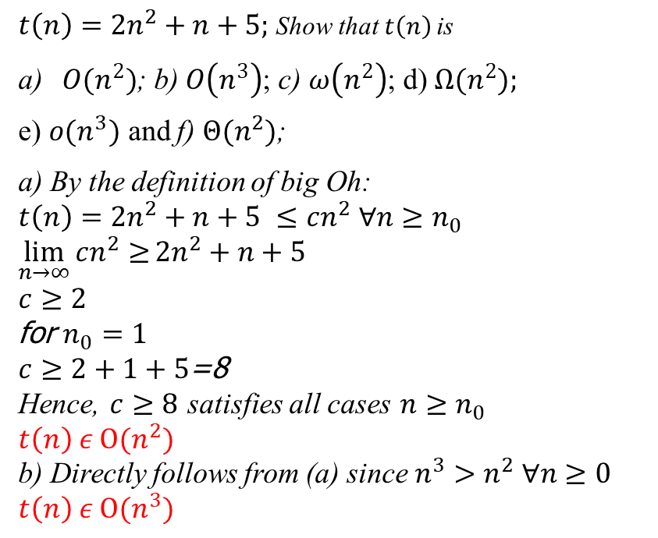
Asymptotic Bound Examples
$t\left(n\right)=2n^{2}+n+5;$ Show that $t\left(n\right)$ is
$O(n^{2})$; b) $O\left(n^{3}\right)$; c) $ω\left(n^{2}\right)$; d)$Ω(n^{2});$
e) $o(n^{3})$ and f) $Θ(n^{2})$;
a) By the definition of big Oh:
$t\left(n\right)=2n^{2}+n+5 ≤cn^{2} ∀n≥n_{0}$
$\lim_{n→∞}{cn^{2}≥}2n^{2}+n+5$
$c≥2$
for $n_{0}=1$
$c≥2+1+5$=8
Hence, $c≥8$ satisfies all cases $n≥n_{0}$
$t\left(n\right) ε O(n^{2})$
b) Directly follows from (a) since $n^{3}>n^{2} ∀n≥0$
$t\left(n\right) ε O(n^{3})$

Slide 27
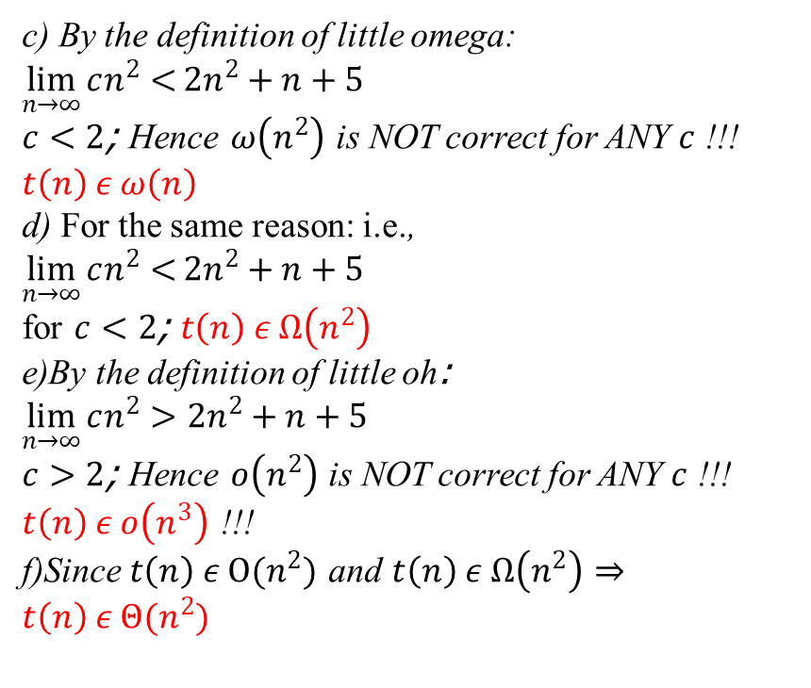
Asymptotic Bound Examples
c) By the definition of little omega:
$\lim_{n→∞}{cn^{2}<}2n^{2}+n+5$
$c<2$; Hence $ω\left(n^{2}\right)$ is NOT correct for ANY $c$ !!!
$t\left(n\right) ε ω\left(n\right)$
d) For the same reason: i.e.,
$\lim_{n→∞}{cn^{2}<}2n^{2}+n+5$
for $c<2$; $t\left(n\right) ε Ω\left(n^{2}\right)$
e)By the definition of little oh: $\lim_{n→∞}{cn^{2}>2n^{2}+n+5}$
$c>2$; Hence $o\left(n^{2}\right)$ is NOT correct for ANY $c$ !!!
$t\left(n\right) ε o\left(n^{3}\right)$ !!!
f)Since $t\left(n\right) ε O(n^{2})$ and $t\left(n\right) ε Ω\left(n^{2}\right)$ $⇒$ $t\left(n\right) ε Θ(n^{2})$

Slide 28
Exercises
Find the number of times the statement block is executed!
for (i=0; i<=n; i++)
for (j=1; j<=i; j*=2)
statement block;
for (i=1; i<=n; i*=3)
for (j=1; j<=n; j*=2)
statement block;

Slide 29
Sparse Vectors and Matrices

Slide 30
Motivation
In numerous applications, we may have to process vectors/matrices which mostly contain trivial information (i.e., most of their entries are zero!). This type of vectors/matrices are defined to be sparse.
Storing sparse vectors/matrices as usual (e.g., matrices in a 2D array or a vector a regular 1D array) causes wasting memory space for storing trivial information.
Example: What is the space requirement for a matrix m_{nxn} with only non-trivial information in its diagonal if
it is stored in a 2D array;
in some other way? Your suggestions?

Slide 31
Sparse Vectors and Matrices
This fact brings up the question:
May the vector/matrix be stored in MM avoiding waste of memory space?

Slide 32
Sparse Vectors and Matrices
Assuming that the vector/matrix is static (i.e., it is not going to change throughout the execution of the program), we should study two cases:
Non-trivial information is placed in the vector/matrix following a specific order;
Non-trivial information is randomly placed in the vector/matrix.

Slide 33
Case 1: Info. follows an order
Example structures:
Triangular matrices (upper or lower triangular matrices)
Symmetric matrices
Band matrices
Any other types ...?

Slide 34
Triangular Matrices
Upper Triangular Matrix
Lower Triangular Matrix

Slide 35
Symmetric and Band Matrices
Symmetric Matrix
Band Matrix

Slide 36
Case 1:How to Efficiently Store...
Store only the non-trivial information in a 1-dim array a;
Find a function f mapping the indices of the 2-dim matrix (i.e., i and j) to the index k of 1-dim array a, or
such that
k=f(i,j)

Slide 37
Case 1: Example for Lower Triangular Matrices
k → 0 1 2 3 4 5 .... n(n-1)/2 ....
m₁₁
m₂₁
m₂₂
m₃₁
m₃₂
m₃₃
.....
m_{n1}
m_{n2}
m_{n3}
......
m_{nn}
k=f(i,j)=i(i-1)/2+j-1
⇒
m_{ij} = a[i(i-1)/2+j-1]

Slide 38
Case 1: Example for Upper Triangular Matrices
k → 0 1 2 … n-1 n .... 2n-2 2n-1…3n-4… n(n+1)/2-1
m₁₁
m₁₂
m₁₃
…
m_{1n}
m₂₂
.....
m_{2n}
m₃₃
m_{3n}
......
m_{nn}
m₁₁ at k=0 m_{1j} at k=j-1
m₂₂ at k=n m_{2j} at k=n+j-2
m₃₃ at k=2n-1 m_{3j} at k=2n-1+j-3
m₄₄ at k=3n-3 m_{4j} at k=3n-3+j-4
m₅₅ at k=4n-6 m_{5j} at k=4n-6+j-5
m₆₆ at k=5n-10 m_{5j} at k=5n-10+j-6
…
m_{ii} at k=(i-1)n-(i-2)(i-1)/2 m_{ij} at k=(i-1)n- (i-2)(i-1)/2+j-i

Slide 39
Case 2: Non-trivial Info. Randomly Located
Example:

Slide 40
Case 2:How to Efficiently Store...
Store only the non-trivial information in a 1-dim array a along with the entry coordinates.
Example:
a
a;0,0
b;1,1
f;1,n-1
c;2,1
g;i,j
e;n-1,0
d;n-1,2

Slide 41
Recursion

Slide 42
Recursion
Definition:
Recursion is a mathematical concept referring
to programs or functions calling or using
itself.
A recursive function is a functional piece of
code that invokes or calls itself.

Slide 43
Recursion
Concept:
A recursive function divides the problem into two conceptual pieces:
a piece that the function knows how to solve (base case),
a piece that is very similar to, but a little simpler than, the original problem, hence still unknown how to solve by the function (call(s) of the function to itself).

Slide 44
Recursion… cont’d
Base case: the simplest version of the problem that is not further reducible. The function actually knows how to solve this version of the problem.
To make the recursion feasible, the latter piece must be slightly simpler.

Slide 45
Recursion Examples
Towers of Hanoi
Story: According to the legend, the life on the world will end when Buddhist monks in a Far-Eastern temple move 64 disks stacked on a peg in a decreasing order in size to another peg. They are allowed to move one disk at a time and a larger disk can never be placed over a smaller one.

Slide 46
Towers of Hanoi… cont’d
Algorithm:
Hanoi(n,i,j)
// moves n smallest rings from rod i to rod j
F0A0 if (n > 0) {
//moves top n-1 rings to intermediary rod (6-i-j)
F0A2 Hanoi(n-1,i,6-i-j);
//moves the bottom (n^{th} largest) ring to rod j
F0A5 move i to j
// moves n-1 rings at rod 6-i-j to destination rod j
F0A8 Hanoi(n-1,6-i-j,j);
F0AB }

Slide 47
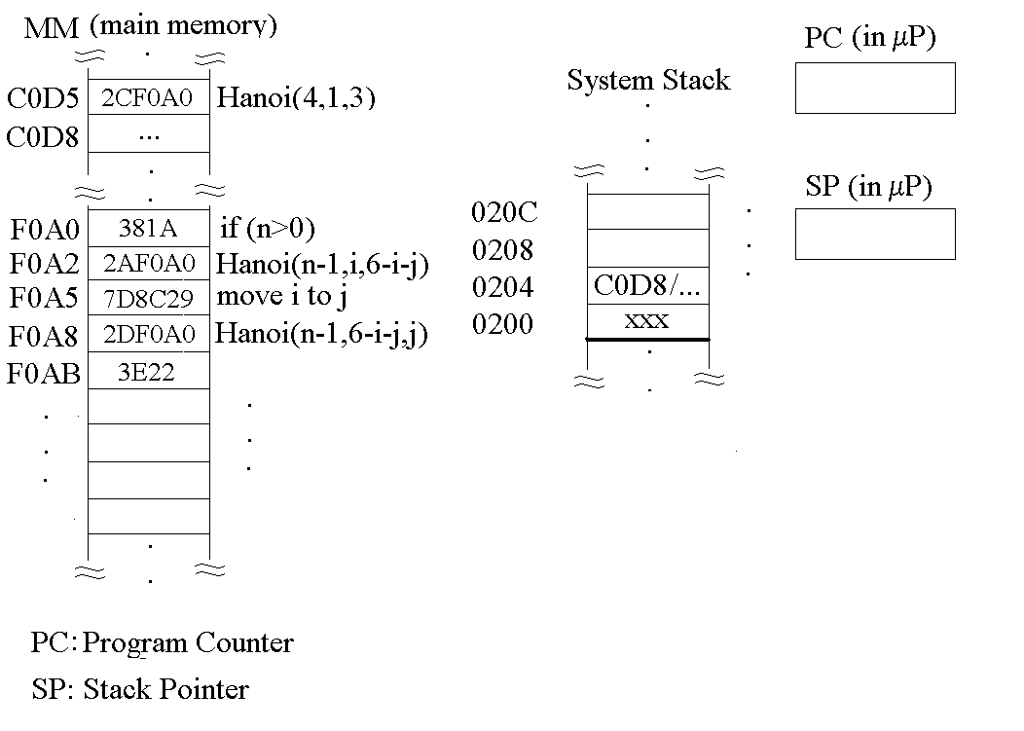
Function Invocation in MM

Slide 48
Function Invocation (Call) in MM
Code and data are both in MM.
Hanoi function is called by the instruction at MM cell C0D5 with arguments (4,1,3).
Program counter is a register in μP that holds MM address of next instruction to execute.
If current instruction is a function call, the serial flow of execution is interrupted.

Slide 49
Function Call in MM… cont’d
Following problems arise:
how to keep the return address from the function called (Hanoi) back to the caller function (C0D8 at main and both F0A5 and F0AB at Hanoi);
how to store the values of variables local to caller function.
Both problems are solved by keeping the return address and local variables’ values in a portion of the main memory called system stack.
Another register called Stack Pointer points to the address pushed most recently to system stack. Return addresses are retrieved from system stack in a last-in-first-out (LIFO) fashion. We will see stacks later.

Slide 50
Towers of Hanoi… cont’d
Example: Hanoi(4,i,j)
4 1 3
3 1 2
2 1 3
1 1 2
0 1 3
1→2
0 3 2
1→3
1 2 3
0 2 1
2→3
0 1 3
1→2
2 3 2
1 3 1
0 3 2
3→1
0 2 1
3→2
1 1 2
0 1 3
1→2
0 3 2
1→3
3 2 3
2 2 1
1 2 3
0 2 1
2→3
0 1 3
2→1
1 3 1
0 3 2
3→1
0 2 1
2→3
2 1 3
1 1 2
0 1 3
1→2
0 3 2
1→3
1 2 3
0 2 1
2→3
0 1 3

Slide 51
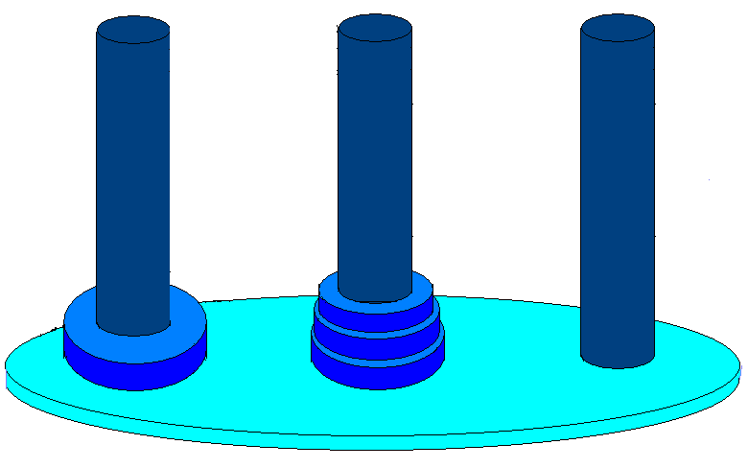
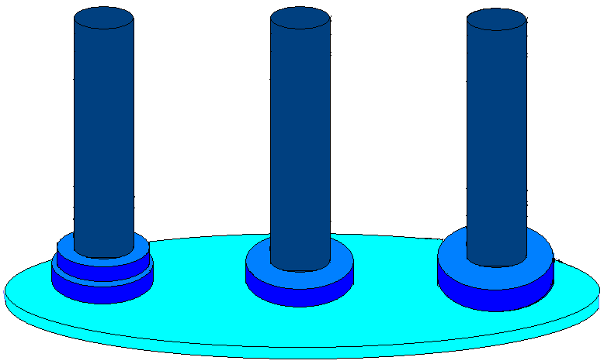
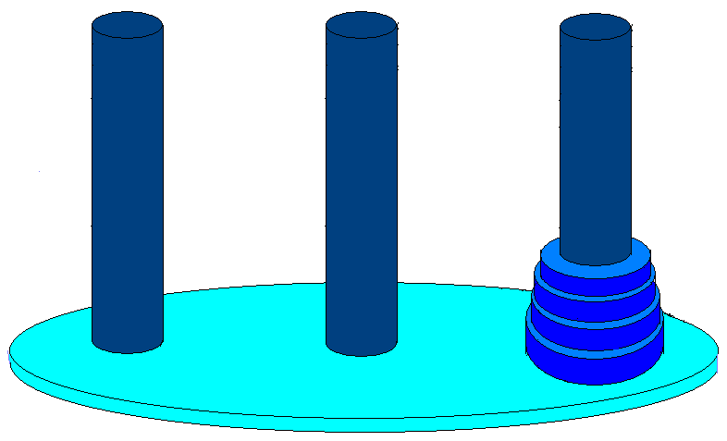
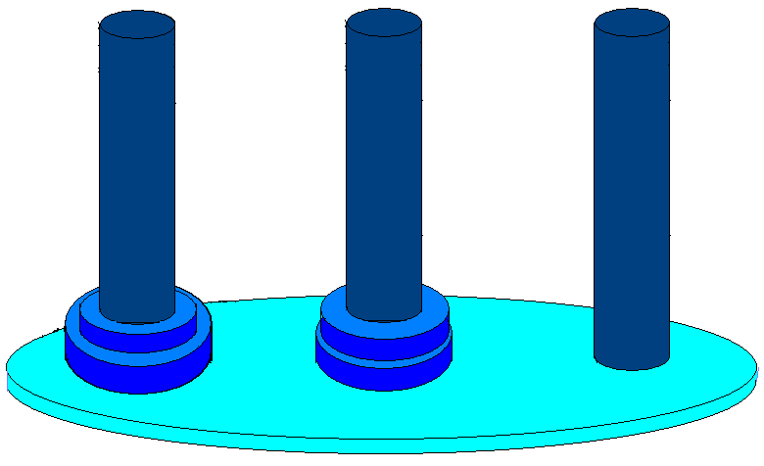
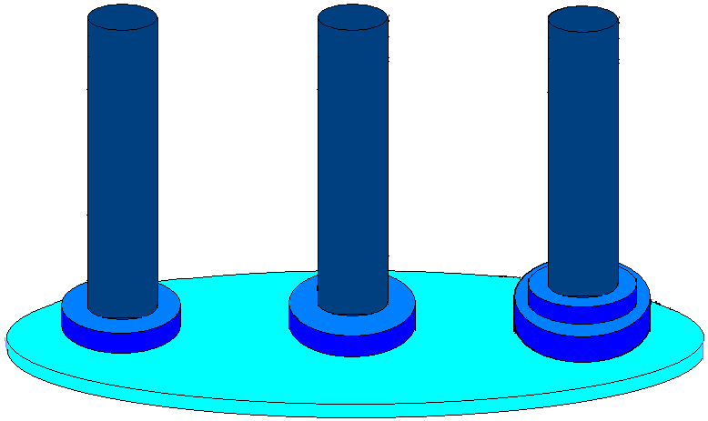
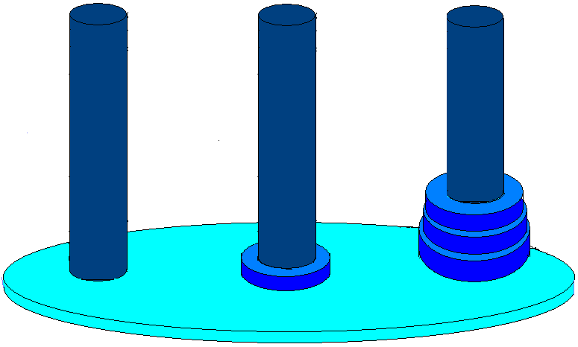
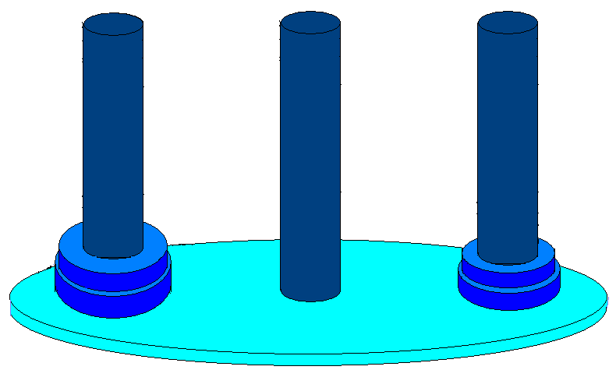
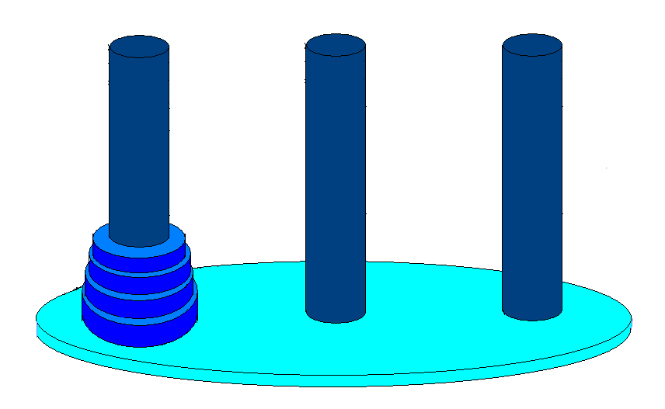
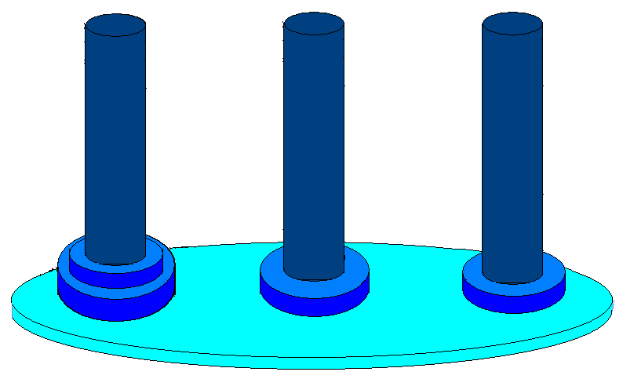
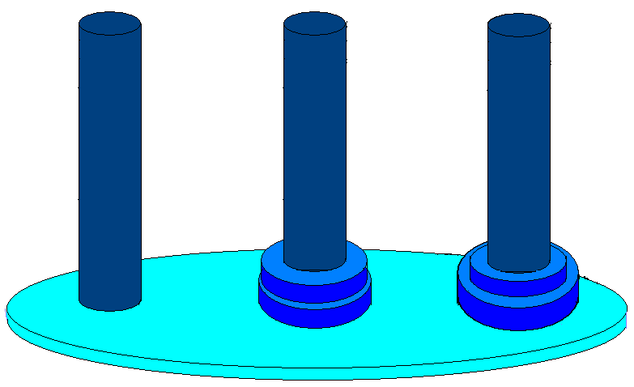
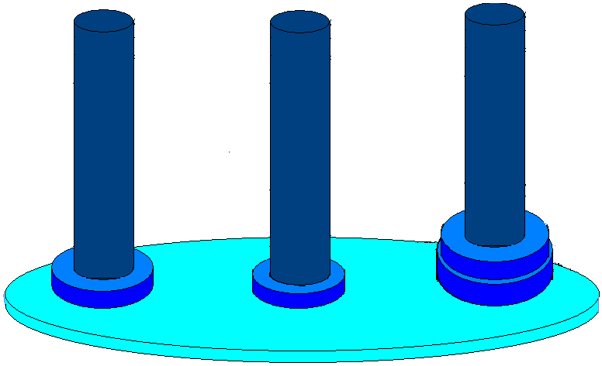
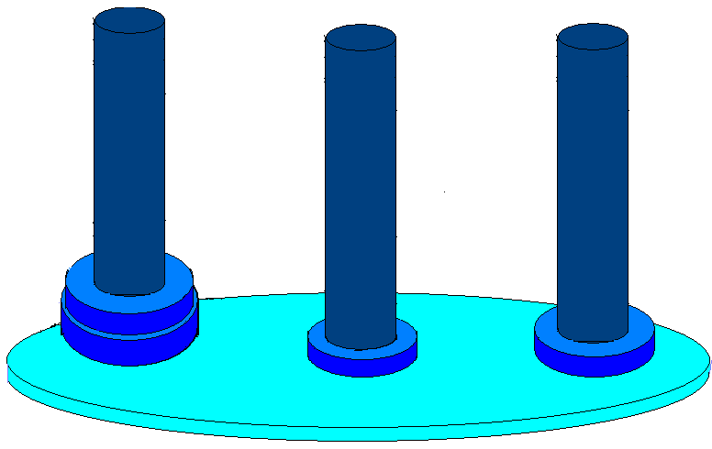
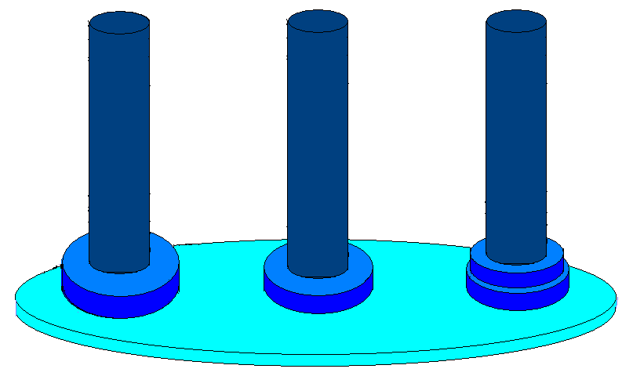
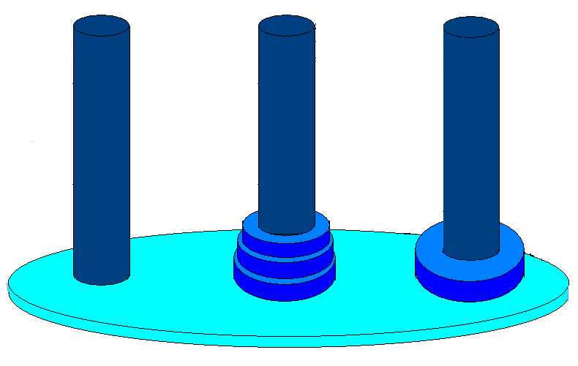
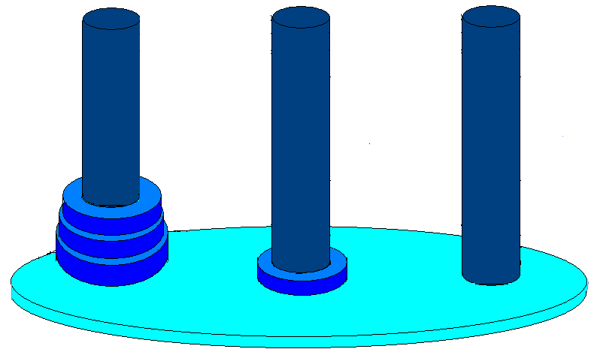
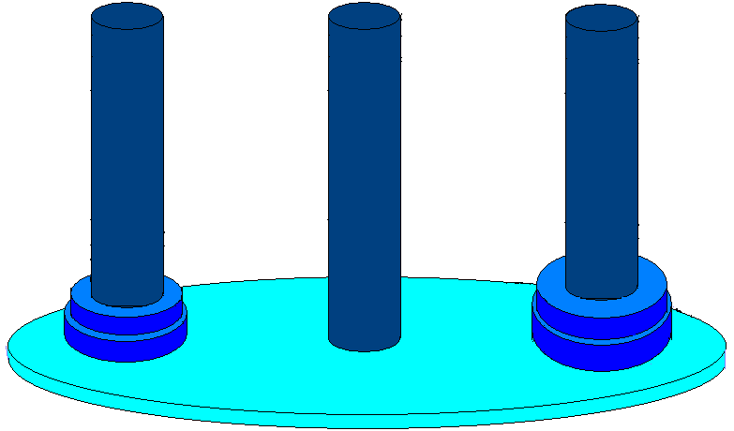
Towers of Hanoi… cont’d
4 1 3 start
3 1 2 start
2 1 3 start
1 1 2 start
1 2 3 end
2 1 3 end
2 3 2 start
1 3 1 start
1 1 2 end
1 2 3 start
1→2
1→3
2→3
1→2
3 1 2 end
2 3 2 end
1 1 2 end
3 2 3 start
2 2 1 start
1 2 3 start
1 3 1 end
1 1 2 start
1 2 3 end
3→1
3→2
1→2
1→3
2→3
1 3 1 start
2 2 1 end 1 3 1 end
2 1 3 start
1 1 2 start
1 1 2 end
1 2 3 start
2→1
3→1
2→3
1→2
1→3
2→3
4 1 3 end
3 2 3 end
2 1 3 end
1 2 3 end

Slide 52
Recursion Examples
Fibonacci Series
t_{n}= t_{n-1} + t_{n-2}; t₀=0; t₁=1
Algorithm
long int fib(n)
{
if (n==0 || n==1)
return n;
else
return fib(n-1)+fib(n-2);
}

Slide 53
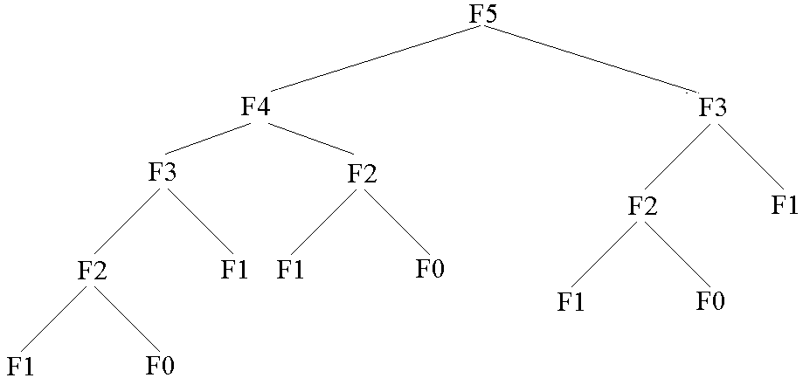
Fibonacci Series… cont’d
Tree of recursive function calls for fib(5)
Any problems???

Slide 54
Fibonacci Series… cont’d
Redundant function calls slow the execution down.
A lookup table used to store the Fibonacci values already computed saves redundant function executions and speeds up the process.
Homework: Write fib(n) with a lookup table!

Slide 55
Recurrences

Slide 56
Recurrences or Difference Equations
Homogeneous Recurrences
Consider a₀ t_{n} + a₁t_{n-1} + … + a_{k} t_{n-k} = 0.
The recurrence
contains t_{i} values which we are looking for.
is a linear recurrence (i.e., t_{i} values appear alone, no powered values, divisions or products)
contains constant coefficients (i.e., a_{i}).
is homogeneous (i.e., RHS of equation is 0).

Slide 57
Homogeneous Recurrences
We are looking for solutions of the form:
t_{n} = x^{n}
Then, we can write the recurrence as
a₀ x^{n} + a₁x^{n-1}+ … + a_{k} x^{n-k} = 0
This k^{th} degree equation is the characteristic equation (CE) of the recurrence.

Slide 58
Homogeneous Recurrences
If r_{i}, i=1,…, k, are k distinct roots of a₀ x^{k} + a₁ x^{k-1}+ … + a_{k} = 0, then
If r_{i}, i=1,…, k, is a single root of multiplicity k, then

Slide 59
Inhomogeneous Recurrences
Consider
a₀ t_{n} + a₁t_{n-1} + … + a_{k} t_{n-k} = b^{n} p(n)
where b is a constant; and p(n) is a polynomial in n of degree d.

Slide 60
Inhomogeneous Recurrences
Generalized Solution for Recurrences
Consider a general equation of the form
(a₀ t_{n} + a₁t_{n-1} + … + a_{k} t_{n-k} ) = b₁^{n} p₁(n) + b₂^{n} p₂(n) + …
We are looking for solutions of the form:
t_{n} = x^{n}
Then, we can write the recurrence as
where d_{i} is the polynomial degree of polynomial p_{i}(n).
This is the characteristic equation (CE) of the recurrence.

Slide 61
Generalized Solution for Recurrences
If r_{i}, i=1,…, k, are k distinct roots of
(a₀ x^{k} + a₁ x^{k-1}+ … + a_{k})=0

Slide 62
Examples
Homogeneous Recurrences
Example 1.
t_{n} + 5t_{n-1} + 4 t_{n-2} = 0; sol’ns of the form t_{n} = x^{n}
x^{n} + 5x^{n-1}+ 4x^{n-2} = 0; (CE) n-2 trivial sol’ns (i.e., x_{1,...,n-2}=0)
(x²+5x+4) = 0; characteristic equation (simplified CE)
x₁=-1; x₂=-4; nontrivial sol’ns
t_{n} = c₁(-1)^{n}+ c₂(-4)^{n} ; general sol’n

Slide 63
Examples
Homogeneous Recurrence
Example 2.
t_{n}-6 t_{n-1}+12t_{n-2}-8t_{n-3}=0; t_{n} = x^{n}
x^{n}-6x^{n-1}+12x^{n-2}-8x^{n-3}= 0; n-3 trivial sol’ns
CE: (x³-6x²+12x-8) = (x-2)³= 0; by polynomial division
x₁= x₂= x₃ = 2; roots not distinct!!!
t_{n} = c₁2^{n}+ c₂n2^{n} + c₃n²2^{n}; general sol’n

Slide 64
Examples
Homogeneous Recurrence
Example 3.
t_{n} = t_{n-1}+ t_{n-2}; Fibonacci Series
x^{n}-x^{n-1}-x^{n-2} = 0; ⇒ CE: x²-x-1 = 0;
; distinct roots!!!
; general sol’n!!
We find coefficients c_{i} using initial values t₀ and t₁ of
Fibonacci series on the next slide!!!

Slide 65
Examples
Example 3… cont’d
We use as many t_{i} values
as c_{i}
Check it out using t₂!!!

Slide 66
Examples
Example 3… cont’d
What do n and t_{n} represent?
n is the location and t_{n} the value of any Fibonacci number in the series.

Slide 67
Examples
Example 4.
t_{n} = 2t_{n-1} - 2t_{n-2}; n ≥ 2; t₀ = 0; t₁ = 1;
CE: x²-2x+2 = 0;
Complex roots: x_{1,2}=1±i
As in differential equations, we represent the complex roots as a
vector in polar coordinates by a combination of a real radius r
and a complex argument θ:
z=r*e^{θ i};
Here,
1+i=√2 * e^{(π/4)i}
1-i=√2 * e^{(-π/4)i}

Slide 68
Examples
Example 4… cont’d
Solution:
t_{n} = c₁ (2)^{n/2} e^{(nπ/4)i} + c₂ (2)^{n/2} e^{(-nπ/4)i};
From initial values t₀ = 0, t₁ = 1,
t_{n} = 2^{n/2} sin(nπ/4); (prove that!!!)
Hint:

Slide 69
Examples
Inhomogeneous Recurrences
Example 1. (From Example 3)
We would like to know how many times fib(n)
on page 22 is executed in terms of n. To find out:
choose a barometer in fib(n);
devise a formula to count up the number of times the barometer is executed.

Slide 70
Examples
Example 1… cont’d
In fib(n), the only statement is the if statement.
Hence, if condition is chosen as the barometer.
Suppose fib(n) takes t_{n} time units to execute,
where the barometer takes one time unit and the
function calls fib(n-1) and fib(n-2), t_{n-1} and t_{n-2},
respectively. Hence, the recurrence to solve is
t_{n} = t_{n-1} + t_{n-2} + 1

Slide 71
Examples
Example 1… cont’d
t_{n} - t_{n-1} - t_{n-2} = 1; inhomogeneous recurrence
The homogeneous part comes directly from
Fibonacci Series example on page 52.
RHS of recurrence is 1 which can be expressed
as 1^{n}x⁰. Then, from the equation on page 48,
CE: (x²-x-1)(x-1) = 0; from page 49,

Slide 72
Examples
Example 1… cont’d
Now, we have to find c₁,…,c₃.
Initial values: for both n=0 and n=1, if condition is
checked once and no recursive calls are done.
For n=2, if condition is checked once and recursive
calls fib(1) and fib(0) are done.
⇒ t₀ = t₁ = 1 and t₂ = t₀ + t₁ + 1 = 3.

Slide 73
Examples
Example 1… cont’d
Here, t_{n} provides the number of times the
barometer is executed in terms of n. Practically,
this number also gives the number of times fib(n) is
called.

