Slide 1
Data Structures – Week #4
Queues

Slide 2
Outline
Queues
Operations on Queues
Array Implementation of Queues
Linked List Implementation of Queues
Queue Applications

Slide 3
Queues (Kuyruklar)
A queue is a list of data with the restriction that
data can be inserted from the “rear” or “tail,” and
data can be retrieved from the “front” or “head”
of the list.
By “rear” we mean a pointer pointing to the element that is last added to the list whereas
“front” points to the first element.
A queue is a first-in-first-out (FIFO) structure.

Slide 4
Operations on Queues
Two basic operations related to queues:
Enqueue (Put data to the rear of the queue)
Dequeue (Retrieve data from the front of the queue)

Slide 5
Implementation of Queues
Queues can be implemented uing
arrays, or
LLs

Slide 6
Array Implementation of Queues
Queues can be implemented using arrays.
During the execution, queue can grow or shrink within this array. The array has two “open” ends.
One end of the doubly-open-ended array is the rear where the insertions are made. The other is the front where elements are removed.

Slide 7
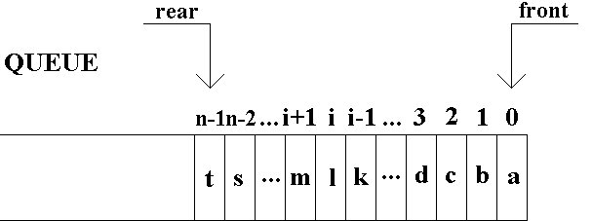
Array Implementation of Queues
Initialization:
front=0; rear=-1;
Condition for an empty queue:
In general: rear+1 = front
In particular: rear = -1;
Condition for a full queue
In general: rear-(n-1) = front;
In particular: rear ≥ n-1;

Slide 8
Sample C Implementation
#define queueSize …;
struct dataType {
…
}
typedef struct dataType dataType;
struct queueType {
int front;
int rear;
dataType content[queueSize];
}
typedef struct queueType queueType;
queueType queue;

Slide 9
Sample C Implementation… isEmpty() and isFull()
//Initialize Queue (i.e., set value of front and rear to 0)
queue.rear=-1;
int isEmpty(queueType q)
{
return (q.rear < q.front);
}
int isFull(queueType q, int n)
{
return (q.rear–(n-1) >= q.front);
}

Slide 10
Enqueue() Operation
int enqueue(queueType *qp,int n,dataType item)
{
if isFull(*qp,n) return 0; //unsuccessful insertion
(*qp).content[++(*qp).rear]=item;
return 1; //successful insertion
}
Running time of enqueue O(?)
An O(1) operation

Slide 11







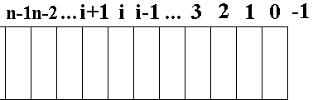
Enqueue Operation Animated
Empty Queue
a enqueued
b enqueued
c enqueued
d enqueued
…
k enqueued
l enqueued

Slide 12
Dequeue Operation
int dequeue(queueType *qp,dataType *item)
{
if isEmpty(*qp) return 0; //unsuccessful removal
*item = (*qp).content[0]; // always: front = 0
for (i=1; i <= (*qp).rear; i++)
(*qp).content[i-1]= (*qp).content[i];
(*qp).rear--;
return 1; //successful removal
} O(?)
An O(n) operation

Slide 13


O(n) Dequeue Operation Animated
a dequeued
b dequeued
c dequeued
d dequeued
…
k dequeued
l dequeued
Empty Queue

Slide 14
Improved Dequeue Operation
int dequeue(queueType *qp,dataType *item)
{
if isEmpty(*qp) return 0; //unsuccessful removal
*item = (*qp).content[(*qp).front++];
return 1; //successful removal
}
An O(1) operation

Slide 15

O(1) Dequeue Operation Animated
a dequeued
b dequeued
c dequeued
d dequeued
…
k dequeued
l dequeued
Empty Queue

Slide 16
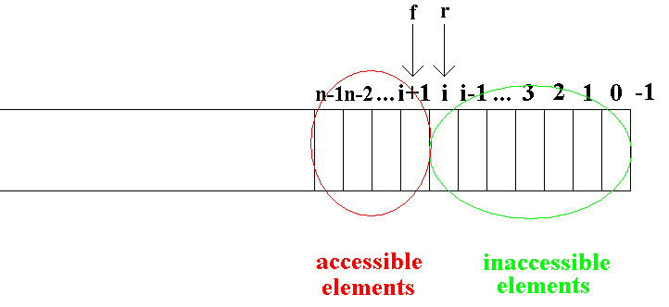
Problem of O(1) Dequeue
As front proceeds towards the larger indexed elements in the queue, we get supposedly available but inaccessible array cells in the queue (i.e., all elements with indices less than that pointed to by front).
Whenever rear points to (n-1)^{st} element, a shift operation still needs to be carried out.
Solution: attaching the end of the queue to the start!!! Such queues we call circular queues.

Slide 17
Circular Queues
Since with the existing conditions an empty and full circular queue is indistinguishable, we redefine the conditions for empty and full queue following a new convention:
Convention: front points to the preceding cell of the cell with the data to be removed next.
Empty circular queue condition: front=rear
Full queue condition: front=(rear+1) mod n

Slide 18
Circular Queues (CQs)
//Initialize Queue (i.e., set value of front and rear to n-1)
queue.rear=n-1; queue.front=n-1; // i.e., -1 mod n
int isEmptyCQ(queueType cq)
{
return (cq.rear == cq.front);
}
int isFullCQ(queueType cq, int n)
{
return (cq.rear == (cq.front-1 % n));
}

Slide 19
Enqueue Operation in CQs
int enqueueCQ(queueType *cqp,dataType item)
{
if isFullCQ(*cqp,n) return 0;//unsuccessful insertion
(*cqp).content[++(*cqp).rear % n]=item;
return 1; //successful insertion
}
An O(1) operation

Slide 20
Dequeue Operation in CQs
int dequeueCQ(queueType *cqp,dataType *item)
{
if isEmptyCQ(*cqp) return 0;//unsuccessful removal
*item = (*cqp).content[++(*cqp).front % n];
return 1; //successful removal
}
An O(1) operation

Slide 21


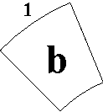

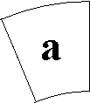
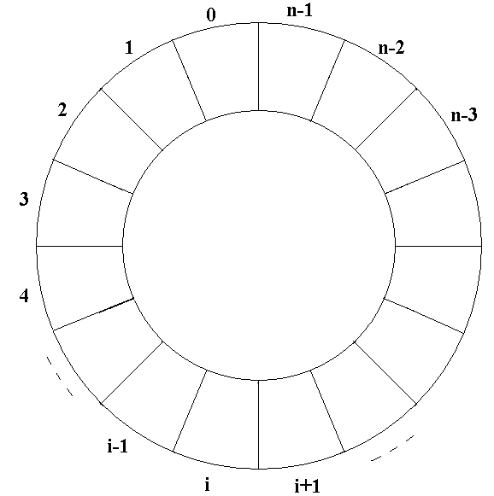
Circular Queues
int enqueueCQ(queueType *cqp,dataType item)
{
if isFullCQ(*cqp) return 0;//unsuccessful insertion
(*cqp).content[++(*cqp).rear%n]=item;
return 1; //successful insertion
}
int dequeueCQ(queueType *cqp,dataType *item)
{
if isEmptyCQ(*cqp) return 0;//unsuccessful removal
*item = (*cqp).content[++(*cqp).front%n];
return 1; //successful removal
}

Slide 22
Linked List Implementation of Queues
//Declaration of a queue node
Struct QueueNode {
int data;
struct QueueNode *next;
}
typedef struct QueueNode QueueNode;
typedef QueueNode * QueueNodePtr;
…

Slide 23
Linked List Implementation of Queues
QueueNodePtr NodePtr, rear, front;
…
…
NodePtr = malloc(sizeof(QueueNode));
rear = NodePtr;
NodePtr->data=2; // or rear->data=2
NodePtr->next=NULL; // or rear->next=NULL;
Enqueue(&rear,&NodePtr);
…
Dequeue( );
…

Slide 24
Enqueue and Dequeue Functions
Void Enqueue (QueueNodePtr *RearPtr, QueueNodePtr *NewNodePtr) {
*NewNodePtr = malloc(sizeof(QueueNode));
(*NewNodePtr)->data=5;
(*NewNodePtr)->next =NULL;
(*RearPtr)->next=*NewNodePtr;
*RearPtr = (*RearPtr)->next;
}
Void Dequeue(QueueNodePtr *FrontPtr) {
QueueNodePtr TempPtr;
TempPtr= *FrontPtr;
*FrontPtr = (*FrontPtr)->next;
free(TempPtr); // or you may return TempPtr!!!
}

Slide 25






Linked List Implementation of Queues
Void Dequeue(QueueNodePtr *FrontPtr) {
QueueNodePtr TempPtr;
TempPtr= *FrontPtr;
*FrontPtr = (*FrontPtr)->next;
free(TempPtr); // or return TempPtr!!!
}
Void Enqueue (QueueNodePtr *RearPtr,
QueueNodePtr *NewNodePtr) {
*NewNodePtr = malloc(sizeof(QueueNode));
(*NewNodePtr)->data=5;
(*NewNodePtr)->next =NULL;
(*RearPtr)->next=*NewNodePtr;
*RearPtr = (*RearPtr)->next;
}

Slide 26
Queue Applications
All systems where a queue (a FIFO structure) is applicable can make use of queues.
Possible examples from daily life are:
Bank desks
Market cashiers
Pumps in gas stations
Examples from computer science are:
Printer queues
Queue of computer processes that wait for using the microprocessor

Slide 27
Priority Queues
While a regular queue functions based on the arrival time as the only criterion as a FIFO structure, this sometimes degrades the overall performance of the system.
Consider a printer queue in a multi-processing system where one user has submitted, say, a 200-page-long print job seconds before many users have submitted print jobs of only several pages long.
A regular queue would start with the long print job and all others would have to wait. This would cause the average waiting time (AWT) of the queue to increase. AWT is an important measure used to evaluate the performance of the computer system, and the shorter the AWT, the better the performance of the system.

Slide 28
Priority Queues
What may be done to improve the performance of the printer queue?
Solution: Assign priority values to arriving jobs
Then, jobs of the same priority will be ordered by their arrival time.

Slide 29
Priority Queues
Assume a printer queue of jobs with three priorities, a, b, and c, where jobs with a (c) have the highest (lowest) priority, respectively.
That is, jobs with priority a are to be processed first by their arrival times, and jobs of priority c last.

Slide 30
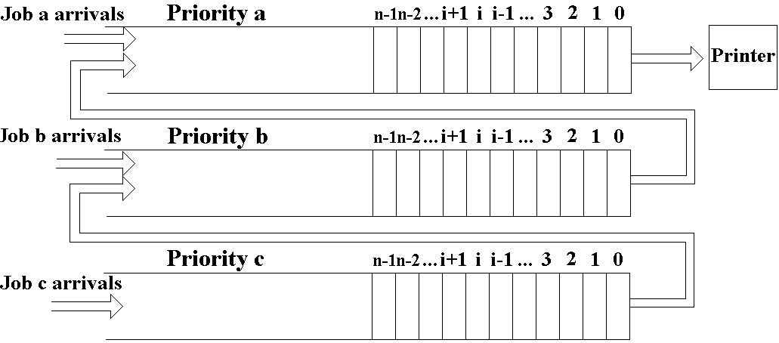
Priority Queues

