Slide 1
Data Structures – Week #6
Special Trees

Slide 2
Outline
Adelson-Velskii-Landis (AVL) Trees
Splay Trees
B-Trees

Slide 3
AVL Trees

Slide 4
Motivation for AVL Trees
Accessing a node in a BST takes O(log₂n) in average.
A BST can be structured so as to have an average access time of O(n). Can you think of one such BST?
Q: Is there a way to guarantee a worst-case access time of O(log₂n) per node or can we find a way to guarantee a BST depth of O(log₂n)?
A: AVL Trees

Slide 5
Definition
An AVL tree is a BST with the following
balance condition:
for each node in the BST, the height of left
and right sub-trees can differ by at most 1, or

Slide 6
Remarks on Balance Condition
Balance condition must be easy to maintain:
This is the reason, for example, for the balance condition’s not being as follows: the height of left and right sub-trees of each node have the same height.
It ensures the depth of the BST is O(log₂n).
The height information is stored as an additional field in BTNodeType.

Slide 7
Structure of an AVL Tree
struct BTNodeType {
infoType *data;
unsigned int height;
struct BTNodeType *left;
struct BTNodeType *right;
}

Slide 8
Rotations
Definition:
Rotation is the operation performed on a BST to restore its AVL property lost as a result of an insert operation.
We consider the node α whose new balance violates the AVL condition.

Slide 9
Rotation
Violation of AVL condition
The AVL condition violation may occur in four cases:
Insertion into left subtree of the left child (L/L)
Insertion into right subtree of the left child (R/L)
Insertion into left subtree of the right child (L/R)
Insertion into right subtree of the right child (R/R)
The outside cases 1 and 4 (i.e., L/L and R/R) are fixed by a single rotation.
The other cases (i.e., R/L and L/R) need two rotations called double rotation to get fixed.
These are fundamental operations in balanced-tree algorithms.

Slide 10
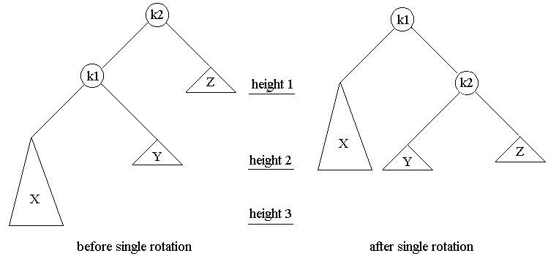
Single Rotation (L/L)
α ≡ k2 node

Slide 11
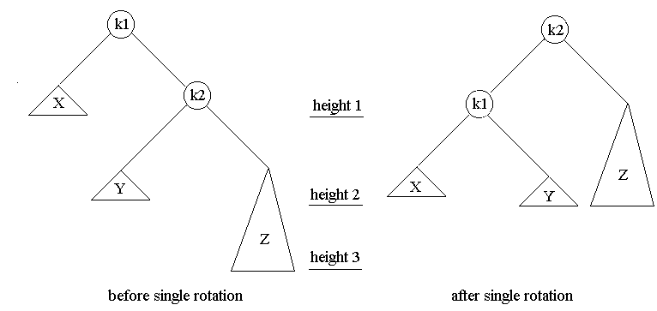
Single Rotation (R/R)
α ≡ k1 node

Slide 12
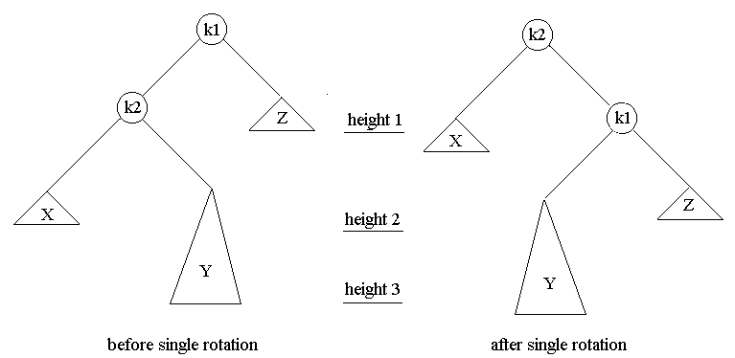
Double Rotation (R/L)
α ≡ k1 node
Single rotation cannot fix the AVL condition violation!!!

Slide 13
Double Rotation (R/L)
α ≡ k1 node
k1
k3
k2
Z
k2
Height 1
k1
X
k3
X
B
Height 2
C
Z
B
C
Height 3
The symmetric case (L/R) is handled similarly left as an exercise to you!

Slide 14
Constructing an AVL Tree – Animation
48
48

Slide 15
Constructing an AVL Tree – Animation
48
16
48
16

Slide 16
Constructing an AVL Tree – Animation
48
16
24
48
16
24

Slide 17
Constructing an AVL Tree – Animation
48
16
24
48
1 -1
16
R/L
Dbl. Rot.
24

Slide 18
Constructing an AVL Tree – Animation
48
16
24
20
24
16
48
20

Slide 19
Constructing an AVL Tree – Animation
48
16
24
20
8
24
16
48
8
20

Slide 20
Constructing an AVL Tree – Animation
48
16
24
20
8
12
24
16
48
8
20
12

Slide 21
Constructing an AVL Tree – Animation
48
16
24
20
8
12
24
L/L
Sngl. Rot.
2 0
16
48
1 0
OK
8
20
-1 0
OK
12

Slide 22
Constructing an AVL Tree – Animation
48
16
24
20
8
12
32
16
8
24
12
20
48
32

Slide 23
Constructing an AVL Tree – Animation
48
16
24
20
8
12
32
54
16
8
24
12
20
48
32
54

Slide 24
Constructing an AVL Tree – Animation
48
16
24
20
8
12
32
54
72
16
8
24
12
20
48
32
54
72

Slide 25
Constructing an AVL Tree – Animation
48
16
24
20
8
12
32
54
72
16
8
24
0 2
R/R
Sngl. Rot.
12
20
48
0 1
OK
32
54
-1 0
OK
72

Slide 26
Constructing an AVL Tree – Animation
48
16
24
20
8
12
32
54
72
18
16
8
48
12
24
54
20
32
72
18

Slide 27
Constructing an AVL Tree – Animation
48
16
24
20
8
12
32
54
72
18
16
1 3
8
48
L/R
Dbl.Rot.
2 1
OK
12
24
54
1 0
OK
20
32
72
0 -1
OK
18

Slide 28
Constructing an AVL Tree – Animation
48
16
24
20
8
12
32
54
72
18
96
24
16
48
8
20
32
54
12
18
72
96

Slide 29
Constructing an AVL Tree – Animation
48
16
24
20
8
12
32
54
72
18
96
24
16
48
8
20
32
54
-1 1
12
18
72
R/R
Sngl. Rot.
-1 0
OK
96

Slide 30
Constructing an AVL Tree – Animation
48
16
24
20
8
12
32
54
72
18
96
64
17
60
98
68
84
36
30
24
16
48
8
20
32
72
12
18
54
96

Slide 31
Height versus Number of Nodes
The minimum number of nodes in an AVL tree recursively relates to the height of the tree as follows:
S(h) = S(h-1) + S(h-2) + 1;
Initial Values: S(0)=1; S(1)=2
Homework: Solve for S(h) as a function of h!

Slide 32
Splay Trees

Slide 33
Motivation for Splay Trees
We are looking for a data structure where, even though some worst case (O(n)) accesses may be possible, m consecutive tree operations starting from an empty tree (inserts, finds and/or removals) take O(m*log₂n).
Here, the main idea is to assume that, O(n) accesses are not bad as long as they occur relatively infrequently.
Hence, we are looking for modifications of a BST per tree operation that attempts to minimize O(n) accesses.

Slide 34
Splaying
The underlying idea of splaying is to move a deep node accessed upwards to the root, assuming that it will be accessed in the near future again.
While doing this, other deep nodes are also carried up to smaller depth levels, making the average depth of nodes closer to O(log₂n).

Slide 35
Splaying
Splaying is similar to bottom-up AVL rotations
If a node X is the child of the root R,
then we rotate only X and R, and this is the last
rotation performed.
else consider X, its parent P and grandparent G.
Two cases and their symmetries to consider
Zig-zag case, and
Zig-zig case.

Slide 36
Zig-zag case
G
X
P
D
P
Height h
G
A
X
A
B
Height h+1
C
D
B
C
Height h+2
This is the same operation as an AVL double rotation in an R/L violation.

Slide 37
Zig-zig case
LC(P): left child of node P
RC(P): right child of node P
G
Height h
X
P
D
A
Height h+1
P
as is
X
C
Height h+2
B
G
LC(G)
A
B
Height h+3
C
D
as is
LC(P)

Slide 38
Animated Example
10
2
11
1
4
3
9
5
Initial BST
8
7
6

Slide 39
Animated Example
10
2
11
1
4
Node with 6 accessed!
3
9
5
G stands for Grandparent
P stands for Parent
X denotes the current node
G
8
Zig-zig
case
P
7
X
6

Slide 40
Animated Example
10
2
11
1
4
Node with 6 accessed!
3
G
9
P
5
Zig-zag
case
X
6
7
8

Slide 41
Animated Example
10
2
G
Zig-zig
case
11
1
4
P
9
Node with 6 accessed!
5
3
X
7
6
1
3
8
5
9
7
8

Slide 42
Animated Example
R
10
X
6
4
11
4
2
9
5
9
1
5
2
3
7
7
1
3
8
8
Node with 6 accessed!

Slide 43
Animated Example
6
4
10
2
5
9
11
1
3
7
8
Node with 6 accessed!

Slide 44
B-Trees

Slide 45
Motivation for B-Trees
Two technologies for providing memory capacity in a computer system
Primary (main) memory (silicon chips)
Secondary storage (magnetic disks)
Primary memory
5 orders of magnitude (i.e., about 10⁵ times) faster,
2 orders of magnitude (about 100 times) more expensive, and
by at least 2 orders of magnitude less in size
than secondary storage due to mechanical operations involved in magnetic disks.

Slide 46
Motivation for B-Trees
During one disk read or disk write ((4-8.5msec for 7200 RPM sequential disks (not SSDs!)), MM can be accessed about 10⁵ times (100 nanosec per access).
To reimburse (compensate) for this time, at each disks access, not a single item, but one or more equal-sized pages of items (each page 2¹¹-2¹⁴ bytes) are accessed.
We need some data structure to store these equal sized pages in MM.
B-Trees, with their equal-sized leaves (as big as a page), are suitable data structures for storing and performing regular operations on paged data.

Slide 47
B-Trees
A B-tree is a rooted tree with the following properties:
Every node x has the following fields:
n[x], the number of keys currently stored in x.
the n[x] keys themselves, in non-decreasing order, so that
key₁[x] ≤ key₂[x] ≤ ... ≤ key_{n[x]}[x] ,
leaf[x], a boolean value, true if x is a leaf.

Slide 48
B-Trees
Each internal (non-leaf) node has n[x]+1 pointers, c₁[x],..., c_{n[x]+1}[x], to its children. Leaf nodes have no children, hence no pointers!
The keys separate the ranges of keys stored in each subtree: if k_{i} is any key stored in the subtree with root c_{i}[x], then
k₁ ≤ key₁[x] ≤ k₂ ≤ key₂[x] ≤ ... ≤ key_{n[x]}[x] ≤ k_{n[x]+1} .
All leaves have the same depth, h, equal to the tree’s height.

Slide 49
B-Trees
There are lower and upper bounds on the number of keys a node may contain. These bounds can be expressed in terms of a fixed integer t ≥ 2 called the minimum degree of the B-Tree.
Lower limits
All nodes but the root has at least t-1 keys.
Every internal node but the root has at least t children.
A non-empty tree’s root must have at least one key.

Slide 50
B-Trees
Upper limits
Every node can contain at most 2t-1 keys.
Every internal node can have at most 2t children.
A node is defined to be full if it has exactly 2t-1 keys.
For a B-tree of minimum degree t ≥ 2 and n nodes

Slide 51
Basic Operations on B-Trees
B-tree search
B-tree insert
B-tree removal

Slide 52
Disk Operations in B-Tree operations
Suppose x is a pointer to an object.
It is accessible if it is in the main memory.
If it is on the disk, it needs to be transferred to the main memory to be accessible. This is done by DISK_READ(x).
To save any changes made to any field(s) of the object pointed to by x, a DISK_WRITE(x) operation is performed.

Slide 53
Search in B-Trees
Similar to search in BSTs with the exception that instead of a binary, a multi-way (n[x]+1-way) decision is made.
21
53
77
7
13
17
34
43
49
58
65
71
82
88
93
key_{i}(x)
c_{i}(x)

Slide 54
Search in B-Trees
B-tree-Search(x,k)
{ i=1;
while (i ≤ n[x] and k > key_{i}[x]) i++;
if (i ≤ n[x] and k = key_{i}[x]) // if key found
return (x,i);
if (leaf[x]) // if key not found at a leaf
return NULL;
else {DISK_READ(c_{i}[x]); // if key < key_{i}[x]
return B-tree-Search(c_{i}[x],k);}
}

Slide 55
Insertion in B-Trees
Insertion into a B-tree is more complicated than that into a BST, since the creation of a new node to place the new key may violate the B-tree property of the tree.
Instead, the key is put into a leaf node x if it is not full.
If full, a split is performed, which splits a full node (with 2t-1 keys) at its median key, key_{t}[x], into two nodes with t-1 keys each.
key_{t}[x] moves up into the parent of x and identifies the split point of the two new trees.

Slide 56
Insertion in B-Trees
A single-pass insertion starts at the root traversing down to the leaf into which the key is to be inserted.
On the path down, all full nodes are split including a full leaf that also guarantees a parent with an available position for the median key of a full node to be placed.

Slide 57
Insertion in B-Trees: Example
69 inserted...
21
53
77
7
13
17
34
43
49
58
65
71
82
88
93
94
97
99
1
4
6
9
11
12
14
15
16
18
19
20
27
29
32
40
41
42
45
47
48
50
51
52
54
55
57
60
61
63
67
68
70
73
74
76
78
79
81
84
85
86
89
90
92

Slide 58
Insertion in B-Trees: Example
69 inserted...
53
21
77
7
13
17
34
43
49
58
65
71
82
88
93
94
97
99
1
4
6
9
11
12
14
15
16
18
19
20
27
29
32
40
41
42
45
47
48
50
51
52
54
55
57
60
61
63
67
68
70
73
74
76
78
79
81
84
85
86
89
90
92

Slide 59
Insertion in B-Trees: Example
69 inserted...
53
21
65
77
7
13
17
34
43
49
58
71
82
88
93
94
97
99
1
4
6
9
11
12
14
15
16
18
19
20
27
29
32
40
41
42
45
47
48
50
51
52
54
55
57
60
61
63
67
68
70
73
74
76
78
79
81
84
85
86
89
90
92

Slide 60
Insertion in B-Trees: Example
69 inserted...
53
21
65
77
7
13
17
34
43
49
58
68
71
82
88
93
94
97
99
1
4
6
9
11
12
14
15
16
18
19
20
27
29
32
40
41
42
45
47
48
50
51
52
54
55
57
60
61
63
73
74
76
78
79
81
84
85
86
89
90
92
67
69
70

Slide 61
Insertion in B-Trees:B-tree-Insert
B-tree-Insert(T,k)
{ r=root[T];
if (n[r] == 2t-1) {
s=malloc(new-B-tree-node);
root[T]=s;
leaf[s]=false;
n[s]=0;
c₁[s]=r;
B-tree-Split-Child(s,1,r);
B-tree-Insert-Nonfull(s,k); }
else B-tree-Insert-Nonfull(r,k);
}

Slide 62
Insertion in B-Trees:B-tree-Split-Child
B-tree-Split-Child(x,i,y)
{ z=malloc(new-B-tree-node);
leaf[z]=leaf[y];
n[z]=t-1;
for (j = 1; j < t; j++) key_{j}[z]=key_{j+t}[y]; A //y’s 2nd half of keys to z
if (!leaf[y])
for (j = 1; j <= t;j++) c_{j}[z]=c_{j+t}[y]; B //y’s 2nd half of pointers to z
n[y]=t-1;
for (j=n[x]+1; j>=i+1; j--) c_{j+1}[x]=c_{j}[x]; C //shift pointers right
c_{i+1}[x]=z; D //z pointed by i+1st pntr of x
for (j=n[x]; j>=i; j--) key_{j+1}[x]=key_{j}[x]; E //shift keys in x right
key_{i}[x]=key_{t}[y]; n[x]++; F //median key moved to parent
DISK_WRITE(y);
DISK_WRITE(z);
DISK_WRITE(x);
}

Slide 63
B-tree-Split-Child: Example
x
t=3
21
53
77
...
y
A
z
...
55
58
65
71
76
...
B
71
76

Slide 64
B-tree-Split-Child: Example
x
C
t=3
21
53
65
77
y
E
z
F
D
...
...
55
58
71
76
...

Slide 65
B-tree-Split-Child: Example
x
t=3
21
53
65
77
y
z
...
...
55
58
71
76
...

Slide 66
Insertion in B-Trees:B-tree-Insert-Nonfull
B-tree-Insert-Nonfull(x,k)
{ i=n[x];
if (leaf[x]) {
while (i≥1 and k < key_{i}[x]) {key_{i+1}[x]=key_{i}[x]; i--;}
key_{i+1}[x]=k;
n[x]++;
DISK_WRITE(x);
}
else {
while (i≥1 and k < key_{i}[x]) i--;
i++;
DISK_READ(c_{i}[x]);
if (n[c_{i}[x]]==2t-1) {
B-tree-Split-Child(x,i, c_{i}[x]);
if (k > key_{i}[x]) i++;
}
B-tree-Insert-Nonfull(c_{i}[x],k);
}
}
if x is a leaf
then place key in x;
write x on disk;
else find the node (root of
subtree) key goes to;
read node from disk;
if node full
split node at key’s
position;
recursive call with
node split and key;

Slide 67
Removing a key from a B-Tree
Removal in B-trees is different than insertion only in that a key may be removed from any node, not just from a leaf.
As the insertion algorithm splits any full node down the path to the leaf to which the key is to be inserted, a recursive removal algorithm may be written to ensure that for any call to removal on a node x, the number of keys in x is at least the minimum degree t.

Slide 68
Various Cases of Removing a key from a B-Tree
If the key k is in node x and x is a leaf, remove the key k from x.
If the key k is in node x and x is an internal node, then
If the child y that precedes k in node x has at least t keys, then find the predecessor k’ of k in the subtree rooted at y. Recursively delete k’, and replace k by k’ in x. Finding k’ and deleting it can be performed in a single downward pass.

Slide 69
Various Cases of Removal a key from a B-Tree
Symmetrically, if the child z that follows k in node x has at least t keys, then find the successor k’ of k in the subtree rooted at z. Recursively delete k’, and replace k by k’ in x. Finding k’ and deleting it can be performed in a single downward pass.
Otherwise, if both y and z have only t-1 keys, merge k and all of z into y so that x loses both k and the pointer to z and y now contains 2t-1 keys. Free z and recursively delete k from y.

Slide 70
Various Cases of Removal a key from a B-Tree
If k is not present in internal node x, determine root c_{i}[x] of the subtree that must contain k, if k exists in the tree. If c_{i}[x] has only t-1 keys, execute step 3a or 3b as necessary to guarantee that we descend to a node containing at least t keys. Then finish by recursing on the appropriate child of x.

Slide 71
Various Cases of Removal a key from a B-Tree
If c_{i}[x] has only t-1 keys but has an immediate sibling with at least t keys, give c_{i}[x] an extra key by moving a key from x down into c_{i}[x], moving a key from c_{i}[x]’s immediate left or right sibling up into x, and moving the appropriate child pointer from the sibling into c_{i}[x].
If c_{i}[x] and both of c_{i}[x]’s immediate siblings have t-1 keys, merge c_{i}[x] with one sibling, which involves moving a key from x down into the new merged node to become the median key for that node.

Slide 72
Removal in B-Trees: Example
initial tree...
53
74 to delete...
21
65
77
7
13
17
34
43
49
58
68
71
82
88
93
94
97
99
1
4
6
9
11
12
14
15
16
18
19
20
27
29
32
40
41
42
45
47
48
50
51
52
54
55
57
60
61
63
73
74
76
78
79
81
84
85
86
89
90
92
67
69
70

Slide 73
Removal in B-Trees: Example
74 removed...
21 to delete...
53
21
65
77
7
13
17
34
43
49
58
68
71
82
88
93
Case 1
Pred. Of 21
94
97
99
1
4
6
9
11
12
14
15
16
18
19
20
27
29
32
40
41
42
45
47
48
50
51
52
54
55
57
60
61
63
67
69
70
73
76
78
79
81
84
85
86
89
90
92

Slide 74
Removal in B-Trees: Example
21 removed...
65 to remove...
53
20
65
77
Case 2a
7
13
17
34
43
49
58
68
71
82
88
93
Succ. of 65
94
97
99
1
4
6
9
11
12
14
15
16
18
19
27
29
32
40
41
42
45
47
48
50
51
52
54
55
57
60
61
63
67
69
70
73
76
78
79
81
84
85
86
89
90
92

Slide 75
Removal in B-Trees: Example
65 removed...
69 to remove...
53
Case 2b recursively
followed by case 3a
20
67
77
7
13
17
34
43
49
58
69
71
82
88
93
Merge 69 & 70 into
node of 68 and
recursively delete 69!
94
97
99
1
4
6
9
11
12
14
15
16
18
19
27
29
32
40
41
42
45
47
48
50
51
52
54
55
57
60
61
63
68
70
73
76
78
79
81
84
85
86
89
90
92

Slide 76
Removal in B-Trees: Example
69 removed...
53
Case 2c recursively
followed by case 1
20
67
77
7
13
17
34
43
49
58
71
82
88
93
94
97
99
1
4
6
9
11
12
14
15
16
18
19
27
29
32
40
41
42
45
47
48
50
51
52
54
55
57
60
61
63
68
70
73
76
78
79
81
84
85
86
89
90
92

Slide 77
Red-Black Trees (RBTs)
A Red-Black tree (RBT) is a BST with an additional bit “color” information in each node.
Coloring of nodes is based upon some rules defined in the next slide.
By putting limits to the coloring of nodes on a path from root to a leaf, RBTs control the length of any such paths and provide an approximate balance. This balance property of RBTs is their desired property.

Slide 78
Red-Black Properties
Every node is either red or black.
The root is black.
Every leaf (NIL) is black.
If a node is red, then both its children are black.
For each node,
all paths from the node to its descendant leaves contain the same number of black nodes.

Slide 79
Example RBT
32
16
48
8
24
36
60
4
12
20
28
34
44
2
6
10
22
42
46
1

Slide 80
Rotations
N1
A
N2
Left-Rotate(T,N1)
B
C
Right-Rotate(T,N2)
N2
N1
C
B
A

Slide 81
Example RBT Right-Rotate(T,16)
32
16
48
8
24
36
60
LS(16)
4
12
20
28
34
44
2
6
10
22
42
46
1
LS stands for « Left Subtree of »

Slide 82
Example Rotation Right-Rotate(T,16)
32
8
48
4
16
36
60
2
6
12
24
34
44
10
20
28
1
42
46
22

Slide 83
Insertion O(lgn)
RB-INSERT(T,z)
/*z inserted to T in O(logn)
y←nil[T]; x← root[T];
while x≠ nil[T] do
y ←x
if (key[z]<key[x])
x ←left[x]
else x ←right[x]
p[z]=y
if y=nil[T]
root[T]←z
else if (key[z]<key[y])
left[y] ←z
else right[y] ←z
left[z] ← nil[T]; right[z] ← nil[T];
color[z]← RED;
RB-INSERT-FIXUP(T,z)

Slide 84
Fixing Up Colors after Insertion
RB-INSERT-FIXUP(T,z)
while color[p[z]] == RED do
if (p[z] == left[p[p[z]]])
y=right[p[p[z]]];
if (color[y]==RED)
color[p[z]]=BLACK
color[y]=BLACK
color[p[p[z]]]=RED
z=p[p[z]]
else if (z==right[p[z]])
z=p[z]
LEFT-ROTATE(T,z)
color[p[z]]=BLACK
color[p[p[z]]]=RED
RIGHT-ROTATE(T,p[p[z]])
else //** if (p[z] ≠ left[p[p[z]]])
y=left[p[p[z]]];
if (color[y]==RED)
color[p[z]]=BLACK
color[y]=BLACK
color[p[p[z]]]=RED
z=p[p[z]]
else if (z==left[p[z]])
z=p[z]
RIGHT-ROTATE(T,z)
color[p[z]]=BLACK
color[p[p[z]]]=RED
LEFT-ROTATE(T,p[p[z]])
color[root[T]]=BLACK;
Case 1
Case 1
Case 2
Case 2
Case 3
Case 3

Slide 85
Preconditions and R-B Property Violations
We assume node z is inserted into R-B tree.
Preconditions for RB-Insert-Fixup
Node z is red.
If p[z] is the root then p[z]=BLACK.
Inserting z into the tree, only one of properties 2 and 4 is violated.
Properties 2 and 4
The root is black. (2)
If a node is red, then both its children are black. (4)

Slide 86
Three possible cases
Three cases distinguishable once z is inserted.
Case 1: z’s uncle y is red.
Case 2: z’s uncle y is black and z is a right child
Case 3: z’s uncle y is black and z is a left child

Slide 87
Example: Case 1
Case 1: z’s uncle y is red.
32
16
48
8
24
60
20
28
z
22

Slide 88
Example: Case 1 solved
32
16
48
8
z
24
60
Turned to red
20
28
22
Turned to black

Slide 89
Example: Case 2
Case 2: z’s uncle y is black and z is a right child
32
16
48
8
24
z
60
20
28
22

Slide 90
Example: Case 2 solved
32
z
24
48
16
28
60
8
20
22

Slide 91
Example: Case 3
Case 3: z’s uncle y is black and z is a left child
32
24
48
z
16
28
60
8
20
22

Slide 92
Example: Case 3 solved
24
z
16
32
8
20
28
48
60
22

