Slide 1
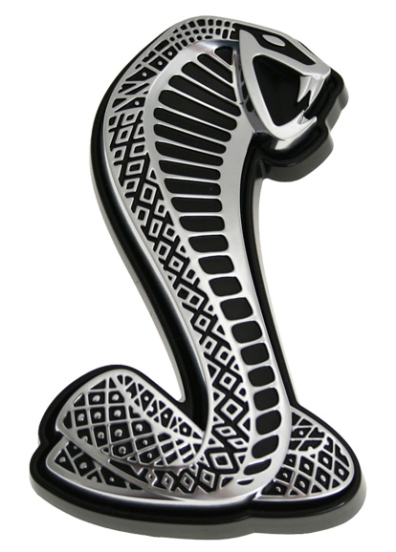
METU Electrical&Electronics Engineering EE463 – Term Project Deadly Viper Assassination Squad Inc.
Mustafa Yıldız
Ali Belli
Mehmet Kılıç

Slide 2
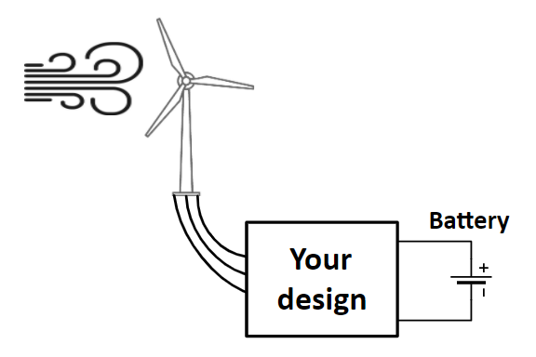
Problem Definition
Variable amplitude
Variable frequency
Regulated output

Slide 3
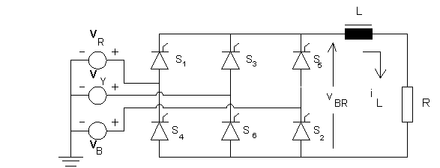
Topology Discussion
Thyristor Rectifier

Slide 4
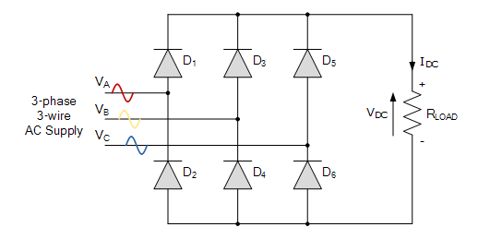
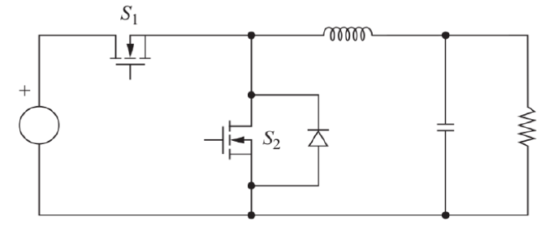
Topology Discussion
Full Wave Diode rectifier and Two Stage Buck Converter

Slide 5
Topology Discussion
Full Wave Diode rectifier and Buck Converter

Slide 6
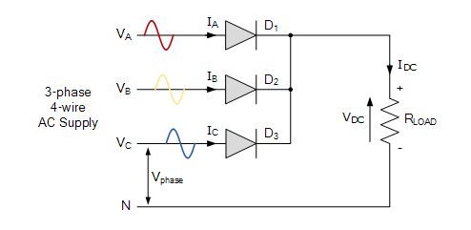
Topology Discussion
Half Wave Diode Rectifier and Full Wave Diode Rectifier

Slide 7
General View of the System

Slide 8
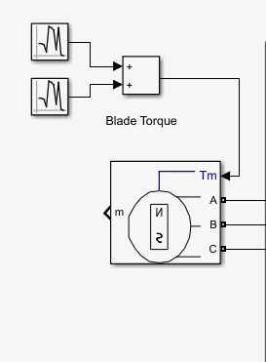
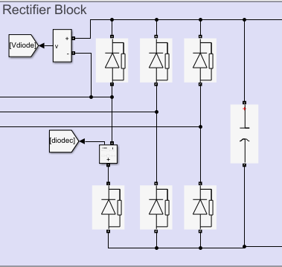
Input and Rectifier Stage

Slide 9
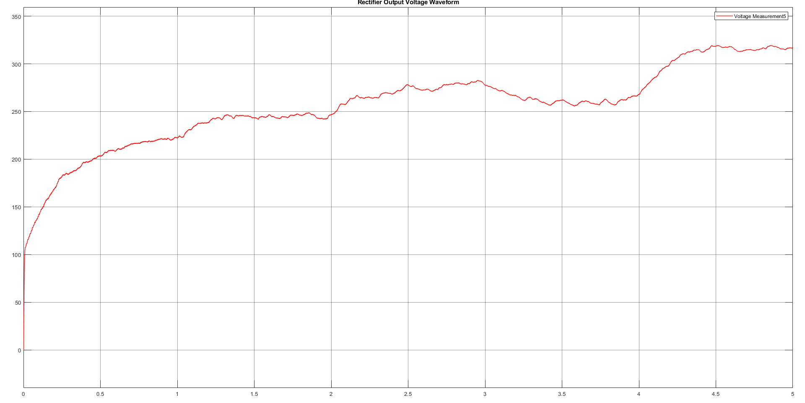
Input and Rectifier Stage

Slide 10
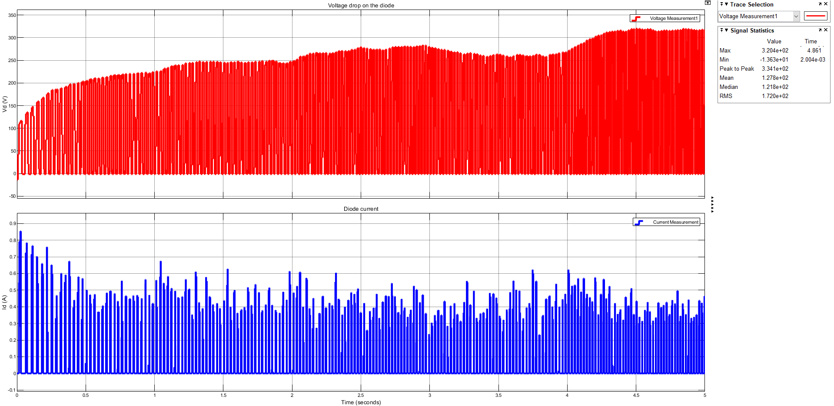
Rectifier Stage Output Waveforms

Slide 11
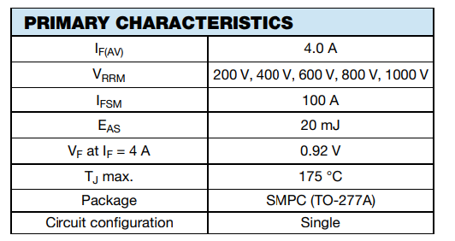
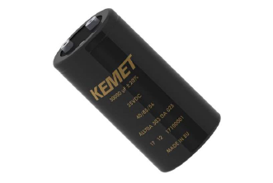
Rectifier Stage Component Selection
AS4PJ-M3/86A Diode ALS70A471DB500 Electrolytic Capacitor

Slide 12
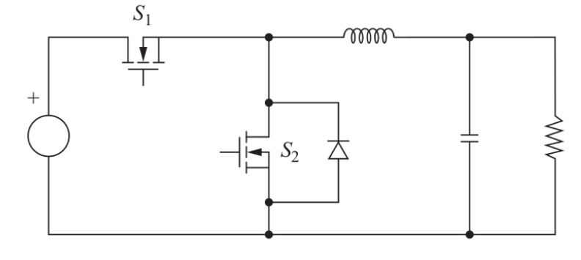
Buck Converter and Synchronous Buck Converter

Slide 13
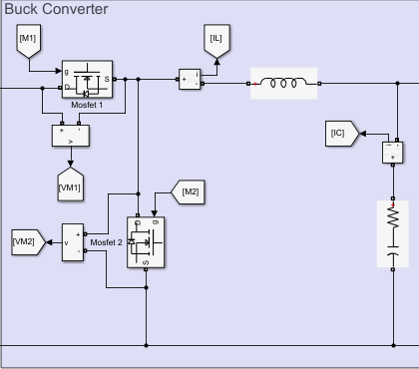
Synchronous Buck Converter Stage

Slide 14
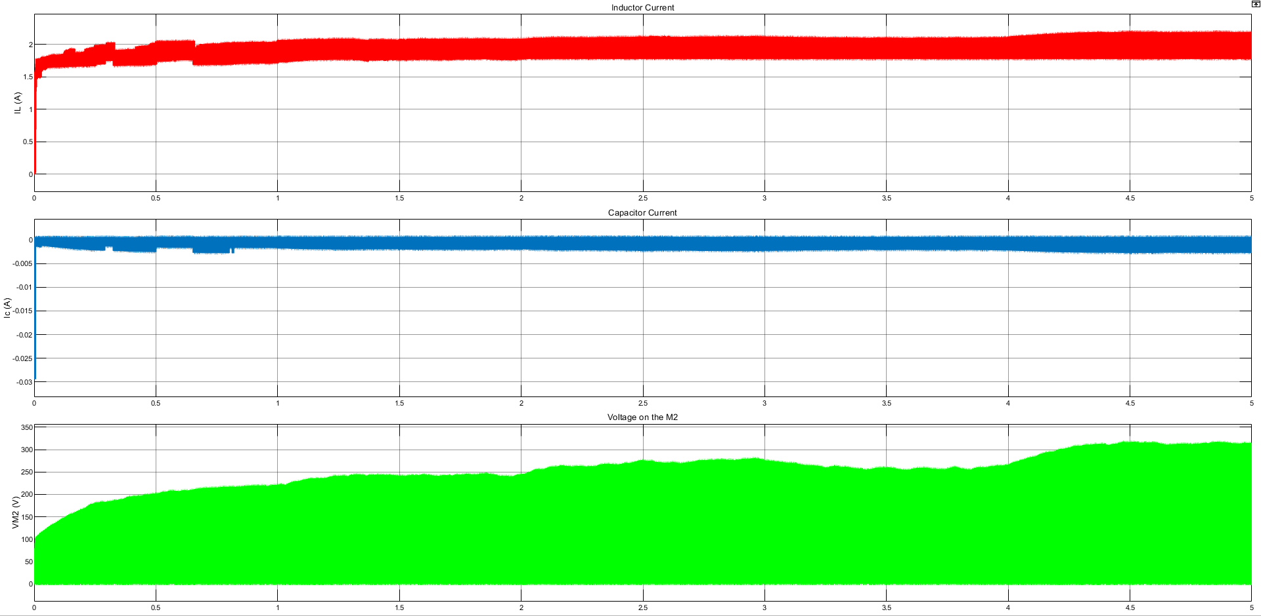
Buck Converter Simulation Results

Slide 15
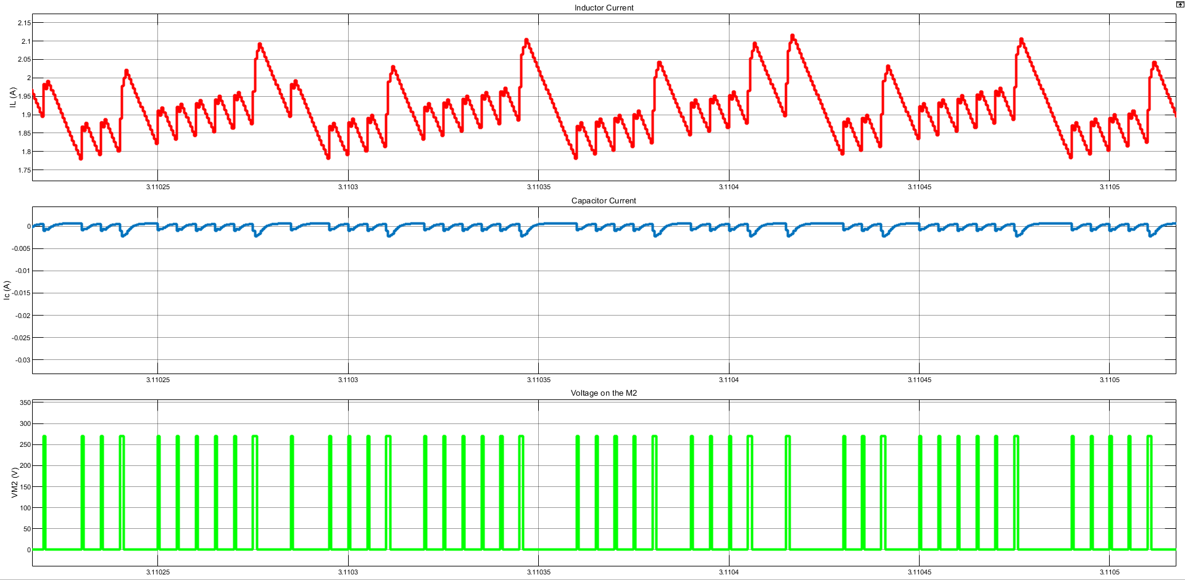
Buck Converter Simulation Results

Slide 16
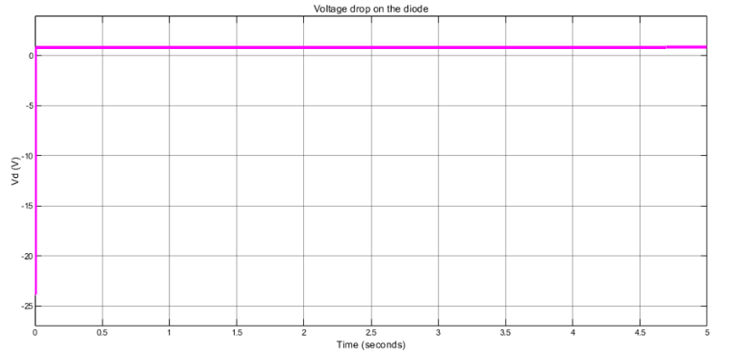
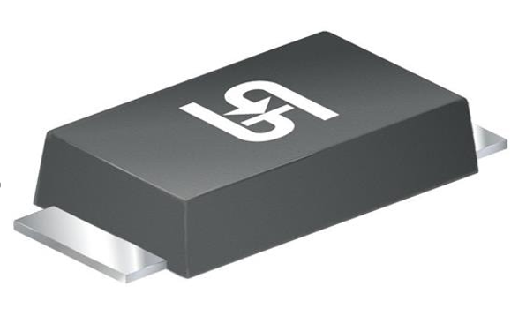
Buck Converter Simulation Results
TSSW3U45 45V/3A

Slide 17
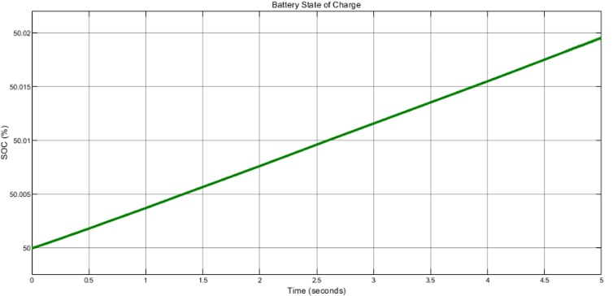
Buck Converter Simulation Results

Slide 18
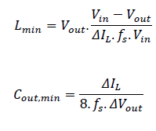


Buck Converter Component Selection

Slide 19
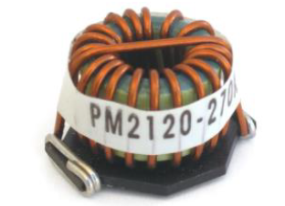
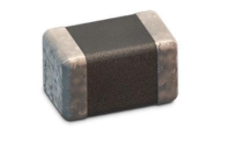
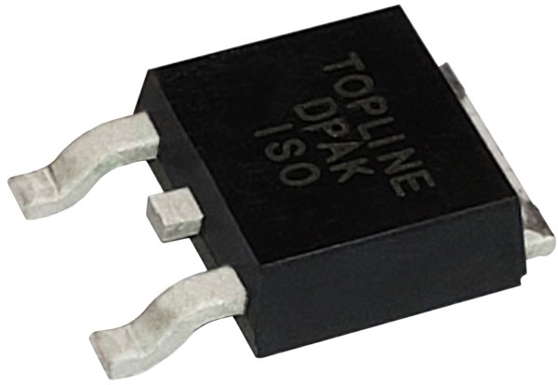
Buck Converter Component Selection
PM2120-102K-RC 1mH Inductance 885012207087 1500nF Capacitor FQD6N50C-D 500V/4.5A

Slide 20
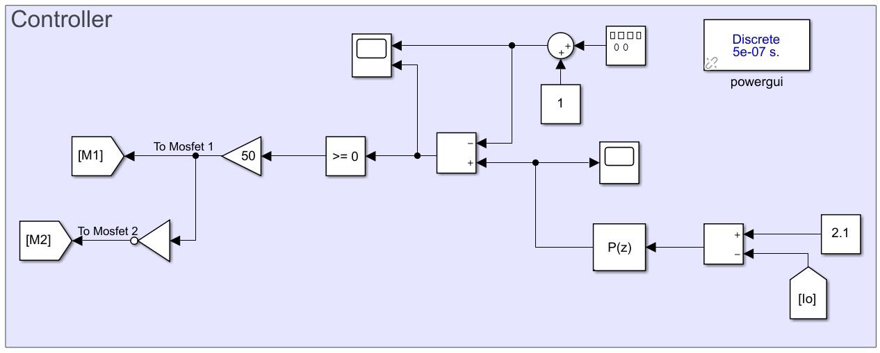
Controller Stage

Slide 21
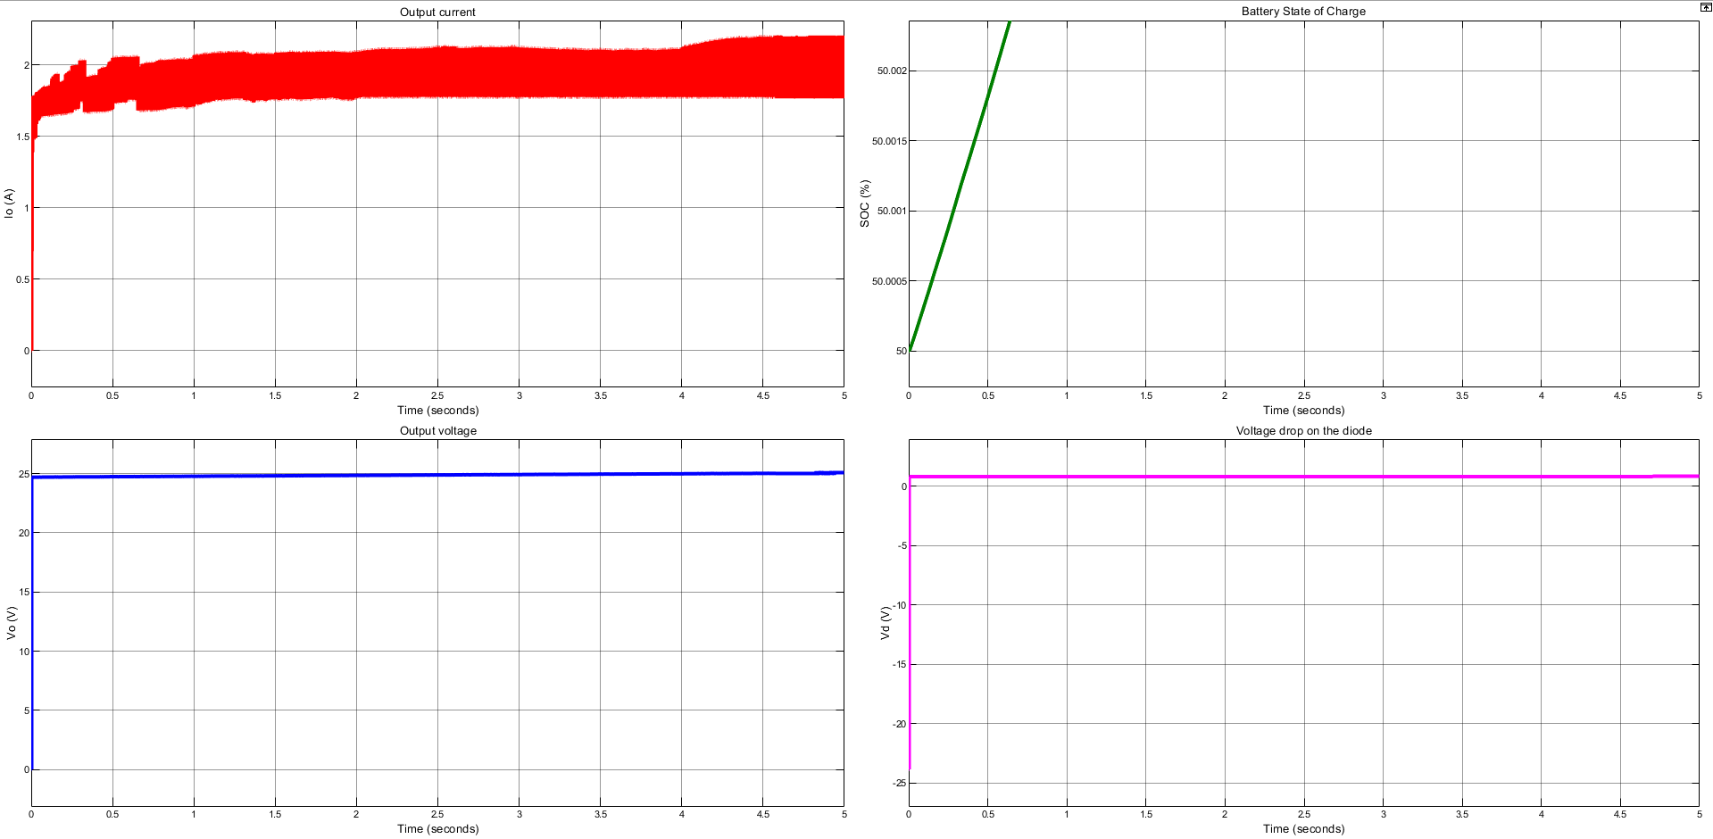
Controller Stage Waveforms

Slide 22
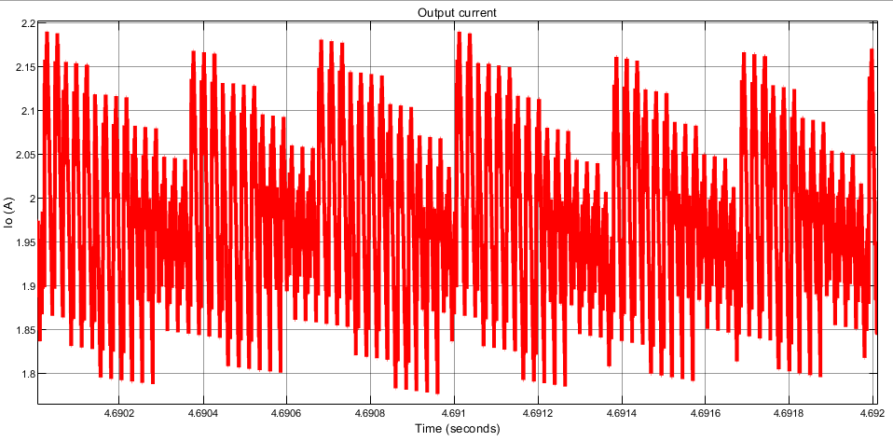
Controller Stage Output Current Waveform

Slide 23
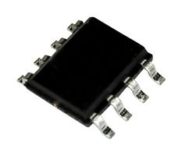
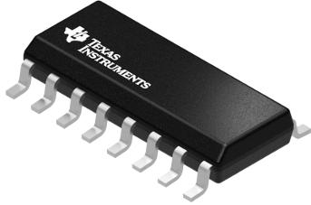
Controller Stage Component Selection
PWM Generator TL594IDR Dual Output Mosfet Driver NCP5181DR2G, up to 600V

Slide 24
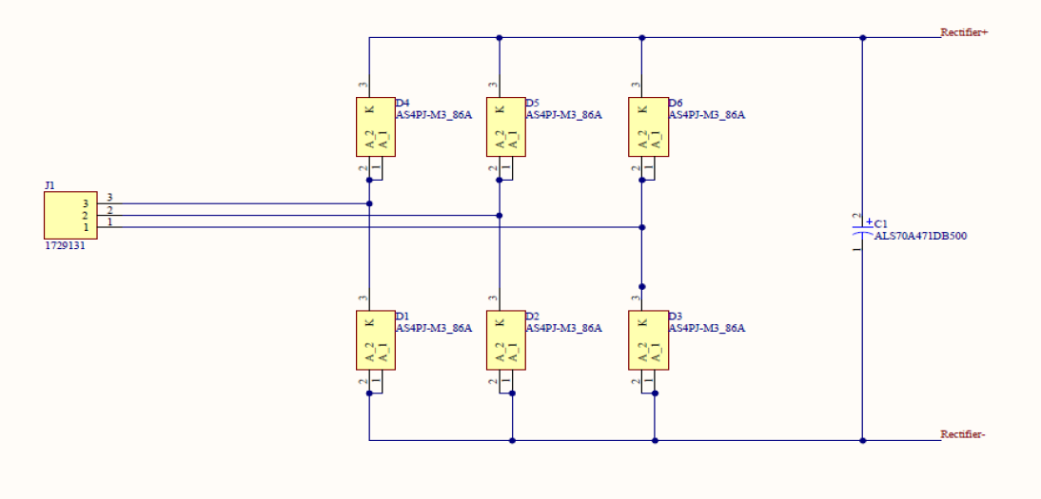
PCB Schematics
Rectifier Stage

Slide 25
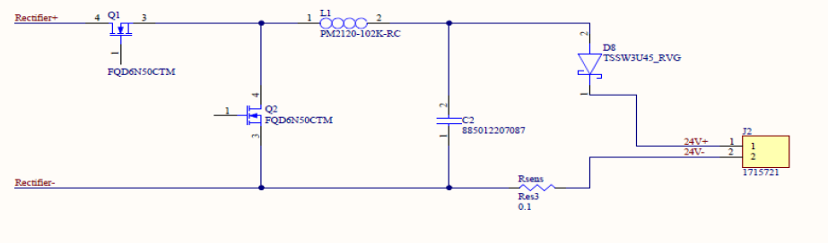
PCB Schematics
Converter Stage

Slide 26
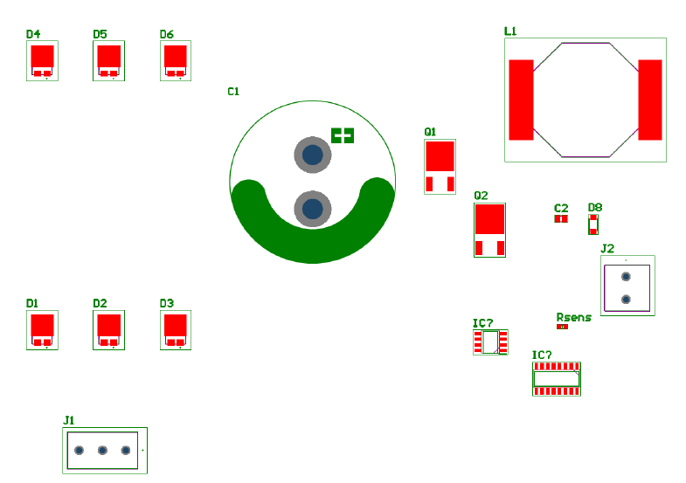
PCB Schematics
PCB Layout without Wirings and Mechanical Limits of PCB

Slide 27
Thanks for listening...

