Slide 1
Project Title
EE498 Term Project
Mehmet KILIÇ

Slide 2
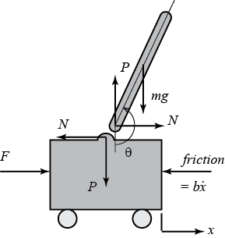
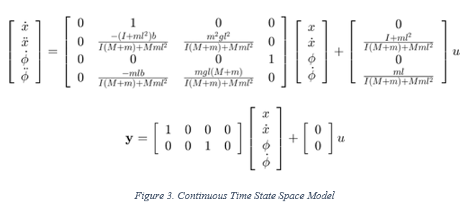

System Model
Mathematical Modeling
Linearization
Resulting System is:
Asymptotically Instable
Controllable
Observable
Some Suitable Methods:
Pole Placement
LQR
MPC
Obtained in MATLAB
DTSS Model

Slide 3
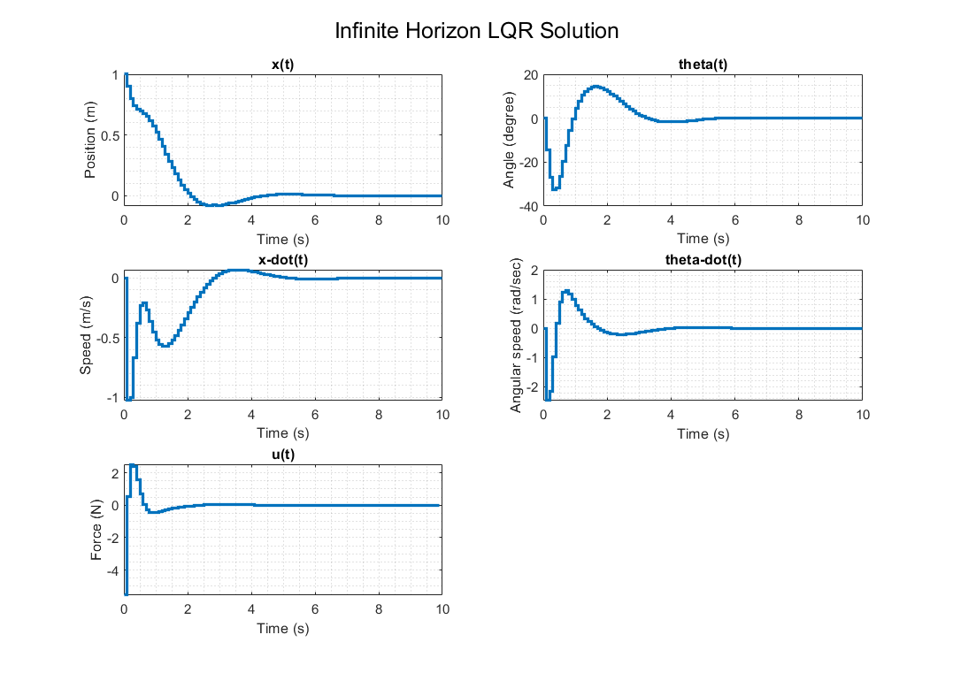
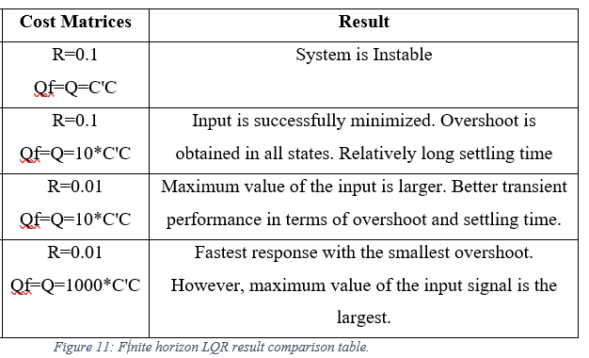
Analysis and Controller Design

Slide 4
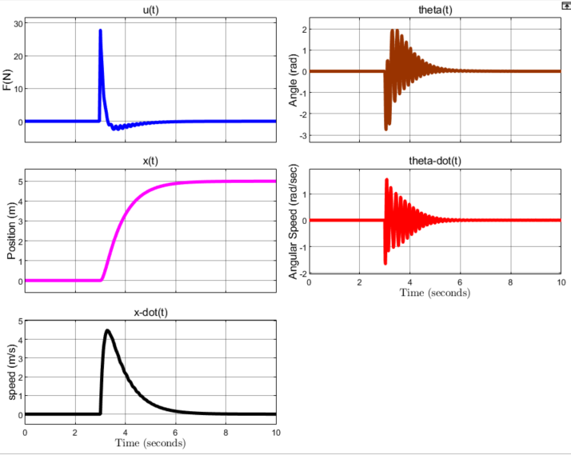
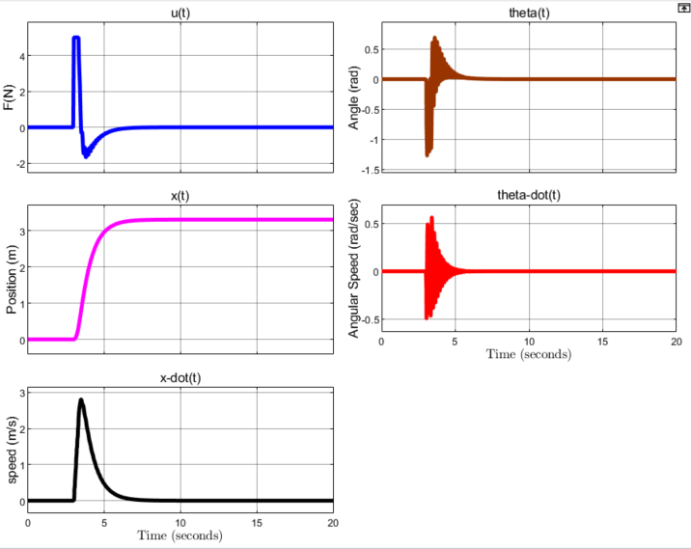
Simulation Results

Slide 5
Main Observations
Good performance without saturation
Input weight must be large
Large steps cause large inputs
Saturation might be problem

