Slide 1
Investigate the effects of lockdown periods on daily new cases specifically in Turkey.
Mehmet Köçer 16030411047

Slide 2
This project is a part of MIS376 data visualization course.
The subject of that particular project is to investigate if any relationship exists between lockdowns and new cases in Turkey.
The method to making an investigation is using data visualization tools and demonstrate the relationship.
We used various Pyhthon libraries in the project, some of them are Plotly,Matplotlib,Seaborn and Pandas.

Slide 3
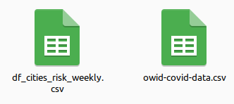
We have two datasets one is from ourworldindata.org and second one is collected by hand from web news(df_cities_risk_weekly.csv).

Slide 4
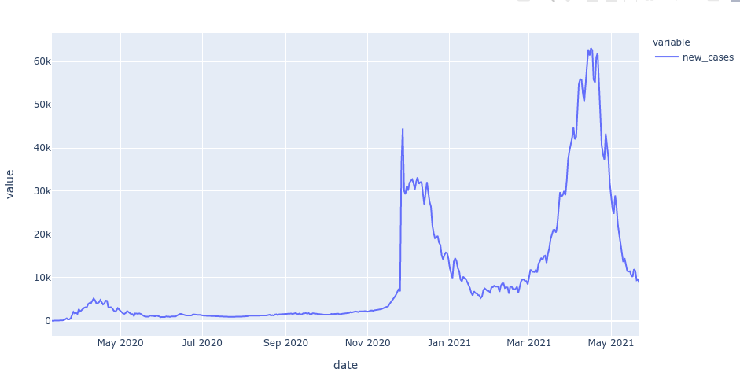
In the first visual we try to go get a sense of new cases from the beginning of the pandemic.

Slide 5
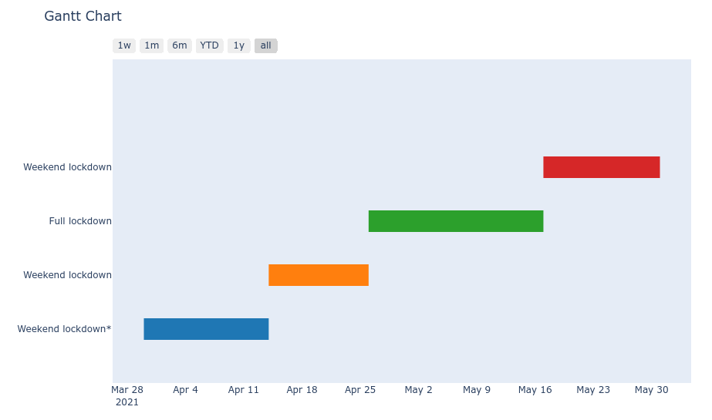
The second visual demonstrates when the lockdown occurs, between March 2021 to May 2021. This period is when we focus to catch any relationship. The green period shows a full lockdown for 21 days. We can investigate if any effect it has on daily new cases. The other three periods are included partial weekend lockdowns. The Blue one is for only high-risk cities.

Slide 6
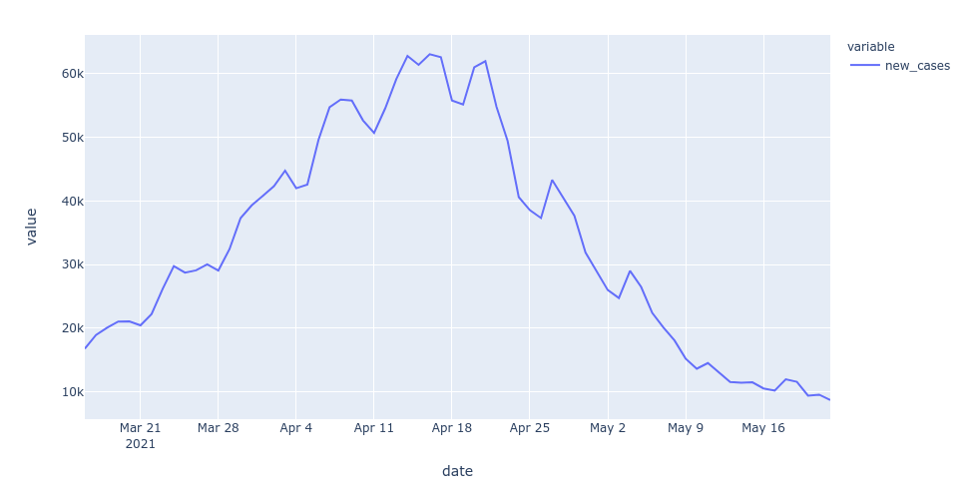
We can see a clear decrease since the beginning of lockdown (26 April).

Slide 7
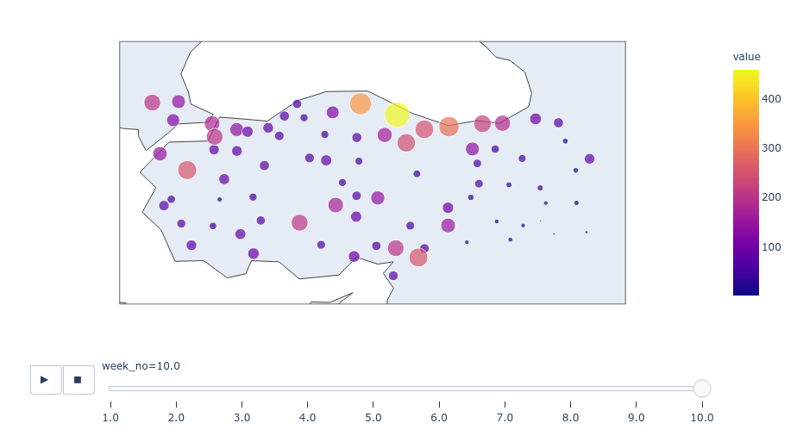
This animated graph tries to investigate the relationship closely with animated bubbles on each city by their coordinates.

Slide 8
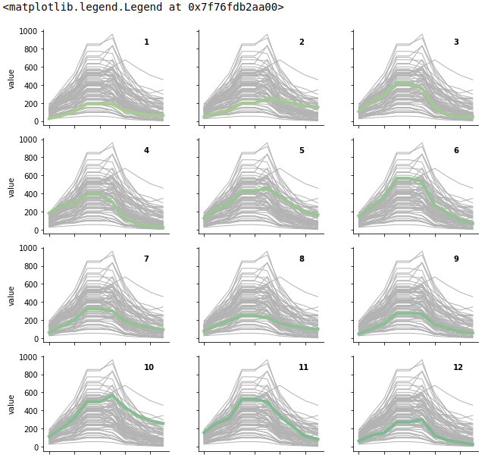
This is the last graph that we created, we can see each individual city graph by their plate no.

Slide 9
Conclusion,
We can conduct that there is a clear effect of lockdown on the new cases rate and cases per/100k interactive map.

