Slide 1
Polynomial Systems Solving
Burak Şener
Mehmet Pekmezci
Mustafa Mert Ergin
Şefik Temel

Slide 2
History of Poly-Nomial
Poly = Multi ( Greek)
Nomial = Nomos (“Law” in Greek)
Nomial = Nomen (“Name” in Latin)
Diophantus - Egypt ( ~ 250 )
Al-Khwarizmi - Persia ( ~ 850 )
François Viète - France ( 1540 – 1603)
René Descartes – France - La Géométrie - 1637
Al-Khwarizmi – Algorithm - Algebra

Slide 3
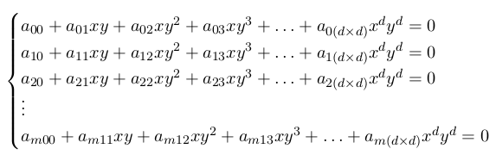

Definitions
Bivariate Polynomial Systems
Multivariate Polynomial Systems
GOAL : Find the Roots (Points cutting the x axis)

Slide 4
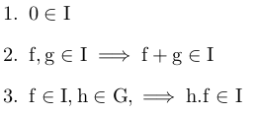

Abstract Algebra
Group (G,+) (closure, associativity, neutral, inverse, commutativity)
  Homomorphism ( isomorphism, automorphism)
Ring (R, + , *) = (G,+) , (* is distributive over +, and associative)
Ideal = Polynomial Ring = Commutative Ring
Greatest Common Divisor (Basis)

Slide 5

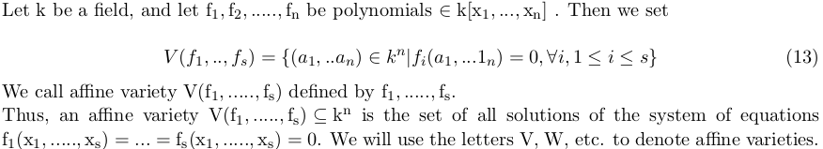
Algebra - Geometry
Affine Space :
Affine Variety :

Slide 6
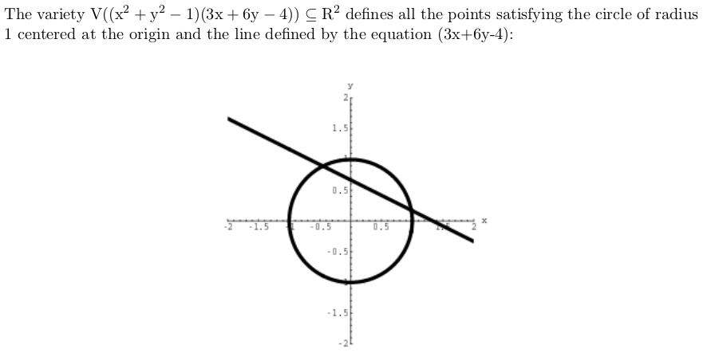
Algebra - Geometry

Slide 7
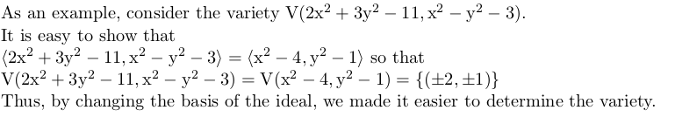

Relation Between Ideal and Variety

