Slide 1
Solver Software
M4GB
Sympy
Groebner Algebra

Slide 2
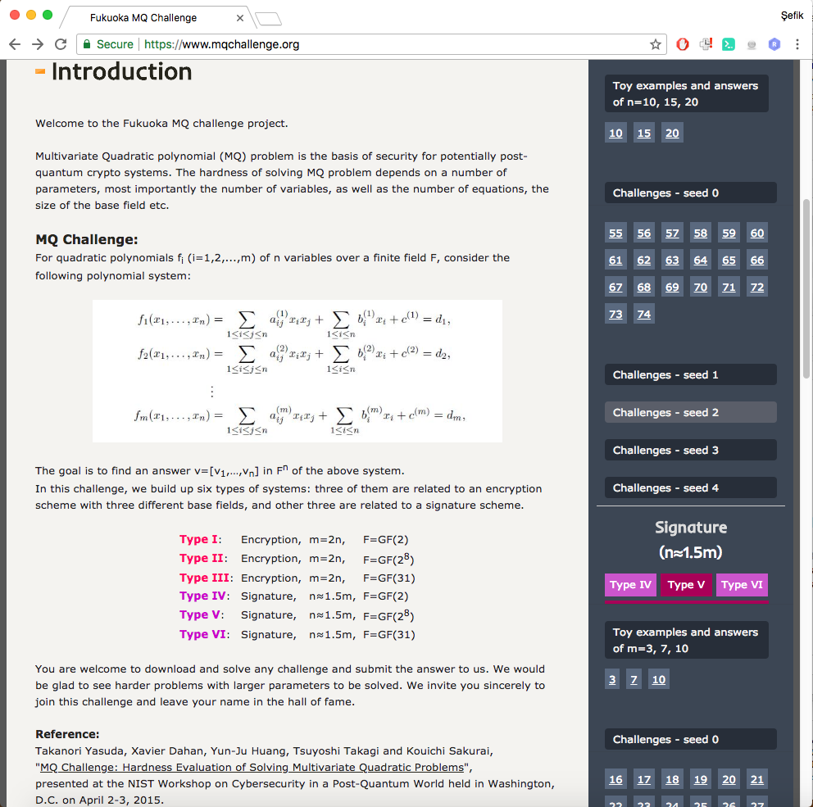
Solver Software
M4GB
C library
Rusydi Makarim, Marc Stevens, M4GB: An efficient Groebner-basis algorithm, ISSAC 2017

Slide 3
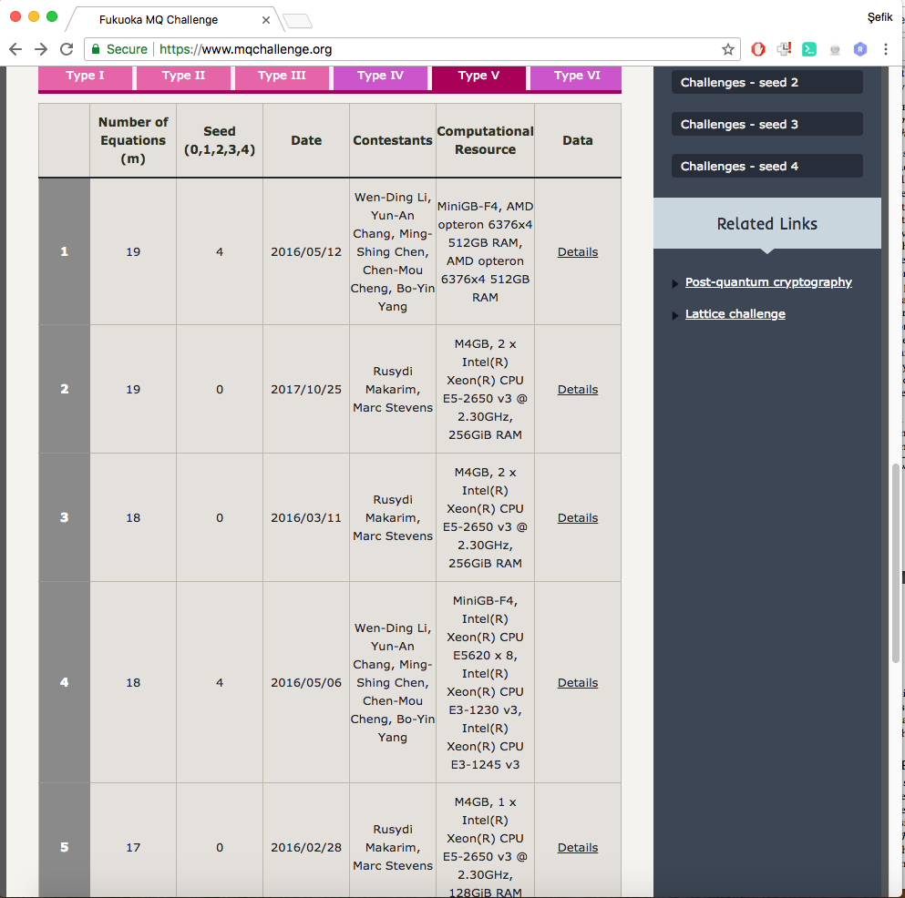
Solver Software
M4GB
C library
Rusydi Makarim, Marc Stevens, M4GB: An efficient Groebner-basis algorithm, ISSAC 2017

Slide 4
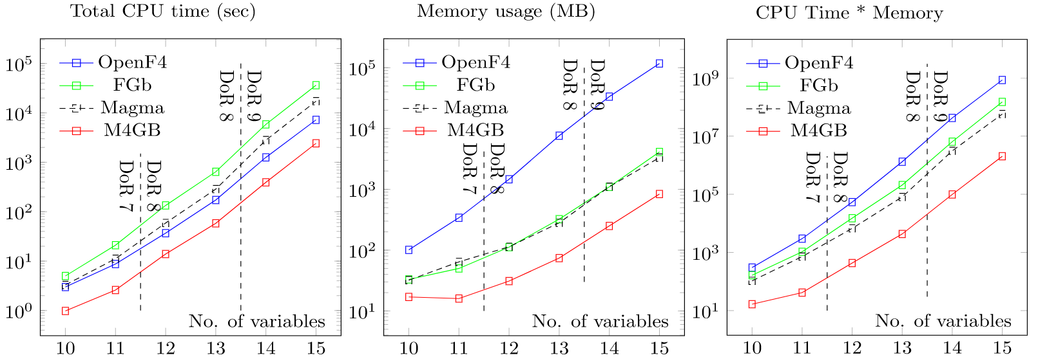
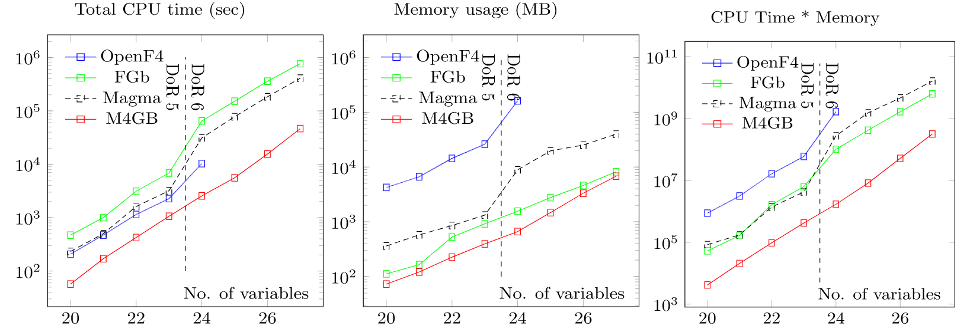
Solver Software
M4GB
#equations = #variables+1
Rusydi Makarim, Marc Stevens, M4GB: An efficient Groebner-basis algorithm, ISSAC 2017
#equations = #variables *2

Slide 5
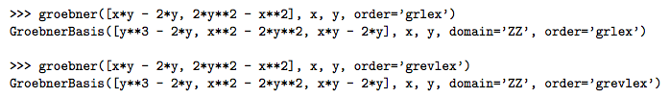
Solver Software
Sympy
Python
sympy.polys.polytools.groebner(F, *gens, **args)
Meurer, Aaron, P. Smith, Christopher, Paprocki, Mateusz et al. SymPy: Symbolic computing in Python, PeerJ Computer Science. 3. e103. 10.7717/peerj-cs.103 2017.

Slide 6
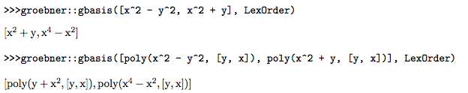
Solver Software
Groebner Algebra
Matlab
groebner::gbasis(polys, , options)

