Slide 1
URBAN SOUND CLASSIFICATION
USING DEEP NETS

Slide 2
URBAN SOUND CLASSIFICATION USING DEEP NETS
DATA SET
8732 WAV files, each containing 4 seconds of urban sounds.
All the data is labeled. The labels are in their file names.
The WAV files are labeled in 10 categories (air_conditioner, car_horn, children_playing, dog_bark, drilling,engine_idling, gun_shot, jackhammer, siren , street_music) and each category has approximately the same amount of sample WAV files.
The dataset is already split into 10 folds containing the WAV files for each category. (being ready for 10 fold cross validation).
Each fold contains 50 – 100 samples for each class.
Last fold (fold10) is used as testing data set, which is never used for training.

Slide 3
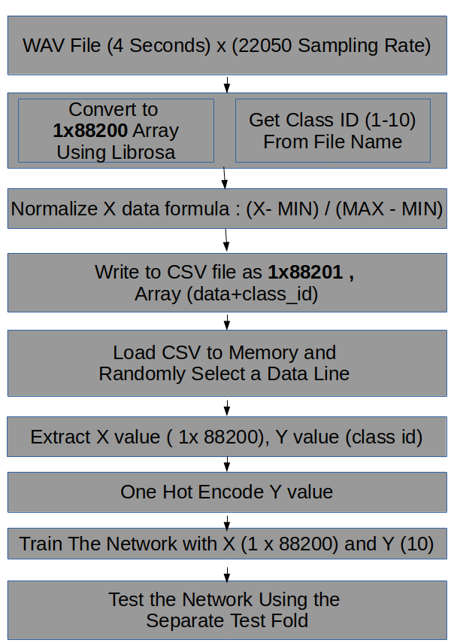
URBAN SOUND CLASSIFICATION USING DEEP NETS
PROGRAM FLOW

Slide 4
URBAN SOUND CLASSIFICATION USING DEEP NETS
PRE-PROCESSING
Three different data processing techniques are experimented :
Every 4 second records are split into 1 second records,
every fold data is shuffled and
normalized with the formula ( X - MIN ) / (MAX – MIN) .
Sound data is augmented using translation/stretching ,
shuffled and normalized with the formula ( X - MIN ) / (MAX – MIN) .
Sound data is directly converted to array of float numbers, and normalized.
Shuffling occurs just before feeding the data to network.

Slide 5
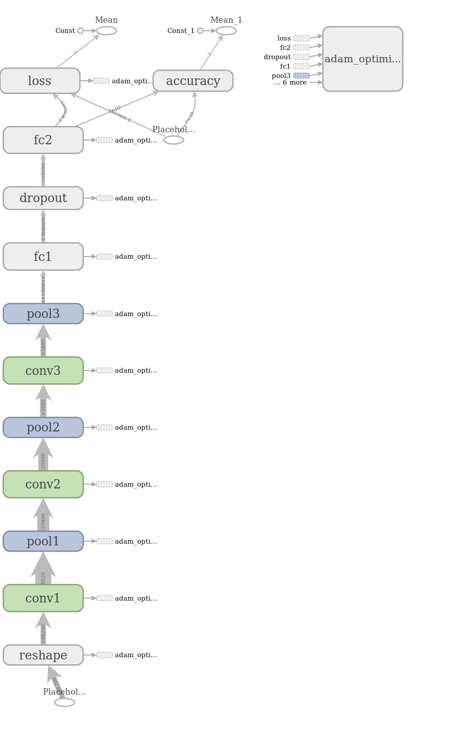
URBAN SOUND CLASSIFICATION USING DEEP NETS
ARCHITECTURE - LeNET

Slide 6
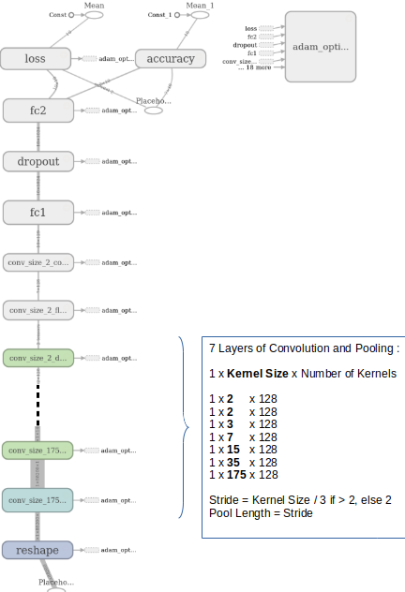
URBAN SOUND CLASSIFICATION USING DEEP NETS
ARCHITECTURE - AlexNET

Slide 7
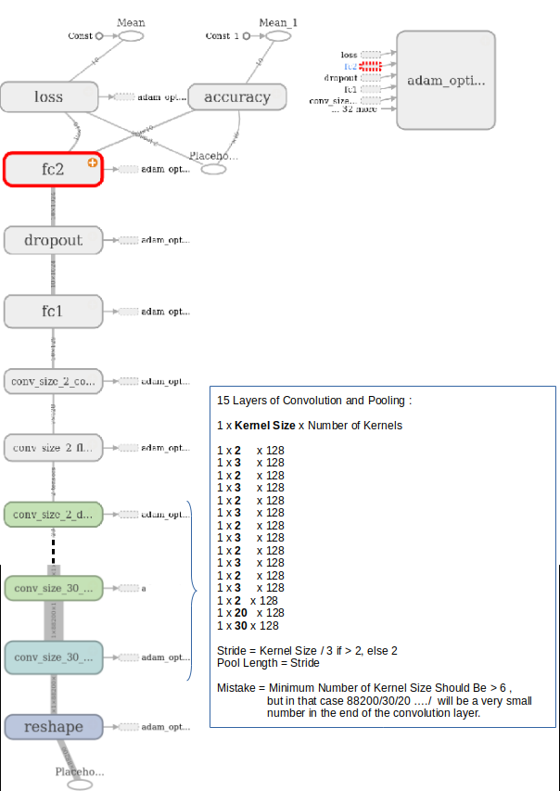
URBAN SOUND CLASSIFICATION USING DEEP NETS
ARCHITECTURE - VGG

Slide 8
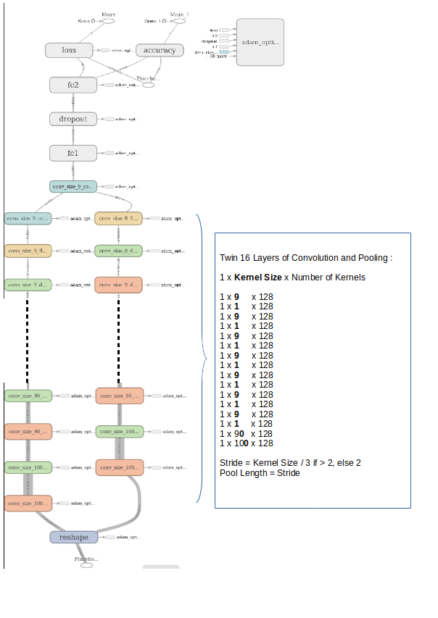
URBAN SOUND CLASSIFICATION USING DEEP NETS
ARCHITECTURE – Twin(Siamese) VGG

Slide 9
URBAN SOUND CLASSIFICATION USING DEEP NETS
AUTOMATIC ARCHITECTURE CONSTRUCTION
The architecture is constructed automatically by looping over the “PARALLEL_CONVOLUTION_KERNELS_SIZES” matrix.
Each row of this matrix is an array of “kernel size”.
The AlexNET architecture is constructed using the matrix
PARALLEL_CONVOLUTION_KERNELS_SIZES=
np.array([ [175,35,15,7,5,3,2,2] ])
The VGG architecture is constructed using the matrix
PARALLEL_CONVOLUTION_KERNELS_SIZES=
np.array([ [100,90,1,9,1,9,1,9,1,9,1,9,1,9,1,9] ])
The Twin VGG architecture is constructed using the matrix
PARALLEL_CONVOLUTION_KERNELS_SIZES=
np.array([ [100,90,1,9,1,9,1,9,1,9,1,9,1,9,1,9],[100,90,1,9,1,9,1,9,1,9,1,9,1,9,1,9] ])

Slide 10
URBAN SOUND CLASSIFICATION USING DEEP NETS
HYPER PARAMETERS
“Learning rate” used in adam optimizer
“Training Epochs” .
“Number of Fully Connected Neurons”
“Architecture”
“Dropout percentage”

Slide 11
URBAN SOUND CLASSIFICATION USING DEEP NETS
SUMMARY RESULTS
Architectures | Learning Rate | Epochs | Fully Connected Neurons | Batch Size | No. of Kernels | Dropout Probability | Best Accuracy
LeNET | 1e-5 | 50 | 8192 | 5 | 128 | 0.5 | 0.40
AlexNET | 1e-5 | 35 | 1024 | 5 | 128 | 0.5 | 0.67
VGG | 1e-5 | 60 | 1024 | 1 | 128 | 0.5 | 0.62
Twin VGG | 1e-5 | 60 | 1024 | 1 | 128 | 0.5 | 0.60

Slide 12
URBAN SOUND CLASSIFICATION USING DEEP NETS
FUTURE WORK
Normalizing the data using MAX and MIN of all the data. (We used only within the same sound record)
MFCC image will be fed to the CNN.
Implementing an LSTM model to predict class.
Using RBM as the fully connected layer of the CNN networks.

