Slide 1
Urban Sound Classification

Slide 2
Dataset
https://serv.cusp.nyu.edu/projects/urbansounddataset/
8732 WAV files, each containing 4 seconds of urban sounds.
All the data is labeled. The labels are in their file names.
The WAV files are labeled in 10 categories (air_conditioner, car_horn, children_playing, dog_bark, drilling,engine_idling, gun_shot, jackhammer, siren , street_music) and each category has approximately the same amount of sample WAV files.
The dataset is already split into 10 folds containing the WAV files for each category. (being ready for 10 fold cross validation).

Slide 3
Classification Steps
Analog to digital conversion (WAV files are digital already and contains “PCM data” which is “amplitudes of sound at constant time intervals” )
Feature Extraction (MFCC)
Training machine learning algorithm using extracted features and data.
Cross validating machine learning algorithm.

Slide 4
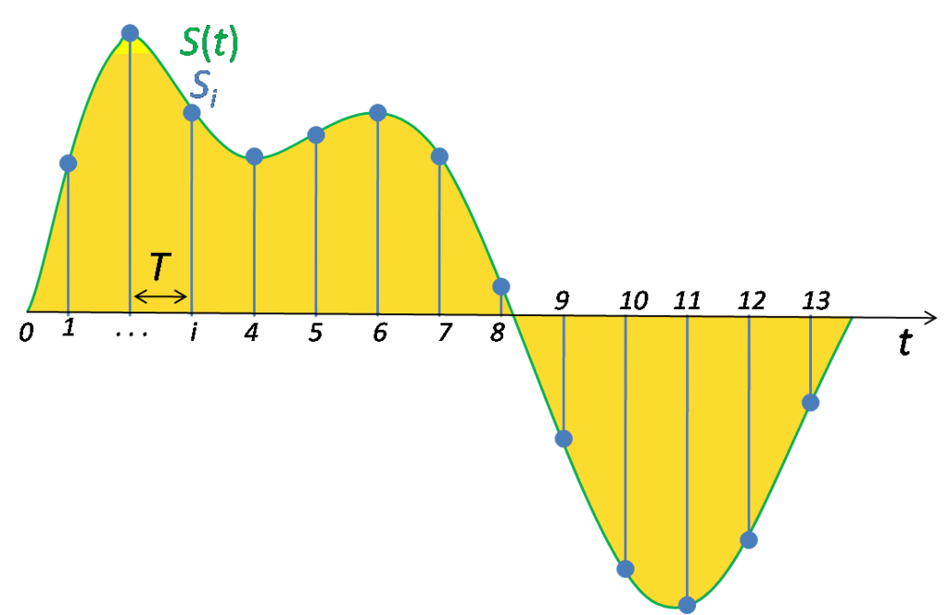
Analog To Digital Conversion
Linear Pulse Code Modulation (PCM) format

Slide 5
Feature Extraction
Fourier Based Methods ( FFT is used within the algorithm) :
  Relative Spectra Filtering of log domain coefficients (Rasta-PLP)
  Predictive Cepstral Coefficients (LPCC)
  Mel-Frequency Cepstral Coefficients (MFCC)
Wavelet Based Methods ( Wavelet Transformation is used within the algorithm) :
  Haar Wavelets
  Discrete Wavelet Transform (DWT)
  Scattering Transform

Slide 6
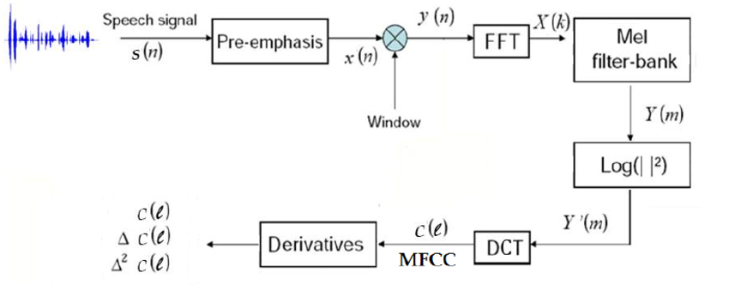
MFCC

Slide 7
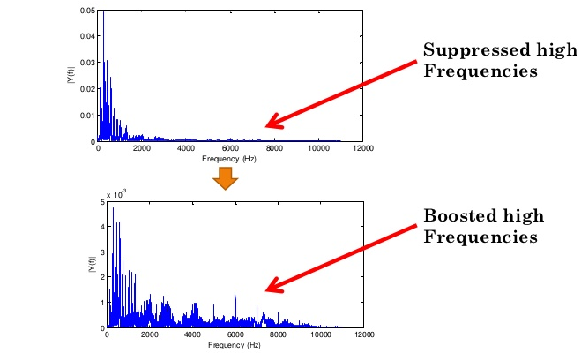
MFCC – Pre Emphasis

Slide 8
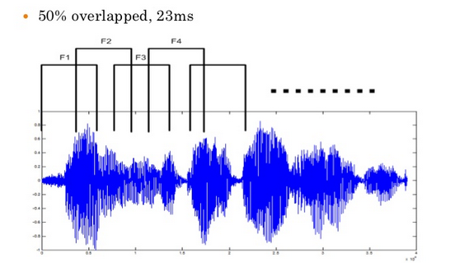
MFCC - Framing

Slide 9
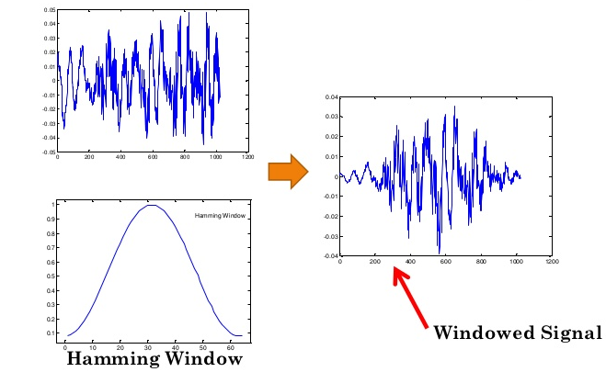
MFCC - Windowing

Slide 10
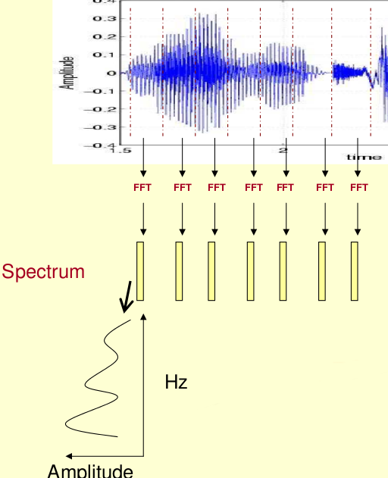
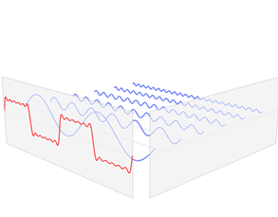
MFCC - FFT

Slide 11
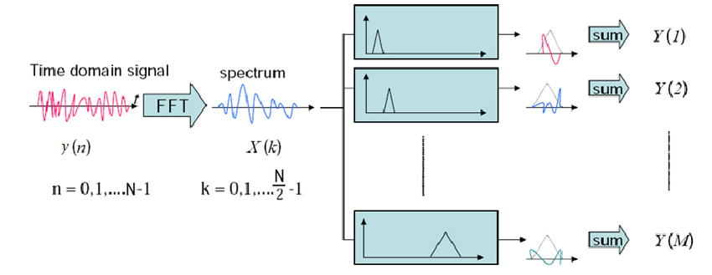
MFCC – Mel Filter Bank

Slide 12
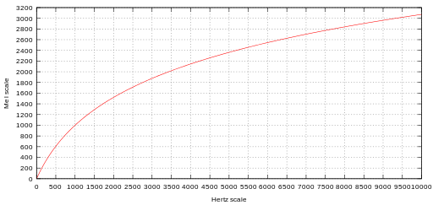
MFCC – Mel Frequency

Slide 13
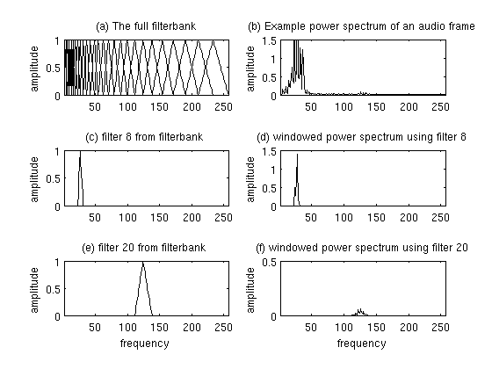
MFCC – Mel Filter Bank

Slide 14
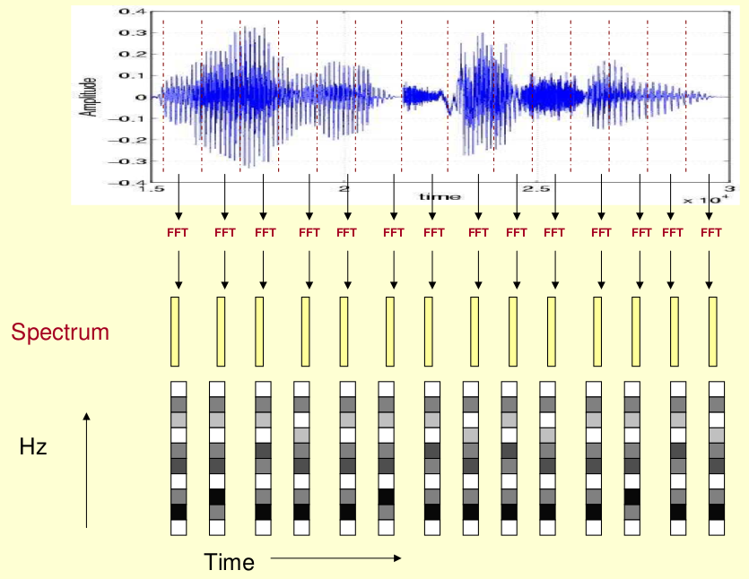
MFCC – Cepstral Analysis

Slide 15
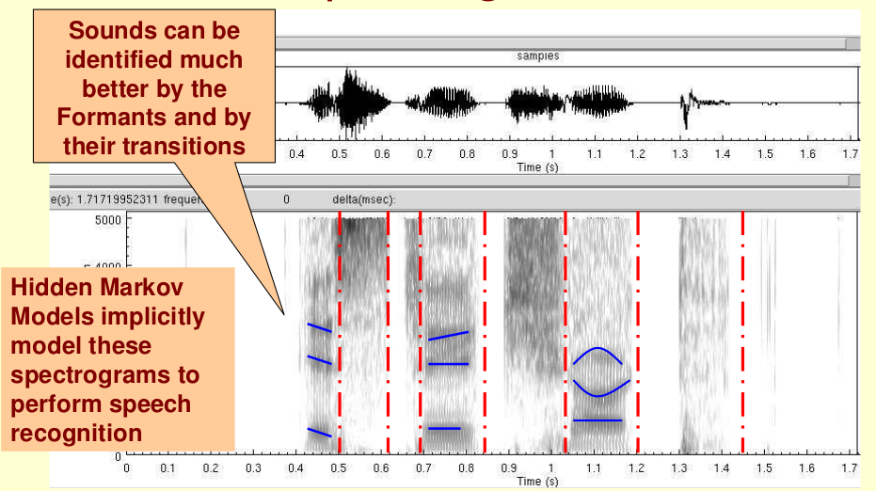
MFCC - Formants

Slide 16
MFCC – Affecting Parameters
Frame length ( generally 25 milliseconds)
Frame shift ( generally 10 milliseconds)
FFT size (512, 1024 or 2048)
Pre-emphasis coefficient ( generally between 0.9 and 1)
Number of filter banks ( generally 24-30)
Number of MFC coefficients (generally 12-20) Features used to train classification algorithm

Slide 17
Classification
Ensemble of SVMs for each feature (MFCC coefficients)
Bagging is used as ensemble algorithm (Majority Voting)
10 fold cross validation is used for training and validation.

Slide 18
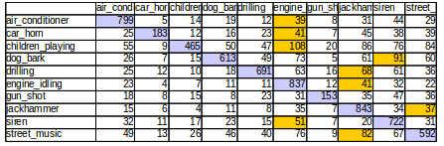
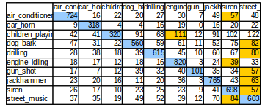
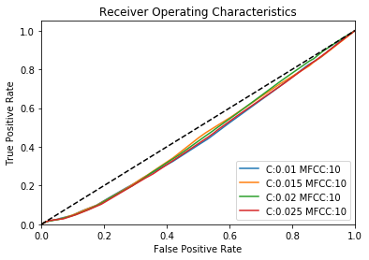
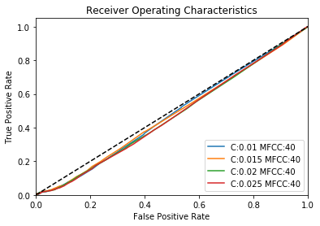
Classification Results
10 MFCC Coefficients
40 MFCC Coefficients
10 MFCC Coefficients

