Slide 1
ME536 – Final Project
Mehmet Sahin

Slide 2
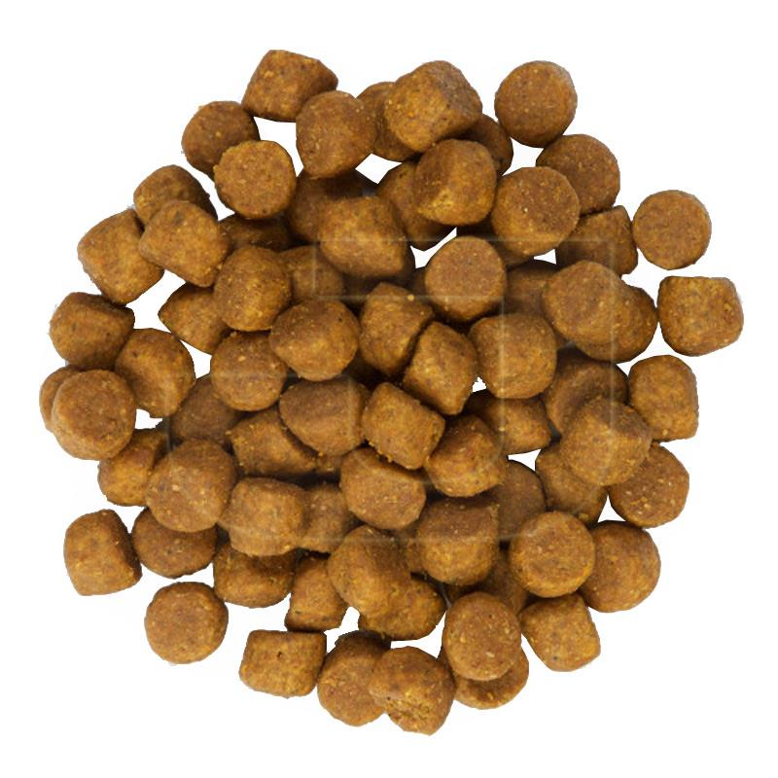
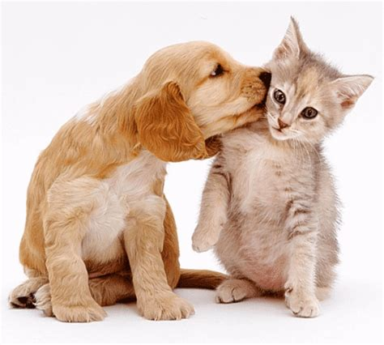
Problem Definition
- My project aims to find different food for pets.
- Learn the animals' favorite foods over time.

Slide 3
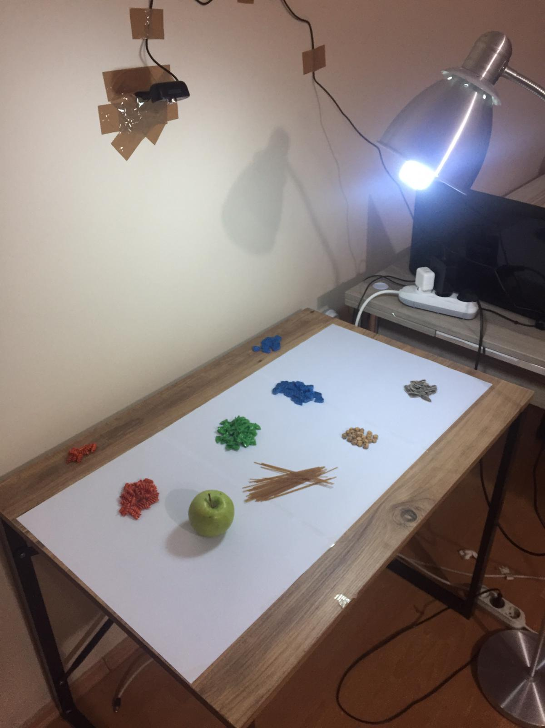

Slide 4
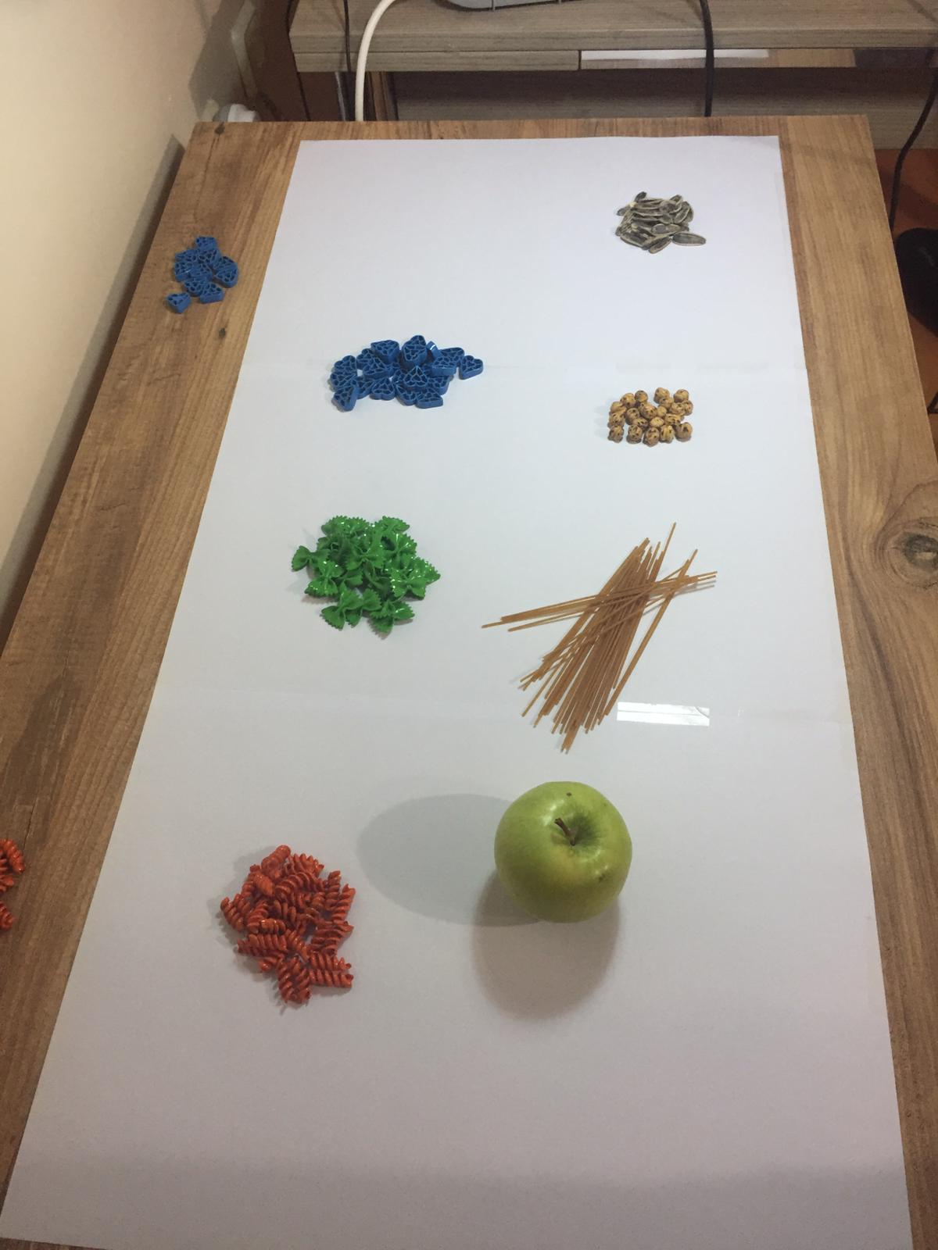
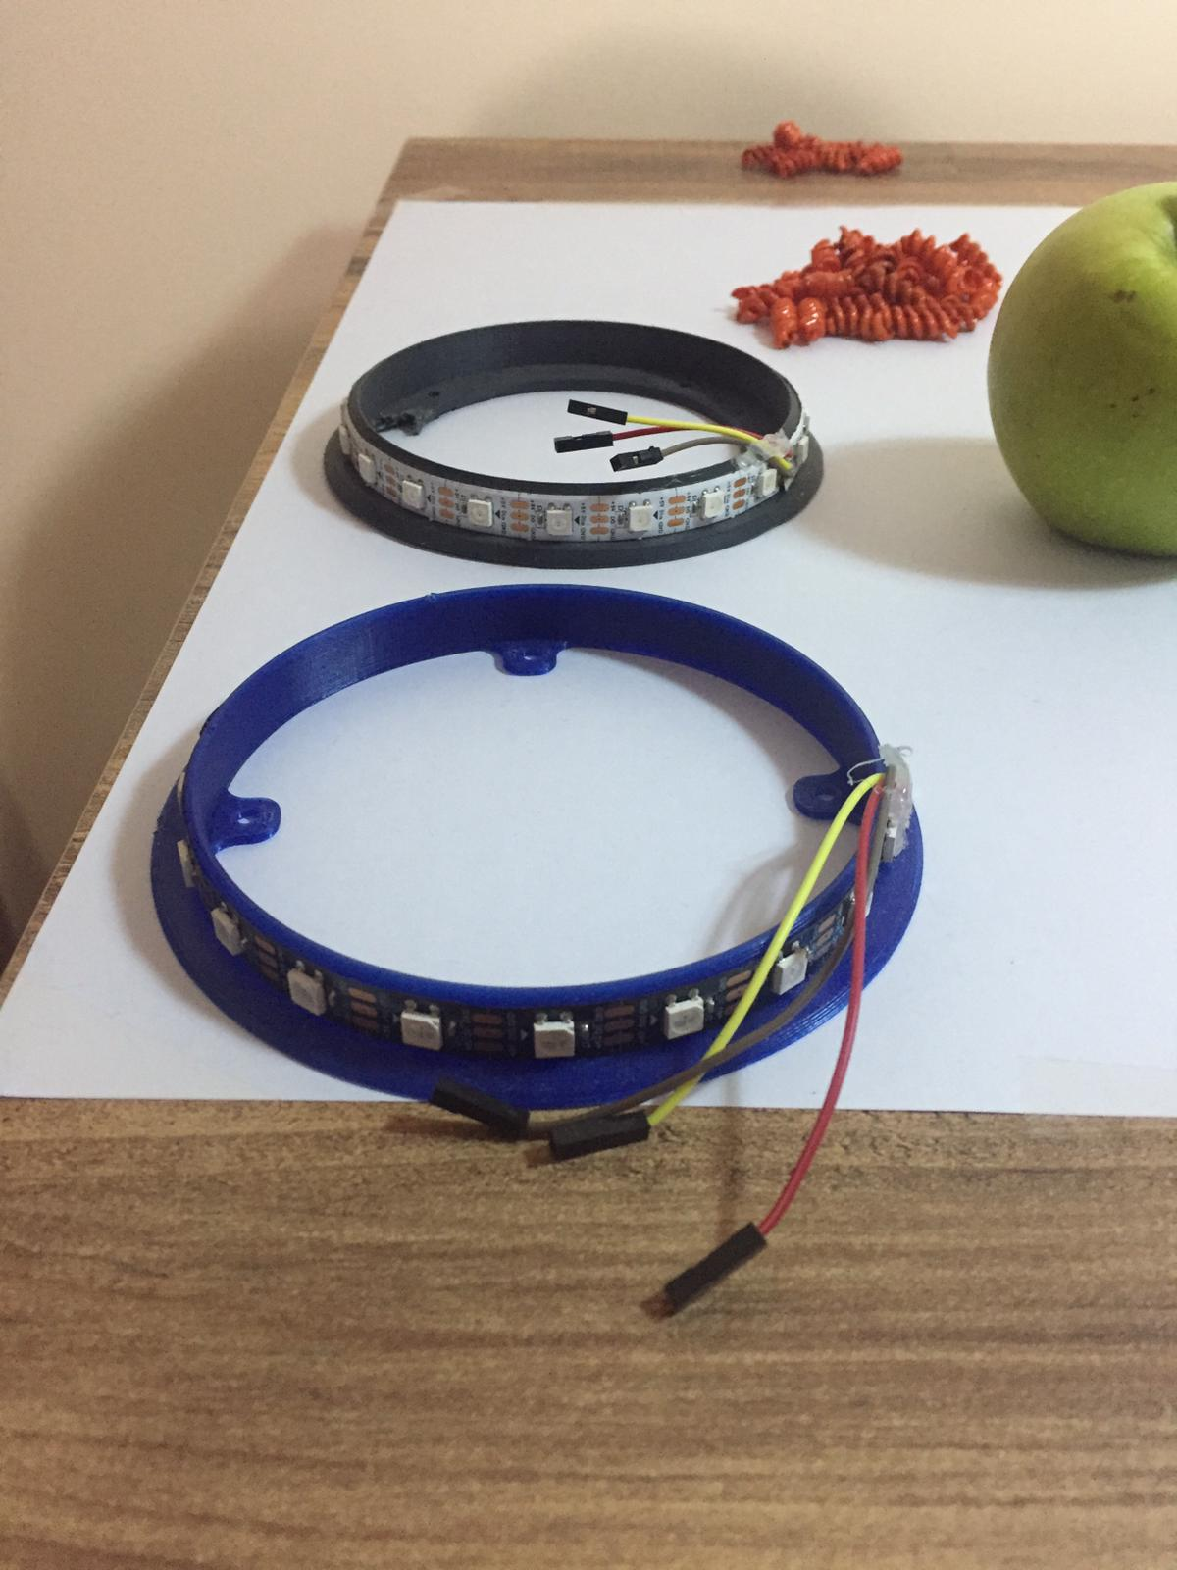

Slide 5
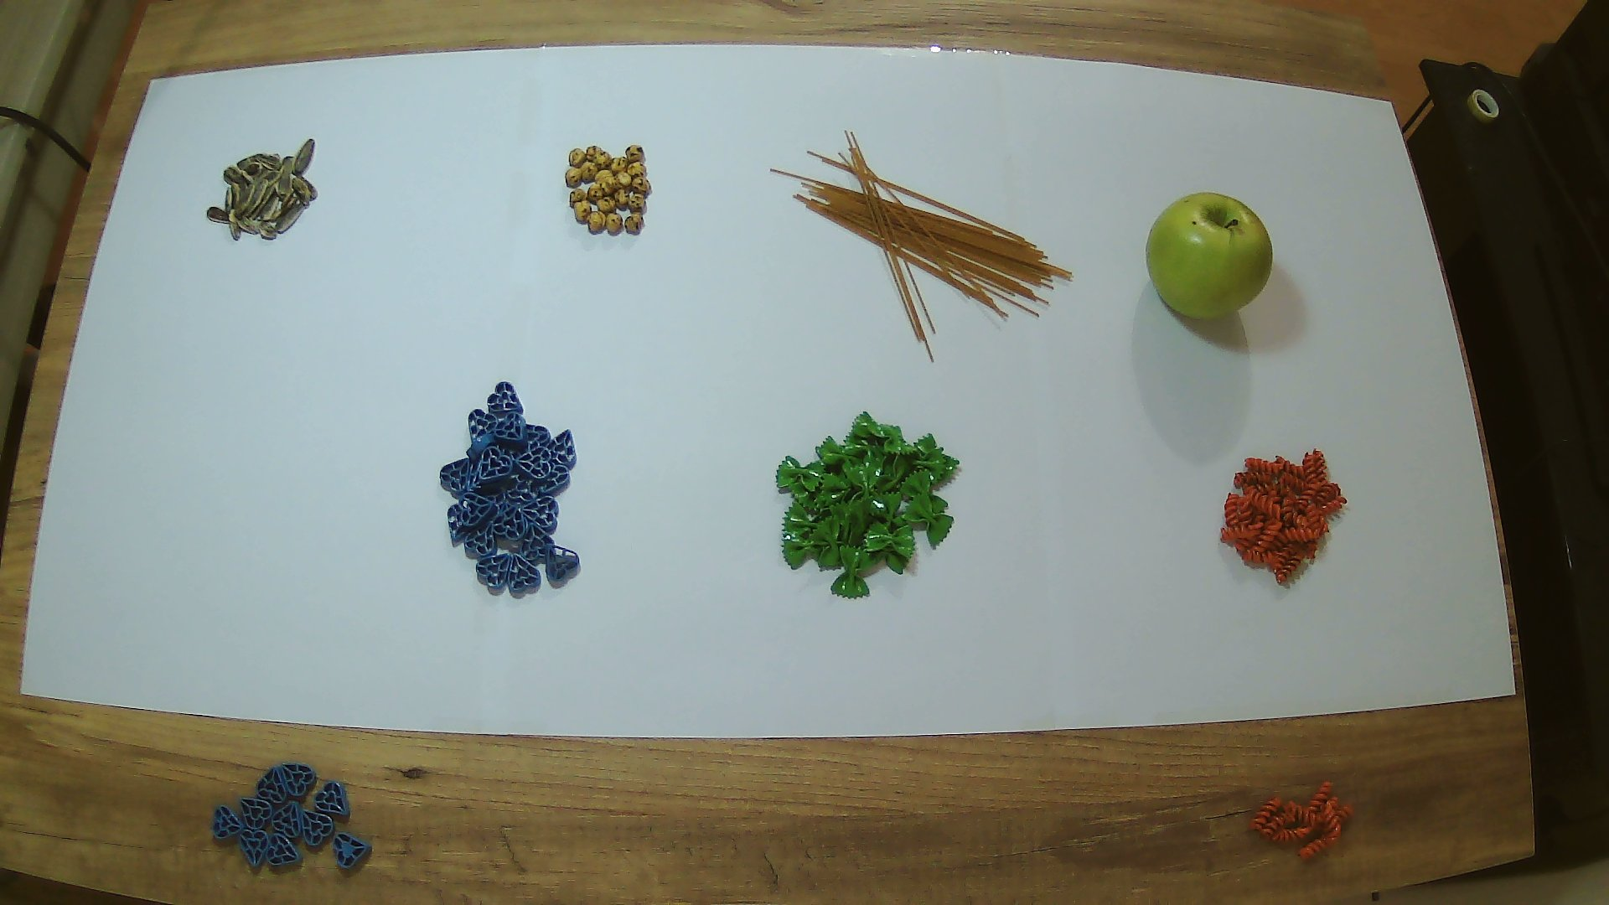
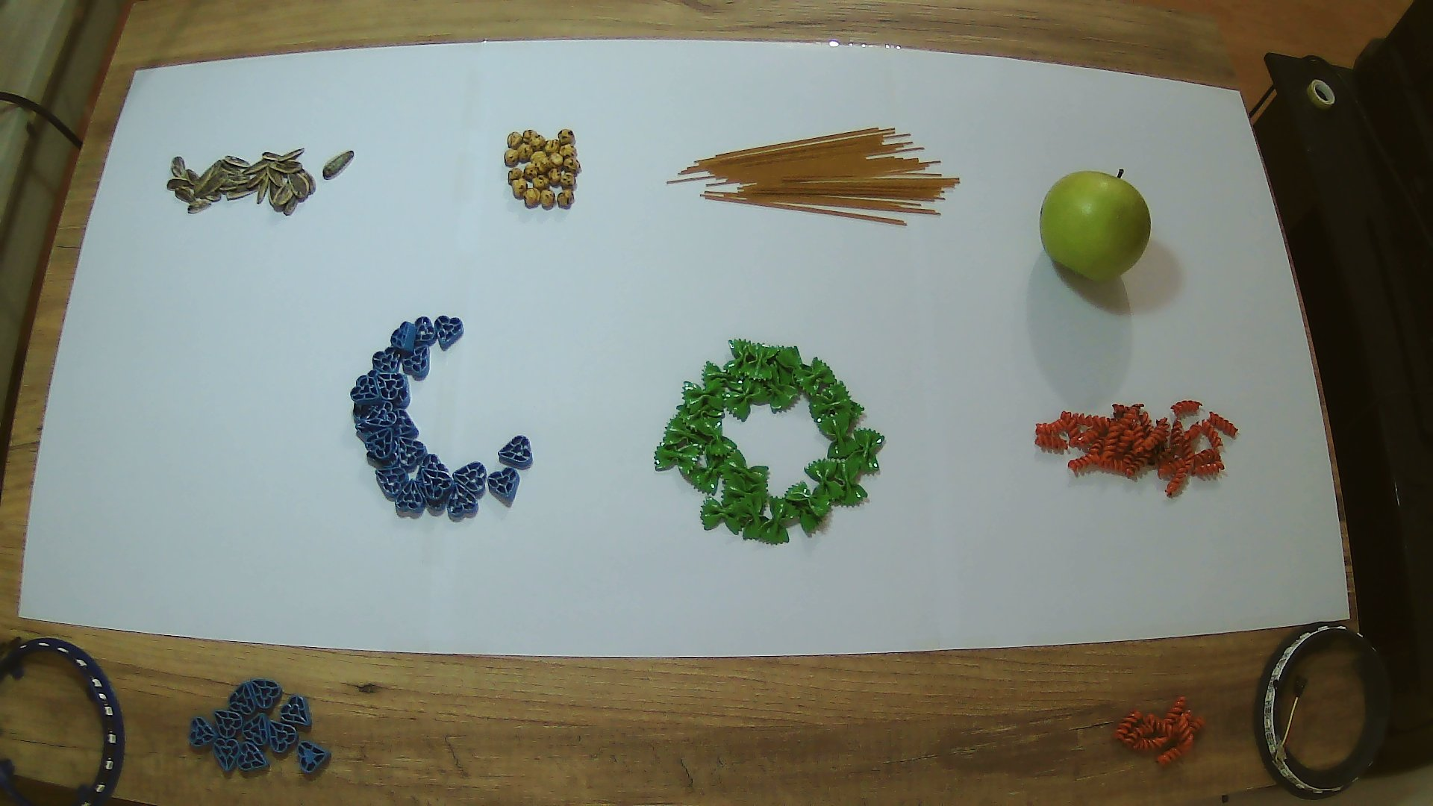
It's time to guess the problem: 10 second

Slide 6
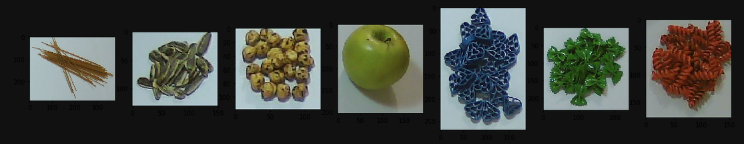
Solution Approach and Results
Image Processing

Slide 7
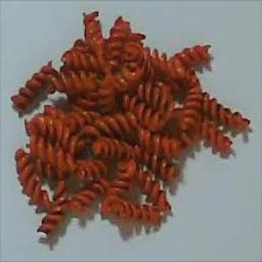
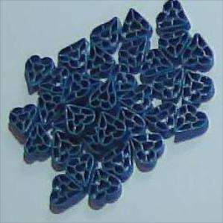
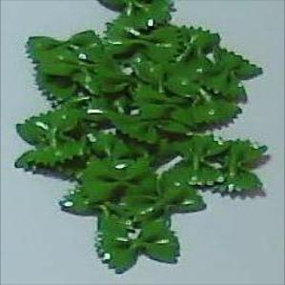
Let’s initialize system...
The 3 sets are our basic sets. Others will be new. When starting the system, we start with 54 elements with elements from 3 different sets.
18 element
18 element
18 element

Slide 8
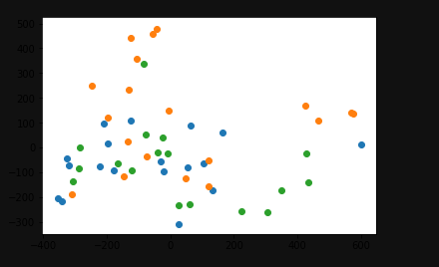
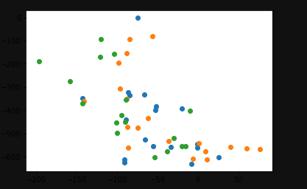
Let’s CNN model(ResNet and Imagenet)
ResNet_v2_50
ImageNet/inception_v3
Visualized with PCA(n_components=2)

Slide 9
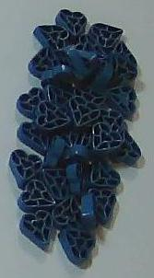
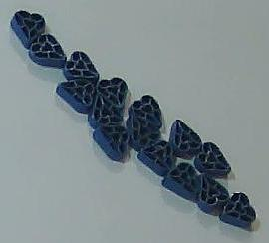

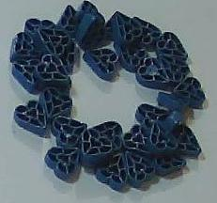

Slide 10

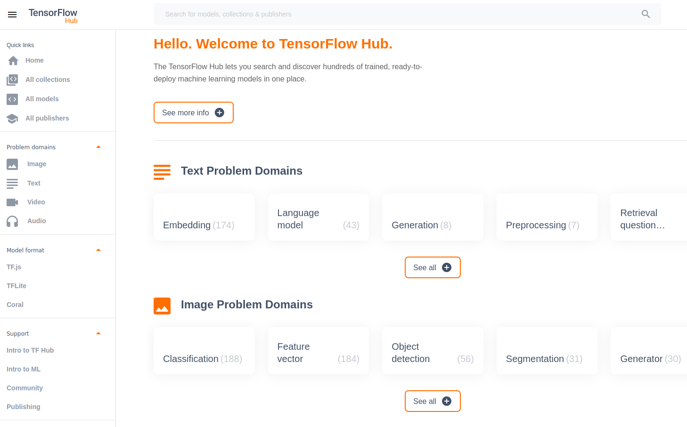
Advice time...

Slide 11
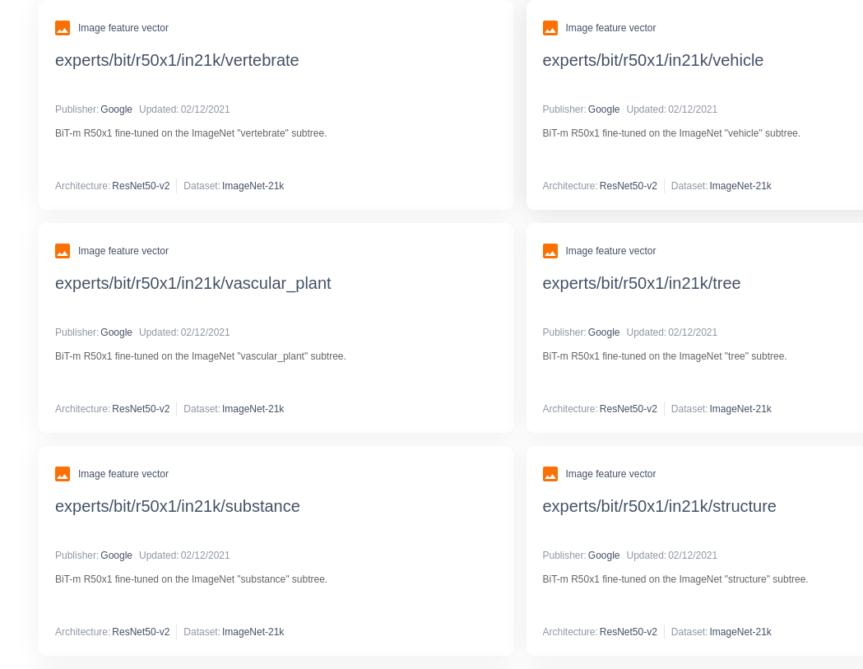

Slide 12
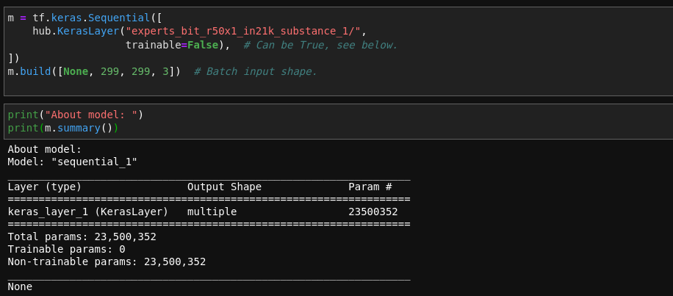
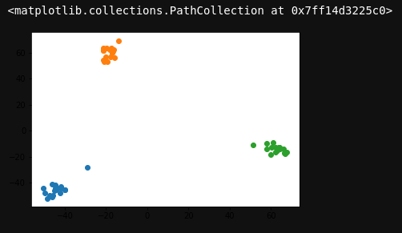

Slide 13
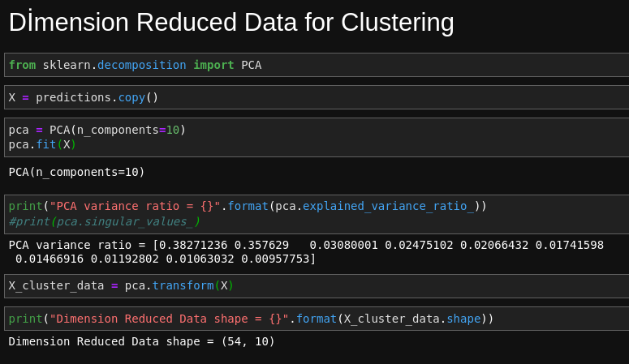

Slide 14
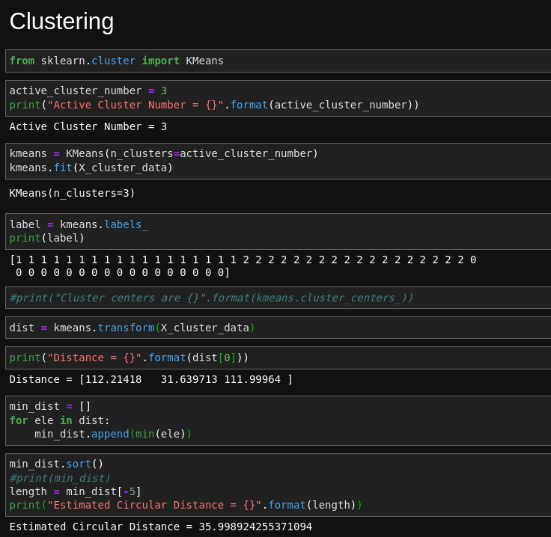

Slide 15
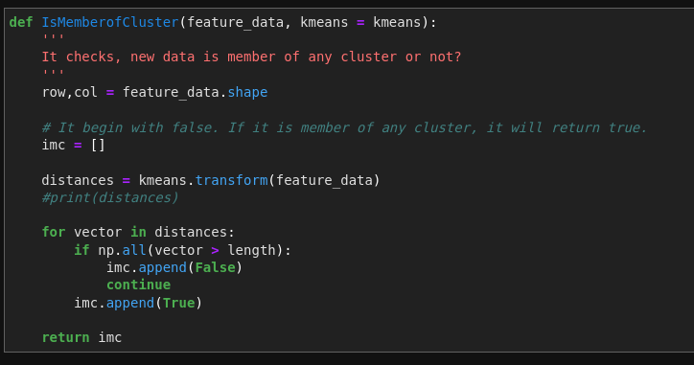

Slide 16
Application of project is in video.
All about project in my GitHub.
https://github.com/mehmetsahin1001/ME536Project/tree/master

Slide 17
References
Manjunath Jogin(2018), Feature Extraction using Convolution Neural Networks (CNN) and Deep Learning
Benyamin Ghojogh(2019), Feature Selection and Feature Extraction in Pattern Analysis: A Literature Review
Sourish Dey(2018), CNN application on structured data-Automated Feature Extraction
Krut Patel(2020), Image Feature Extraction: Traditional and Deep Learning Techniques

