Slide 1

Alpaka Parallel Programming Library
In a Nutshell

Slide 2
alpaka – Abstraction Library for Parallel Kernel Acceleration
Alpaka is…
A parallel programming library: Accelerate your code by exploiting your hardware‘s parallelism!
An abstraction library independent of hardware ecosystem: Create portable code that runs on CPUs and GPUs!
Free & open-source software

Slide 3
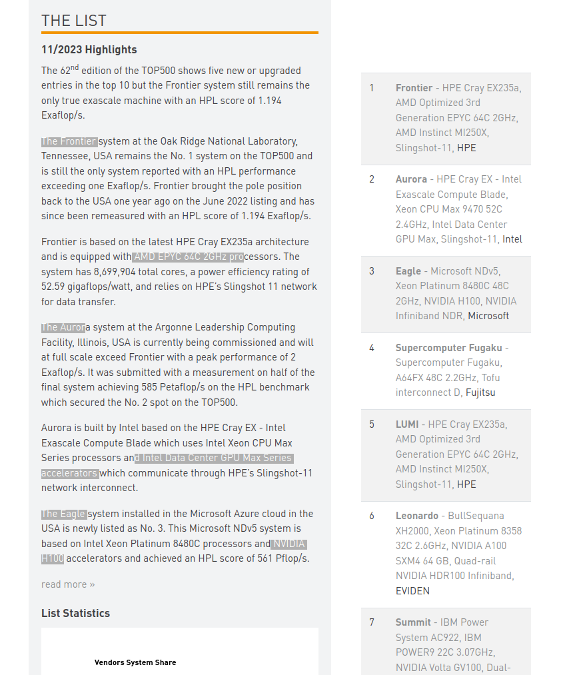
in a Nutshell
www.top500.org
Problem of HPC Systems?
Heterogenous Hardware Ecosystem!
Problem of HPC Systems?
Heterogenous Hardware Ecosystem!
Problem of HPC Systems?
Heterogenous Hardware Ecosystem!
TOP500
Frontier(USA) 1.194 Exaflop/s, AMD EPYC CPU + AMD Instict GPU
Aurora(USA) 585 Petaflop/s, Intel Xeon CPU + Intel GPU Max
Eagle(USA) 561 Petaflop/s, Intel Xeon CPU + NVIDIA H100 GPU
Fugaku (Japan) 442 Petaflop/s, Fujitsu A64FX CPU
Lumi (Finland) 380 Petaflop/s, AMD EPYC CPU + AMD Instinct GPU
Leonardo (Italy) 238.7 Petaflop/s, Intel Xeon CPU + NVIDIA A100 GPU
MareNostrum (Spain) 183.2 Petaflops/s, Intel Xeon CPU +
NVIDIA H100 GPU
Summit(USA) 148.3 Petaflops/s, IBM Power9 CPU + NVIDIA Volta GPU
Eos(USA) 121.4 Petaflops/s, Intel Xeon CPU + NVIDIA H100 GPU
Sierra(USA) 94 Petaflops/s, IBM POWER9 CPU + NVIDIA Tesla V100 GPU

Slide 4
In a nutshell
alpaka‘s purpose
Without alpaka
Hardware ecosystem is heterogenous and multiple hardware types commonly used (CPUs, GPUs, …)
Platforms not inter-operable → parallel programs not easily portable
alpaka: one API to rule them all
Abstraction (not hiding!) of the underlying hardware, compiler and OS platforms
  No default device, default queue, built-in variables or functions. No language extentions
Easy change of the backend
  Code needs only minor adjustments to support different accelerators
Direct usage of vendor APIs
Easy indexing of threads in kernels
Proposition and validation of type of parallelism (Block sizes in grid, Thread sizes in block…)
Heterogenous Programming: Using different backends in a synchronized manner
User
alpaka
CPU
GPU

Slide 5
in a Nutshell: Accelerator
Switching the Accelerator Easily
alpaka provides a number of pre-defined Accelerators in the acc namespace.
For GPUs:
  AccGpuCudaRt for NVIDIA GPUs
  AccGpuHipRt for AMD, Intel and NVIDIA GPUs
For CPUs
  AccCpuFibers based on Boost.fiber
  AccCpuOmp2Blocks based on OpenMP 2.x
  AccCpuOmp4 based on OpenMP 4.x
  AccCpuTbbBlocks based on TBB
  AccCpuThreads based on std::thread
// Example: CUDA GPU accelerator
using Acc = alpaka::AccGpuCudaRt<Dim, Idx>;
// Switch to AMD: HIP GPU accelerator
using Acc = alpaka::AccGpuHipRt<Dim, Idx>;
// Switch to CPU Omp: CPU accelerator using Acc = alpaka::AccCpuOmp2Blocks<Dim, Idx>;

Slide 6

in a Nutshell
Programming with alpaka
C++ only!
Header-only library: No additional runtime dependency introduced
Modern library: alpaka is written entirely in C++17
Supports a wide range of modern C++ compilers (g++, clang++, Apple LLVM, MS Visual Studio)
Portable across operating systems: Linux, macOS, Windows are supported
Alpaka directly uses vendor API’s. For example: Alpaka cuda backend uses Cuda API directly etc.

Slide 7

in a Nutshell
alpaka in the wild – example use case
PIConGPU: https://github.com/ComputationalRadiationPhysics/picongpu
Fully relativistic, manycore, 3D3V particle-in-cell (PIC) code
Central algorithm in plasma physics
Scalable to more than 18,000 GPUs
Developed at Helmholtz-Zentrum Dresden-Rossendorf
Supports NVIDIA and AMD GPUs.

Slide 8

in a Nutshell
alpaka is free software (MPL 2.0). Find us on GitHub!
Our GitHub organization: https://www.github.com/alpaka-group
Contains all alpaka-related projects, documentation, samples, …
New contributors welcome!
The library: https://www.github.com/alpaka-group/alpaka
Full source code
Issue tracker
Installation instructions
Small examples

Slide 9
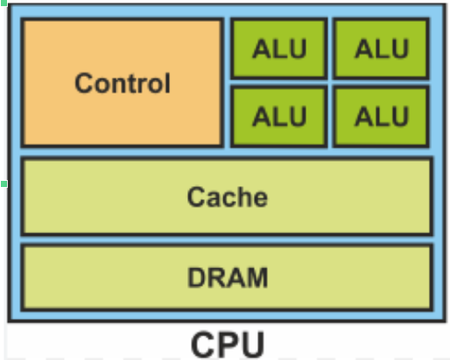
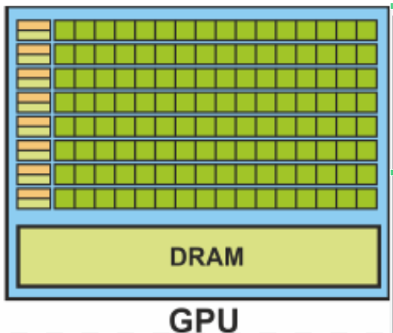
in a Nutshell
SM0
SM1
Main difference between CPU and GPU programming?
CPU:
  1 thread per core and not may cores
  Big cache size per thread
  Low memory bandwidth(BW)
GPU:
  Massively parallel many threads per core (Streaming Multiprocessor) and many cores
  Low cache size per thread
  High memory BW
SM2
...
...
...
...
SMn
Abstraction: Grid of Blocks
ThreadBlock1
ThreadBlock2
…
…
…
…
ThreadBlockN

Slide 10
in a Nutshell
Basics: Thread mapping on CPUs
CPU consists of multiple cores
  Because of simultaneous multithreading there can be more logical than physical cores!
alpaka Threads are executed by CPU cores.
Single thread per block. Single block per core.
Multiple elements per thread.
Thread 0
CPU
Core 0
Core 1
Thread 1
Core 2
Core 3
Thread 2
Thread 3

Slide 11
in a Nutshell
GPU
SM 1
Thread Mapping on GPUs
GPU consists of streaming multiprocessors (SMs)
Each SM consists of multiple cores
A block has many threads and threads in a block are executed synchronously in the same SM. (SM can run more than one block)
Each thread is matched to a core.
T0
SM0
SM1
Shared Memory
Shared Memory
T1
C0
C1
C0
C1
C0
C0
C1
T2
C1
C0
C0
C2
T3
C2
C3
C2
C3
C3
T4
T5
SM2
SM3
Shared Memory
Shared Memory
...
...
C0
C1
C0
C1
...
C2
C3
C2
C3
Tn
Global Memory DRAM (L2)
Constant Memory (Read Only)

Slide 12
in a Nutshell
GPU
How distribute threads between SMs while matching each thread to a core?
Main determinants of mapping threads to the SMs:
  Number of cores SM,
  Register and local memory size for each thread,
  Shared memory usage of each thread,
  Limits for Threads per SM, Threads per Block, Blocks per Device
Memory latencies: Global Memory and Constant memory has different latencies.
Memory sizes: Size of shared memory used by threads in a block or blocks assigned to an SM
SM 1
T0
SM0
SM1
Shared Memory
Shared Memory
T1
C0
C1
C0
C1
C0
C0
C1
T2
C1
C0
C0
C2
T3
C2
C3
C2
C3
C3
T4
T5
SM2
SM3
Shared Memory
Shared Memory
...
...
C0
C1
C0
C1
...
C2
C3
C2
C3
Tn
Global Memory DRAM (L2)
Constant Memory (Read Only)

Slide 13
in a Nutshell
Grid
Alpaka proposes and validates WorkDivision!
WorkDivision data structure consists:
  Number of Blocks per grid
  Number of Threads per block
  Elements per thread
Alpaka validates and proposes correct parallelisation strategies to map threads to SMs
Block0
Block1
Shared Memory
Shared Memory
reg
reg
reg
reg
T0
T1
T2
T3
lm
lm
lm
lm
Global Memory DRAM (L2)
Constant Memory (Read Only)

Slide 14
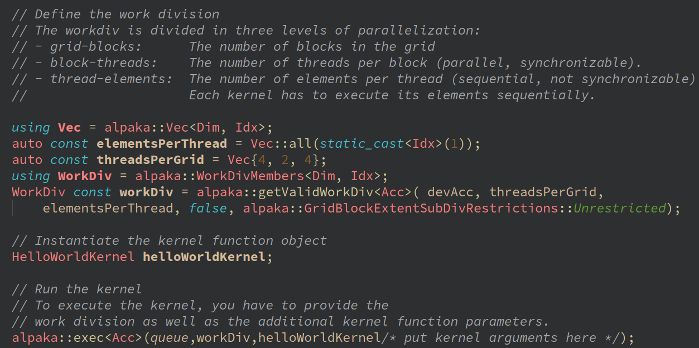
in a Nutshell
Easy definition, validation of Type of Parallelism by WorkDivision
Determines the number of kernel instantiations
Determines the type of parallelism
  Dimensions of a grid in terms of blocks,
  Dimensions of a block in terms of threads
  Elements per thread

Slide 15
in a Nutshell
Alpaka Features [Todo:Explain shortly?]
Buffer: Not only a pointer; a data structure knows the device, extent, pitch
Device: All functions depending on a device require it to be given as a parameter. Hence, device utilisation is transparent.
Queues: Non-blocking queues as well as blocking queues are provided for all devices. Changes to the synchronicity of multiple tasks can be made on a per queue basis by changing the queue type at the place of creation. No need pair of functions like cudaMemcpyAsync and cudaMemcpy.
Constant and Shared Memory Support
https://alpaka.readthedocs.io/en/latest/advanced/rationale.html

Slide 16
in a Nutshell
Example: 1D Convolution Filter
using DevAcc = alpaka::ExampleDefaultAcc<Dim, Idx>;
using QueueProperty = alpaka::Blocking;
using QueueAcc = alpaka::Queue<DevAcc, QueueProperty>;
using BufAcc = alpaka::Buf<DevAcc, DataType, Dim, Idx>;
auto const platformHost = alpaka::PlatformCpu{};
auto const devHost = alpaka::getDevByIdx(platformHost, 0);
// Select a device
auto const platformAcc = alpaka::Platform<DevAcc>{};
auto const devAcc = alpaka::getDevByIdx(platformAcc, 0);
// Create a queue on the device
QueueAcc queue(devAcc);
// Allocate memory host input
auto hostInputMemory = alpaka::allocBuf<DataType, Idx>(devHost, inputSize);
// Fill array with data
for(size_t i = 0; i < inputSize; i++)
hostInputMemory[i] = static_cast<DataType>(i + 1);
// Allocate memory host filter
auto hostFilterMemory = alpaka::allocBuf<DataType, Idx>(devHost, filterSize);
// Fill array with any data
for(size_t i = 0; i < filterSize; i++)
hostFilterMemory[i] = static_cast<DataType>(i + 1) / 10.0f;
// Allocate memory in device
BufAcc inputDeviceMemory = alpaka::allocBuf<DataType, Idx>(devAcc, inputSize);
BufAcc filterDeviceMemory = alpaka::allocBuf<DataType, Idx>(devAcc, filterSize);
BufAcc outputDeviceMemory = alpaka::allocBuf<DataType, Idx>(devAcc, static_cast<Idx>(inputSize));
// Copy input and filter (convolution kernel array) from host to device
alpaka::memcpy(queue, inputDeviceMemory, hostInputMemory, inputSize);
alpaka::memcpy(queue, filterDeviceMemory, hostFilterMemory, filterSize);
// Make sure memcpy finished.
alpaka::wait(queue);
using Vec = alpaka::Vec<Dim, Idx>;
using WorkDiv = alpaka::WorkDivMembers<Dim, Idx>;
auto const elementsPerThread = Vec::all(static_cast<Idx>(1));
// Grid size
auto const threadsPerGrid = inputSize;
WorkDiv const workDiv = alpaka::getValidWorkDiv<DevAcc>(
DevAcc, threadsPerGrid, elementsPerThread,false,
alpaka::GridBlockExtentSubDivRestrictions::Unrestricted);
// Instantiate the kernel (paralelizable code) function-object
ConvolutionKernel convolutionKernel;
// Native pointers needed for the kernel execution function
DataType* nativeFilterDeviceMemory = alpaka::getPtrNative(filterDeviceMemory);
DataType* nativeInputDeviceMemory = alpaka::getPtrNative(inputDeviceMemory);
DataType* nativeOutputDeviceMemory = alpaka::getPtrNative(outputDeviceMemory);
// Run the kernel
alpaka::exec<DevAcc>( queue, workDiv,convolutionKernel, nativeInputDeviceMemory,
NativeFilterDeviceMemory, nativeOutputDeviceMemory,
InputSize, filterSize);
// Allocate memory on host
auto resultGpuHost = alpaka::allocBuf<DataType, Idx>(devHost, inputSize);
// Copy from device memory to host
alpaka::memcpy(queue, resultGpuHost, outputDeviceMemory, inputSize);
alpaka::wait(queue);

Slide 17
in a Nutshell
Grid
Alpaka proposes and validates WorkDivision!
WorkDivision data structure consists:
  Number of Blocks per grid
  Number of Threads per block
  Elements per thread
Alpaka validates and proposes correct parallelisation strategies to map threads to SMs
Block0
Block1
Shared Memory
Shared Memory
reg
reg
reg
reg
T0
T1
T2
T3
lm
lm
lm
lm
Global Memory (L2)
Constant Memory (Read Only)

Slide 18
in a Nutshell
CUDA kernel call at host
  dim3 gridSize(42,1,1);
  dim3 blockSize(256,1,1);
  // extern shared memory and stream is optional
  fooKernel< 16 ><<< gridSize, blockSize, 0, 0 >>>( ptr, 23 );
CUPLA kernel call at host:
  dim3 gridSize(42,1,1);
  dim3 blockSize(256,1,1);
  // extern shared memory and stream is optional
  CUPLA_KERNEL(fooKernel< 16 >)( gridSize, blockSize, 0, 0 )( ptr, 23 );
CUDA shared memory (in kernel)
  __shared__ int foo;
  __shared__ int fooCArray[32];
  __shared__ int fooCArray2D[4][32];
  // extern shared memory (size was defined during the host side kernel call)
  extern __shared__ float fooPtr[];
  int bar = fooCArray2D[ threadIdx.x ][ 0 ];
CUPLA shared memory (in kernel)
  sharedMem( foo, int );
  sharedMem( fooCArray, cupla::Array< int, 32 > );
  sharedMem( fooCArray, cupla::Array< cupla::Array< int, 4 >, 32 > );
  sharedMemExtern( fooPtr, float );
  int bar = fooCArray2D[ threadIdx.x ][ 0 ]
CUPLA:
Converting CUDA code to Alpaka
Change the suffix *.cu of the CUDA source files to *.cpp
Remove cuda specific includes on top of your header and source files
Add #include <cuda_to_cupla.hpp> remove #include <cuda_runtime.h>
Tansform kernels (__global__ functions) to functors
The functor's operator() must be qualified as const
Add the function prefix ALPAKA_FN_ACC to the operator() const
Add as first (templated) kernel parameter the accelerator with the name acc (it is important that the accelerator is named acc because all cupla-to-alpaka replacements use the variable acc)
If the kernel calls other functions you must pass the accelerator acc to each call
Add the qualifier const to each parameter which is not changed inside the kernel
CUDA kernel
  template< int blockSize >
  __global__ void fooKernel( int * ptr, float value )
  {
  // ...
  }
Cupla kernel
  template< int blockSize >
  struct fooKernel
  {
  template< typename T_Acc >
  ALPAKA_FN_ACC
  void operator()( T_Acc const & acc, int * const ptr, float const value) const
  {
  // ... }
  };
Use ALPAKA_FN_ACC in device function definitions and add an acc parameter.
(Note that to be exact the acc parameter is only necessary when alpaka functions like blockIdx or atomicMax etc are used.)
CUDA Device Function
template< typename T_Elem >
__device__ int deviceFunction( T_Elem x )
{
// ...
}
CUPLA
template< typename T_Acc, typename T_Elem >
ALPAKA_FN_ACC int deviceFunction( T_Acc const & acc, T_Elem x )
{
// ...
}
CUDA Device Function Call
auto result = deviceFunction( x );
CUPLA
auto result = deviceFunction( acc, x );

Slide 19
In a nutshell
As a summary
Without alpaka
Multiple hardware types commonly used (CPUs, GPUs, …)
Increasingly heterogeneous hardware configurations available
Platforms not inter-operable → parallel programs not easily portable
alpaka: one API to rule them all
Abstraction (not hiding!) of the underlying hardware & software platforms
  AMD, Nvidia, Intel GPUs, CPU
Easy change of the backend
  Code needs only minor adjustments to support different accelerators
Easy indexing of threads in kernels
Easy setup of the type of parallelism by WorkDivision (Block sizes in grid, Thread sizes in block…)
Heterogenous Programming: Using different backends in a synchronized manner
User
alpaka
CPU
GPU

Slide 20
in a Nutshell
Thank you! If you use alpaka for your research, please cite one of the following publications:
Matthes A., Widera R., Zenker E., Worpitz B., Huebl A., Bussmann M. (2017): Tuning and Optimization for a Variety of Many-Core Architectures Without Changing a Single Line of Implementation Code Using the Alpaka Library. In: Kunkel J., Yokota R., Taufer M., Shalf J. (eds) High Performance Computing. ISC High Performance 2017. Lecture Notes in Computer Science, vol 10524. Springer, Cham, DOI: 10.1007/978-3-319-67630-2_36.
E. Zenker et al., “Alpaka – An Abstraction Library for Parallel Kernel Acceleration”, 2016 IEEE International Parallel and Distributed Processing Symposium Workshops (IPDPSW), Chicago, IL, 2016, pp. 631 – 640, DOI: 10.1109/IPDPSW.2016.50.
Worpitz, B. (2015, September 28). Investigating performance portability of a highly scalable particle-in-cell simulation code on various multi-core architectures. Zenodo. DOI: 10.5281/zenodo.49768.

