Slide 1

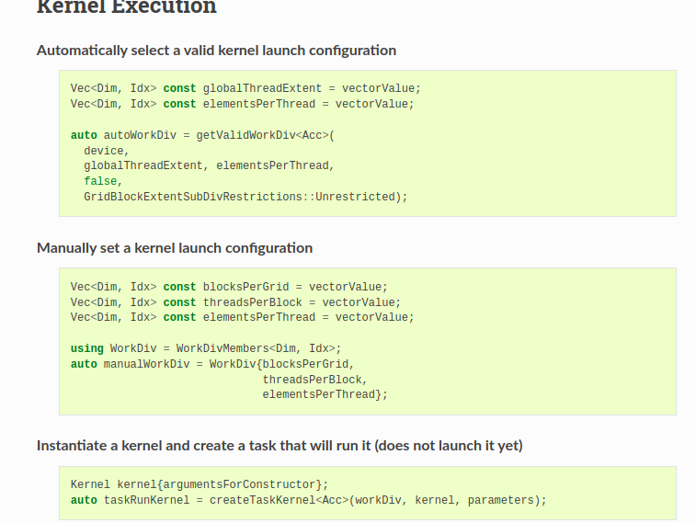
Introduction to Alpaka Programming
Introduction to Alpaka Programming
Introduction to Alpaka Programming

Slide 2
alpaka – Abstraction Library for Parallel Kernel Acceleration
Alpaka is…
A parallel programming library: Accelerate your code by exploiting your hardware‘s parallelism!
An abstraction library independent of hardware ecosystem: Create portable code that runs on CPUs and GPUs!
Free & open-source software

Slide 3
alpaka‘s purpose
Without alpaka
Hardware ecosystem is heterogenous and multiple hardware types commonly used (CPUs, GPUs, …)
Platforms not inter-operable → parallel programs not easily portable
alpaka: one API to rule them all
Abstraction (not hiding!) of the underlying hardware, compiler and OS platforms
Direct usage of vendor APIs in the backend
Easy change of the backend
  Code needs only minor adjustments to support different accelerators
Easy indexing of threads in kernels
Easy setup of the type of parallelism (Block sizes in grid, Thread sizes in block…)
Heterogenous Programming: Using different backends in a synchronized manner
User
alpaka
CPU
GPU

Slide 4

Programming with alpaka
C++ only!
Header-only library: No additional runtime dependency introduced
Modern library: alpaka is written entirely in C++17
Supports a wide range of modern C++ compilers (g++, clang++, Apple LLVM, MS Visual Studio)
Portable across operating systems: Linux, macOS, Windows are supported
Alpaka directly uses vendor API’s. For example: Alpaka cuda backend uses Cuda API directly etc.

Slide 5

alpaka is free software (MPL 2.0). Find us on GitHub!
Our GitHub organization: https://www.github.com/alpaka-group
Contains all alpaka-related projects, documentation, samples, …
New contributors welcome!
The library: https://www.github.com/alpaka-group/alpaka
Full source code
Issue tracker
Installation instructions
Small examples

Slide 6
Basics: Thread mapping on CPUs
CPU consists of multiple cores
  Because of simultaneous multithreading there can be more logical than physical cores!
alpaka Threads are executed by CPU cores.
Single thread per block. Single block per core.
Multiple elements per thread.
Thread 0
CPU
Core 0
Core 1
Thread 1
Core 2
Core 3
Thread 2
Thread 3

Slide 7
GPU
Matching threads to cores in GPUs:
How distribute threads between SMs while matching each thread to a core?
Main determinants of mapping threads to the SMs:
  Number of cores SM,
  Register and local memory (lm) usage of each thread,
  Shared memory usage of each thread,
  Threads per SM, Threads per Block, Blocks per Device
Memory latencies: Global Memory and Constant memory has different latencies.
Memory sizes: Size of shared memory used by threads in a block or blocks assigned to an SM
SM 1
T0
SM0
SM1
Shared Memory
Shared Memory
T1
C0
C1
C0
C1
C0
C0
C1
T2
C1
C0
C0
C2
T3
C2
C3
C2
C3
C3
T4
T5
SM2
SM3
Shared Memory
Shared Memory
...
...
C0
C1
C0
C1
...
C2
C3
C2
C3
Tn
Global Memory (L2)
Constant Memory (Read Only)

Slide 8
Alpaka proposes and validates WorkDivision!
WorkDivision data structure consists:
  Number of Blocks per grid
  Number of Threads per block
  Elements per thread
Alpaka validates and proposes correct parallelisation strategies to map threads to SMs
Grid
Block0
Block1
Shared Memory
Shared Memory
reg
reg
reg
reg
T0
T1
T2
T3
lm
lm
lm
lm
Global Memory (L2)
Constant Memory (Read Only)

Slide 9
struct myKernel {
/* … */
};
Basics:Threads, Kernels and Indexing
A Kernel is executed by a number of Threads
Threads are executing the same algorithm for different data elements
Indexing: Distributing the data to be processed among threads by mapping data indexes to thread indices in the kernel code!
A Kernel defines an algorithm
A Thread applies an algorithm. Uses the data part determined by it’s thread index.
Thread 0
Thread 1
Data
Element
0
Data
Element
1

Slide 10
What is an Alpaka Kernel?
Contains the algorithm
Written on per-data-element basis
alpaka Kernels are functors (function-like C++ structs / classes)
operator() is annotated with ALPAKA_FN_ACC specifier
operator() must return void
operator() must be const
struct HelloWorldKernel {
template <typename Acc>
ALPAKA_FN_ACC void operator()(Acc const & acc) const {
using namespace alpaka;
uint32_t threadIdx = getIdx<Grid, Threads>(acc)[0];
printf("Hello, World from alpaka thread %u!\n", threadIdx);
}
};

Slide 11
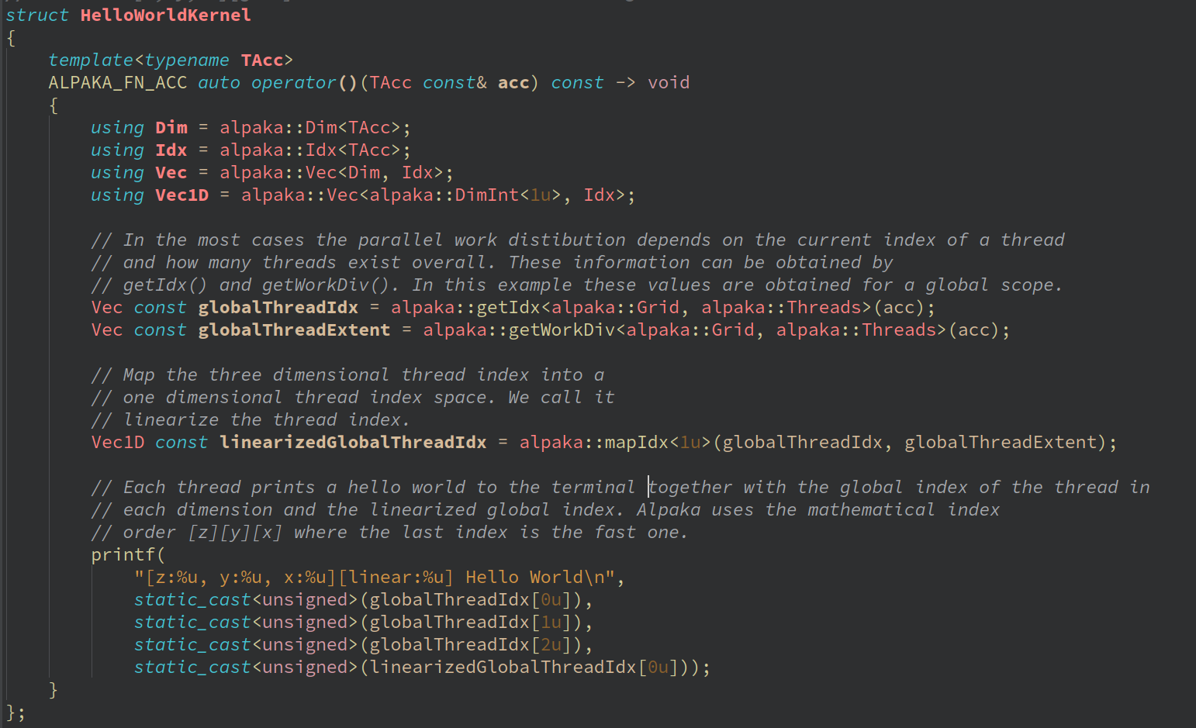
Why Alpaka - 1: Easy Indexing of Threads and Data
Direct calculation of the index of a thread with respec to a grid or block origin in the kernel.
Mapping the thread indexes to less dimensional space.

Slide 12
Obtaining the indices in Kernel
alpaka provides several API functions for obtaining indices:
  Index of Thread on the Grid: alpaka::getIdx<alpaka::Grid, alpaka::Threads>(acc)[dim];
  Index of Thread on a Block: alpaka::getIdx<alpaka::Block, alpaka::Threads>(acc)[dim];
  Index of Block on the Grid: alpaka::getIdx<alpaka::Grid, alpaka::Blocks>(acc)[dim];
You can also obtain the extents of the Grid or the Blocks:
  Number of Threads on the Grid: alpaka::getWorkDiv<alpaka::Grid, alpaka::Threads>(acc)[dim];
  Number of Threads on a Block: alpaka::getWorkDiv<alpaka::Block, alpaka:Threads>(acc)[dim];
  Number of Blocks on the Grid: alpaka::getWorkDiv<alpaka::Grid, alpaka::Blocks>(acc)[dim];

Slide 13
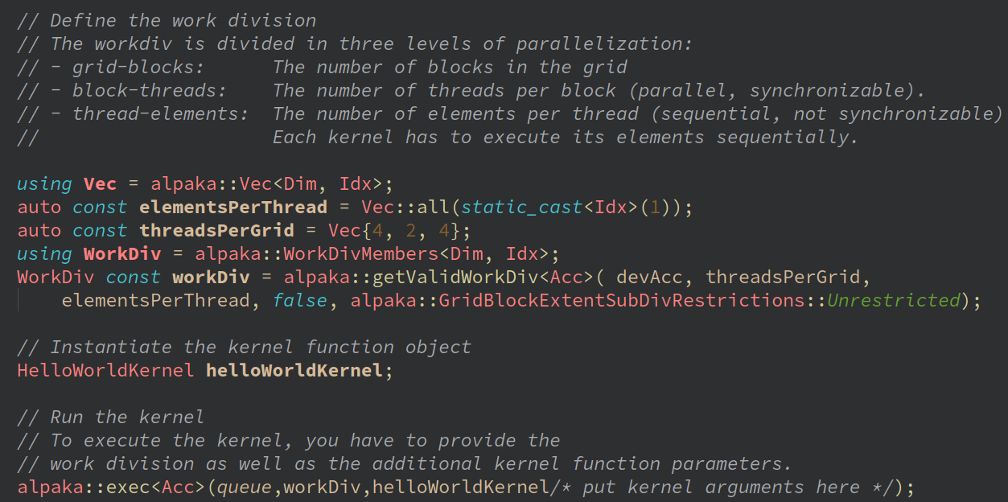
Why Alpaka-2:
Easy definition of Type of Parallelism by WorkDivision
Determines the number of kernel instantiations
Determines the type of parallelism
  Dimensions of a grid in terms of blocks,
  Dimensions of a block in terms of threads
  Elements per thread
Alpaka proposes suitable WorkDivision
using “getValidWorkDiv” function.

Slide 14
Easy definition of Type of Parallelism:
Preparing the Host for 2D Grid
Go the top of main() and enable 2D dimensionality on the Host:
  using Dim = dim::DimInt<2>;
Further down in main(), set up a 2D Thread hierarchy:
  auto blocksPerGrid = alpaka::Vec<Dim, Idx>{2u, 4u};
  auto threadsPerBlock = alpaka::Vec<Dim, Idx>{1u, 1u};
  auto elementsPerThread = alpaka::Vec<Dim, Idx>{1u, 1u};

Slide 15
Important Alpaka Structures
Accelerator provides abstract view of all capable physical devices. AccCpuThreads, AccGpuCudaRt, AccGpuHipRt...
Device represents a single physical device
Queue enables communication between the host and a single Device
Platform is a union of Accelerator, Device and Kernel
Task is a device-side operation (e.g kernel, memory operation)
Buffer is dynamic array for all devices, copyable among host and devices.
Others: Event, Vector (static array)

Slide 16
Why Alpaka3: Changing the accelerator with minimal code change
Accelerator concept is an abstraction of concrete devices and programming models
The programmer changes the accelerator in just one line of code
In the background, an entirely different code path for the “new” device is chosen
Accelerator provides portable access to device-specific functions
/* Before the code change */
using Acc = alpaka::AccCpuOmp2Blocks<Dim, Idx>;
/* Kernels will run on CPUs */
/* Parallelism provided by OpenMP 2.x */
/* After the code change */
using Acc = alpaka::AccGpuHipRt<Dim, Idx>;
/* Kernels will run on AMD + NVIDIA GPUs */
/* Parallelism provided by HIP */

Slide 17
Switching the Accelerator
alpaka provides a number of pre-defined Accelerators in the acc namespace.
For GPUs:
  AccGpuCudaRt for NVIDIA GPUs
  AccGpuHipRt for AMD and NVIDIA GPUs
For CPUs
  AccCpuFibers based on Boost.fiber
  AccCpuOmp2Blocks based on OpenMP 2.x
  AccCpuOmp4 based on OpenMP 4.x
  AccCpuTbbBlocks based on TBB
  AccCpuThreads based on std::thread
// Example: CPU accelerator
using Acc = alpaka::AccCpuOmp2Blocks<Dim, Idx>;
// Example: CUDA GPU accelerator
using Acc = alpaka::AccGpuCudaRt<Dim, Idx>;
// Example: HIP GPU accelerator
using Acc = alpaka::AccGpuHipRt<Dim, Idx>;

Slide 18
Accelerator Details
Accelerator chosen by the programmer and hides hardware specifics behind alpaka’s abstract API
  using Acc = acc::AccGpuCudaRt<Dim, Idx>;
Inside Kernel: contains thread state, provides access to alpaka’s device-side API
  The Accelerator provides the means to access to the indices
  // get thread index on the grid
  auto gridThreadIdx = alpaka::getIdx<Grid, Threads>(acc);
  // get block index on the grid
  auto gridBlockIdx = alpaka::getIdx<Grid, Blocks>(acc);
  The Accelerator gives access to alpaka’s shared memory (for threads inside the same block)
  // allocate a variable in block shared static memory
  auto & mySharedVar = block::shared::st::allocVar<int, __COUNTER__>(acc);
  // get pointer to the block shared dynamic memory
  float * mySharedBuffer = block::shared::dyn::getMem<float>(acc);
  It also enables synchronization on the block level
  // synchronize all threads within the block
  block::sync::syncBlockThreads(acc);
  Internally, the accelerator maps all device-side functions to their native counterparts
    Device-side functions require the accelerator as first argument:
      math::sqrt(acc, /* … */); time::clock(acc);
      atomic::atomicOp<atomic::op::Or>(acc, /* … */, hierarchy::Grids); (Atomics)
On Host: Meta-parameter for choosing correct physical device and dependent types

Slide 19
Physical device information and management by “alpaka Device”
Each alpaka Device represents a single physical device;
Contains device information:
  auto const name = alpaka::getName(myDev); // Back-end-defined device name
  auto const bytes = alpaka::getMemBytes(myDev); // Size of device memory
  auto const free = alpaka::getFreeMemBytes(myDev); // Size of available device memory
Provides the means for device management:
  alpaka::reset(myDev); // Reset GPU device state
Encapsulates back-end device:
  auto nativeDevice = alpaka::getDev(myDev); // nativeDevice is not portable!

Slide 20
Queue data structure
Queue: Connecting Host and Device
alpaka Queues enable communication between Host and Device
Two queue types: blocking and non-blocking
Blocking queues block the Host until Device-side command returns
Non-blocking queues return control to Host immediately, Device-side command runs asynchronously
// Choose queue behaviour - Blocking or NonBlocking
using QueueProperty = alpaka::NonBlocking;
// Define queue type
using Queue = alpaka::Queue<Acc, QueueProperty>;
// Create queue for communication with myDev
auto myQueue = Queue{myDev};

Slide 21
Queue operations
Queues execute Tasks (see next slide):
  alpaka::enqueue(myQueue, taskRunKernel);
Check for completion:
  bool done = alpaka::empty(myQueue);
Wait for completion, Events (see next slide), or other Queues:
  alpaka::wait(myQueue); // blocks caller until all operations have completed
  alpaka::wait(myQueue, myEvent); // blocks myQueue until myEvent has been reached
  alpaka::wait(myQueue, otherQueue); // blocks myQueue until otherQueue’s ops have completed

Slide 22
Queue Data Structure
Setting up Accelerator, Device and Queue
// Choose types for dimensionality and indices
using Dim = alpaka::DimInt<1>;
using Idx = std::size_t;
// Choose the back-end
using Acc = alpaka::AccGpuHipRt<Dim, Idx>;
// Obtain first device in the HIP GPU list
auto myDev = alpaka::getDevByIdx<Acc>(0u);
// Create non-blocking queue for chosen device
using Queue = alpaka::Queue<Acc, alpaka::NonBlocking>;
auto myQueue = Queue{myDev};
// Done! We can now enqueue device-side operations.

Slide 23
Task and Event
Tasks and Events
Device-side operations (kernels, memory operations) are called Tasks
Tasks on the same queue are executed in order (FIFO principle)
  alpaka::enqueue(queueA, task1);
  alpaka::enqueue(queueA, task2); // task2 starts after task1 has finished
Order of tasks in different queues is unspecified
  alpaka::enqueue(queueA, task1);
  alpaka::enqueue(queueB, task2); // task2 starts before, after or in parallel to task1
For easier synchronization, alpaka Events can be inserted before, after or between Tasks:
  auto myEvent = alpaka::Event<alpaka::Queue>(myDev);
  alpaka::enqueue(queueA, myEvent);
  alpaka::wait(queueB, myEvent); // queueB will only resume after queueA reached myEvent

Slide 24
The Platform
Changing the target platform
using namespace alpaka;
using Dim = dim::DimInt<1u>;
using Idx = std::size_t;
/*** BEFORE ***/
using Acc = alpaka::AccCpuOmp2Blocks<Dim, Idx>;
/*** AFTER ***/
using Acc = alpaka::AccGpuHipRt<Dim, Idx>;
/* No change required - dependent types and variables are automatically changed */
auto myDev = alpaka::getDevByIdx<Acc>(0u);
using Queue = alpaka::Queue<Acc, queue::NonBlocking>;
auto myQueue = Queue{myDev};

Slide 25
Summary of Alpaka Structures
Accelerator provides abstract view of all capable physical devices
Device represents a single physical device
Queue enables communication between the host and a single Device
Platform is a union of Accelerator, Device and Kernel
Task is a device-side operation (e.g kernel, memory operation)
Others: Event, Buffer (dynamic array), Vector (static array)
Question: How is portability between back-ends achieved?

Slide 26
in a Nutshell
Programming Heterogeneous Systems
Real-world scenario: Use all available compute power
Also real-world scenario: Multiple different hardware types available
Requirement: Usage of one back-end per hardware platform
Requirement: Back-ends need to be interoperable
CPU
Host
NVIDIA GPU

Slide 27
Programming Heterogeneous Systems
Why Alpaka – 4: Using multiple Platforms Synchronously
Alpaka enables easy heterogeneous programming!
Create one Accelerator per back-end
Acquire at least one Device per Accelerator
Create one Queue per Device
// Define Accelerators
using AccCpu = alpaka::AccCpuOmp2Blocks<Dim, Idx>;
using AccGpu = alpaka::AccGpuCudaRt<Dim, Idx>;
// Acquire Devices
auto devCpu = alpaka::getDevByIdx<AccCpu>(0u);
auto devGpu = alpaka::getDevByIdx<AccGpu>(0u);
// Create Queues
using QueueProperty = alpaka::NonBlocking;
using QueueCpu = alpaka::Queue<AccCpu, QueueProperty>;
using QueueGpu = alpaka::Queue<AccGpu, QueueProperty>;
auto queueCpu = QueueCpu{devCpu};
auto queueGpu = QueueGpu{devGpu};

Slide 28
Programming Heterogeneous Systems
Communication by Buffers
Buffers are defined and created per Device
Buffers can be copied between different Devices / Queues
Not restricted to a single platform!
Restriction: CPU to GPU copies (and vice versa) require GPU queue
// Allocate buffers
auto bufCpu = alpaka::allocBuf<float, Idx>(devCpu, extent);
auto bufGpu = alpaka::allocBuf<float, Idx>(devGpu, extent);
/* Initialization … */
// Copy buffer from CPU to GPU - destination comes first
alpaka::memcopy(gpuQueue, bufGpu, bufCpu, extent);
// Execute GPU kernel
alpaka::enqueue(gpuQueue, someKernelTask);
// Copy results back to CPU and wait for completion
alpaka::memcopy(gpuQueue, bufCpu, bufGpu, extent);
// Wait for GPU, then execute CPU kernel
alpaka::wait(cpuQueue, gpuQueue);
alpaka::enqueue(cpuQueue, anotherKernelTask);

Slide 29
As a summary
Without alpaka
Multiple hardware types commonly used (CPUs, GPUs, …)
Increasingly heterogeneous hardware configurations available
Platforms not inter-operable → parallel programs not easily portable
alpaka: one API to rule them all
Abstraction (not hiding!) of the underlying hardware & software platforms
  AMD, Nvidia, Intel GPUs, CPU
Easy change of the backend
  Code needs only minor adjustments to support different accelerators
Easy indexing of threads in kernels
Easy setup of the type of parallelism by WorkDivision (Block sizes in grid, Thread sizes in block…)
Heterogenous Programming: Using different backends in a synchronized manner
User
alpaka
CPU
GPU

Slide 30
Thank you! If you use alpaka for your research, please cite one of the following publications:
Matthes A., Widera R., Zenker E., Worpitz B., Huebl A., Bussmann M. (2017): Tuning and Optimization for a Variety of Many-Core Architectures Without Changing a Single Line of Implementation Code Using the Alpaka Library. In: Kunkel J., Yokota R., Taufer M., Shalf J. (eds) High Performance Computing. ISC High Performance 2017. Lecture Notes in Computer Science, vol 10524. Springer, Cham, DOI: 10.1007/978-3-319-67630-2_36.
E. Zenker et al., “Alpaka – An Abstraction Library for Parallel Kernel Acceleration”, 2016 IEEE International Parallel and Distributed Processing Symposium Workshops (IPDPSW), Chicago, IL, 2016, pp. 631 – 640, DOI: 10.1109/IPDPSW.2016.50.
Worpitz, B. (2015, September 28). Investigating performance portability of a highly scalable particle-in-cell simulation code on various multi-core architectures. Zenodo. DOI: 10.5281/zenodo.49768.

