Slide 1

Plasma-PEPSC Webinar
28 May 2024
alpaka Parallel Programming Library
Notes:
Hello everyone. Thank you for participating. In this presentation I will initially introduce alpaka generally. Then I will go over an alpaka program and explain it step by step. Lastly I will talk about performance and participants of alpaka.

Slide 2
alpaka – Abstraction Library for Parallel Kernel Acceleration
alpaka is…
A parallel programming library: Accelerate your code by exploiting your hardware‘s parallelism!
An abstraction library independent of hardware ecosystem: Create portable code that runs on CPUs and GPUs!
Open-source software & open-development
Notes:
Alpaka is a parallel programming library. You ca accelerate your code by exploiting your hardware’s paralelism. It is an abstraction library independent of hardware ecosystem.
With alpaka you can create create portable code which runs on different GPUs, and on CPUs.
Alpaka is free and open-source.
And lastly it is yet another library using an animal as logo.

Slide 3
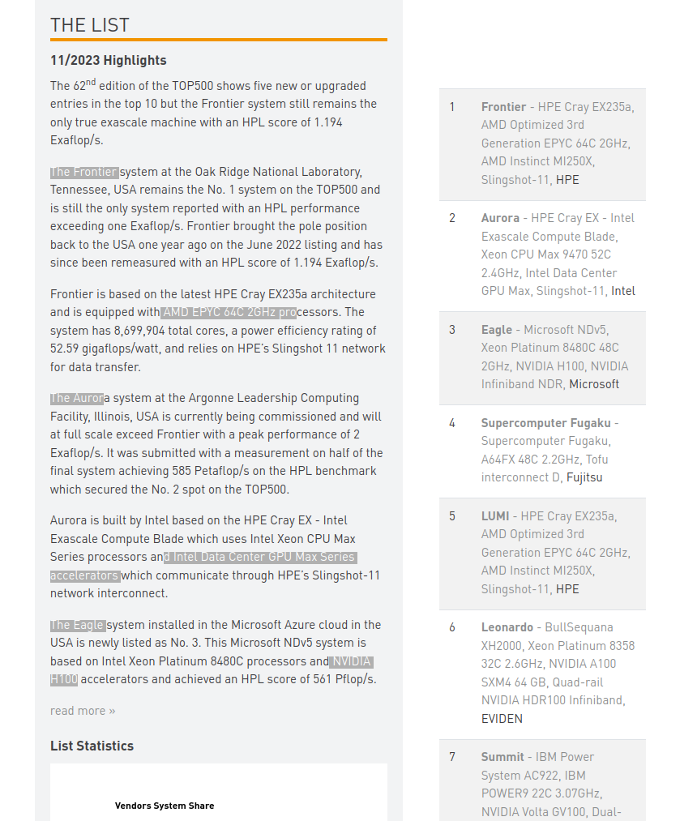
www.top500.org
Problem of HPC Systems?
Heterogenous Hardware Ecosystem!
TOP500
Frontier(USA) 1.194 Exaflop/s,
AMD EPYC CPU + AMD Instict GPU
Aurora(USA) 585 Petaflop/s,
Intel Xeon CPU + Intel GPU Max
Eagle(USA) 561 Petaflop/s,
Intel Xeon CPU + Nvidia GPU H100
Fugaku(Japan) 442 Petaflop/s,
Fujitsu A64FX CPU
Lumi(Finland) 380 Petaflop/s,
AMD EPYC CPU + AMD Instinct GPU
Notes:
If we just go over the list of top HPC systems, we can see that hardware ecosystem is quite heterogenous.
The first one in the list, Frontier in USA is using AMD GPUs, Aurora is using Intel GPUs, the third one Eagle is using Nvidia GPUs, Fugaku is using CPUs which are actually CPUs with ARM architecture and Lumi in Finland is using AMD GPUs.
And these different vendors propose different programming APIs. Even they are using different colors in their logos and publications.

Slide 4
Without alpaka
Hardware ecosystem is heterogenous, platforms are not inter-operable → parallel programs not easily portable
alpaka: one API to rule them all
Abstraction (not hiding!) of the underlying hardware, compiler and OS
  No default device, built-in functions, language extentions
Easy change of the backend in code
Direct usage of vendor APIs
  GPU Backends: Hip (AMD), Cuda (NVidia), SYCL (Intel GPUs)
  One can use vendor profilers and debuggers (Cuda,HIP…) for alpaka code!
  CPU Backends: OpenMp, Threads, TbbBlocks
Zero abstraction overhead for Kernel execution!
Heterogenous Programming: Using different backends in a synchronized manner.
User
alpaka
CPU
GPU

Slide 5
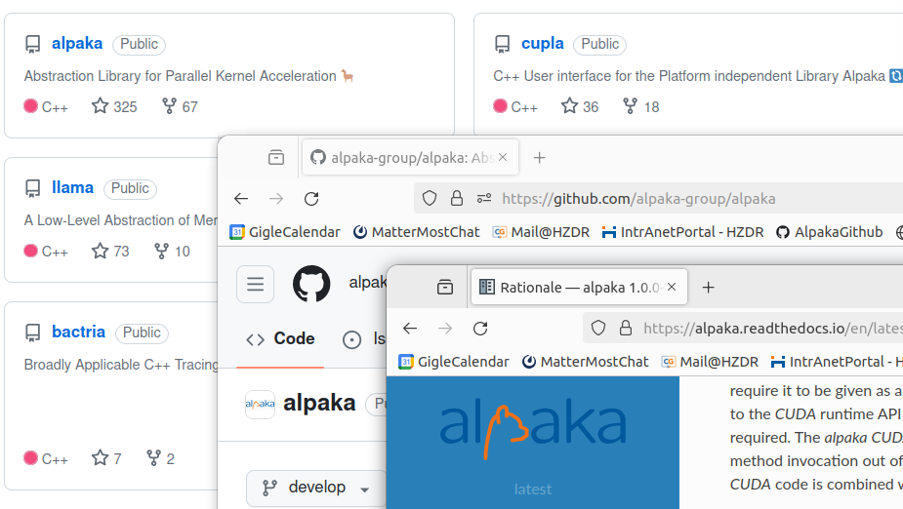

Find us on GitHub!
alpaka library: https://www.github.com/alpaka-group/alpaka
  Full source code and many examples, Issue tracker
The documents: https://alpaka.readthedocs.io/en/latest/
  Installation guide
  Cheatsheet
  Abstraction model and the rationale behind alpaka
Project group: https://www.github.com/alpaka-group
  Contains all alpaka-related projects such as vikunja, cupla ...
alpaka is a free software (MPL 2.0)
Notes:
// text cupla easy porting from cuda, vikunja is for high level algorithms
Find us on GitHub!
alpaka library: https://www.github.com/alpaka-group/alpaka
Full source code and many examples, Issue tracker
The documents: https://alpaka.readthedocs.io/en/latest/
Installation guide
Cheatsheet
Abstraction model and the rationale behind alpaka
Project group: https://www.github.com/alpaka-group
Contains all alpaka-related projects, documentation, samples, …
alpaka is a free software (MPL 2.0)

Slide 6

Programming with alpaka
C++ only!
alpaka is written entirely in C++17. Coming soon: C++20.
Header-only library. No additional runtime dependency.
#include <alpaka/alpaka.hpp> is enough!
Supports a wide range of modern C++ compilers (g++, clang++, Apple LLVM, MSVC)
Portable across operating systems: Linux, macOS, Windows

Slide 7
Installation and Examples
I-Install Dependencies
alpaka requires Boost, CMake and a modern C++ compiler (g++, clang++, Visual C++, …)
  Linux: sudo apt install libboost-all-dev (DEB)
  MacOS: brew install boost (using homebrew, https://brew.sh)
  Windows: vcpkg install boost (using vcpkg, https://github.com/microsoft/vcpkg)
Depending on your target platform you may need additional packages
  NVIDIA GPUs: CUDA Toolkit (https://developer.nvidia.com/cuda-toolkit)
  AMD GPUs: ROCm / HIP (https://rocmdocs.amd.com/en/latest/index.html)
  Intel GPUs: OneAPI Toolkit (https://www.intel.com/content/www/us/en/developer/tools/oneapi/base-toolkit.html#gs.9x3lnh)
CMake is the preferred system for building and installing
  Linux: sudo apt install cmake (DEB). macOS and Windows: Download the installer from https://cmake.org/download/

Slide 8
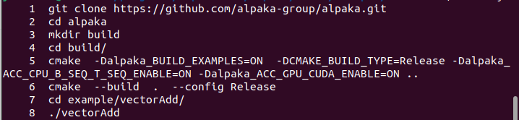
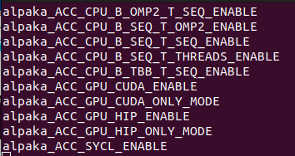
II - Compiling and running examples
You can build all examples at once from your build directory:
  configure the build with setting some cmake variables according to your system
  cmake -Dalpaka_BUILD_EXAMPLES=ON -DCMAKE_BUILD_TYPE=Release
  -Dalpaka_ACC_CPU_B_SEQ_T_SEQ_ENABLE=ON
  -Dalpaka_ACC_GPU_CUDA_ENABLE=ON ..
  build the examples
  cmake --build . --config Release
  alpaka/build/example/ directory will include compiled examples.
  e.g. alpaka/build/example/vectorAdd will have vectorAdd
Run all examples from the build directory of alpaka
  ctest example/
Run all tests from the build directory of alpaka if BUILD_TESTING cmake variable is set to ON.
  ctest test/
Examples can be re-compiled and run in their corresponding directories under build directory if there is a code change in the source tree.
  cd alpaka/build/example/vectorAdd
  cmake --build . (or run the make command if make file is there )
CMake variables which should be set to ON depending on your system during the configuration (by cmake -D... ..) before compilation.

Slide 9
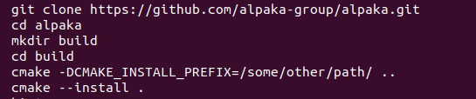
III - Install alpaka Library
Download alpaka: git clone -b develop https://github.com/alpaka-group/alpaka.git
In the terminal/powershell, switch to the downloaded alpaka directory:
  cd /path/to/alpaka
Create a build directory and switch to it:
  mkdir build then cd build
Configure build directory (If default directories is ok for you or you are planning to use alpaka from build directory; you can omit the install prefix cmake variable)
  cmake -DCMAKE_INSTALL_PREFIX=/some/other/path/ ..
Install alpaka directly, compilation is not needed since it is a header only librarys! alpaka installation will reside in /some/other/path/
  cmake --install .
You should now have a complete alpaka installation in the directory you chose earlier.
For Detailed information: https://github.com/alpaka-group/alpaka-workshop-slides/tree/develop

Slide 10
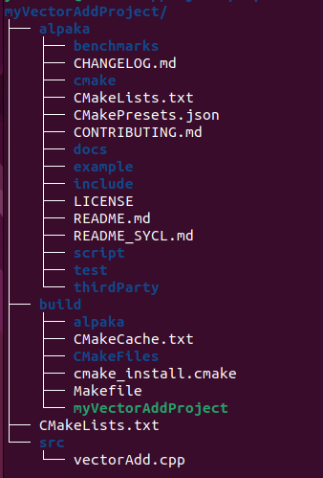
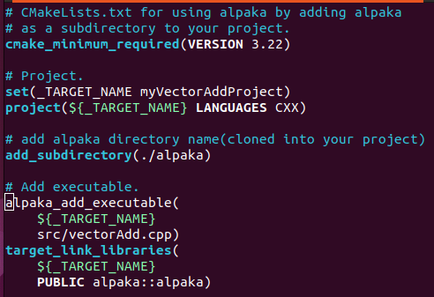
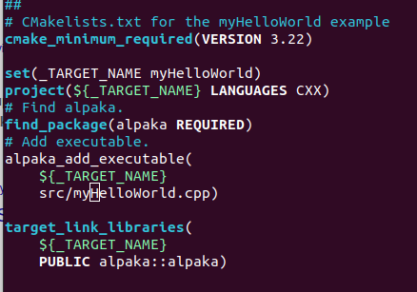
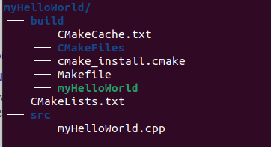
Option 2
1. Copy one of the examples to a folder outside the alpaka source tree. The folder will be your project directory.
2. Remove ExampleDefaultAcc and getAccName from the code. Select a backend (accelerator) inside the code instead of ExampleDefaultAcc.
3. Clone alpaka under your project-directory
4. Add alpaka directory to CmakeLists.txt by add_subdirectory
5. Repeat steps 3-5 of Option1 under your project directory.
IV - Create your first alpaka project
Option 1
1. After installation, create your cmake file as the one below in a new project directory. Use
find_package(alpaka REQUIRED)
  2. Create your cpp code (possibly under src directory of the project directory)
  3. Inside the directory of your project run commands:
  mkdir build then cd build
  4. Configure your project by setting the relevant cmake variables to ON according to your system.
  cmake -DCMAKE_BUILD_TYPE=Release
  -Dalpaka_ACC_CPU_B_SEQ_T_SEQ_ENABLE=ON
  -Dalpaka_ACC_GPU_CUDA_ENABLE=ON -Dalpaka_ACC_GPU_HIP_ENABLE=ON ..
5. Build your code
  cmake --build . --config Release

Slide 11
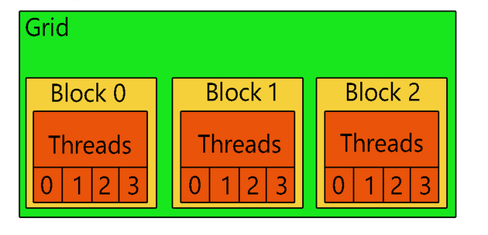
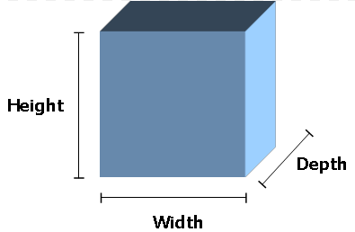
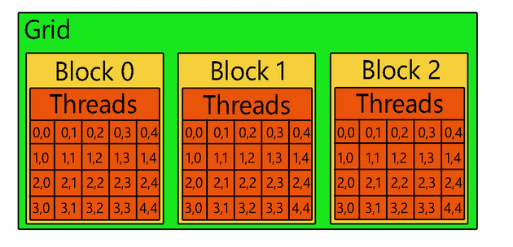
Tenets of Thread-Parallel Programming
Grid, block and thread based paralelisation model.
The model is instantiated differently on different processors, because of cache size and speed, the synchronization mechanism of the hardware, or simply the CPU-GPU difference. By using this abstraction the execution can be optimally adapted to the available hardware.
Large number of threads should run the same code (kernel) on different data in parallel.
Indexing of threads. Each thread should work on a different data portion or do a specific task, therefore each thread has an index accessible in kernel.
  - Extent: A vector representing the sizes along dimensions.
  In 3d an extent is {Depth,Height, Width}
  - Dimensions: Set of dimension names. {Z-dimension, Y-dimension, X-dimension}
  - Number of Dimensions
Grid-Block Extent: Vec{3}
Block-Thread Extent: Vec{4}
Grid-Block Extent: Vec{3} or Vec{1,3}
Block-Thread Extent: Vec{4,5}

Slide 12
Vector Addition Problem
A + B = C
A0
B0
C0
C = A+B
Thread0
A1
B1
C1
Thread1
Block0
A2
B2
C2
Thread2
Thread3
A3
B3
C3
Thread4
A4
B4
C4
Grid
A5
B5
C5
Block1
Thread5
...
...
...
…….
...
...
...
…..
…….
...
...
...
…….
BlockM-1
An
Bn
Cn
ThreadN-1
Work Division

Slide 13
Vector Addition Problem
A + B = C
A0
B0
C0
C = A+B
I- Mapping the ThreadIndex to the DataIndex
One to one,
Identity
II- Grouping threads
Thread0
A1
B1
C1
Thread1
Block0
A2
B2
C2
Thread2
Thread3
A3
B3
C3
Thread4
A4
B4
C4
Grid
A5
B5
C5
Block1
Thread5
...
...
...
…….
...
...
...
…..
…….
...
...
...
…….
BlockM-1
An
Bn
Cn
ThreadN-1
Work Division

Slide 14
Vector Addition Code Steps
Create Kernel.
Decide where will the paralel and non-parallel parts of the code run.
Decide how to parallelise (number of blocks and threads).
Allocate host and device memory for A,B and C.
Copy the memory to the device.
Run the kernel
Copy the result data back to the host.

Slide 15
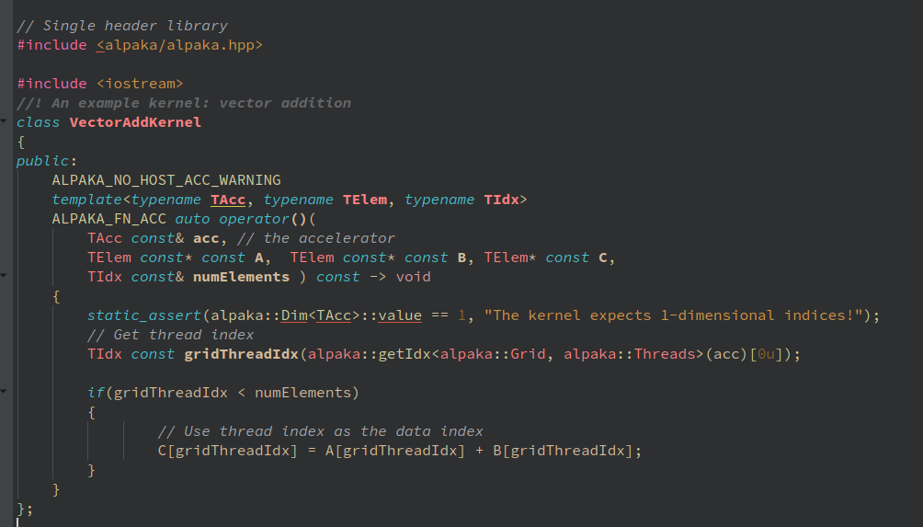
1. Define the alpaka Kernel
Contains the algorithm that is run by each thread
alpaka Kernels are functors (function-like C++ structs / classes) or lambdas
Arguments can be pointers and trivially copyable types
Agnostic to device details

Slide 16
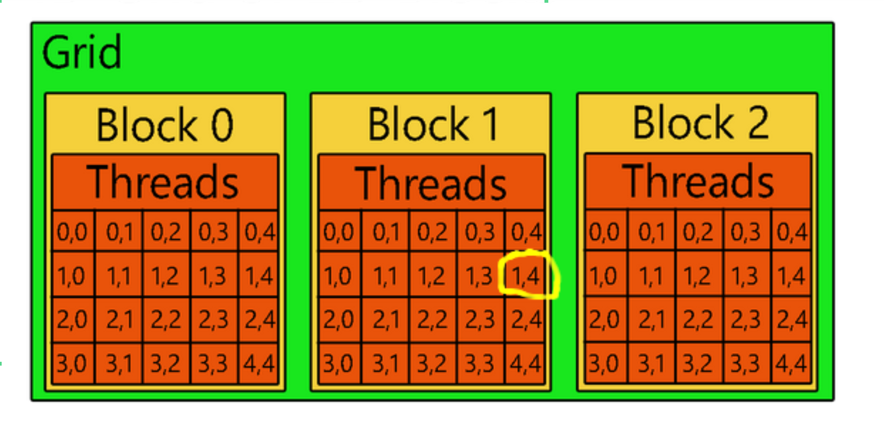
Obtaining
the indices of threads/blocks
inside the Kernel
  Index of Thread on the Grid:
  auto gridThreadIndex = alpaka::getIdx<alpaka::Grid, alpaka::Threads>(acc);
  // gridThreadIndex is {1,9}
  Index of Thread on a Block:
  auto theradBlockIndex = alpaka::getIdx<alpaka::Block, alpaka::Threads>(acc);
  // threadBlockIndex is {1,4}
  Index of Block on the Grid:
  auto blockGridIndex = alpaka::getIdx<alpaka::Grid, alpaka::Blocks>(acc);
  // the blockGridIndex is {1}

Slide 17
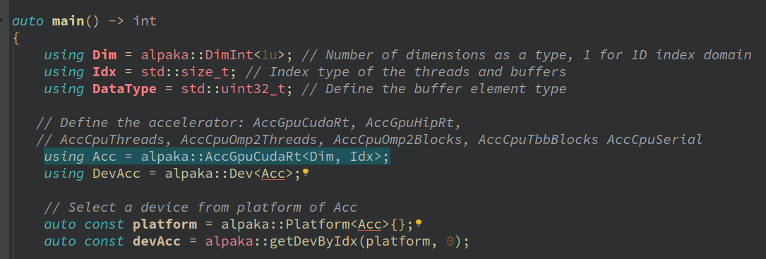
2. Select the Accelerator, Platform and Device
alpaka provides a number of pre-defined Accelerators.
  AccGpuCudaRt for Nvidia GPUs
  AccGpuHipRt for AMD GPUs
  AccGpuSyclIntel for AMD, Intel and Nvidia GPUs
  AccCpuOmp2Blocks based on OpenMP 2.x
  AccCpuTbbBlocks based on TBB
  AccCpuThreads based on std::thread
  AccCpuSycl
  AccFpgaSyclIntel
Device instance represents a single physical device

Slide 18
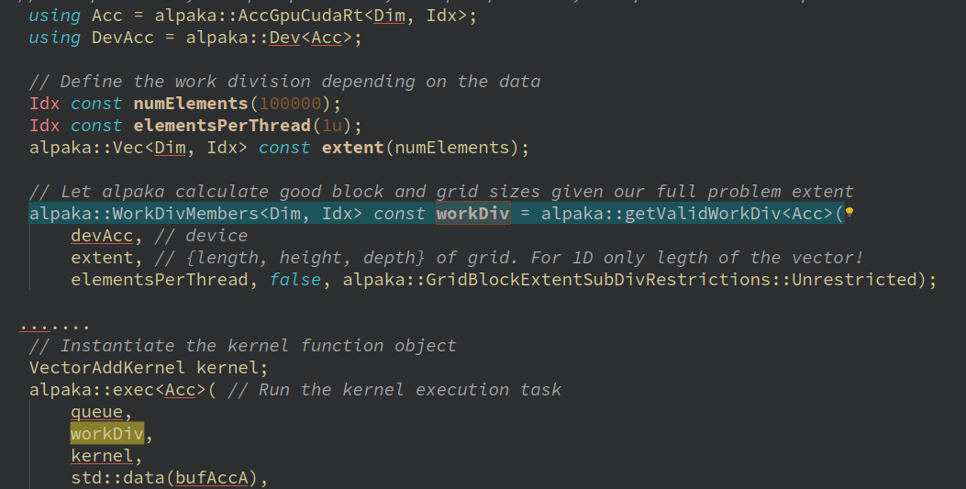
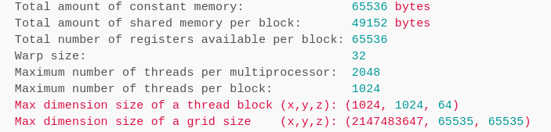
3. How to parallelise?
I- Get a valid work division from alpaka
Use getValidWorkDiv function which devides the full grid-thread extent into blocks.
Inputs:
  Full grid-thread extent (total number of threads needed) and Elements per thread extent
The probable output:
{Vec{alpaka::core::divCeil(numElements,1024)}, Vec{1024}, Vec{1} }
II - Determine the workdivision manually
WorkDivision data structure consists 3 vectors:
  Grid block extent.
    Vec{alpaka::core::divCeil(numElements,1024)} or Vec{1,1,alpaka::core::divCeil(numElements,1024)} depending on the number of dimensions.
  Block thread extent: Vec{1024} or Vec{1,1,1024}
  Elements per thread is Vec{1} or Vec{1,1,1}
Nvidia Tesla K20 deviceQuery

Slide 19
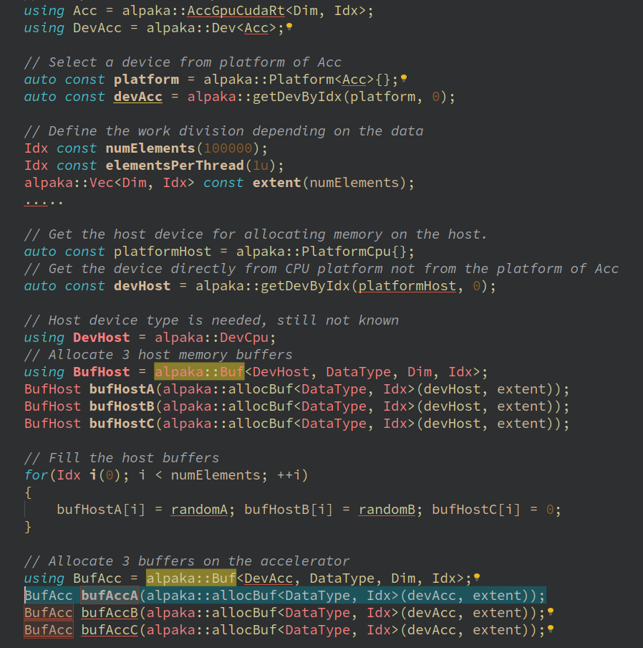
4. Allocate data vectors A and B on host and device.
alpaka::Buf is multi-dimensional dynamic (runtime sized) container.
It contains
  memory,
  size,
  the device, the memory is allocated in!
alpaka::allocBuf() allocates memory to the given device.

Slide 20
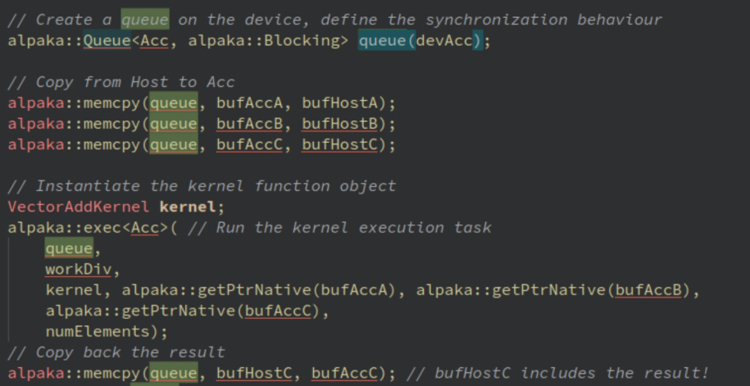
5.1 Create the Queue for memcpy and kernel task
alpaka::Queue is “a queue of tasks”
Queue is always FIFO, everything is sequential inside the queue.
and more
  Different queues run in parallel for many devices
  Used for synchronization
  Accelerator back-ends can be mixed (used in interleaves) within a device queue.
  ...

Slide 21
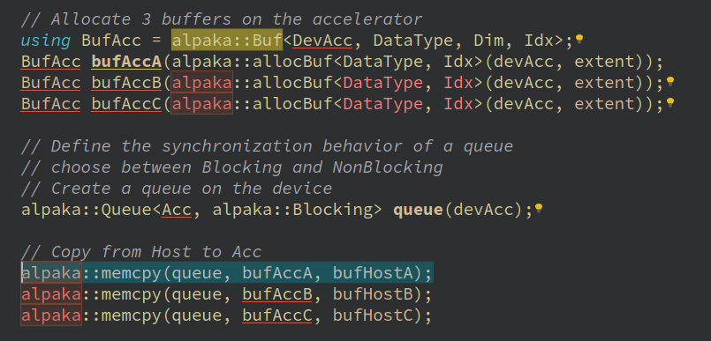
5.2 Copy data vectors to the Device
alpaka::memcpy copies the data from one buffer/view to another buffer or view.
alpaka::Buf knows the device it belongs to.
Alternatively alpaka::View is used to adapt already allocated memory.
  if we already have a C++ std::vector at host; we don’t need to create an alpaka::Buf to copy it between different devices. Converting it to an alpaka::View is enough to copy it using alpaka::memcpy.

Slide 22
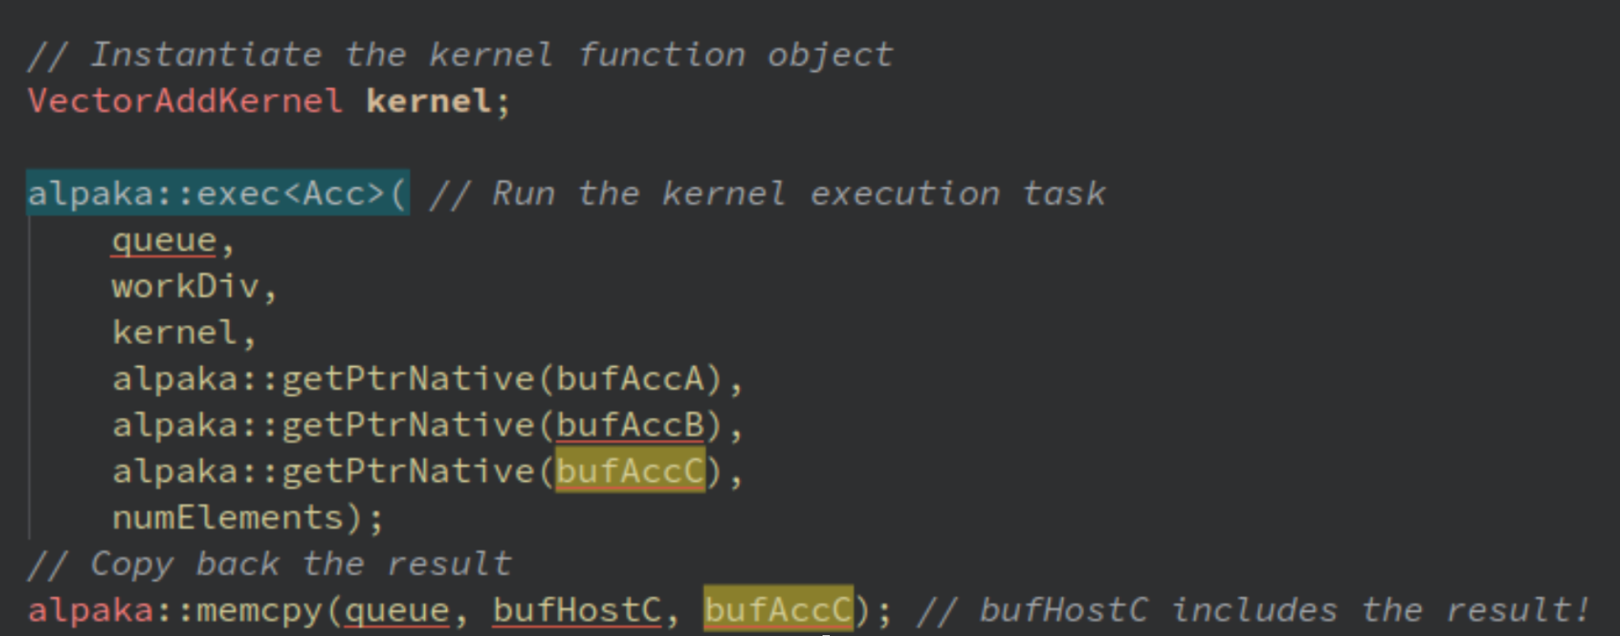
6. Execute the kernel
Call alpaka::exec function
The result is stored in an alpaka::Buf
7. Copy result back
Copy the result in device to the host

Slide 23
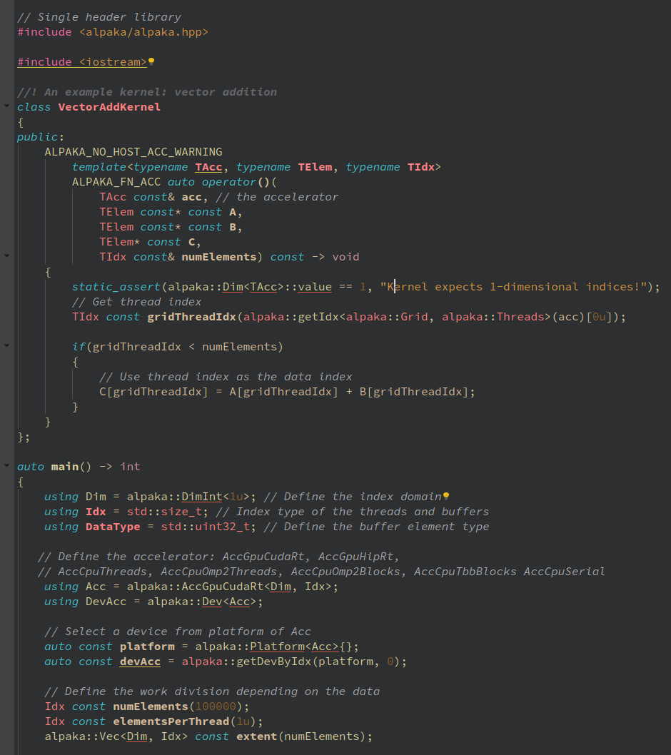
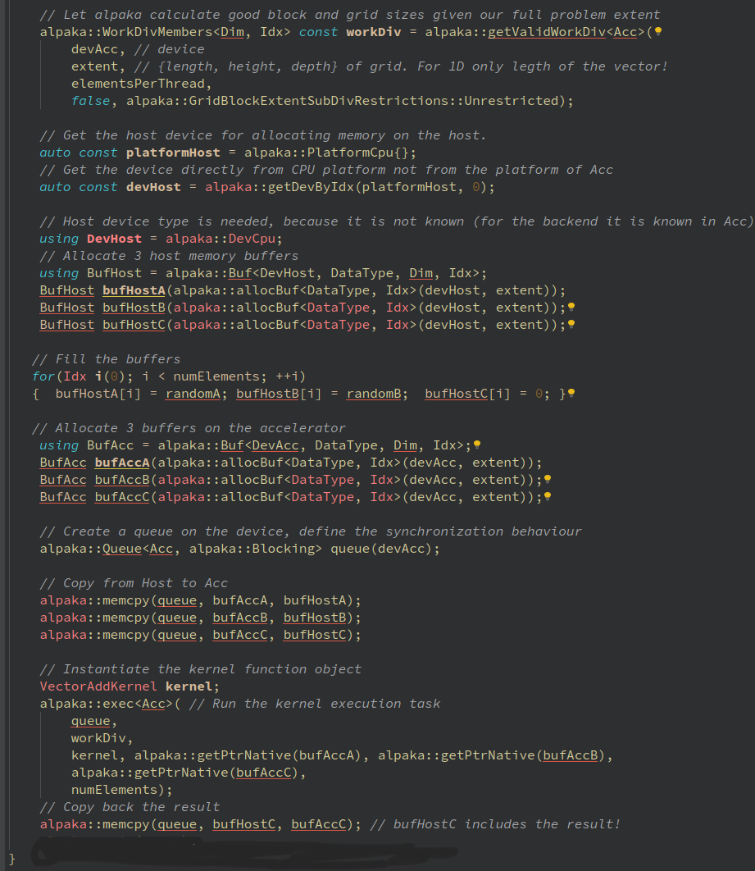
Parallel vector addition code

Slide 24
Parallel vector addition code
Single header
Get Work division
kernel
Get host device (CPU)
allocate memory at host (CPU)
allocate memory at device (GPU)
Copy vectors to device (GPU)
Select accelerator
Execute kernel
and the device (GPU)
Copy result to host (CPU)

Slide 25
Programing Tips
If you want to pass multi-dimensional data to kernel, use mdspan (enable it via cmake option)
(If you don’t use mdspan; you will need to take care of alignment/pitch values. Pass the pointer, extents and the pitch.)
To incease perfomance; using shared memory and constant memory of GPUs are among alpaka features.
A kernel can be run directly by exec function or can be enqueued as a task.
Vendor specific profiling and debugging tools (e.g. nsys, rocprof …) can be used on compiled alpaka code.
If you debug GPU code try to compile your code for CPU; and use CPU debugger tools
(Change accelerator type to CPU accelerators, then debug using gdb and similar tools.)
Inside alpaka Kernel, you can use printf; but you should not use std::cout for GPU backends.
For unused number of dimensions in workdiv; use 1, for that dimension.
auto blockThreadExtent = alpaka::Vec<TDim3D,Idx>{1u,1u,128u};

Slide 26
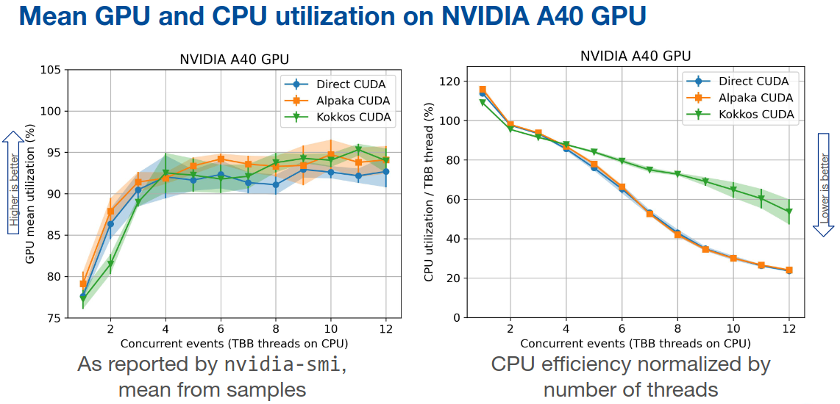
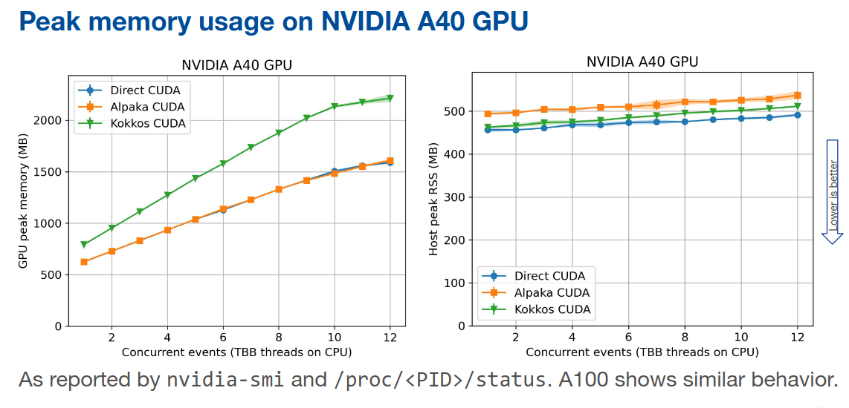




Performance of Alpaka
Source:
https://indico.jlab.org/event/459/contributions/11824/attachments/9281/14171/20230511-CHEaP23_CMSPortability.pdf

Slide 27
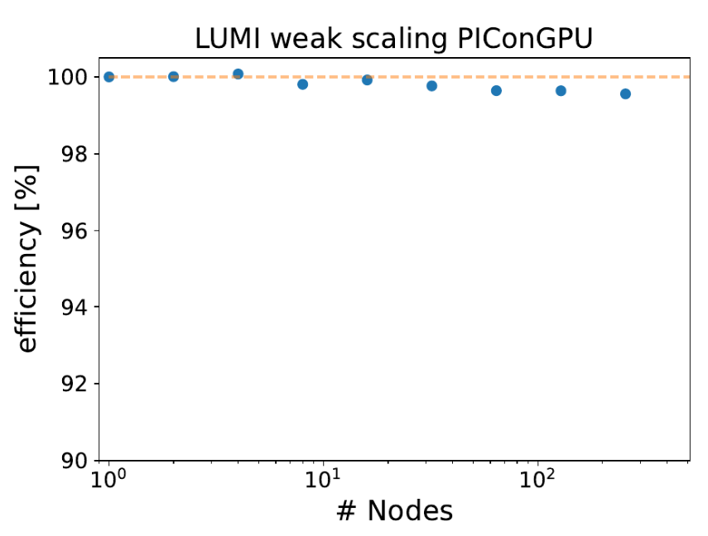
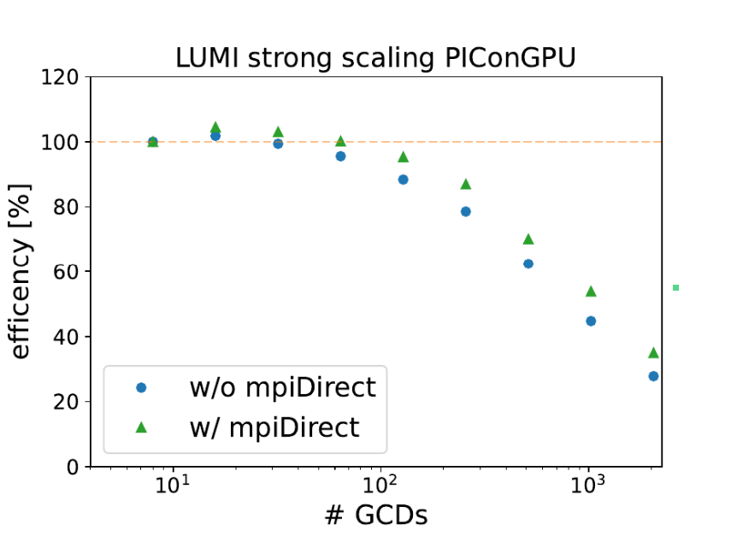

alpaka in the wild...
PIConGPU:
Fully relativistic, manycore, 3D3V particle-in-cell (PIC) code
Implements central algorithms in plasma physics
Scalable to more than 18,000 GPUs
Developed at Helmholtz-Zentrum Dresden-Rossendorf
https://github.com/ComputationalRadiationPhysics/picongpu

Slide 28

Don’t write code initially on cuda because alpaka is already low level!
Use alpaka directly by using examples and the cheat-sheet.
BUT if you already have a codebase in cuda, converting to cupla can be a fast solution to benefit from alpaka features!
  cupla - C++ User interface for the Platform Independent Library alpaka
How to start using alpaka
https://github.com/alpaka-group/cupla

Slide 29
Cuda
cupla
Cuda to portable C++ code
Change the suffix .cu of the CUDA source files to .cpp
Remove #include <cuda_runtime.h> and other cuda specific include files.
Add #include <cuda_to_cupla.hpp>
Kernel Function
  template<int blockSize>
  __global__ void fooKernel(int * ptr, float value)
  { // … }
Kernel call at host
dim3 gridSize(42,1,1);
dim3 blockSize(256,1,1);
fooKernel<16><<< gridSize, blockSize, 0, 0>>>(ptr, 23);
Device function
  template<typename TElem>
  __device__ int deviceFunction(TElem x)
  { // … }
  // call
  auto result = deviceFunction(x);
Shared memory
__shared__ int foo;
  __shared__ int fooCArray2D[4][32];
Kernel Functor
  template<int blockSize>
  struct fooKernel {
  template<typename Tacc>
  ALPAKA_FN_ACC void operator()(TAcc const & acc, int * const ptr, float const value) const
  { // ... }
  };
Kernel call at host
dim3 gridSize(42,1,1); dim3 blockSize(256,1,1);
  CUPLA_KERNEL(fooKernel<16>)( gridSize, blockSize, 0, 0)(ptr, 23);
Device function
template< typename TAcc, typename TElem >
  ALPAKA_FN_ACC int deviceFunction( TAcc const & acc, TElem x)
  { // … }
  // call
  auto result = deviceFunction(acc, x);
Shared memory
  sharedMem(foo, int);
  sharedMem(fooCArray2D, cupla::Array< cupla::Array<int,4>, 32>);

Slide 30




Community and Long Term Support
Partners using and contributing to alpaka
alpaka is a part of Strategic Helmholtz Program-Oriented Funding Roadmap 2027-2034

Slide 31
As a summary
Without alpaka
In HPC world, Multiple hardware types are available from different vendors (CPUs, GPUs, …)
Platforms are not inter-operable → parallel programs are not easily portable
alpaka: one API to rule them all
Abstraction (not hiding!) of the underlying hardware & software platforms
  AMD, Nvidia, Intel GPUs, Different CPU parallelisations like TbbBlocks, OpenMP, Threads
Easy change of the backend in Code
Builts down to the same machine code with the vendor solutions
Zero abstraction overhead for Kernel execution!
Heterogenous Programming: Using different backends in a synchronized manner
User
alpaka
CPU
GPU

Slide 32
If you use alpaka for your research, please cite one of the following publications:
Matthes A., Widera R., Zenker E., Worpitz B., Huebl A., Bussmann M. (2017): Tuning and Optimization for a Variety of Many-Core Architectures Without Changing a Single Line of Implementation Code Using the alpaka Library. In: Kunkel J., Yokota R., Taufer M., Shalf J. (eds) High Performance Computing. ISC High Performance 2017. Lecture Notes in Computer Science, vol 10524. Springer, Cham, DOI: 10.1007/978-3-319-67630-2_36.
E. Zenker et al., “alpaka – An Abstraction Library for Parallel Kernel Acceleration”, 2016 IEEE International Parallel and Distributed Processing Symposium Workshops (IPDPSW), Chicago, IL, 2016, pp. 631 – 640, DOI: 10.1109/IPDPSW.2016.50.
Worpitz, B. (2015, September 28). Investigating performance portability of a highly scalable particle-in-cell simulation code on various multi-core architectures. Zenodo. DOI: 10.5281/zenodo.49768.
Thank you!
You can contact us for any of your questions about alpaka!

Slide 33
APPENDICES

Slide 34
Appendix-1 Summary of alpaka Structures
Accelerator provides abstract view of all capable physical devices
Device represents a single physical device
Queue enables communication between the host and a single Device, enables synchronisation of tasks on different queues
Platform is a union of Accelerator, Device and Kernel
Task is a device-side operation (e.g kernel, memory operation)
Others: Event, Buffer (runtime sized contiguous container), Vector (static array)

Slide 35
Appendix-2: Programming Heterogeneous Systems-I
// Define Accelerators
using AccCpu = alpaka::AccCpuOmp2Blocks<Dim, Idx>;
using AccGpu = alpaka::AccGpuCudaRt<Dim, Idx>;
// Acquire at least one Device per Accelerator
auto devCpu = alpaka::getDevByIdx<AccCpu>(0u);
auto devGpu = alpaka::getDevByIdx<AccGpu>(0u);
// Create one queue per device
using QueueProperty = alpaka::NonBlocking;
using QueueCpu = alpaka::Queue<AccCpu, QueueProperty>;
using QueueGpu = alpaka::Queue<AccGpu, QueueProperty>;
auto queueCpu = QueueCpu{devCpu};
auto queueGpu1 = QueueGpu{devGpu};
auto queueGpu2 = QueueGpu{devGpu};
// Run tasks in parallel
alpaka::enqueue(queueCpu, taskCpu);
alpaka::enqueue(QueueGpu1, taskGpu1);
alpaka::enqueue(QueueGpu2, taskGpu2);
// Make sure all non-blocking queue tasks finished
// before the main thread ends
alpaka::wait(queueCpu);
alpaka::wait(QueueGpu1);
alpaka::wait(QueueGpu2);
How to use multiple backends in parallel?
Acquire at least one Device per Accelerator
Create one Queue per Device

Slide 36
Appendix-3
Programming Heterogeneous Systems-II
// Allocate buffers
auto bufCpu = alpaka::allocBuf<float, Idx>(devCpu, extent);
auto bufGpu = alpaka::allocBuf<float, Idx>(devGpu, extent);
/* Initialization … */
// Copy buffer from CPU to GPU - destination comes first
alpaka::memcopy(gpuQueue, bufGpu, bufCpu, extent);
// Execute GPU kernel
alpaka::enqueue(gpuQueue, someKernelTask);
// Copy results back to CPU and wait for completion
alpaka::memcopy(gpuQueue, bufCpu, bufGpu, extent);
// Wait for GPU, then execute CPU kernel
alpaka::wait(cpuQueue, gpuQueue);
alpaka::enqueue(cpuQueue, anotherKernelTask);
Communication by Buffers
Buffers are defined and created per Device
Buffers can be copied between different Devices
Notice: CPU to GPU copies (and vice versa) require GPU queue

Slide 37
GPU
Threads
Appendix-4: How to set work-division?
How to distribute threads among SMs?
Main determinants of mapping threads to the SMs:
  Number of cores SM,
  Warpsize,
  Register and local memory (lm) usage of each thread,
  Shared memory usage of each thread,
  Threads per SM, Threads per Block, Blocks per Device
Memory latencies: Global Memory and Constant memory has different latencies.
Memory sizes: Size of shared memory used by threads in a block or blocks assigned to an SM
SM 1
T0
SM0
SM1
Shared Memory
Shared Memory
T1
C0
C1
C0
C1
C0
C0
C1
T2
C1
C0
C0
C2
T3
C2
C3
C2
C3
C3
T4
T5
SM2
SM3
Shared Memory
Shared Memory
...
...
C0
C1
C0
C1
...
C2
C3
C2
C3
Tn
Global Memory (L2)
Constant Memory (Read Only)

Slide 38
1D Grid with 1D Blocks
Appendix-5 – Understanding WorkDivision
1D WorkDivision
Grid Block Extent 1D vector = Vec{M}
Block Thread Extent 1D vector = Vec{4u}
Thread Elem Extent 1D vector = Vec{1u}
Grid Thread Extent 1D vector =Vec{4*M} or Vec{N}
1D WorkDivision {{M},{4u},{1u}}
// if Dim is 3 then fill with 1u
1D WorkDivision {{1u,1u,M},{1u,1u,4},{1u,1u,1u}}
Block0
Block1
BlockM-1
T0
T0
T0
…..
T1
T1
…..
T1
T2
T2
T2
T3
T3
T3
2D Grid with 2D Blocks
Block0,0
Block0,1
Block0,1
Block0,1
Block0,2
Block0,M-1
T0,0
T0,0
T0,1
2D WorkDivision!
Grid Block Extent 2D vector = Vec{M,M}
Block Thread Extent 2D vector = Vec{2u,2u}
Thread Elem Extent 2D vector = Vec{1u,1u}
Grid Thread Extent 2D vector =Vec{4u*M,4u*M} or Vec{N,N}
2D WorkDivision {{M,M},{2u,2u},{1u,1u}}
2D WorkDivision {{1u,M,M},{1u,2u,2u},{1u,1u,1u}}
T0,1
0,0
0,1
…..
0,0
0,1
0,0
0,1
0,0
0,1
T1,0
…..
T1,0
T1,1
T1,1
1,0
1,1
1,0
1,1
1,0
1,1
1,0
1,1
…..
…..
…..
…..
…..
…..
…..
…..
BlockM-1,0
BlockM-1,M-1
0,0
0,1
0,0
0,1
…..
…..
…..
…..
…..
1,0
1,1
1,0
1,1

Slide 39
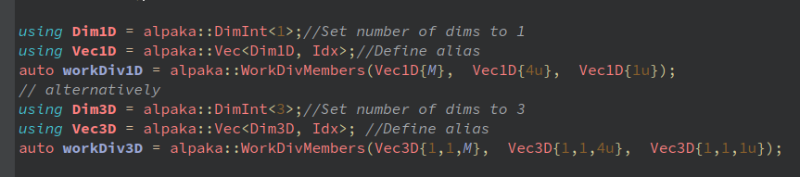
A + B = C
Appendix-6 Set the workdivision manually
WorkDivision data structure consists 3 vectors:
  Grid block extent.
    Vec{M} or Vec{1,1,M} depending on the number of dimensions.
  Block thread extent.
    Vec{4} or Vec{1,1,4}
  Elements per thread
Setting work-div manually
Thread0
A0
B0
C0
Thread1
A1
B1
C1
Block0
A2
B2
C2
Thread2
Thread3
A3
B3
C3
Thread4
A4
B4
C4
Grid
A5
B5
C5
Block1
Thread5
…….
...
...
...
...
...
...
…..
…….
…….
...
...
...
BlockM-1
An
Bn
Cn
ThreadN-1
Work Division

Slide 40
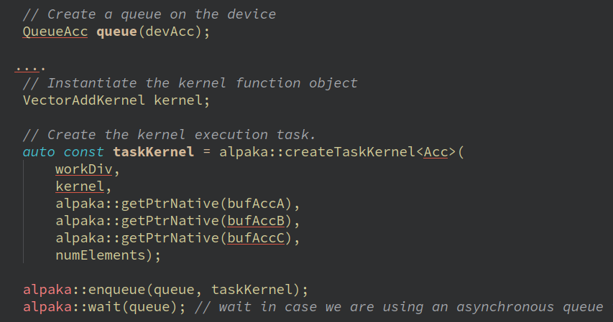
Appendix-7 Tasks and Events
Device-side related operations (kernels, memory operations) can be wrapped in tasks.
Tasks are executed by enqueue() function.
Tasks on the same queue are executed in order (FIFO principle)
  alpaka::enqueue(queueA, task1); alpaka::enqueue(queueA, task2); // task2 starts after task1 has finished, even queueA is non-blocking
Order of tasks in different queues is unspecified
  alpaka::enqueue(queueA, task1);
  alpaka::enqueue(queueB, task2); // task2 starts before, after or in parallel to task1
For easier synchronization, alpaka Events can be inserted before, after or between Tasks:
  auto myEvent = alpaka::Event<alpaka::Queue>(myDev);
  alpaka::enqueue(queueA, myEvent);
  alpaka::wait(queueB, myEvent); // queueB will only resume after queueA reached myEvent

Slide 41
Appendix-8 Accelerator Details
Accelerator chosen by the programmer and hides hardware specifics behind alpaka’s abstract API
  using Acc = acc::AccGpuCudaRt<Dim, Idx>;
Inside Kernel: contains thread state, provides access to alpaka’s device-side API
  The Accelerator provides the means to access to the indices
  // get thread index on the grid
  auto gridThreadIdx = alpaka::getIdx<Grid, Threads>(acc);
  // get block index on the grid
  auto gridBlockIdx = alpaka::getIdx<Grid, Blocks>(acc);
  The Accelerator gives access to alpaka’s shared memory (for threads inside the same block)
  // allocate a variable in block shared static memory
  auto & mySharedVar = block::shared::st::allocVar<int, __COUNTER__>(acc);
  // get pointer to the block shared dynamic memory
  float * mySharedBuffer = block::shared::dyn::getMem<float>(acc);
  It also enables synchronization on the block level
  // synchronize all threads within the block
  block::sync::syncBlockThreads(acc);
  Internally, the accelerator maps all device-side functions to their native counterparts
    Device-side functions require the accelerator as first argument:
      math::sqrt(acc, /* … */); time::clock(acc);
      atomic::atomicOp<atomic::op::Or>(acc, /* … */, hierarchy::Grids); (Atomics)
On Host: Meta-parameter for choosing correct physical device and dependent types

Slide 42
APPENDIX-9 Device information and device management
Each alpaka Device represents a single physical device;
Contains device information:
  auto const name = alpaka::getName(myDev); // Back-end-defined device name
  auto const bytes = alpaka::getMemBytes(myDev); // Size of device memory
  auto const free = alpaka::getFreeMemBytes(myDev); // Size of available device memory
Provides the means for device management:
  alpaka::reset(myDev); // Reset GPU device state
Encapsulates back-end device:
  auto nativeDevice = alpaka::getDev(myDev); // nativeDevice is not portable!

Slide 43
APPENDIX-10 Queue operations
Queues execute Tasks (see next slide):
  alpaka::enqueue(myQueue, taskRunKernel);
Check for completion:
  bool done = alpaka::empty(myQueue);
Wait for completion, Events (see next slide), or other Queues:
  alpaka::wait(myQueue); // blocks caller until all operations have completed
  alpaka::wait(myQueue, myEvent); // blocks myQueue until myEvent has been reached
  alpaka::wait(myQueue, otherQueue); // blocks myQueue until otherQueue’s ops have completed

Slide 44
Appendix-11 Changing the target platform by changing accelerator
using namespace alpaka;
using Dim = dim::DimInt<1u>;
using Idx = std::size_t;
/*** BEFORE ***/
using Acc = alpaka::AccCpuOmp2Blocks<Dim, Idx>;
/*** AFTER ***/
using Acc = alpaka::AccGpuHipRt<Dim, Idx>;
/* No change required - dependent types and variables are automatically changed */
auto myDev = alpaka::getDevByIdx<Acc>(0u);
using Queue = alpaka::Queue<Acc, queue::NonBlocking>;
auto myQueue = Queue{myDev};

