Slide 1
QueryMaster End-to-End Text-to-SQL Agent
FEE306 Applied Artificial Neural Networks - Final Project
Mehmet Zahit Avcı 22040102030

Slide 2
Problem & Motivation
SQL is difficult for non-technical users.
Text-to-SQL can make database access easier.
Many existing solutions require powerful hardware or cloud services.
The goal: To build a local, efficient and a verifiable Text-to-SQL agent
runing on consumer hardware.

Slide 3
Methodology & Tech Stack
Base Model: Qwen3-8B (4-bit)
Fine-tuning: LoRA with MLX
Hardware: Apple Silicon
Training Data: BIRD + SynSQL
Interface: Streamlit for local inference
Execution & Validation: Embedded SQLite & Mermaid.js

Slide 4
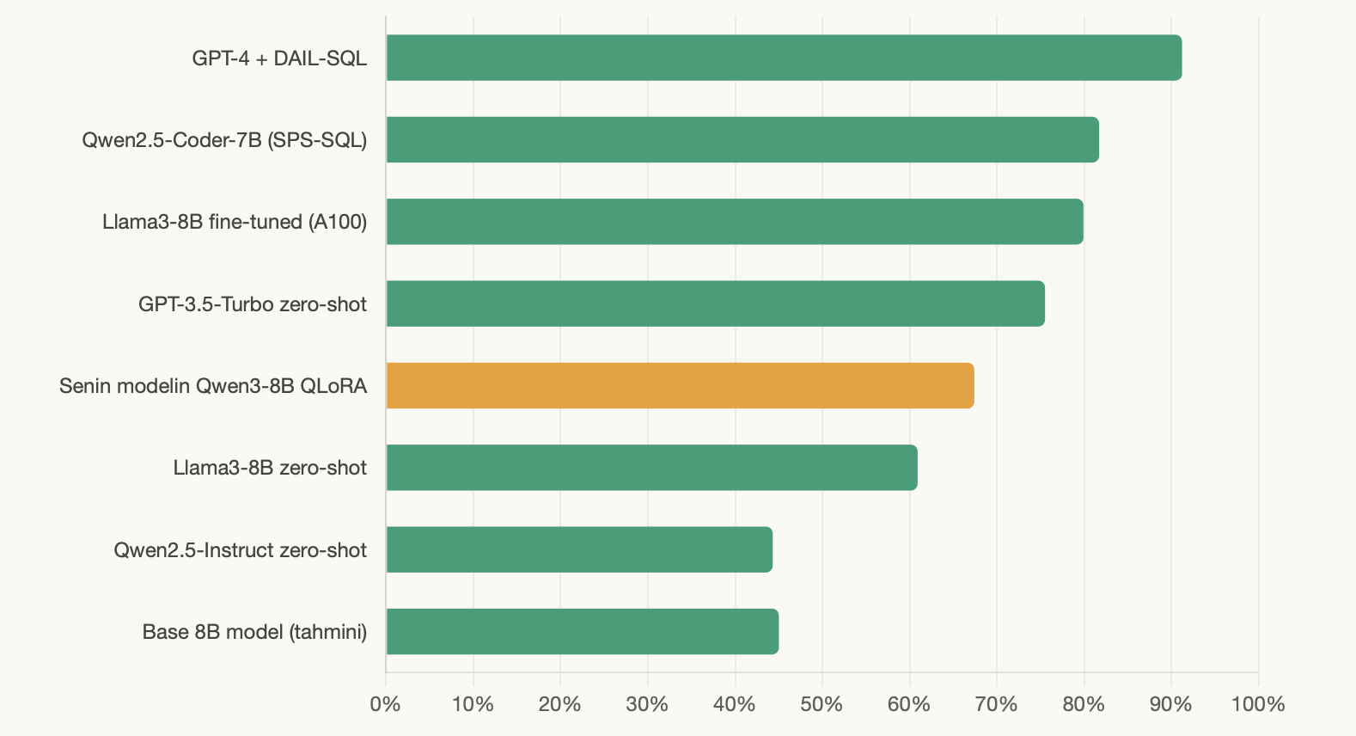
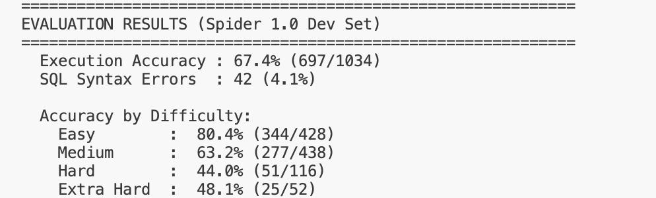
Evaluation Results
Benchmark: Spider 1.0 Development Set
Execution Accuracy: 67.4%
Syntax Error Rate: 4.1%
Correct Predictions: 697 / 1034
QueryMaster
Accuracy comparison
Difficulty breakdown

Slide 5
Advanced Features
Dynamic SQLite Execution: Displays tabular results from produced queries that are executed in real-time on uploaded or in-memory databases.
ER Diagrams: Uses Mermaid.js to automatically visualize table relationships and instantly understand DDL schemas.
Execution Flowcharts: Step-by-step visualization of the logical execution order of the AI-generated SQL queries.
Accuracy Validation: Executes the created query against the expected Gold SQL in order to do multiset row comparison and mathematically check accuracy.
Export & Reporting: Allows downloading query results as CSV/JSON and exporting a comprehensive Markdown report of the entire analysis.

Slide 6
Live Demo
Streamlit Interface

Slide 7
Future Work
API Microservices: Deploy the inference layer as a scalable FastAPI service for broader integration.
Multi-Dialect Support: Extend the execution engine to support enterprise databases like PostgreSQL and MySQL.
Agentic Frameworks: Integrate frameworks like LangChain to allow the model to auto-correct its SQL based on real-time execution errors.
Stronger Base Models: Exploring 14B or 32B parameter open-weight models and faster strategies for even higher accuracy on complex schemas.

