Slide 1
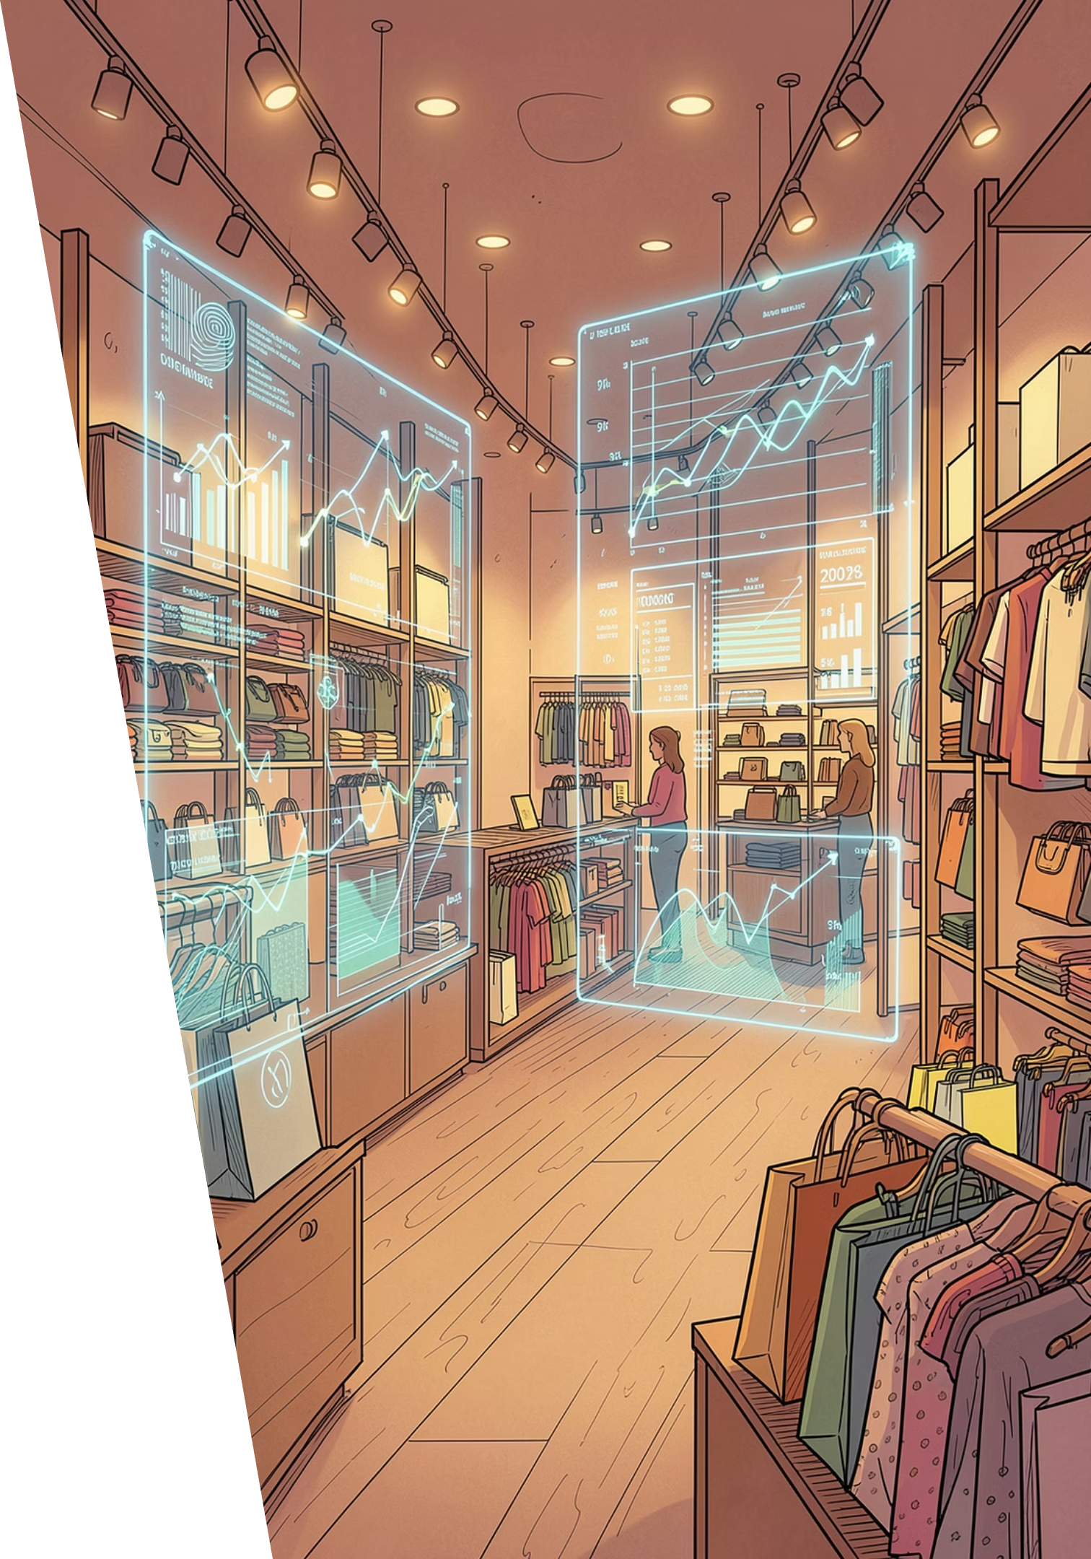
Customer Shopping Behavior Analysis
Uncovering spending patterns, customer segments, and product preferences across 3,900 purchases to guide strategic business decisions.

Slide 2
Dataset at a Glance
3,900
18
Transactions
Features
37
$59.76
Missing Values
Avg Purchase
Review Rating column
Demographics
Purchase Details
Behavior
Age, Gender, Location, Subscription
Item, Category, Amount, Season
Discount, Frequency, Reviews

Slide 3

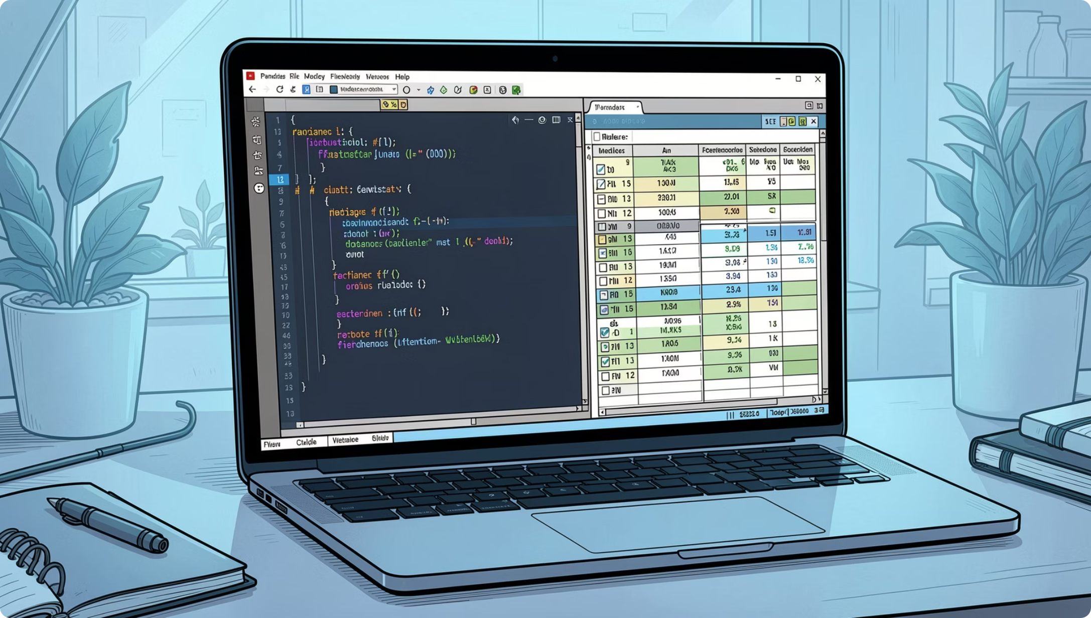
Data Preparation in Python
Clean & Standardize
Imputed missing ratings by category median; renamed columns to snake_case
Feature Engineering
Created age_group and purchase_frequency_days
Load to PostgreSQL
Cleaned DataFrame loaded for SQL analysis

Slide 4
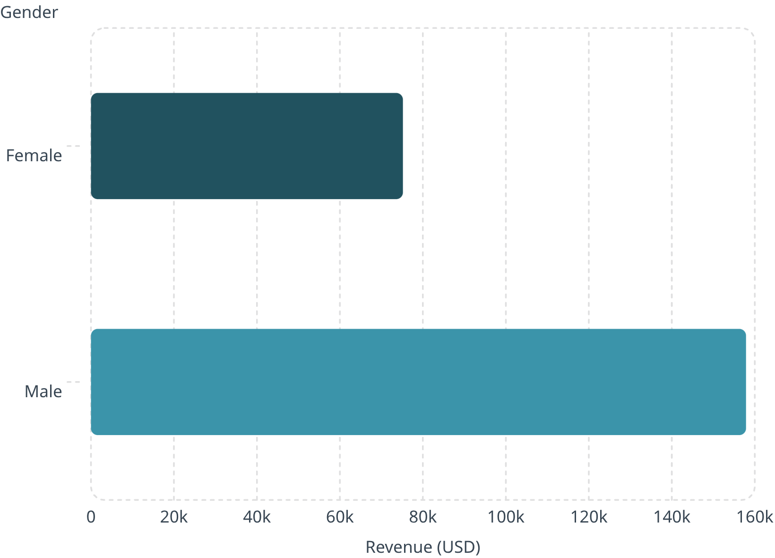

Revenue by Gender
Key Insight
Male customers generated 2.1x more revenue than female customers — a significant gap worth investigating for marketing strategy.
Male: $157,890 · Female: $75,191

Slide 5
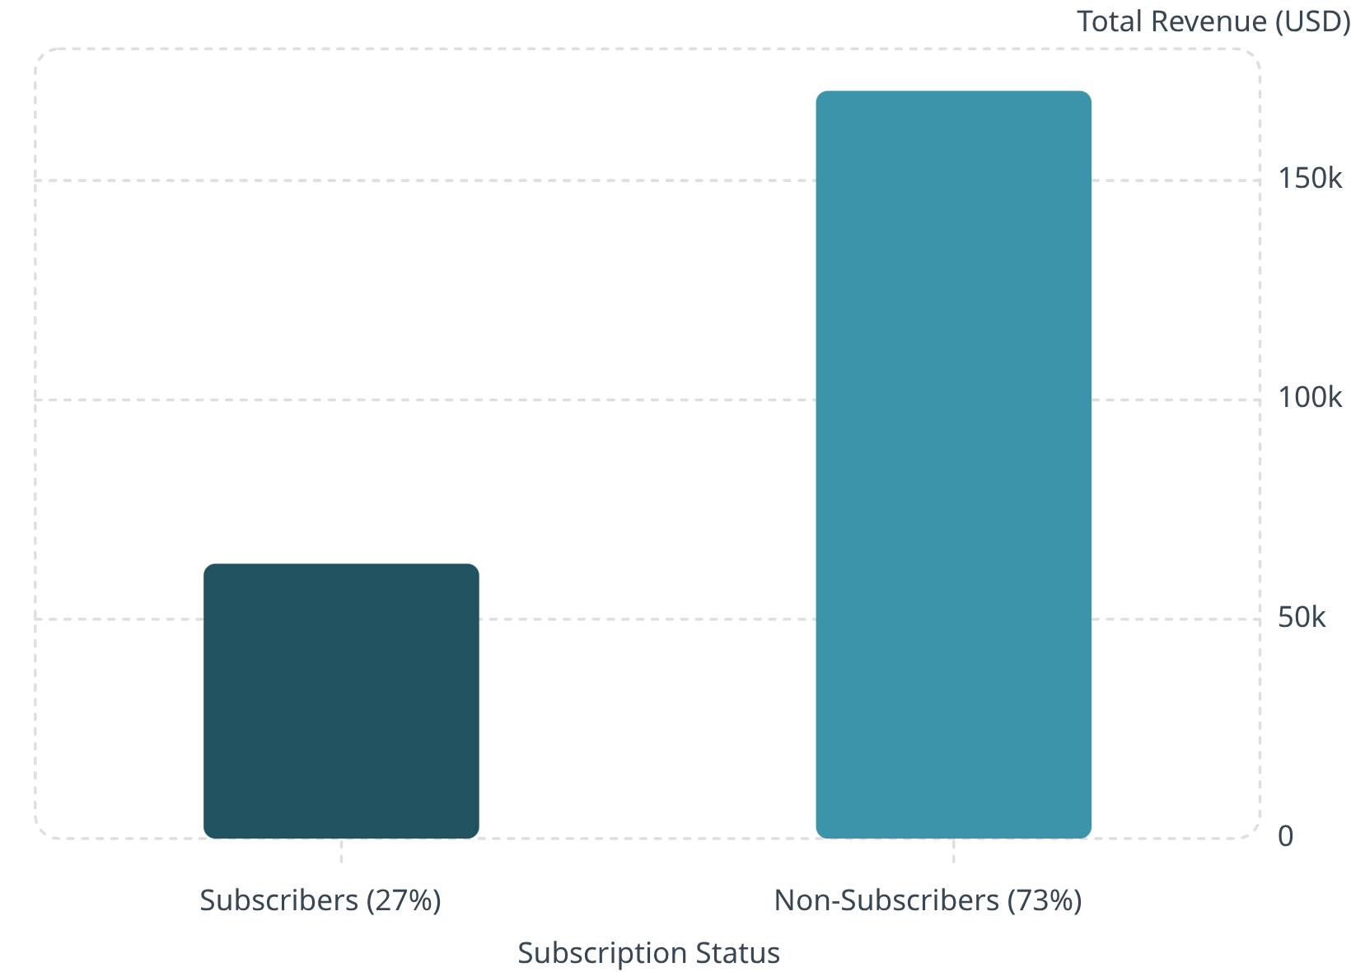
Subscribers vs. Non-Subscribers
Segment Breakdown
Non-Subscribers
Subscribers
2,847 customers · Avg spend $59.87
1,053 customers · Avg spend $59.49
Non-subscribers drive 73% of total revenue despite similar average spend.

Slide 6
Top Products & Categories
Top 5 by Review Rating
Top 3 per Category
Product
Avg Rating
Category
Top Products
Gloves
3.86
Accessories
Jewelry, Sunglasses, Belt
Sandals
3.84
Clothing
Blouse, Pants, Shirt
Boots
3.82
Footwear
Sandals, Shoes, Sneakers
Hat
3.80
Outerwear
Jacket, Coat
Skirt
3.78

Slide 7
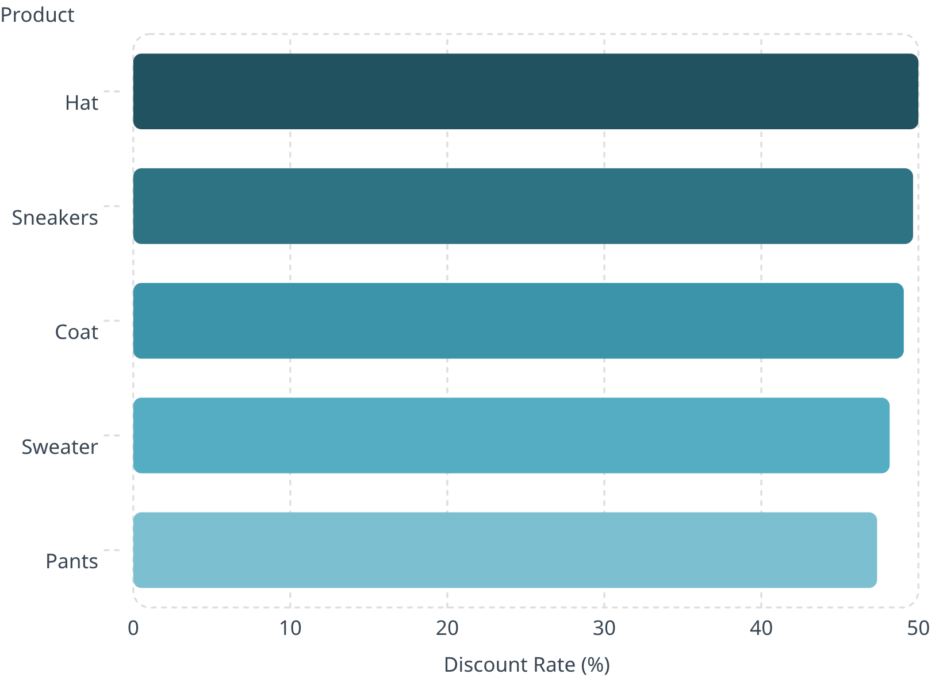

Discount Behavior & Shipping
Products Most Often Discounted
Shipping Type Comparison
Standard
Express
Avg $58.46
Avg $60.48
Express shippers spend slightly more — potential upsell opportunity.
839 customers used discounts and still spent above average

Slide 8
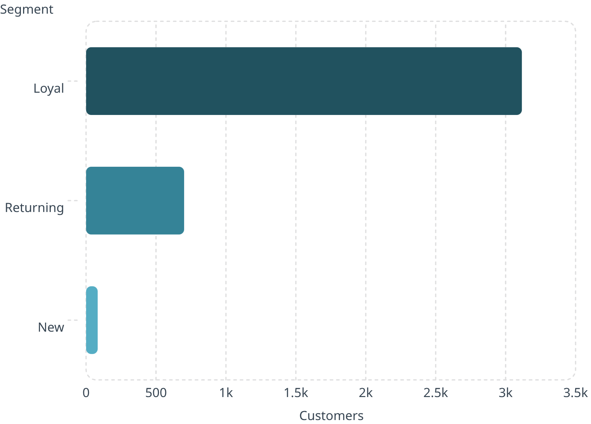

Customer Segmentation
Segment Definitions
Loyal — 3,116
80% of base; high repeat purchase rate
Returning — 701
18%; potential to convert to loyal
New — 83
2%; onboarding is critical

Slide 9
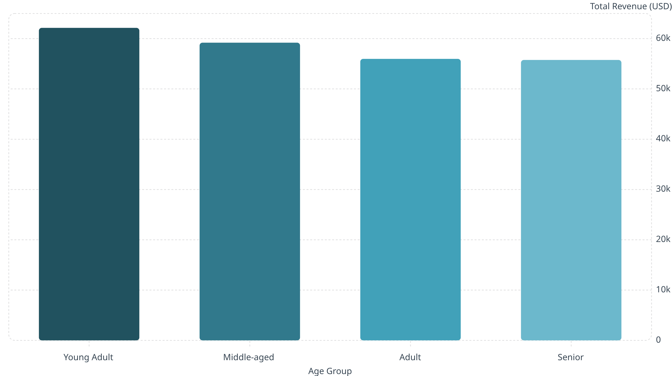
Revenue by Age Group
Young Adults lead revenue contribution, but spending is remarkably consistent across all age groups — broad targeting is viable.

Slide 10
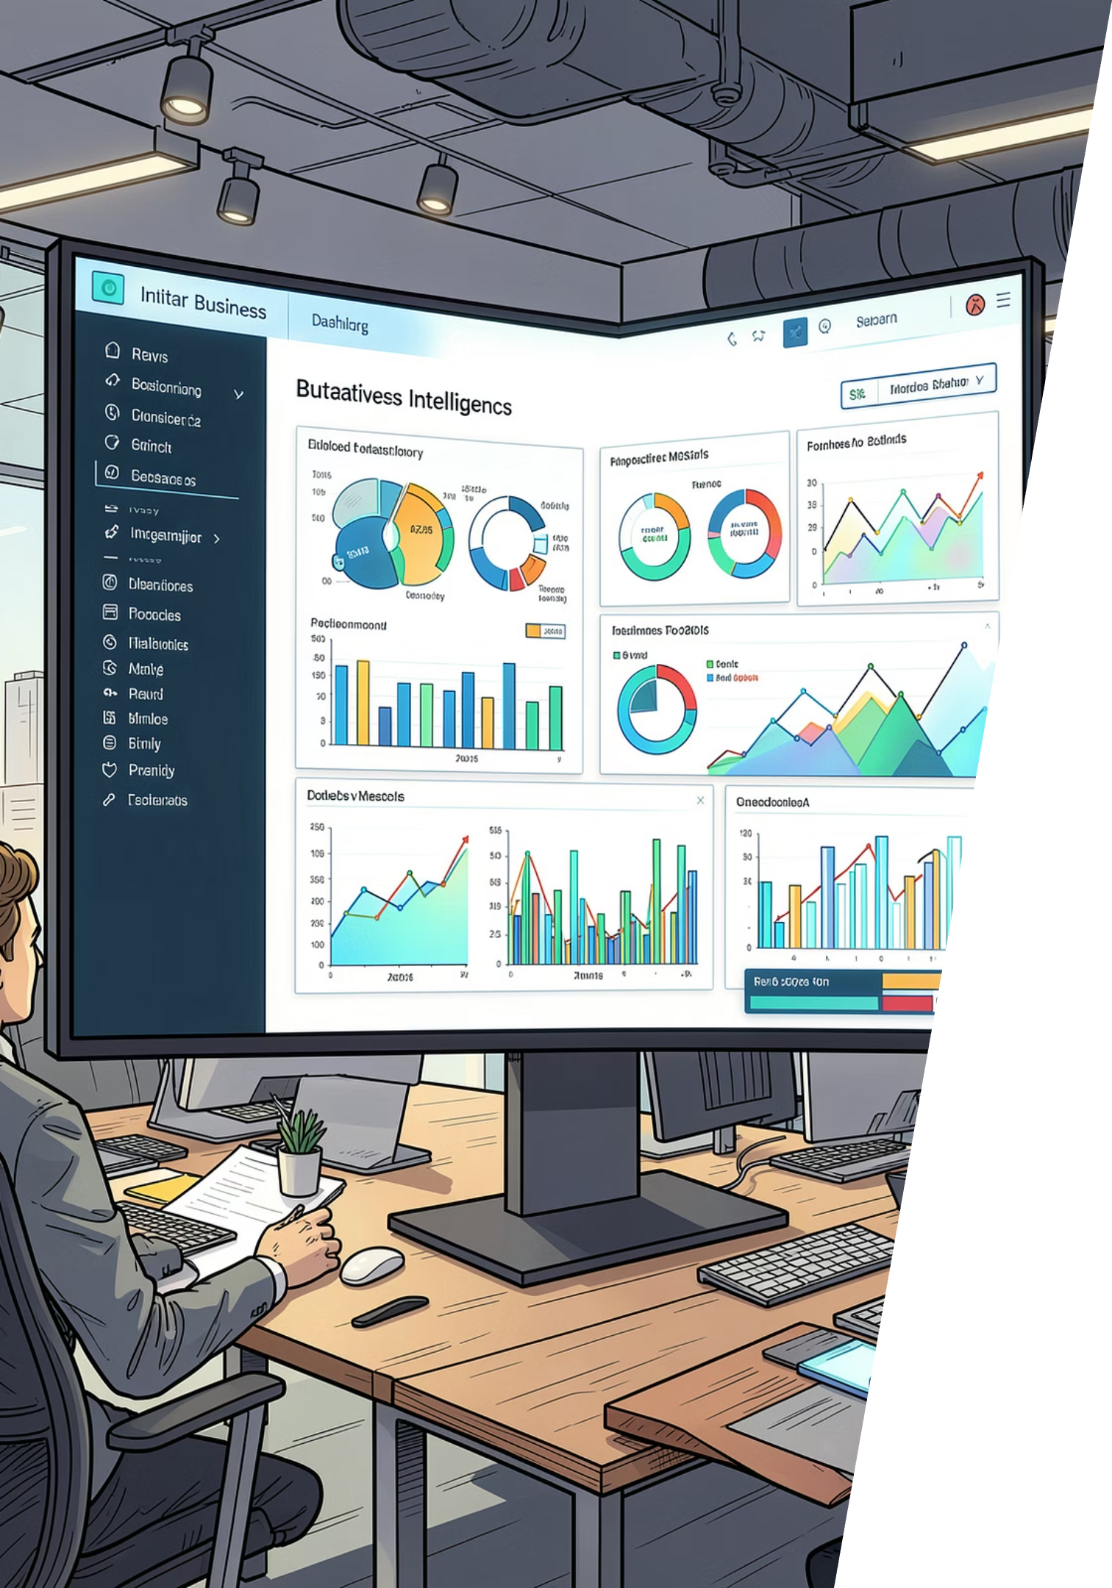




Power BI Dashboard & Recommendations
Boost Subscriptions
Promote exclusive subscriber benefits
Loyalty Programs
Reward repeat buyers toward "Loyal" segment
Review Discounts
Balance sales lift with margin control
Targeted Marketing
Focus on high-revenue age groups & express shippers

