Slide 1
Hotel management system
Project by
Name: Md.Niloy
Id : CE19006
Session:2018-19
Supervisor Md.Mosaddik Hasan Associate Professor Department of CSE, MBSTU

Slide 2
Contents
Introduction
Developing Tools
Features
Context Diagram
Project View
Limitations
Purpose

Slide 3
Introduction
In today's fast-paced world, the hospitality industry plays a crucial role in providing comfortable and memorable experiences to travelers and guests.
In my project guests can easily book rooms according to their choise.Admin can view,edit,search and delete the records of guests.Strong security maintains here.

Slide 4
Developing Tools
Operating System : Windows 7, 8, 10
Language : C
Platform : Code Blocks

Slide 5
Features
✓Booking guests room.
✓ Ensuring safety of guests information.
✓ Viewing guests information
✓ Editing guest record
✓ Searching guest record
Checking out

Slide 6
Context Diagram
Check in
Guest
View record
Edit record
Admin
Login
Search record
Exit
Check out

Slide 7
Project View

Slide 8
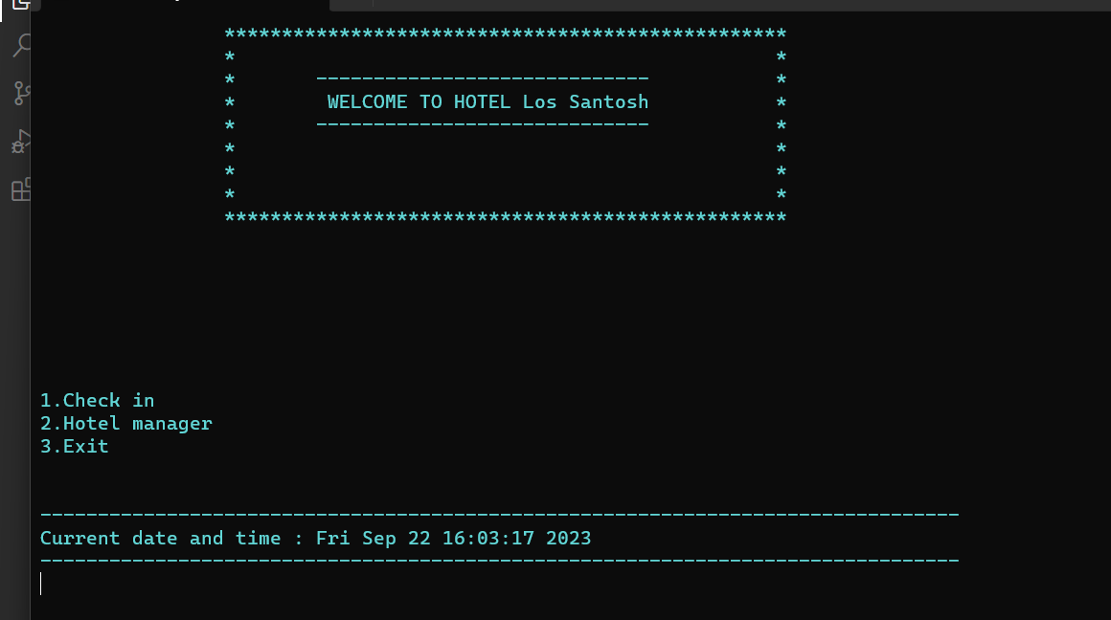
Front page

Slide 9
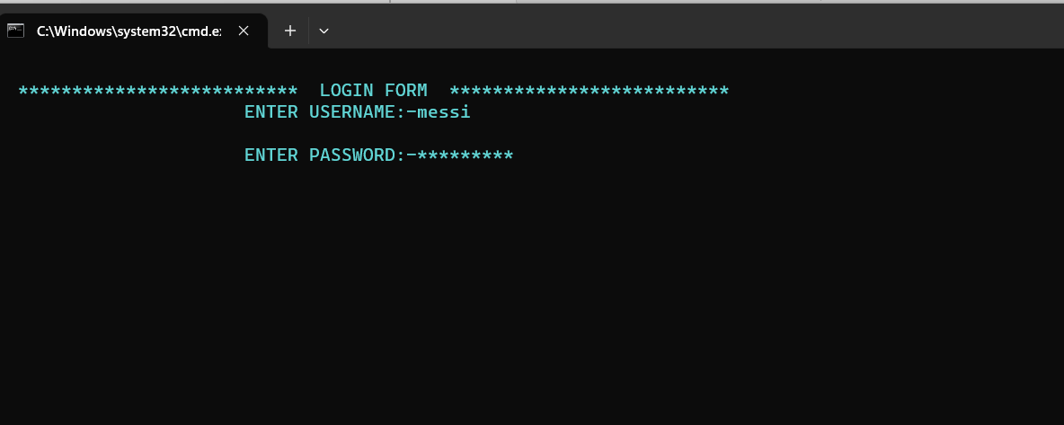
Login page

Slide 10
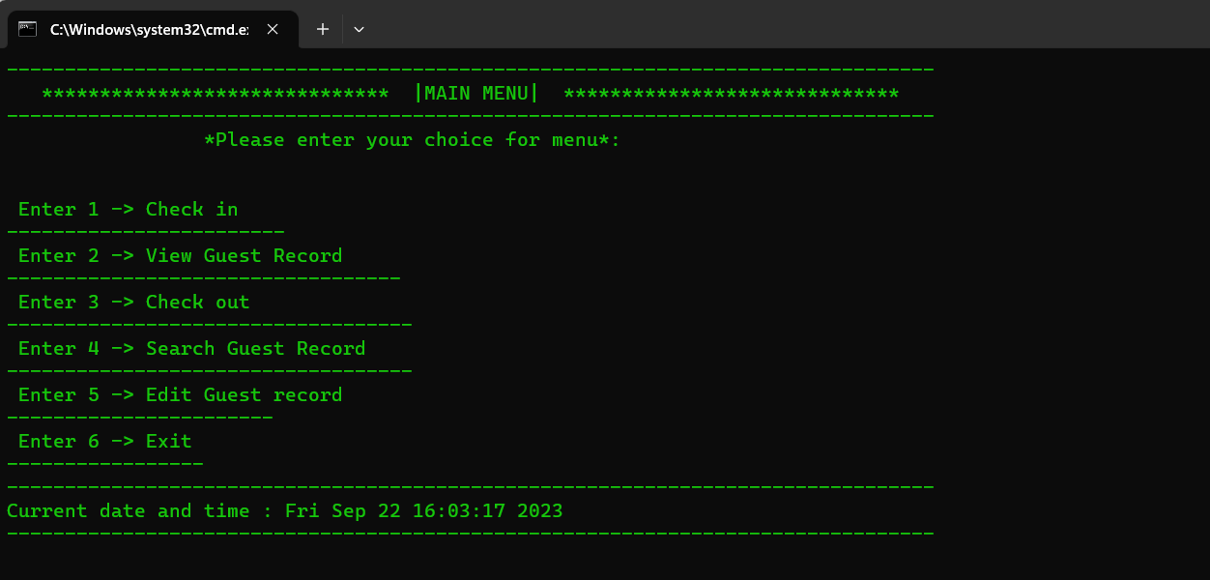
Main Menu

Slide 11
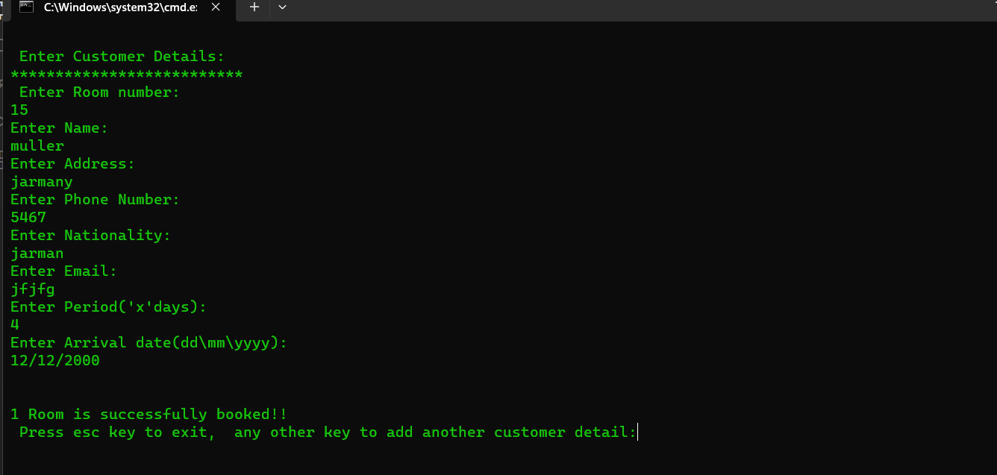
Check in

Slide 12
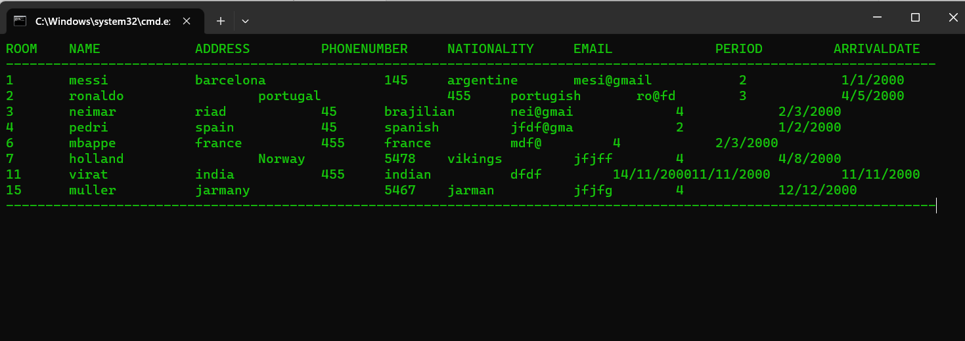
view all record

Slide 13
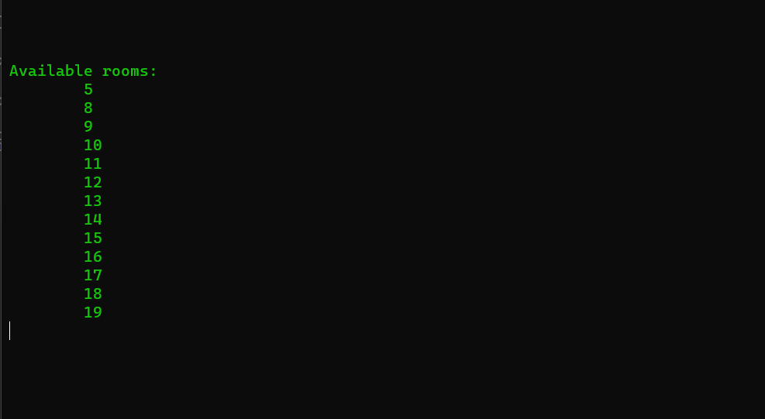
Available room

Slide 14
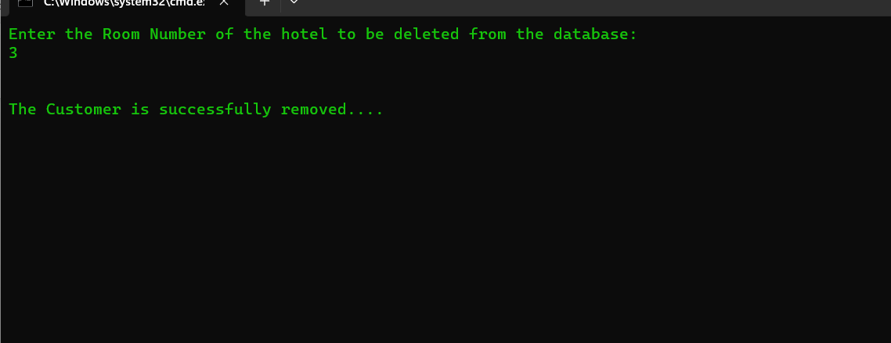
Check out

Slide 15
Limitations
This project has limited features.
This project can’t be used as web application or apps.
Design pattern is not good enough.

Slide 16
Purpose
1. The purpose of this project is booking hotel rooms and operating hotel management systems.

Slide 17
THANK YOU

