Slide 1
Dataset Eligibility (ds003029)
Research paper Summary on “Neural Fragility as an EEG Marker of the Seizure Onset”
1. Summary of the Paper
The study introduces and validates a novel intracranial EEG (iEEG) biomarker called "neural fragility".
It is designed to accurately locate the Seizure Onset Zone (SOZ) in patients suffering from drug-resistant epilepsy.
Instead of looking at isolated brainwaves, the researchers modeled the brain as a dynamic network, identifying specific "fragile" nodes that cause the entire network to become unstable and trigger a seizure.
2. Why it Was Conducted (The Problem)
Over 15 million epilepsy patients worldwide do not respond to anti-epileptic drugs.
For these patients, surgical removal of the SOZ is required, but surgical success rates vary wildly between 30% and 70%.
This low success rate exists because there is no clinically validated, objective biomarker to pinpoint the exact origin of the seizure.
Current localization methods rely heavily on visual inspection by clinicians or single-channel linear analytics (like high-frequency oscillations), which fail to capture the internal network properties that cause seizures in the first place.
3. What Type of Dataset is Used
The researchers utilized a retrospective dataset of intracranial EEG (iEEG) recordings, comprising both electrocorticography (ECoG) and stereo-EEG (SEEG).
The data includes 91 patients compiled from five major clinical centers, covering 462 total seizures.
The dataset is fully clinically annotated with timestamps for interictal (resting) and ictal (seizure) states, and it was structured into the BIDS-iEEG format and published directly to the OpenNeuro repository as dataset ds003029.
4. How it Was Measured (The Methodology)
The researchers constructed a time-varying linear dynamical model (taking the mathematical form of x(t+1)=Ax(t)) for sequential 250-millisecond windows of the continuous iEEG data.
Neural fragility was mathematically quantified by calculating the minimum perturbation (change) required at a specific electrode's connections to make the entire network model unstable.
They tested this neural fragility metric against 20 other standard linear and graphical EEG features by training a Random Forest machine learning classifier to predict surgical outcomes.
Neural fragility proved superior, predicting successful surgical outcomes with 76% accuracy and heavily outperforming traditional univariate frequency-band power metrics.

Slide 2
Dataset Eligibility (ds003029)
Clinical Ground Truth — It contains expert neurologist annotations marking the exact sample of seizure onset (sz onset) and offset, giving us verified labels to benchmark against.
Reproducibility — It's open-access, so my results can be independently verified by anyone, which directly addresses the literature gap I identified in my proposal about proprietary datasets limiting academic reproducibility.
High Fidelity — These are intracranial (iEEG) recordings, not scalp EEG. The electrodes sit directly on/inside the brain, giving us extremely clean signals with minimal skull interference.
Multicenter — Data was collected across multiple hospitals (Johns Hopkins, UMMC, UMF), which strengthens the generalisability of any findings.

Slide 3
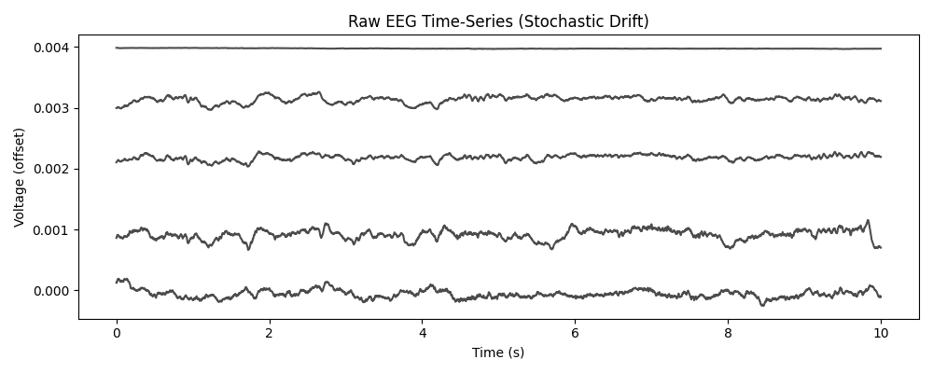
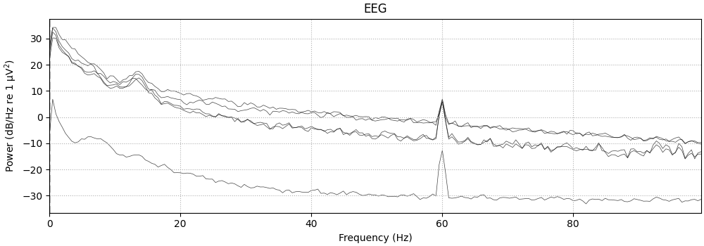
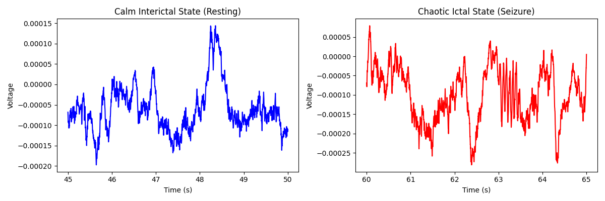
Exploratory Data Analysis (EDA) & Visualisations
Notes:
The Raw Time-Series: A 10-second plot of the raw EEG channels. It will look incredibly messy. This shows the raw stochastic drift.
Power Spectral Density (PSD) Plot: This shows the energy of the signal across different frequencies. The underlying frequency bands (Alpha, Beta, Theta) of the brainwaves.
State Comparison: The calm interictal state side-by-side with a chaotic ictal state. This visually demonstrates the structural break the models will be trying to detect.

Slide 4
The Preprocessing Pipeline
Step 1: Frequency Filtering
Applied a band-pass filter (1Hz to 50Hz) to isolate neurological data, and a 60Hz Notch filter to remove power line hum.
Step 2: Artefact Rejection
Identified massive spikes from blinking/movement using Independent Component Analysis (ICA) and voltage thresholding.
Step 3: Epoching
Sliced continuous recordings into smaller, chronological 'epochs' (e.g., 2-second windows) for manageable algorithmic processing.

Slide 5
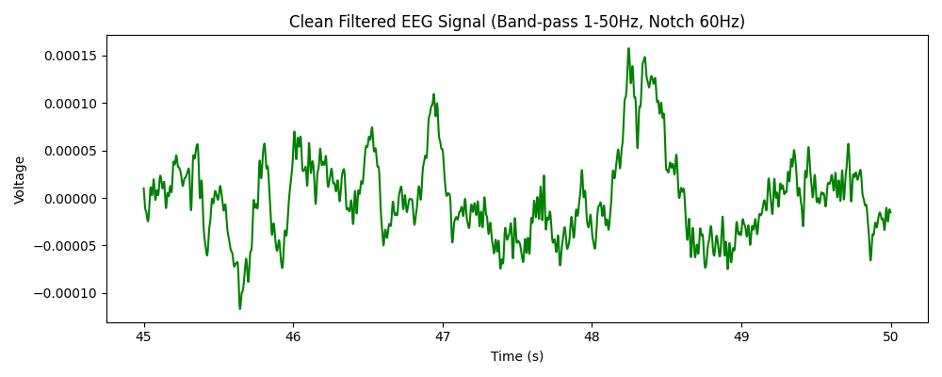
Output and Next Steps
The data is now mathematically normalised and separated.
Notes:
I am now ready to move into WP2 and begin building the ARIMA baseline models on this cleaned data.

Slide 6
Executive Summary: The 'Three P's'
Progress:
Downloaded dataset ds003029, successfully loaded the BIDS formatting into Python (using the MNE library), and completed initial Exploratory Data Analysis (EDA) and preprocessing pipelines.
Plan:
Finalise the cleaned, epoched baseline data to begin building the ARIMA univariate models next week.
Problem:
Working with cloud data was not going smooth. Apart from this no major technical snags. Filtering and PSD generation executed successfully.

