Slide 1
Device Driver

Slide 2
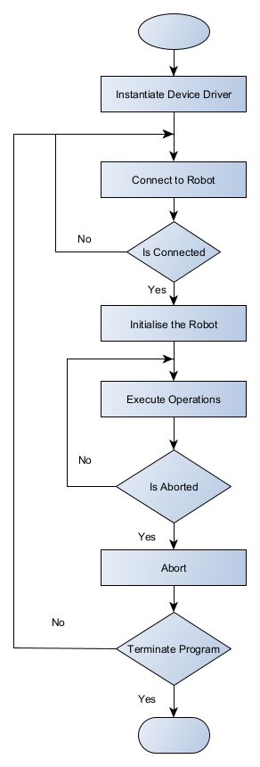
Scheduler Program

Slide 3
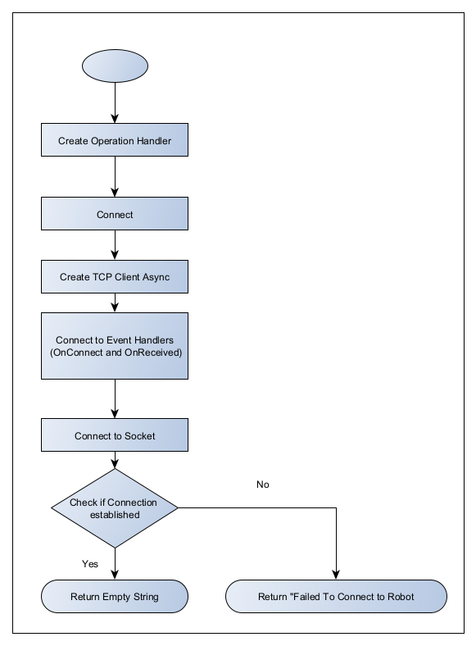
Device Open Connection

Slide 4
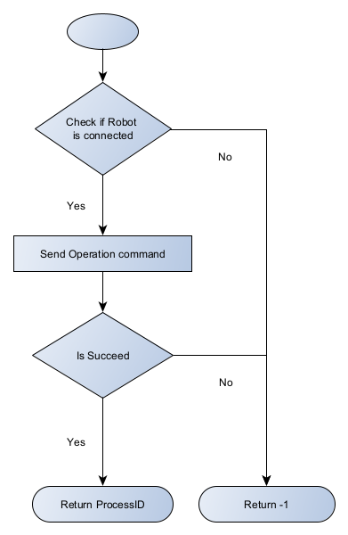
Init

Slide 5
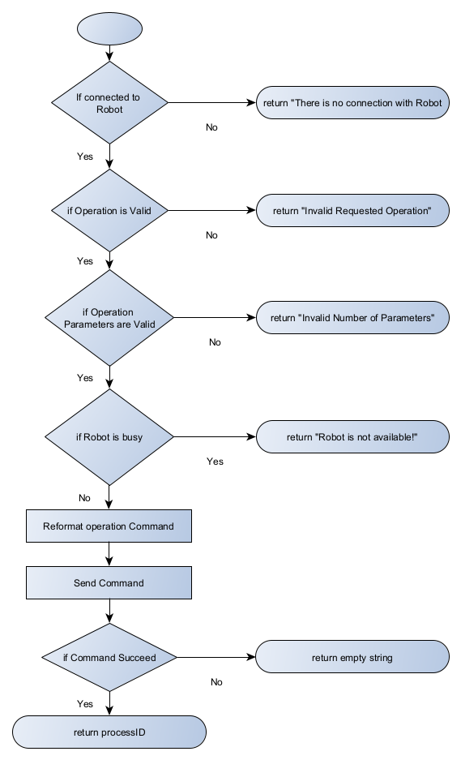
Execute Operation

Slide 6
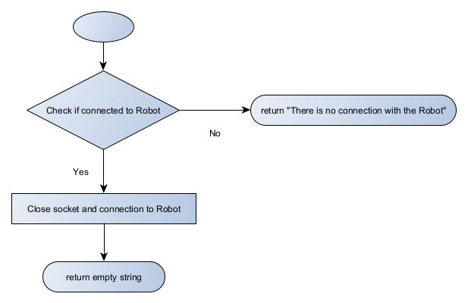
Abort

Slide 7
Thank You

