Slide 1
SCICOMP301 Topics in Computer Science
Project 2 Scheduling Experiments
Mehrad haghshenas

Slide 2
Theory
CPU utilization: A CPU algorithm’s goal is to keep the CPU as busy as possible. The percentage of CPU usage is referred to as the CPU utilization. Theoretically it can be 0-100 but in a real-time system, it varies from 40-90.
Throughput: Also referred to as the average CPU performance. It is the number of processes completed per unit.
Turnaround time: The time from the arrival time of a process to the completion of the process is called the turnaround time. This consists of the time spent waiting for memory access, using CPU, and waiting for I / O.
Waiting time: The time spent in the waiting process in the ready queue. This is determined by the scheduling algorithm.

Slide 3
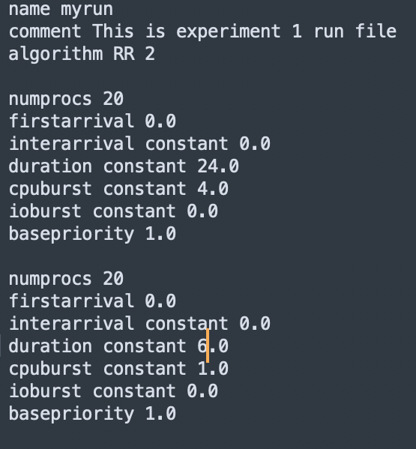
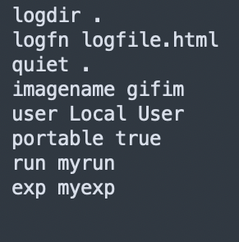
Experiment 1 Hypothesis:
No difference in results when all distribution values are constant.
Right: run
Left: psconfig

Slide 4
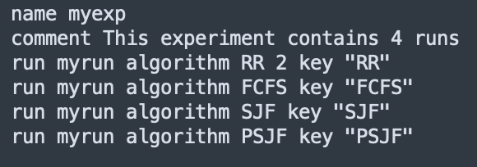
Exp File

Slide 5
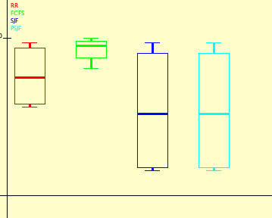
Box plots
Waiting time:
FCFS > RR > SJF = PSJF

Slide 6
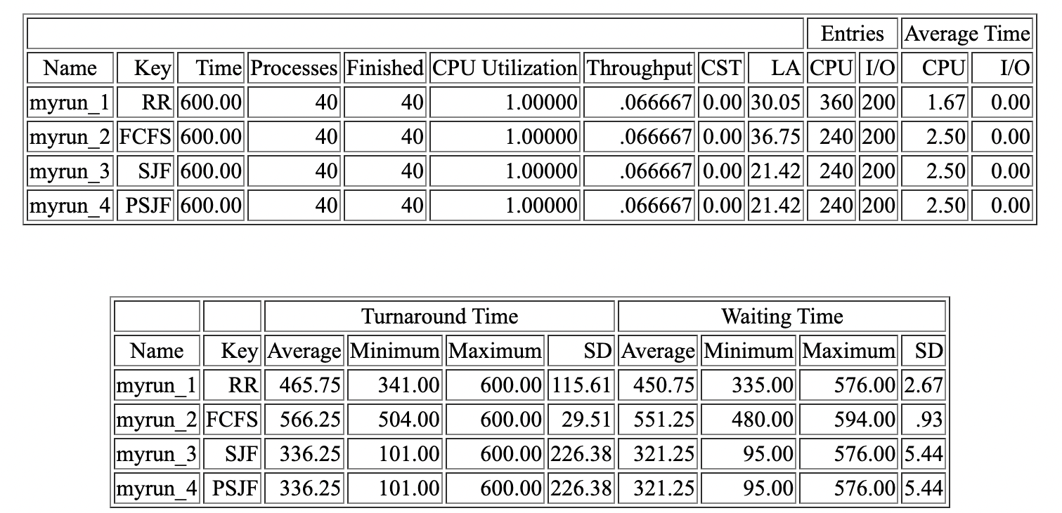
SJF and PSJF are winners

Slide 7
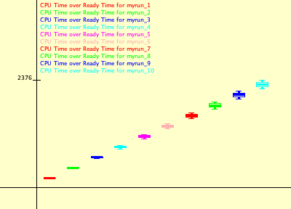
As the number of process increases the waiting time increases as well

Slide 8
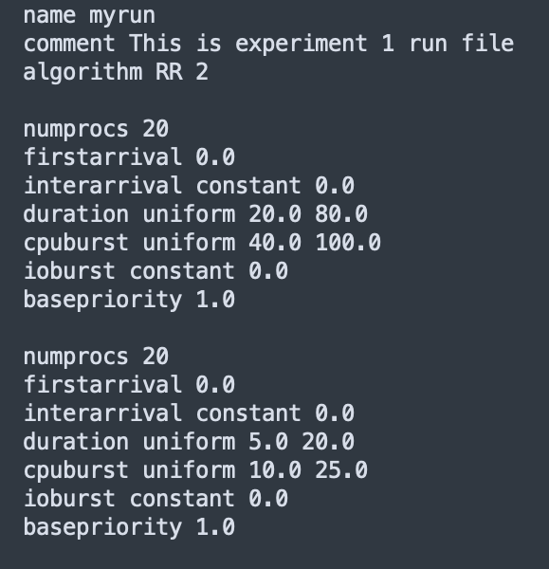
Experiment 2 Hypothesis:
no difference in results when all distribution values are from the uniform distribution

Slide 9
Exp File

Slide 10
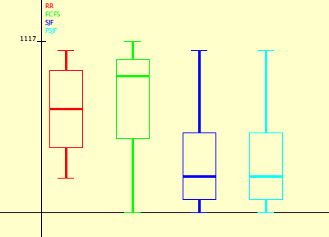
Box plots
Waiting time:
FCFS > RR > SJF = PSJF

Slide 11
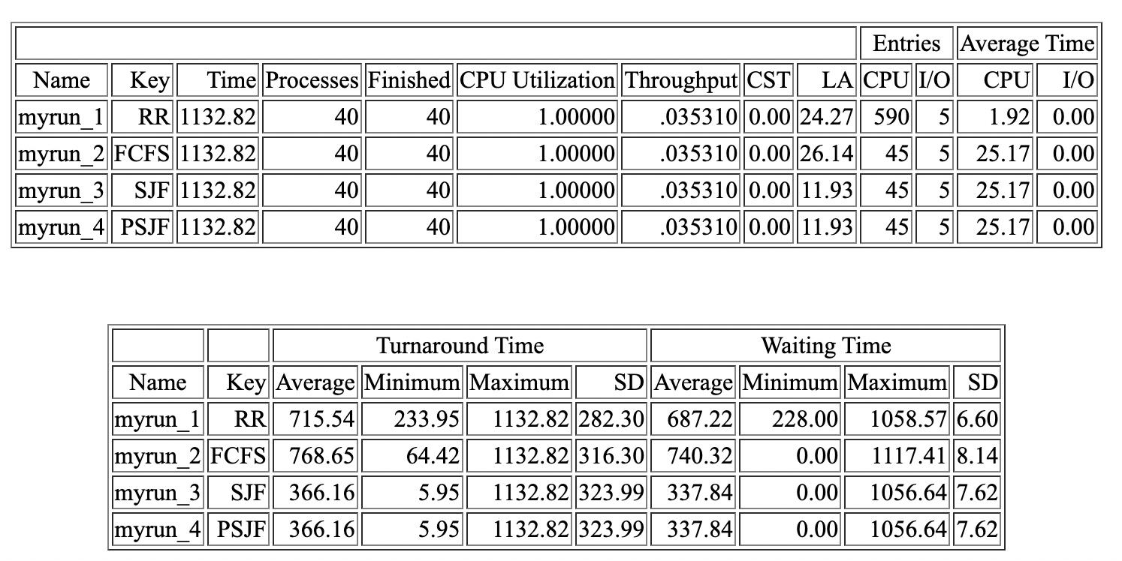
Winners are SJF and PSJF

Slide 12
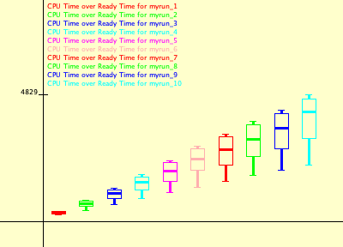
As the number of process increases the waiting time and the variance between the waiting time increases as well.

Slide 13
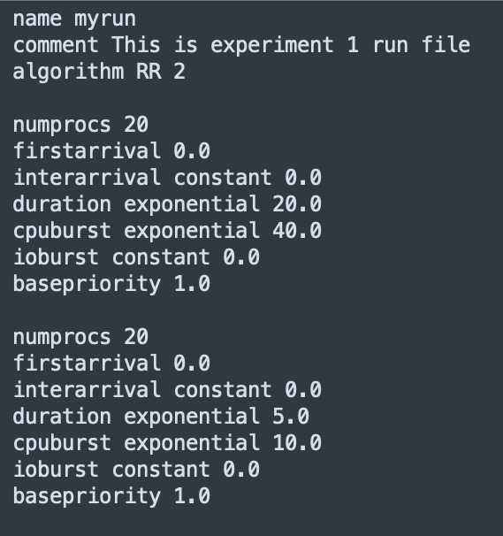
Experiment 3 Hypothesis:
no difference in results when all distribution values are from the exponential distribution

Slide 14
Exp File

Slide 15
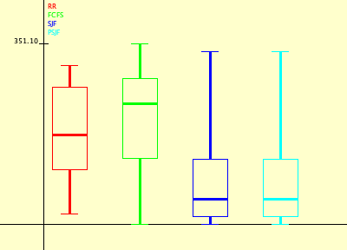
Box plots
Waiting time:
FCFS > RR > SJF = PSJF

Slide 16
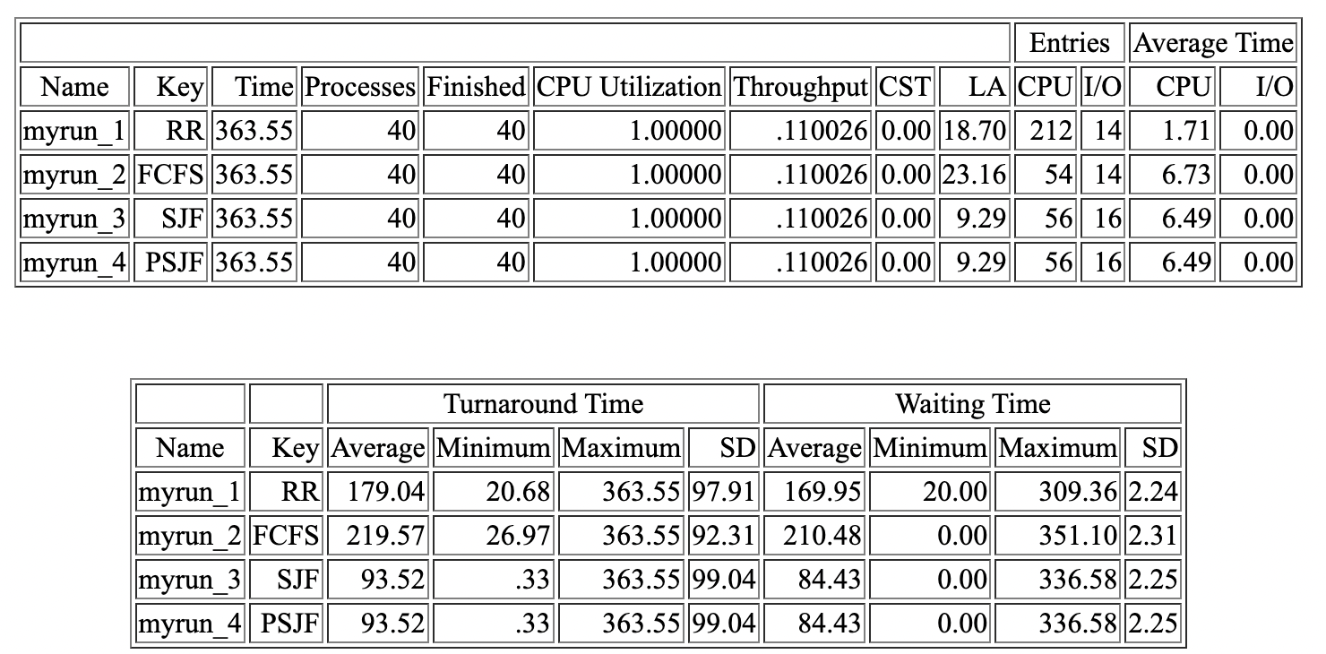
Winners are SJF and PSJF

Slide 17
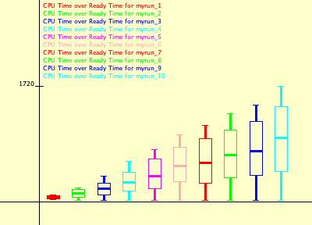
As the number of process increases again we see an increase in the variance of waiting time and the waiting time itself.

Slide 18
Stress Testing
Number of processes | success
10 | yes
100 | yes
1000 | yes
10000 | yes
100000 | yes
1000000 | no
10000000 | no
100000000 | no
1000000000 | no
1000000000 | no
Experiment 3:
1, 10, 100, 1000, and 10000 ran successfully.
100000, 1000000, 10000000, 100000000, and 1000000000 did not run successfully.
Experiment 1:
1, 10, 100, 1000, and 10000 ran successfully.
100000, 1000000, 10000000, 100000000, and 1000000000 did not run successfully.
Exception: java.lang.OutOfMemoryError thrown from the UncaughtExceptionHandler in thread "Thread-2”
No difference.

Slide 19
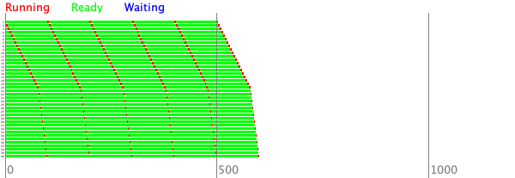
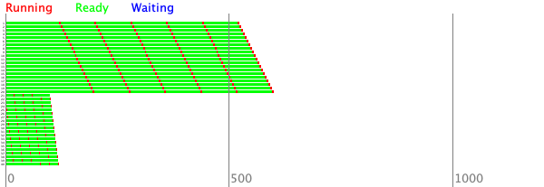
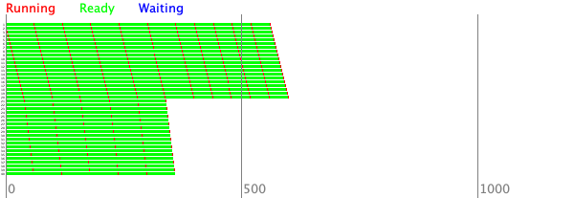
Ghantt Charts
FCFS
PSJF
RR
SJF

