Slide 1
PROJECT OVERVIEW · 2026
What a neuron's
internal state buys
A methods-first walkthrough of a vector-valued
spiking neuron on Spiking Heidelberg Digits
Mehran Jaberinezhad · November 2026
one neuron · 1,000 coordinates
N = 100
D = 1000
SHD · 20 classes
13 methods / 4 results
Most of the deck is the model; the last four slides are the evidence.
Project overview · November 2026
1
Notes:
The deck is now methods-first: 13 slides on the model and protocol, 4 on the SHD evidence. The question is whether a genuinely vector-valued state buys computation at fixed neuron count, readout and budget. The answer is tested on SHD, 20 classes, with speakers 4 and 5 never seen in training.

Slide 2
THE QUESTION
A spike is one bit. What if the state is not?
STANDARD LIF
THIS MODEL
V_{i}(t+1) = (1 − α) V_{i}(t) + I_{i}(t)
z_{i}(t) ∈ ℝ¹⁰⁰⁰
s_{i}(t) = H(V_{i}(t) − θ_{i})
Every coordinate participates in the dynamics. The spike is still binary, but it emits the whole state vector.
One scalar state. One threshold. One output bit.
The neuron can integrate, leak and fire. It cannot hold a pattern whose coordinates vary independently: a spike says only that the scalar crossed threshold.
s_{i}(t) = H(⟨z_{i,} w_{out,i}⟩ + θ_{i} − w_{ad} b_{i})
The readout is a learned hyperplane through the state, not a scalar membrane. The width of what a spike can transmit equals the width of the state.
one number → one bit
fixed N · fixed readout · fixed budget
Does state width itself buy computation?
The comparison is architectural; the empirical test is on SHD (next slides).
Neuron as vector · Spiking Heidelberg Digits
2
Notes:
The scalar neuron is not a straw man: it is the standard event-driven unit. The vector model keeps the same spike interface and the same count readout; only the state and the intra-neuron operations become vector-valued. The controlled question is stated at the bottom.

Slide 3
METHODS · BENCHMARK
SHD: 20 words, 700 channels, one second
TRAINING TRIALS
OFFICIAL TEST TRIALS
EVENT STREAM → 2 MS BINS
8,156
2,264
speakers 0–3, 6–11
speakers 4 & 5 unseen
GERMAN DIGITS
COCHLEAR CHANNELS
20
700
700 channels · 1,000 ms · sparse asynchronous events
classes 0–19
binary events
0 ms
500 ms
1000
WHY SHD
500 signal bins
+50
Event-based, 20-way, standard split. Accuracy is comparable across models and the test speakers are truly held out.
A bin is 1 if at least one event falls in it. No channel normalisation. A 100 ms silence tail lets the last spikes decay before the count readout.
SHD: 8,156 train / 2,264 test; 700 channels; 1 s trials; speakers 4 & 5 absent from training.
Neuron as vector · Spiking Heidelberg Digits
3
Notes:
SHD is the standard event-based digit benchmark: 20 German digits, 700 cochlear channels, sparse events. We bin at 2 ms, which gives 500 bins for the 1 s trial, then append 50 zero bins (100 ms) so the count readout sees the tail of the response. The official test set has 2,264 trials; speakers 4 and 5 never appear in training, which makes it a genuine unseen-speaker test.

Slide 4
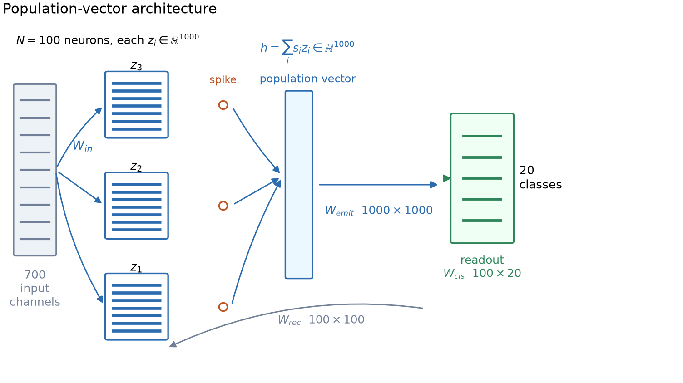
METHODS · ARCHITECTURE
One shared input, 100 vector neurons, one count readout
INPUT
700 channels → 1,400
two delay-line copies; shared input matrix
NEURON
100 × 1,000 state
rank-64 mixing; learned leak
READOUT
100 spikes → 20
counts over 550 bins; classifier
Figure 1. Population-vector architecture. A spike emits the whole state; emitted vectors are summed and fed back through the emission matrix; a linear readout on spike counts produces the class.
3,069,201 parameters
All blocks drawn to scale in width, not in parameter count; see Methods §2.4–2.5.
Neuron as vector · Spiking Heidelberg Digits
4
Notes:
The figure is the whole architecture. The input is 700 channels, expanded to 1,400 by the fixed delay line, then projected by one shared 1,400×1,000 matrix. Each of the 100 neurons carries a 1,000-dimensional state and mixes it with a rank-64 operator. A spike emits the whole state; the emitted vectors are summed and passed through a shared 1,000×1,000 W_emit. The readout is a linear classifier on spike counts over the 550 bins.

Slide 5
METHODS · WHERE THE VECTOR ENTERS · 1/3
The input projection makes the vector
SHARED PROJECTION + PER-NEURON GATE
SHAPES
a_{t} = x_{t} W_{in}
x(t)
Wᵢₙ
a(t)
d_{in,i,t} = g_{i} ⊙ a_{t}
1 × 1400
1400 × 1000
1 × 1000
one projection, reused by all 100 neurons
The input is a 1×1,400 row; the input matrix is 1,400×1,000. The result is one 1,000-D pattern shared by all neurons. The gate is a learned 1,000-D mask per neuron.
g_{i} ⊙ a_{t}
the gate selects coordinates; it does not mix them
input matrix: 1.4M
gate: 100k
WHY THIS IS THE FIRST INSERTION POINT
A scalar neuron would have one weight vector and produce one current. Here a shared matrix produces a 1,000-D pattern; the gate makes that pattern neuron-specific. Parameter cost is 1,400×1,000, not 100 times that.
Methods §2.4.1–2.4.2; two delay-line copies give 1,400 input channels.
Neuron as vector · Spiking Heidelberg Digits
5
Notes:
The first place the vector enters is the input projection. Every neuron does not own a 1,400×1,000 matrix; there is one shared W_in, and each neuron has a learned 1,000-D gate. The gate is coordinate-wise, so the input path creates a vector but does not mix its coordinates.

Slide 6
METHODS · WHERE THE VECTOR ENTERS · 2/3
Rank-64 mixing inside each neuron
ONE LOW-RANK OPERATOR, SHARED BY ALL NEURONS
LOW-RANK BOTTLENECK
m_{i} = (z_{i} W_{down}) W_{up}
1000
64
1000
The two factors are 1,000×64 and 64×1,000; both are shared. The 64-D bottleneck is the only place where coordinates of one neuron's state interact. A dense 1,000×1,000 map per neuron would cost 100M parameters; this costs 128k.
state
rank
update
The bottleneck forces a shared low-dimensional subspace. It is an architectural prior, not a claim that the state is only 64-dimensional.
rank R = 64
128k parameters
This is the only active mechanism that mixes coordinates within a single neuron. The emission matrix mixes across neurons; the gate and the readout are coordinate-wise or linear.
Methods §2.4.4; both factors initialised from zero-mean Gaussians (1/D and 0.25/R).
Neuron as vector · Spiking Heidelberg Digits
6
Notes:
The second insertion point is the intrinsic mixing. Each neuron multiplies its own 1,000-D state by a shared 1,000×64 matrix, then by a shared 64×1,000 matrix. The rank is 64, so the operator is deliberately low-rank. This is the only active mechanism that mixes coordinates inside one neuron.

Slide 7
METHODS · WHERE THE VECTOR ENTERS · 3/3
A spike broadcasts the whole vector
RECURRENT COUPLING + SHARED EMISSION
ONE BIT → ONE VECTOR
c_{i}(t) = Σ_{j} W_{rec}[j,i] s_{j}(t)
s₁ = 1
h(t) = (1/√N)(Σ_{j} s_{j}(t) z_{j}(t)) W_{emit}
W
s₂ = 1
Σ
d_{rec,i} = c_{i}(t) h(t)
emit
s₃ = 1
A spike is one scalar; the state is 1,000-D. A single spike therefore injects the whole state of neuron j into a shared 1,000-D population signal, scaled by the scalar coupling.
The sum is a 1,000-D population vector; one shared matrix maps it back to state space and is used by every neuron.
recurrent: 10k
emission: 1M
WHY THE 1/√N
The sum over N neurons grows with N; the 1/√N keeps the emitted vector's scale roughly constant, so the learned dynamics do not have to re-tune when the population size changes.
Methods §2.4.3; the emission matrix is initialised as identity + 0.02 noise, 1,000×1,000.
Neuron as vector · Spiking Heidelberg Digits
7
Notes:
The third insertion point is the broadcast. When neuron j spikes, the scalar coupling c_i multiplies a shared 1,000-D vector h, which is built by summing the states of all neurons that spiked, weighted by their spike, and passing through W_emit. That is how one bit can carry a whole state vector. The 1/sqrt(N) keeps the scale from growing with N.

Slide 8
METHODS · DYNAMICS
The state update and the spike functional
LEAK, TWO-STAGE TARGET, SPIKE
THE VECTOR IS READ BY A HYPERPLANE
z_{i}(t+1) = (1 − α_{i}) z_{i}(t) + α_{i} z̃_{i}(t)
z_{i} ∈ ℝ¹⁰⁰⁰
z̃_{i} = tanh(m_{i} + λ tanh(m_{i}⁽²⁾ + d_{i}))
w_{out,i} ∈ ℝ¹⁰⁰⁰
o_{i} = ⟨z_{i,} w_{out,i}⟩ + θ_{i} − w_{ad} b_{i}
s_{i} = H(o_{i})
The spike is still one bit. What changed is that the decision boundary is a learned hyperplane through 1,000 coordinates, not a threshold on one membrane potential.
The leak is learned per neuron; λ is a learned scalar mixing the two rank-64 paths; θ is the calibrated threshold; the readout vector is a learned hyperplane.
Reported configuration: leak init 0.1, λ init 1.0, thresholds calibrated to ~10 Hz, readout weights ~ N(0, 1/D). adLIF currents are configured but do not enter the reported two-stage target.
Methods §2.4.5–2.4.8; two-stage target Eq. 30; spike functional Eq. 23.
Neuron as vector · Spiking Heidelberg Digits
8
Notes:
The state update is a leaky integrator with a learned per-neuron leak. The target is the two-stage nonlinearity: a rank-64 mixing, a second rank-64 path, and a tanh. The spike is a Heaviside of a learned hyperplane through the whole state. That is the only place the full vector is read.

Slide 9
METHODS · FORWARD PASS
One trial, end to end
ONE BIN, IN ORDER
AROUND THE LOOP
a_t = x_t W_in
T = 550
d_in = g ⊙ a_t
500 signal bins + 50 silence bins
m = (z W_down) W_up
m2 = (z W_down2) W_up2
10 chunks
c = s W_rec
checkpoint every 55 bins
h = (1/√N)(Σ_j s_j z_j) W_emit
d = d_in + c h + β
fp16 state
z̃ = tanh(m + λ tanh(m2 + d))
fp32 master weights; GradScaler
z ← (1 − α) z + α z̃
counts
o = ⟨z, w_out⟩ + θ − w_ad b
sum spikes over t; W_cls → 20
s = H(o)
Algorithm 1 in Methods §2.5; grad checkpointing in §2.8.4.
Neuron as vector · Spiking Heidelberg Digits
9
Notes:
This is the per-bin forward pass. The delay line and input projection happen once for the whole trial; the loop then updates the state, computes the spike, and accumulates counts. The right rail gives the loop-level facts: 550 bins, ten checkpointed chunks, fp16 state with fp32 masters, and a count readout.

Slide 10
METHODS · INITIALISATION + CALIBRATION
Start near 10 Hz, not at silence
TOTAL PARAMETERS
INPUT + EMISSION
THRESHOLD CALIBRATION
3,069,201
2.80M
p = clip(10 Hz × 2 ms, 0.001, 0.49) = 0.02
19 groups
91% of the budget
Set all thresholds to zero. Run three fixed-point iterations on 96 FIT trials:
θ_{i} ← θ_{i} − Q_{(1−p)}(o_{i})
RANK-64 MIXERS
RECURRENT + READOUT
256k
12k
Skip the first 68 bins, flatten over time and batch, and take the (1−p) quantile of the pre-activation values. Three iterations land near the 2%-per-bin target.
two stages
classifier and thresholds
2% per bin ≈ 10 Hz
WHY CALIBRATE
The thresholds stay trainable after calibration. Calibration sets the operating point; training can move it.
A count readout needs spikes. Zero thresholds either silence the population or saturate it; 10 Hz is a stable operating point across neurons.
Methods §2.6; parameter groups Table 4; calibration Algorithm 2.
Neuron as vector · Spiking Heidelberg Digits
10
Notes:
Initialisation matters because the readout is a count. We calibrate every threshold to a target of about 10 Hz: p is the target spike probability per 2 ms bin, 0.02. Three fixed-point iterations on the pre-activation quantile put each neuron near that rate. The threshold remains trainable.

Slide 11
METHODS · MECHANISMS · 1/2
Memory beyond the membrane
SPIKE-FREQUENCY ADAPTATION
LEARNABLE LEAK + INITIAL STATE
b_{i}(t+1) = ρ b_{i}(t) + s_{i}(t)
α_{i} = sigmoid(raw_{i}), init 0.1
o_{i} ← o_{i} − w_{ad} b_{i}
z_{i}(0) = z0_{i} (learned, 100k)
A soft spike-history term. ρ = 0.95; the adaptation weight starts at 0.1 and is learned. It replaces reset/refractory: the neuron is slowed after firing, not blanked.
Each neuron gets its own leak; the population is not forced to share one time constant. The initial state is a learned 1,000-D vector per neuron, not zeros.
ρ = 0.95
adaptation: 0.1
100 leak values
100k initial state
Both are small: adaptation adds 100 weights; the learned initial state adds 100,000. The 20-epoch screen kept both; they are part of the reported model.
Methods §2.7.1–2.7.2; adaptation Eq. 27; state dynamics Eq. 31.
Neuron as vector · Spiking Heidelberg Digits
11
Notes:
Two memory mechanisms are active. Adaptation adds a soft spike-frequency term, which is the model's replacement for reset and refractory. The state dynamics make the leak per-neuron and the initial state learnable. Both are cheap: 100 weights for adaptation, 100,000 for z0.

Slide 12
METHODS · MECHANISMS · 2/2
Delays, two-stage mixing, surrogate gradient
LEARNABLE DELAYS
TWO-STAGE MIXING
SURROGATE GRADIENT
d_{c} = 20 σ(raw_{c})
z̃ = tanh(m + λ tanh(m2 + d))
forward: H(o)
raw_{c} ∈ [−10, 10]
λ = 0.1 + 1.9 σ(raw), init 1
backward: 1/(1+2|o|)²
Per-channel delays in (0, 20) ms, initialised 0.5–10 ms. A fixed two-copy delay line (10 ms stride) gives the network a short memory before the input projection.
A second rank-64 path adds a nonlinear correction to the first. λ is a learned scalar that mixes the two paths; it starts at 1.
The forward spike is exact; the backward pass uses the SLAYER surrogate. The derivative is never evaluated at a true discontinuity.
WHAT IS ACTUALLY IN THE REPORTED RUN
The two-stage path and the SLAYER surrogate are active. The adLIF block is configured but inert: its currents are subtracted from a pre-activation that the two-stage target does not read. Reported model = adaptation + two-stage mixing.
Methods §2.7.3–2.7.7; adLIF inert in the reported configuration, see §2.5.2.
Neuron as vector · Spiking Heidelberg Digits
12
Notes:
Three more mechanisms. Per-channel delays and a fixed delay line give the input a short temporal context. The two-stage mixer adds a second rank-64 path and a learned scalar lambda. The surrogate gradient is SLAYER: exact Heaviside forward, smooth 1/(1+2|o|)^2 backward. The adLIF block is configured but does not affect the reported forward pass, which is stated explicitly.

Slide 13
METHODS · AUGMENTATION
Only the training events are perturbed
SAME-CLASS BLEND, IN ORDER
ACTIVE IN TRAINING
if A or B is empty: return A
same-class blend · p = 0.5, keep = 0.5
target = (centre(A) + centre(B)) / 2
event dropout · p = 0.1
A', B' = shift each to target
Both are applied to raw events; VAL and TEST are byte-identical. No augmentation at test time.
keep each event with p = 0.5
merge, sort by time
keep only 0 ≤ t < W
WHY THESE TWO
Blend creates new same-class event patterns without changing the label; dropout forces the readout to tolerate missing events.
A and B are two raw-event trials of the same class, before binning. The partner is drawn from FIT only. The output is a new event list, not a weighted average of bins.
Screened and not carried: jitter, insertion, global shift, channel dropout (Results 3.5).
Methods §2.7.9; Algorithm 3; augmentation is train-only, raw-event level.
Neuron as vector · Spiking Heidelberg Digits
13
Notes:
Augmentation is the only place the training distribution changes. Same-class blend aligns two raw-event trials by centre of mass, keeps each event independently with p=0.5, merges and clips. Event dropout deletes each event with p=0.1. Both happen before binning; the validation and test files are untouched. The other four operations were screened and not carried.

Slide 14
METHODS · TRAINING PROTOCOL
Thirty epochs, one seed, checkpointed BPTT
SHD events
Delay line
Forward
Loss
Adam
Checkpoint
7,340 FIT; 816 VAL
2 ms bins
2 copies
10 ms stride
10 checkpointed
chunks of 55
CE + 1e-4 rate
10 Hz target
1e-3, cosine
3% warmup
10 chunks of 55;
final weights reported
LOSS
OPTIMISER
cross-entropy + 1e-4 × mean((rate − 10 Hz)²)
Adam, lr 1e-3, cosine, warmup 3%, clip 1.0
The rate term is a soft penalty on the mean spike rate; it prevents silent or saturated solutions.
30 epochs, batch 96; the schedule is step-based, not epoch-based.
PRECISION
CHECKPOINTING
fp16 state, fp32 masters, GradScaler
10 chunks × 55 bins; use_reentrant=False
No autocast; explicit casts keep the state dynamics stable.
State, adaptation and adLIF currents are passed across chunk boundaries.
Single seed (0). Five-epoch screens selected the block set; the 30-epoch run is the reported model.
Methods §2.8; 3,069,201 parameters; 5,055 MiB peak; ~505 s/epoch on the RTX 3060.
Neuron as vector · Spiking Heidelberg Digits
14
Notes:
The training loop is standard BPTT with two non-standard choices: ten checkpointed chunks so the graph fits in 6 GiB, and a rate penalty that keeps the mean firing rate near 10 Hz. The 30-epoch run uses Adam with a cosine schedule and a 3% warmup. The reported checkpoint is the final epoch; best-VAL is opt-in.

Slide 15
METHODS · CONTROLS
Four controls isolate the vector
SCALAR, SAME N
CAPACITY-MATCHED
D = 1, N = 64 / 100
D = 1, N = 1,411
Same neurons, same readout, no state width. The cleanest test of width alone.
Same parameter budget as the vector model, but a scalar state. Tests whether parameters explain the gap.
BROADCAST
WIDTH SWEEP
D = 1, E = 1000
D = 4 → 1000, N = 64
Scalar state, 1,000-wide transmission. Separates the width of the state from the width of what a spike sends.
Same architecture, five widths. A dose-response curve, not a single comparison.
The broadcast control is the key: it can recover transmission width without state width.
Methods §2.8; control definitions and the width sweep are the design, results follow.
Neuron as vector · Spiking Heidelberg Digits
15
Notes:
The controls are the argument. A scalar with the same neuron count tests width. A capacity-matched scalar tests whether parameters alone explain the gap. The broadcast control keeps a scalar state but gives it a 1,000-wide transmission, so it separates state width from transmission width. The width sweep turns the comparison into a dose-response curve.

Slide 16
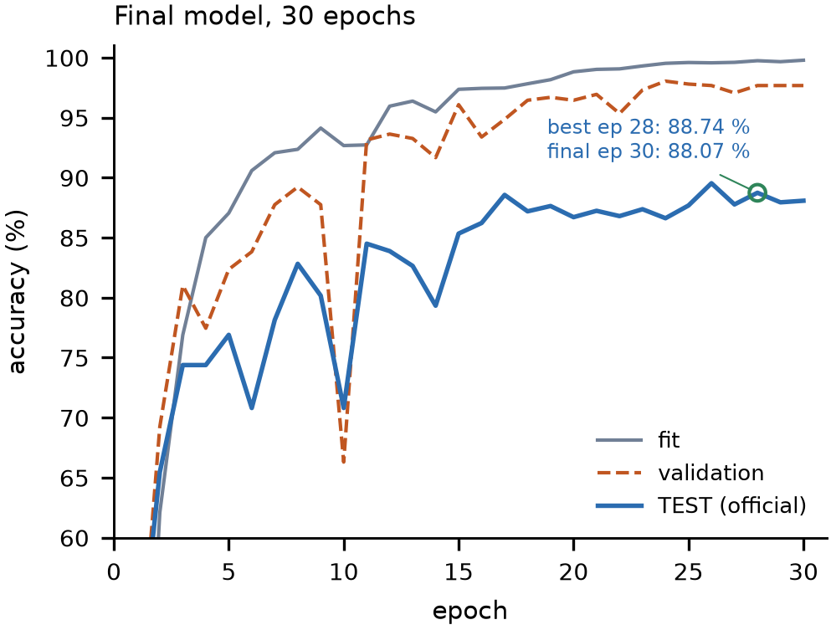
RESULTS · 1/4
It learns SHD
FINAL TEST
FIT
88.07%
99.78%
1994 / 2264
first 7,340
VAL
UNSEEN
97.67%
85.87%
816 trials
speakers 4 & 5
It still generalises to unseen speakers: 85.87% on the 1,840 trials from speakers 4 & 5, versus 97.64% on the 424 seen-speaker trials.
Figure 3a. Fit, validation and official test accuracy over 30 epochs. Best test 88.74%; final 88.07%.
Confirmed: N=100, D=1000, 30 epochs, seed 0, 3,069,201 params; official test n=2,264.
Neuron as vector · Spiking Heidelberg Digits
16
Notes:
The final model reaches 88.07% on the official test set: 1,994 of 2,264. Fit is 99.78%, validation is 97.67%, so the model is not failing to fit. The unseen-speaker split is the closest thing to a generalisation estimate: 85.87% on the 1,840 trials from speakers 4 and 5, which never appear in training.

Slide 17
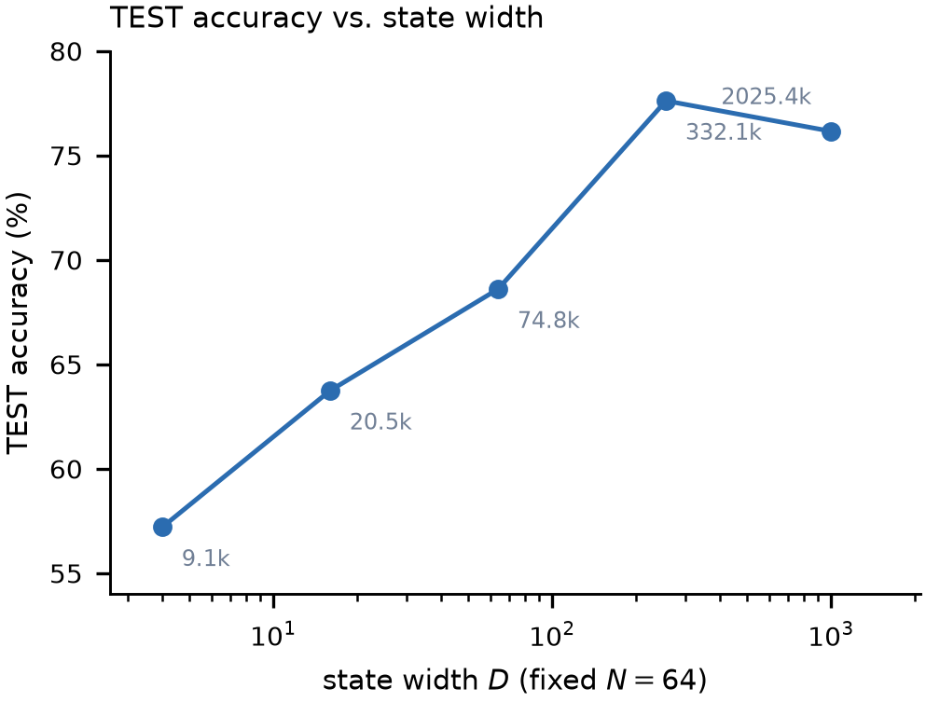
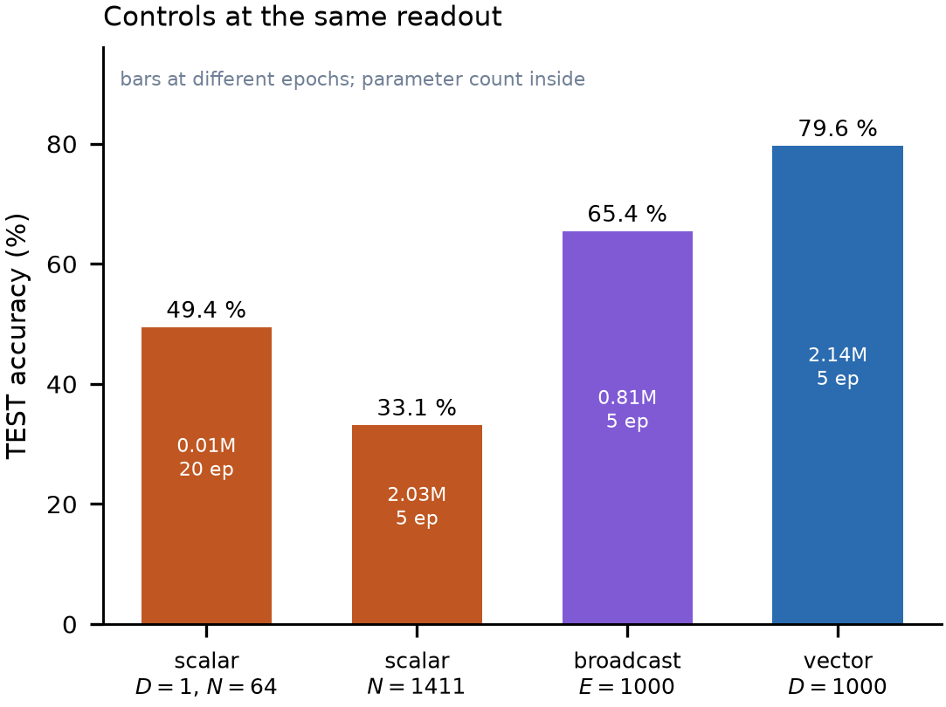
RESULTS · 2/4
Width helps; parameters do not explain it
Figure 2a. TEST accuracy vs state width at N=64, five epochs.
Figure 2b. Scalar, capacity-matched scalar, broadcast, and vector controls at the same readout.
D=4→256 buys +20.4 pp; D=1000 is not better than D=256 at this budget. At N=100, five epochs: scalar 35.91%, broadcast 65.42%, vector 79.64%. A 2M-parameter scalar reaches 33.13%.
Screening (5 epochs) except where noted; all numbers on the official test set, n=2,264.
Neuron as vector · Spiking Heidelberg Digits
17
Notes:
Left: width sweep at fixed N=64. Accuracy rises from 57.20% at D=4 to 77.61% at D=256, then flattens. Right: the controls. The scalar at N=64 is 49.43% at 20 epochs; the capacity-matched 1,411-neuron scalar is 33.13% at five epochs. The broadcast control recovers a large part of the gap with a scalar state, which is exactly why it is the sharpest control.

Slide 18
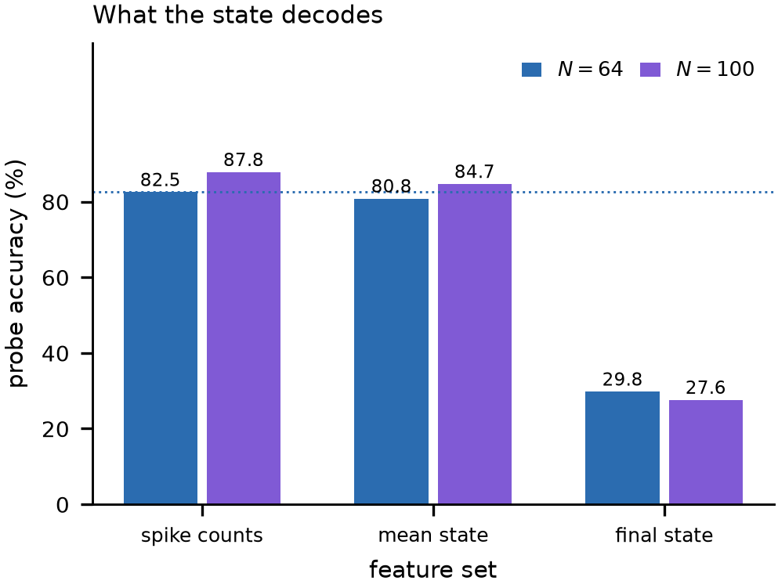
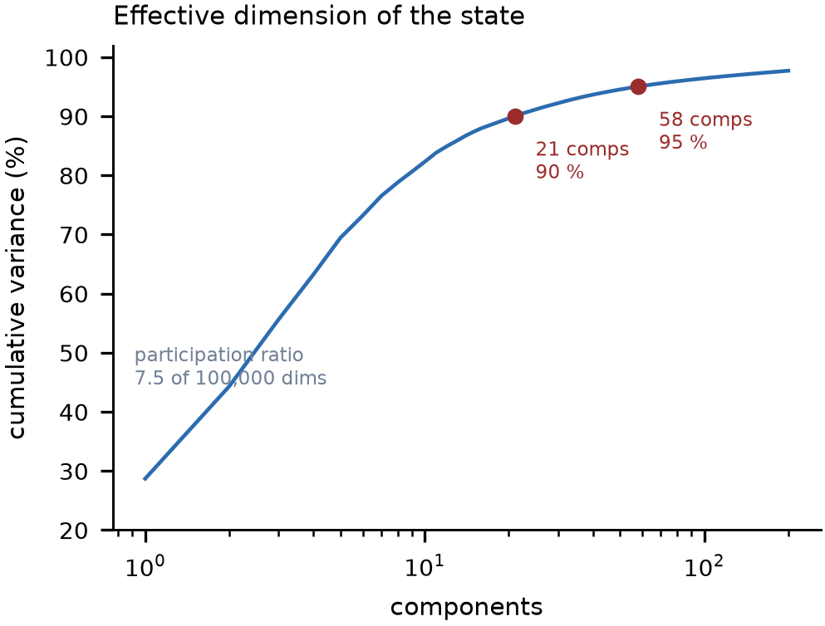
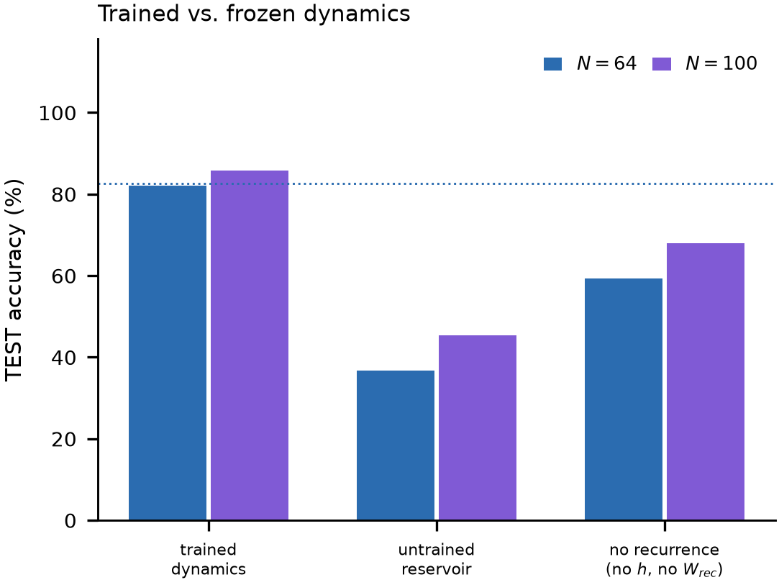
RESULTS · 3/4
What the state carries
Figure 4a. Linear probes on frozen states.
Figure 4b. Effective dimension: 7.49 of 100,000.
Figure 4c. Learned vs frozen dynamics.
Spike counts decode slightly better than the trial-mean state (87.81% vs 84.67%); the final state alone is 27.61%, so the code is in the trajectory, not the endpoint. The population mean uses 7.49 effective dimensions, and learned dynamics are worth about 40 pp over an untrained reservoir.
Frozen final checkpoint; probes on FIT; reported as accuracy on the 2,264 test trials.
Neuron as vector · Spiking Heidelberg Digits
18
Notes:
The probes ask what the state contains. Spike counts decode 87.81%, the trial-mean state 84.67%, the final state only 27.61%: the information is in the trajectory. The participation ratio is 7.49 effective dimensions out of 100,000, and nine components reach 90% of the variance. The right panel shows that the learned dynamics are worth about 40 pp over a shuffled or frozen reservoir.

Slide 19
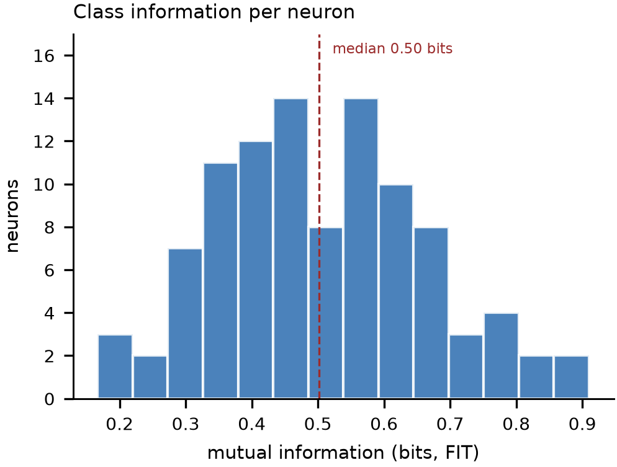
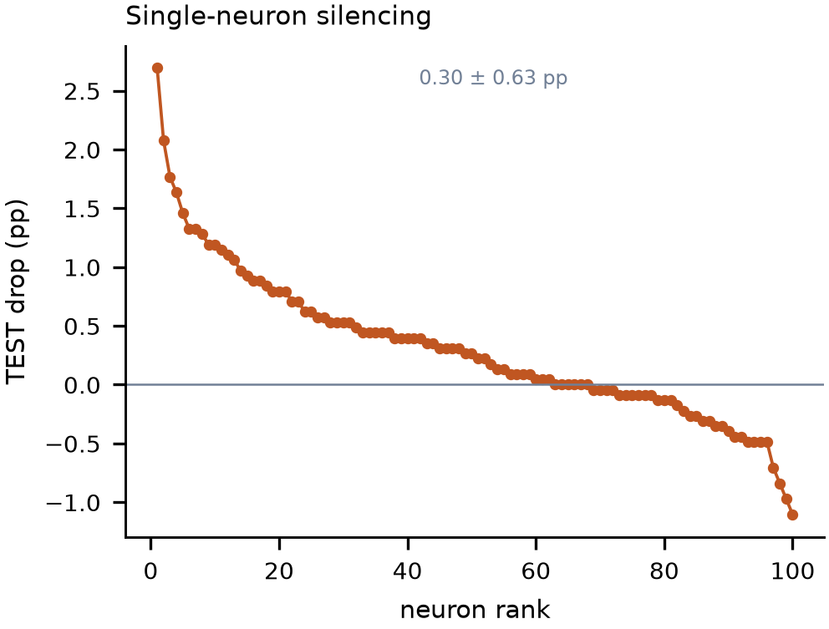
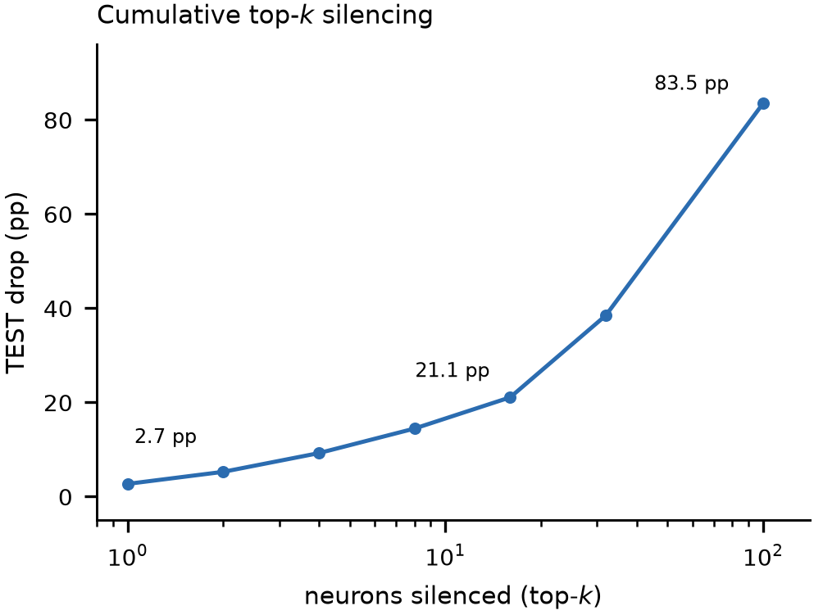
RESULTS · 4/4
A distributed, redundant code
Figure 5a. MI per neuron: median 0.502 bits.
Figure 5b. Single silencing: 0.30 ± 0.63 pp.
Figure 5c. Cumulative top-k: smooth decay.
Information is spread across the population: median mutual information 0.502 bits, 91 of 100 neurons informative, and silencing one neuron costs only 0.30 pp on average. The top-k curve degrades smoothly, which is what a distributed code predicts and a dedicated detector does not.
FIT mutual information; knockouts on the official test set; N=100, 30 epochs.
Neuron as vector · Spiking Heidelberg Digits
19
Notes:
The code is distributed. Every neuron carries some class information, the median is about half a bit, and no single neuron is necessary: silencing one costs 0.30 pp on average, with some deletions even improving accuracy. The cumulative top-k curve falls smoothly, which is the signature of a redundant population code rather than a sparse, dedicated one.

Slide 20
WHAT WE CAN AND CANNOT CLAIM
Takeaways
SHOWN
NOT YET
— A vector state beats a scalar state at fixed N and readout.
— Single seed; no seed variance.
— Width has a dose-response: D=4→256 buys +20.4 pp.
— Blocks selected on five-epoch TEST.
— The gap is not parameter count: 2M scalar 33.13%.
— No N=100 all-off baseline; scalar controls untuned.
— The code is distributed: no critical unit.
— VAL is speaker-overlapping; held-out pilot overstates.
THE CLAIM
On SHD, the width of a neuron's internal state — not its parameter count — is the variable that buys computation. The mechanism is a spike that transmits the whole state, not a wider scalar.
Next: seed variance, 30-epoch ablations, and a speaker-disjoint validation split.
All numbers from the current Results draft; confirmed vs screening tags in the manuscript.
Neuron as vector · Spiking Heidelberg Digits
20
Notes:
The claim is deliberately narrow. The model shows that state width buys accuracy at fixed neuron count and readout, that the effect is not parameter count, and that the code is distributed. The limitations are single seed, five-epoch selection, an unmatched N=100 baseline, and a speaker-overlapping validation split. Those are the next experiments.

