Slide 1
PROJECT OVERVIEW · 2026
What a neuron's
internal state buys
A methods-first walkthrough of a vector-valued
spiking neuron on Spiking Heidelberg Digits
Mehran Jaberinezhad · November 2026
one neuron · 1,000 coordinates
N = 100
D = 1000
SHD · 20 classes
REPO · [https://github.com/mehran-jaberi/neuron_as_vector]
Most of the deck is the model; the last four slides are the evidence.
Project overview · November 2026
1

Slide 2
THE QUESTION
A spike is one bit. What if the state is not?
STANDARD LIF
THIS MODEL
V_{i}(t+1) = (1 − α) V_{i}(t) + I_{i}(t)
z_{i}(t) ∈ ℝ¹⁰⁰⁰
s_{i}(t) = H(V_{i}(t) − θ_{i})
Every coordinate participates in the dynamics. The spike is still binary, but it emits the whole state vector.
One scalar state. One threshold. One output bit.
The neuron can integrate, leak and fire. It cannot hold a pattern whose coordinates vary independently: a spike says only that the scalar crossed threshold.
The readout is a learned hyperplane through the state, not a scalar membrane. The width of what a spike can transmit equals the width of the state.
one number → one bit
fixed N · fixed readout · fixed budget
Does state width itself buy computation?
The comparison is architectural; the empirical test is on SHD (next slides).
Neuron as vector · Spiking Heidelberg Digits
2
Notes:
The scalar neuron is not a straw man: it is the standard event-driven unit. The vector model keeps the same spike interface and the same count readout; only the state and the intra-neuron operations become vector-valued. The controlled question is stated at the bottom.

Slide 3
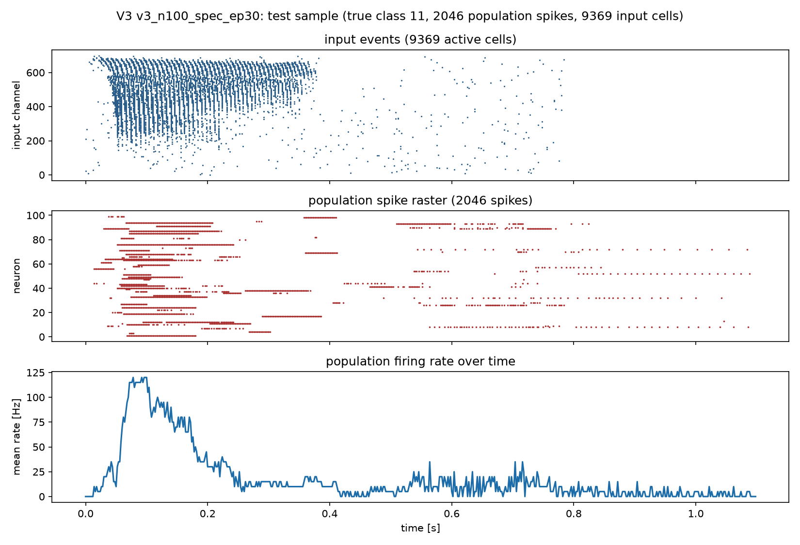
METHODS · BENCHMARK
SHD: 20 words, 700 channels, one second
TRAINING TRIALS
OFFICIAL TEST TRIALS
8,156
2,264
speakers 0–3, 6–11
speakers 4 & 5 unseen
ENGLISH AND GERMAN DIGITS
COCHLEAR CHANNELS
20
700
classes 0–19
binary events
WHY SHD
Event-based, 20-way, standard split. Accuracy is comparable across models and the test speakers are truly held out.
Reported final run, held-out trial: input events (top), 100-neuron spike raster (middle), population rate (bottom).
SHD: 8,156 train / 2,264 test; 700 channels. Activity: v3_n100_spec_ep30, held-out trial.
Neuron as vector · Spiking Heidelberg Digits
3
Notes:
SHD is the standard event-based digit benchmark: 20 German digits, 700 cochlear channels, sparse events. We bin at 2 ms, which gives 500 bins for the 1 s trial, then append 50 zero bins (100 ms) so the count readout sees the tail of the response. The official test set has 2,264 trials; speakers 4 and 5 never appear in training, which makes it a genuine unseen-speaker test.

Slide 4
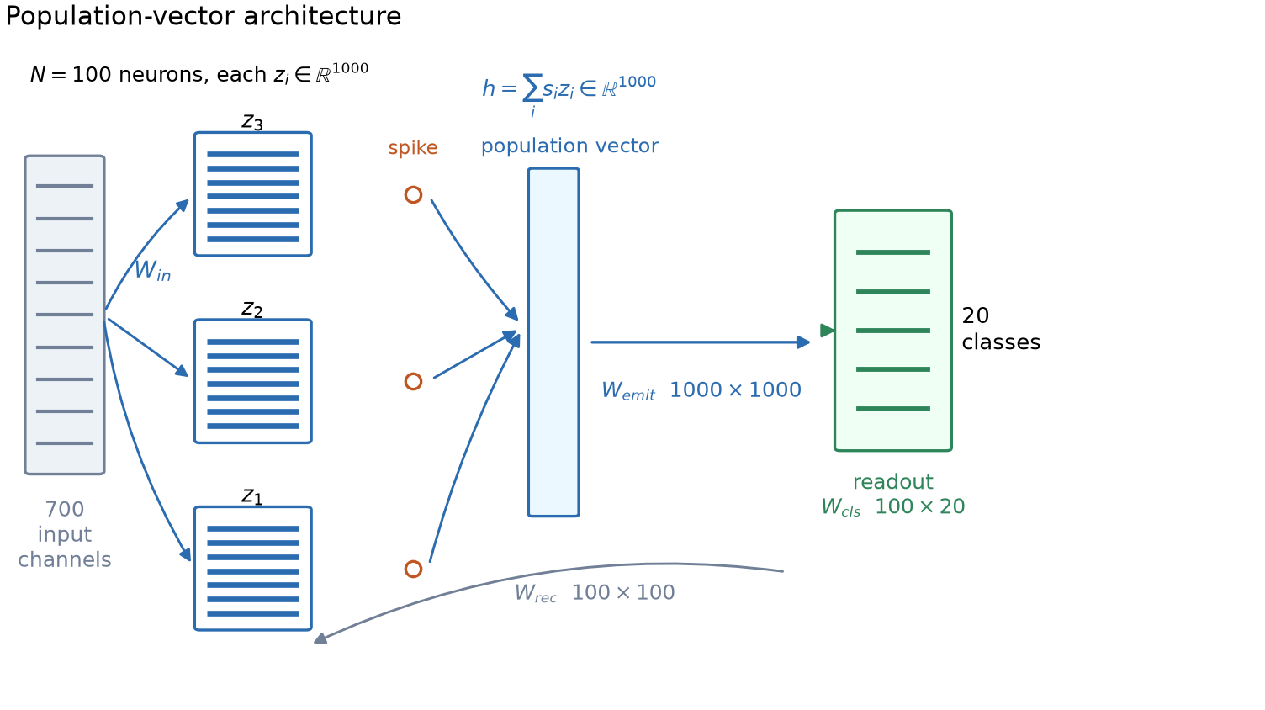
METHODS · ARCHITECTURE
One shared input, 100 vector neurons, one count readout
INPUT
700 channels → 1,400
two delay-line copies; shared input matrix
NEURON
100 × 1,000 state
rank-64 mixing; learned leak
READOUT
100 spikes → 20
counts over 550 bins; classifier
Figure 1. Population-vector architecture. A spike emits the whole state; emitted vectors are summed and fed back through the emission matrix; a linear readout on spike counts produces the class.
3,069,201 parameters
All blocks drawn to scale in width, not in parameter count; see Methods §2.4–2.5.
Neuron as vector · Spiking Heidelberg Digits
4
Notes:
The figure is the whole architecture. The input is 700 channels, expanded to 1,400 by the fixed delay line, then projected by one shared 1,400×1,000 matrix. Each of the 100 neurons carries a 1,000-dimensional state and mixes it with a rank-64 operator. A spike emits the whole state; the emitted vectors are summed and passed through a shared 1,000×1,000 W_emit. The readout is a linear classifier on spike counts over the 550 bins.

Slide 5
METHODS · WHERE THE VECTOR ENTERS · 1/3
The input projection makes the vector
SHARED PROJECTION + PER-NEURON GATE
SHAPES
a_{t} = x_{t} W_{in}
x(t)
Wᵢₙ
a(t)
d_{in,i,t} = g_{i} ⊙ a_{t}
1 × 1400
1400 × 1000
1 × 1000
one projection, reused by all 100 neurons
The input is a 1×1,400 row; the input matrix is 1,400×1,000. The result is one 1,000-D pattern shared by all neurons. The gate is a learned 1,000-D mask per neuron.
g_{i} ⊙ a_{t}
the gate selects coordinates; it does not mix them
input matrix: 1.4M
gate: 100k
WHY THIS IS THE FIRST INSERTION POINT
A scalar neuron would have one weight vector and produce one current. Here a shared matrix produces a 1,000-D pattern; the gate makes that pattern neuron-specific. Parameter cost is 1,400×1,000, not 100 times that.
Methods §2.4.1–2.4.2; two delay-line copies give 1,400 input channels.
Neuron as vector · Spiking Heidelberg Digits
5
Notes:
The first place the vector enters is the input projection. Every neuron does not own a 1,400×1,000 matrix; there is one shared W_in, and each neuron has a learned 1,000-D gate. The gate is coordinate-wise, so the input path creates a vector but does not mix its coordinates.

Slide 6
METHODS · WHERE THE VECTOR ENTERS · 2/3
Rank-64 mixing inside each neuron
ONE LOW-RANK OPERATOR, SHARED BY ALL NEURONS
LOW-RANK BOTTLENECK
m_{i} = (z_{i} W_{down}) W_{up}
1000
64
1000
The two factors are 1,000×64 and 64×1,000; both are shared. The 64-D bottleneck is the only place where coordinates of one neuron's state interact. A dense 1,000×1,000 map per neuron would cost 100M parameters; this costs 128k.
state
rank
update
The bottleneck forces a shared low-dimensional subspace. It is an architectural prior, not a claim that the state is only 64-dimensional.
rank R = 64
128k parameters
This is the only active mechanism that mixes coordinates within a single neuron. The emission matrix mixes across neurons; the gate and the readout are coordinate-wise or linear.
Methods §2.4.4; both factors initialised from zero-mean Gaussians (1/D and 0.25/R).
Neuron as vector · Spiking Heidelberg Digits
6
Notes:
The second insertion point is the intrinsic mixing. Each neuron multiplies its own 1,000-D state by a shared 1,000×64 matrix, then by a shared 64×1,000 matrix. The rank is 64, so the operator is deliberately low-rank. This is the only active mechanism that mixes coordinates inside one neuron.

Slide 7
METHODS · WHERE THE VECTOR ENTERS · 3/3
A spike broadcasts the whole vector
RECURRENT COUPLING + SHARED EMISSION
ONE BIT → ONE VECTOR
c_{i}(t) = Σ_{j} W_{rec}[j,i] s_{j}(t)
s₁ = 1
h(t) = (1/√N)(Σ_{j} s_{j}(t) z_{j}(t)) W_{emit}
W
s₂ = 1
Σ
d_{rec,i} = c_{i}(t) h(t)
emit
s₃ = 1
A spike is one scalar; the state is 1,000-D. A single spike therefore injects the whole state of neuron j into a shared 1,000-D population signal, scaled by the scalar coupling.
The sum is a 1,000-D population vector; one shared matrix maps it back to state space and is used by every neuron.
recurrent: 10k
emission: 1M
WHY THE 1/√N
The sum over N neurons grows with N; the 1/√N keeps the emitted vector's scale roughly constant, so the learned dynamics do not have to re-tune when the population size changes.
Methods §2.4.3; the emission matrix is initialised as identity + 0.02 noise, 1,000×1,000.
Neuron as vector · Spiking Heidelberg Digits
7
Notes:
The third insertion point is the broadcast. When neuron j spikes, the scalar coupling c_i multiplies a shared 1,000-D vector h, which is built by summing the states of all neurons that spiked, weighted by their spike, and passing through W_emit. That is how one bit can carry a whole state vector. The 1/sqrt(N) keeps the scale from growing with N.

Slide 8
METHODS · DYNAMICS
The state update and the spike functional
LEAK, TWO-STAGE TARGET, SPIKE
THE VECTOR IS READ BY A HYPERPLANE
z_{i}(t+1) = (1 − α_{i}) z_{i}(t) + α_{i} z̃_{i}(t)
z_{i} ∈ ℝ¹⁰⁰⁰
z̃_{i} = tanh(m_{i} + λ tanh(m_{i}⁽²⁾ + d_{i}))
w_{out,i} ∈ ℝ¹⁰⁰⁰
o_{i} = ⟨z_{i,} w_{out,i}⟩ + θ_{i} − w_{ad} b_{i}
s_{i} = H(o_{i})
The spike is still one bit. What changed is that the decision boundary is a learned hyperplane through 1,000 coordinates, not a threshold on one membrane potential.
The leak is learned per neuron; λ is a learned scalar mixing the two rank-64 paths; θ is the calibrated threshold; the readout vector is a learned hyperplane.
Reported configuration: leak init 0.1, λ init 1.0, thresholds calibrated to ~10 Hz, readout weights ~ N(0, 1/D). adLIF currents are configured but do not enter the reported two-stage target.
Methods §2.4.5–2.4.8; two-stage target Eq. 30; spike functional Eq. 23.
Neuron as vector · Spiking Heidelberg Digits
8
Notes:
The state update is a leaky integrator with a learned per-neuron leak. The target is the two-stage nonlinearity: a rank-64 mixing, a second rank-64 path, and a tanh. The spike is a Heaviside of a learned hyperplane through the whole state. That is the only place the full vector is read.

Slide 9
METHODS · FORWARD PASS
One trial, end to end
ONE BIN, IN ORDER
AROUND THE LOOP
T = 550
a_t = x_t W_in
500 signal bins + 50 silence bins
d_in = g ⊙ a_t
m = (z W_down) W_up
10 chunks
c = s W_rec
checkpoint every 55 bins
h = (1/√N)(Σ_j s_j z_j) W_emit
d = d_in + c h + β
fp16 state
z̃ = tanh(m + λ tanh(m2 + d))
fp32 master weights; GradScaler
z ← (1 − α) z + α z̃
counts
o = ⟨z, w_out⟩ + θ − w_ad b
sum spikes over t; W_cls → 20
s = H(o)
Algorithm 1 in Methods §2.5; grad checkpointing in §2.8.4.
Neuron as vector · Spiking Heidelberg Digits
9
Notes:
This is the per-bin forward pass. The delay line and input projection happen once for the whole trial; the loop then updates the state, computes the spike, and accumulates counts. The right rail gives the loop-level facts: 550 bins, ten checkpointed chunks, fp16 state with fp32 masters, and a count readout.

Slide 10
METHODS · INITIALISATION + CALIBRATION
Start near 10 Hz, not at silence
TOTAL PARAMETERS
INPUT + EMISSION
THRESHOLD CALIBRATION
3,069,201
2.80M
p = clip(10 Hz × 2 ms, 0.001, 0.49) = 0.02
19 groups
91% of the budget
Set all thresholds to zero. Run three fixed-point iterations on 96 FIT trials:
θ_{i} ← θ_{i} − Q_{(1−p)}(o_{i})
RANK-64 MIXERS
RECURRENT + READOUT
256k
12k
Skip the first 68 bins, flatten over time and batch, and take the (1−p) quantile of the pre-activation values. Three iterations land near the 2%-per-bin target.
two stages
classifier and thresholds
2% per bin ≈ 10 Hz
WHY CALIBRATE
The thresholds stay trainable after calibration. Calibration sets the operating point; training can move it.
A count readout needs spikes. Zero thresholds either silence the population or saturate it; 10 Hz is a stable operating point across neurons.
Methods §2.6; parameter groups Table 4; calibration Algorithm 2.
Neuron as vector · Spiking Heidelberg Digits
10
Notes:
Initialisation matters because the readout is a count. We calibrate every threshold to a target of about 10 Hz: p is the target spike probability per 2 ms bin, 0.02. Three fixed-point iterations on the pre-activation quantile put each neuron near that rate. The threshold remains trainable.

Slide 11
METHODS · MECHANISMS · 1/2
Memory beyond the membrane
SPIKE-FREQUENCY ADAPTATION
LEARNABLE LEAK + INITIAL STATE
b_{i}(t+1) = ρ b_{i}(t) + s_{i}(t)
α_{i} = sigmoid(raw_{i}), init 0.1
o_{i} ← o_{i} − w_{ad} b_{i}
z_{i}(0) = z0_{i} (learned, 100k)
A soft spike-history term. ρ = 0.95; the adaptation weight starts at 0.1 and is learned. It replaces reset/refractory: the neuron is slowed after firing, not blanked.
Each neuron gets its own leak; the population is not forced to share one time constant. The initial state is a learned 1,000-D vector per neuron, not zeros.
ρ = 0.95
adaptation: 0.1
100 leak values
100k initial state
Both are small: adaptation adds 100 weights; the learned initial state adds 100,000. The 20-epoch screen kept both; they are part of the reported model.
Methods §2.7.1–2.7.2; adaptation Eq. 27; state dynamics Eq. 31.
Neuron as vector · Spiking Heidelberg Digits
11
Notes:
Two memory mechanisms are active. Adaptation adds a soft spike-frequency term, which is the model's replacement for reset and refractory. The state dynamics make the leak per-neuron and the initial state learnable. Both are cheap: 100 weights for adaptation, 100,000 for z0.

Slide 12
METHODS · TRAINING PROTOCOL
Thirty epochs, one seed, checkpointed BPTT
SHD events
Delay line
Forward
Loss
Adam
Checkpoint
7,340 FIT; 816 VAL
2 ms bins
2 copies
10 ms stride
10 checkpointed
chunks of 55
CE + 1e-4 rate
10 Hz target
1e-3, cosine
3% warmup
10 chunks of 55;
final weights reported
LOSS
OPTIMISER
cross-entropy + 1e-4 × mean((rate − 10 Hz)²)
Adam, lr 1e-3, cosine, warmup 3%, clip 1.0
The rate term is a soft penalty on the mean spike rate; it prevents silent or saturated solutions.
30 epochs, batch 96; the schedule is step-based, not epoch-based.
PRECISION
CHECKPOINTING
fp16 state, fp32 masters, GradScaler
10 chunks × 55 bins; use_reentrant=False
No autocast; explicit casts keep the state dynamics stable.
State, adaptation and adLIF currents are passed across chunk boundaries.
Single seed (0). Five-epoch screens selected the block set; the 30-epoch run is the reported model.
Methods §2.8; 3,069,201 parameters; 5,055 MiB peak; ~505 s/epoch on the RTX 3060.
Neuron as vector · Spiking Heidelberg Digits
14
Notes:
The training loop is standard BPTT with two non-standard choices: ten checkpointed chunks so the graph fits in 6 GiB, and a rate penalty that keeps the mean firing rate near 10 Hz. The 30-epoch run uses Adam with a cosine schedule and a 3% warmup. The reported checkpoint is the final epoch; best-VAL is opt-in.

Slide 13
METHODS · CONTROLS
Four controls isolate the vector
SCALAR, SAME N
CAPACITY-MATCHED
D = 1, N = 64 / 100
D = 1, N = 1,411
Same neurons, same readout, no state width. The cleanest test of width alone.
Same parameter budget as the vector model, but a scalar state. Tests whether parameters explain the gap.
BROADCAST
WIDTH SWEEP
D = 1, E = 1000
D = 4 → 1000, N = 64
Scalar state, 1,000-wide transmission. Separates the width of the state from the width of what a spike sends.
Same architecture, five widths. A dose-response curve, not a single comparison.
The broadcast control is the key: it can recover transmission width without state width.
Methods §2.8; control definitions and the width sweep are the design, results follow.
Neuron as vector · Spiking Heidelberg Digits
15
Notes:
The controls are the argument. A scalar with the same neuron count tests width. A capacity-matched scalar tests whether parameters alone explain the gap. The broadcast control keeps a scalar state but gives it a 1,000-wide transmission, so it separates state width from transmission width. The width sweep turns the comparison into a dose-response curve.

Slide 14
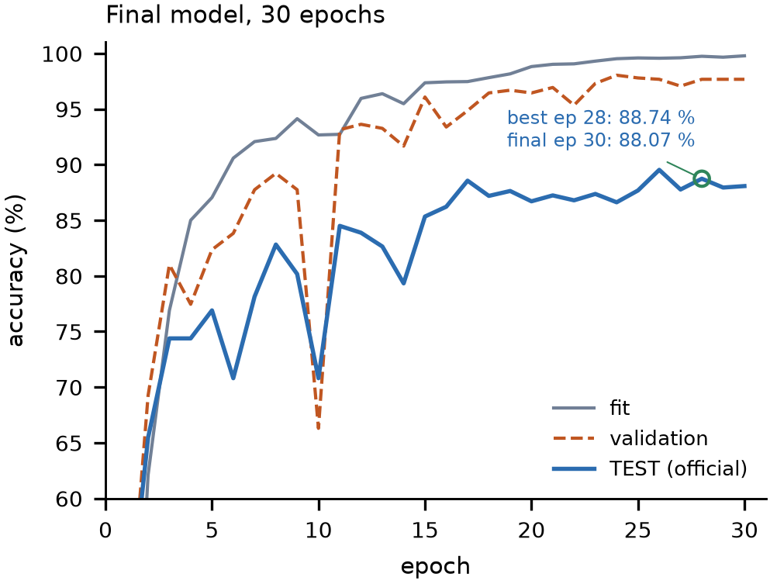
RESULTS · 1/5
It learns SHD
FINAL TEST
FIT
88.07%
99.78%
1994 / 2264
first 7,340
VAL
UNSEEN
97.67%
85.87%
816 trials
speakers 4 & 5
It still generalises to unseen speakers: 85.87% on the 1,840 trials from speakers 4 & 5, versus 97.64% on the 424 seen-speaker trials.
Figure 3a. Fit, validation and official test accuracy over 30 epochs. Best test 88.74%; final 88.07%.
Confirmed: N=100, D=1000, 30 epochs, seed 0, 3,069,201 params; official test n=2,264.
Neuron as vector · Spiking Heidelberg Digits
16
Notes:
The final model reaches 88.07% on the official test set: 1,994 of 2,264. Fit is 99.78%, validation is 97.67%, so the model is not failing to fit. The unseen-speaker split is the closest thing to a generalisation estimate: 85.87% on the 1,840 trials from speakers 4 and 5, which never appear in training.

Slide 15
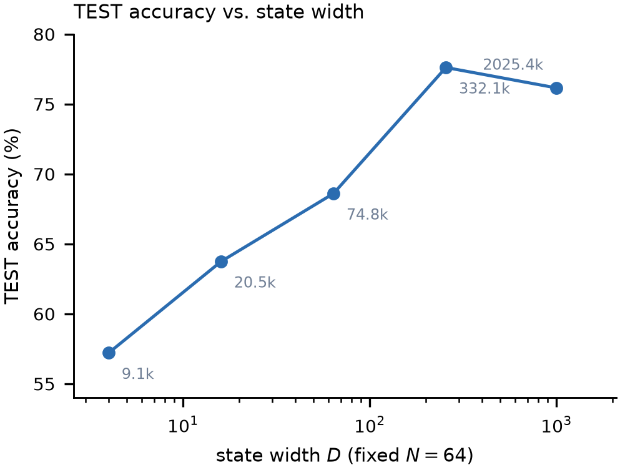
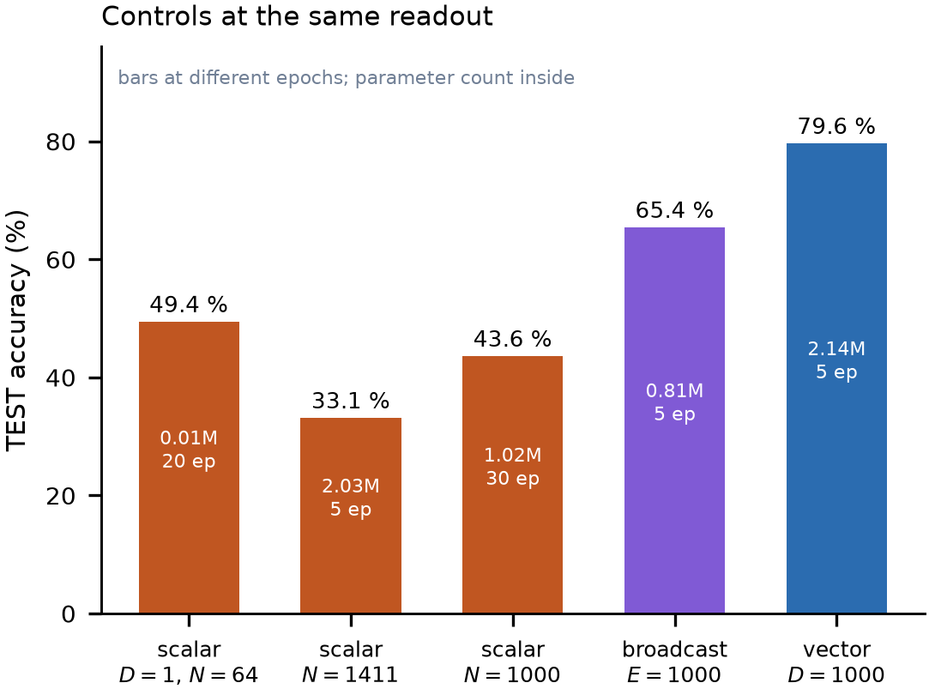
RESULTS · 2/5
Width helps; parameters do not explain it
Figure 2a. TEST accuracy vs state width at N=64, five epochs.
Figure 2b. Scalar, capacity-matched scalar, broadcast, and vector controls at the same readout.
D=4→256 buys +20.4 pp; D=1000 is not better than D=256 at this budget. At N=100, five epochs: scalar 35.91%, broadcast 65.42%, vector 79.64%. A 2M-parameter scalar reaches 33.13%.
Screening (5 epochs) except where noted; all numbers on the official test set, n=2,264.
Neuron as vector · Spiking Heidelberg Digits
17
Notes:
Left: width sweep at fixed N=64. Accuracy rises from 57.20% at D=4 to 77.61% at D=256, then flattens. Right: the controls. The scalar at N=64 is 49.43% at 20 epochs; the capacity-matched 1,411-neuron scalar is 33.13% at five epochs. The broadcast control recovers a large part of the gap with a scalar state, which is exactly why it is the sharpest control.

Slide 16
RESULTS · 3/5
A 1,000-neuron scalar still does not fit SHD
More neurons at D=1 is not the same axis as more state width.
SCALAR · N=1,000 · D=1
VECTOR · N=100 · D=1,000
30 EPOCHS · 1,024,703 PARAMS
5 EPOCHS · 2,140,100 PARAMS
43.6%
76.7%
TEST · 987 / 2,264
TEST · 1,736 / 2,264
FIT 49.6% · VAL 42.7%
FIT 96.4% · VAL 93.5%
34 min wall-clock · 67 s / epoch
31 min wall-clock · 343 s / epoch
THE TELL
49.6% on FIT: the 1,000-neuron scalar does not fit the training split, so this is not a generalisation gap. In the same half-hour the vector gets 5 passes instead of 30 and still gains 33 points of TEST. The 30-epoch vector reaches 88.1% TEST and 99.8% FIT; the scalar never gets above 50% on FIT.
The variable that moves accuracy is state width, not neuron count.
Not parameter-matched: 1.02M scalar vs 2.14M vector; the scalar spends 1M weights on a full recurrent matrix.
Scalar: v3_emerg_n1000_d1_ep30 (30 ep); vector: 2026-10-26_20-55-54 (5 ep); final: v3_n100_spec_ep30.
Neuron as vector · Spiking Heidelberg Digits
18
Notes:
Sanity check requested after the draft: N=1,000 at D=1, 30 epochs, reaches 43.6% TEST and only 49.6% FIT, in 34 min. The five-epoch N=100 D=1000 run reaches 76.7% TEST and 96.4% FIT in 31 min. This is not a like-for-like parameter comparison, 1.02M vs 2.14M, but it rules out the simple 'more neurons' reading: the scalar has 1M recurrent weights and still cannot fit. The 30-epoch vector is 88.07% TEST / 99.78% FIT. Caveat: the five-epoch vector is the earlier 2.14M configuration, not the final 3.07M one.

Slide 17
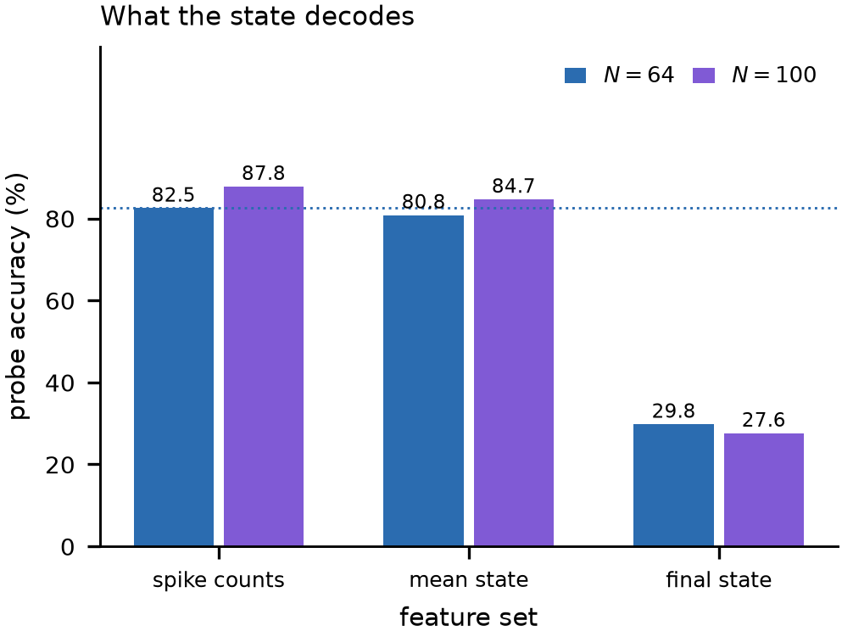
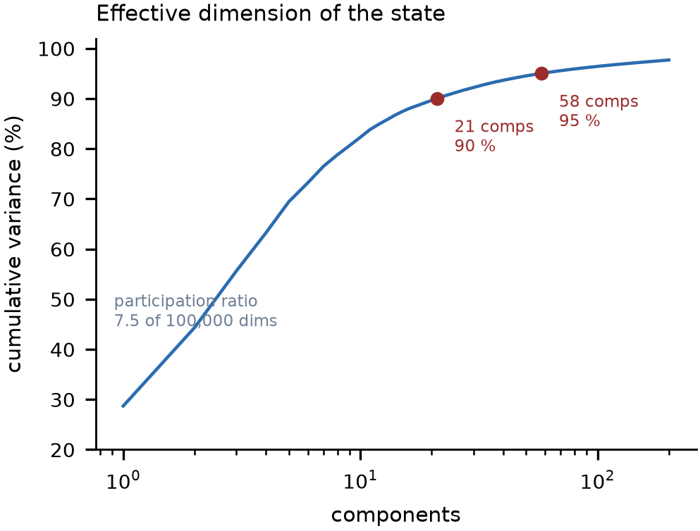
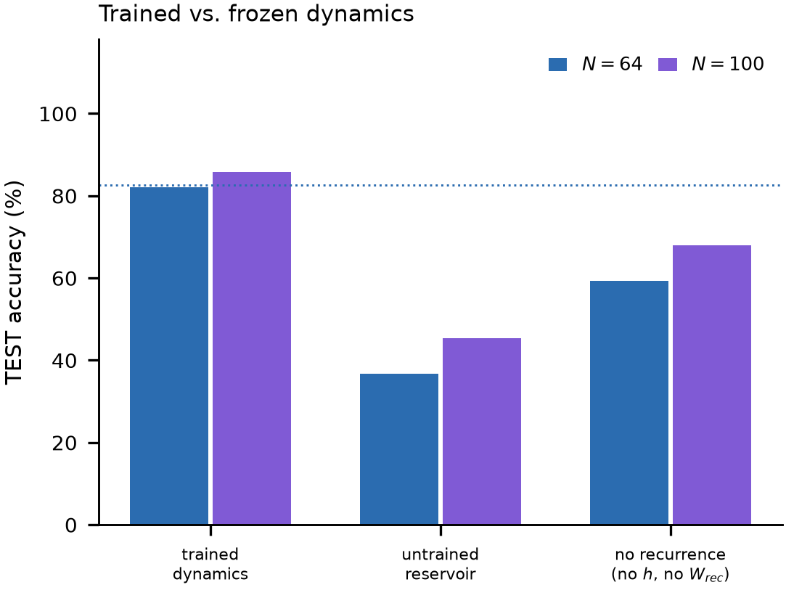
RESULTS · 4/5
What the state carries
Figure 4a. Linear probes on frozen states.
Figure 4b. Effective dimension: 7.49 of 100,000.
Figure 4c. Learned vs frozen dynamics.
Spike counts decode slightly better than the trial-mean state (87.81% vs 84.67%); the final state alone is 27.61%, so the code is in the trajectory, not the endpoint. The population mean uses 7.49 effective dimensions, and learned dynamics are worth about 40 pp over an untrained reservoir.
Frozen final checkpoint; probes on FIT; reported as accuracy on the 2,264 test trials.
Neuron as vector · Spiking Heidelberg Digits
19
Notes:
The probes ask what the state contains. Spike counts decode 87.81%, the trial-mean state 84.67%, the final state only 27.61%: the information is in the trajectory. The participation ratio is 7.49 effective dimensions out of 100,000, and nine components reach 90% of the variance. The right panel shows that the learned dynamics are worth about 40 pp over a shuffled or frozen reservoir.

Slide 18
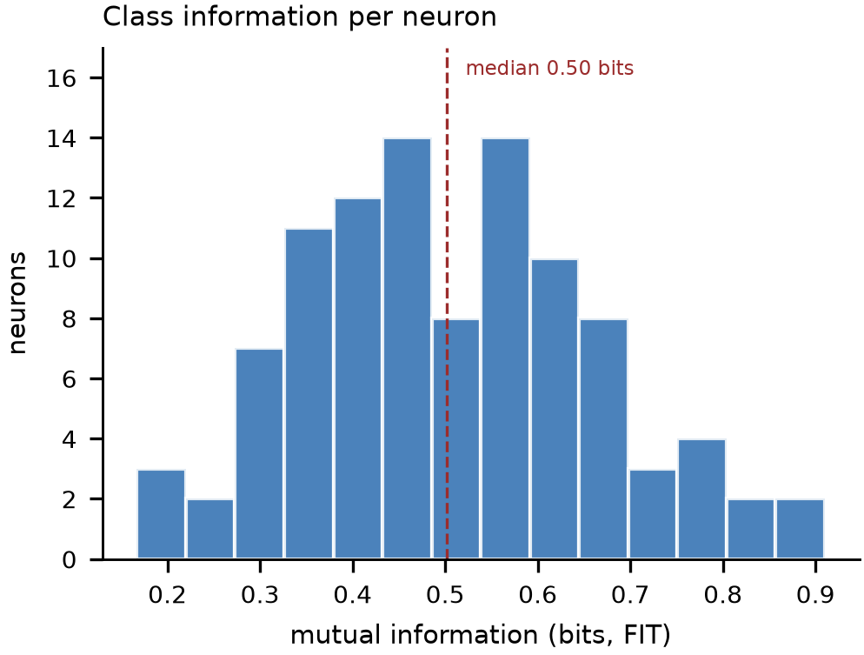
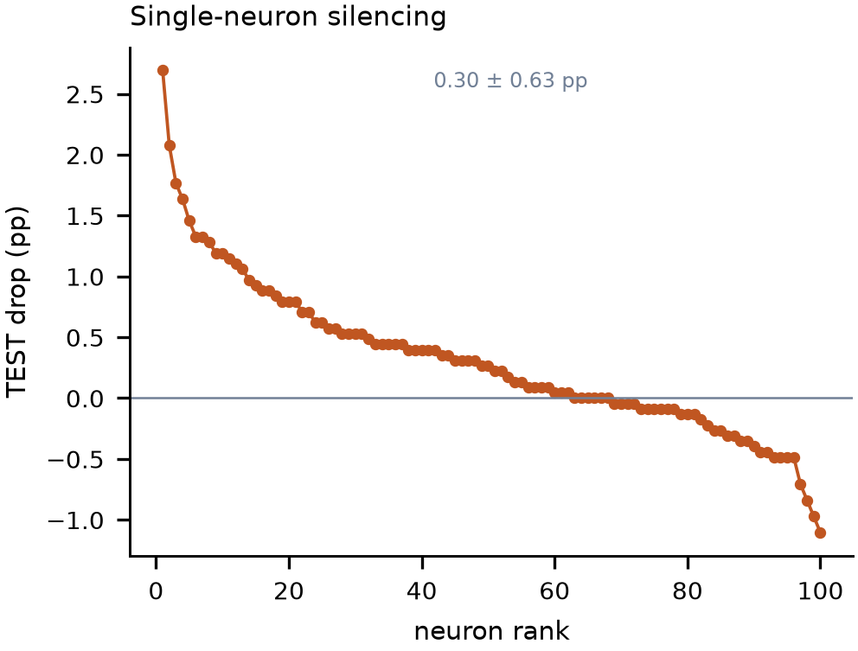
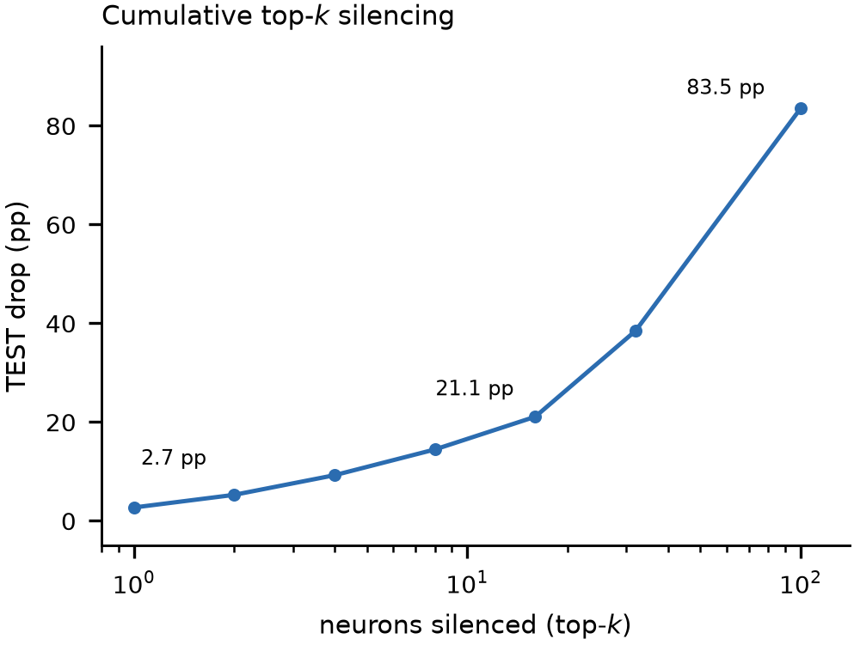
RESULTS · 5/5
A distributed, redundant code
Figure 5a. MI per neuron: median 0.502 bits.
Figure 5b. Single silencing: 0.30 ± 0.63 pp.
Figure 5c. Cumulative top-k: smooth decay.
Information is spread across the population: median mutual information 0.502 bits, 91 of 100 neurons informative, and silencing one neuron costs only 0.30 pp on average. The top-k curve degrades smoothly, which is what a distributed code predicts and a dedicated detector does not.
FIT mutual information; knockouts on the official test set; N=100, 30 epochs.
Neuron as vector · Spiking Heidelberg Digits
20
Notes:
The code is distributed. Every neuron carries some class information, the median is about half a bit, and no single neuron is necessary: silencing one costs 0.30 pp on average, with some deletions even improving accuracy. The cumulative top-k curve falls smoothly, which is the signature of a redundant population code rather than a sparse, dedicated one.

Slide 19
FUTURE DIRECTIONS
Make it cheaper; give each neuron an identity
REDUCE THE FOOTPRINT
PER-NEURON EMBEDDING
91% of the parameters sit in two dense 1,000-wide maps: the input projection (1.4M) and the emission matrix (1M).
e_{i} ∈ ℝ^{d,} g_{i} = W_{g} e_{i,} β_{i} = W_{β} e_{i}
Share the 1,000-D map and learn only a small embedding per neuron. At d = 8, one 1,000-D head costs 8.8k instead of 100k; the same embedding can drive the gate, the bias and the readout.
W_{emit} ≈ D + U Vᵀ
Diagonalise the dense emitter and keep a rank-r correction. The cost becomes 1,000 + 2,000r; at r = 16 that is about 33k parameters, not 1M. The same factorization applies to the input matrix.
w_{out,i} = W_{o} e_{i}
The question is whether a neuron needs a full private vector, or just a compact identity that selects a shared pattern.
1M → ~33k
input: 1.4M → ~38k
d = 8: 8.8k / head
Both are design sketches, not measured results. The test is whether the SHD gain survives at a much smaller budget.
Future work; no results claimed. Diagonal + low-rank and embedding costs are parameter counts, not run outcomes.
Neuron as vector · Spiking Heidelberg Digits
21
Notes:
Two concrete directions. First, shrink the footprint: the dense input and emission matrices dominate the parameter budget, so diagonalising the emitter and keeping a low-rank correction, and factorising the input projection, could remove most of that cost. Second, replace the 100 independent 1,000-D gates and biases with a small learned embedding per neuron and a shared map; the embedding can also condition the readout. Neither is measured yet — they are the next experiments, and the criterion is whether SHD accuracy survives.

Slide 20
WHAT WE CAN AND CANNOT CLAIM
Takeaways
SHOWN
NOT YET
— A vector state beats a scalar state at fixed N and readout.
— Single seed; no seed variance.
— Width has a dose-response: D=4→256 buys +20.4 pp.
— Blocks selected on five-epoch TEST.
— The gap is not parameter count: 2M scalar 33.13%.
— No N=100 all-off baseline; scalar controls untuned.
— The code is distributed: no critical unit.
— VAL is speaker-overlapping; held-out pilot overstates.
THE CLAIM
On SHD, the width of a neuron's internal state — not its parameter count — is the variable that buys computation. The mechanism is a spike that transmits the whole state, not a wider scalar.
REPO · [https://github.com/mehran-jaberi/neuron_as_vector]
All numbers from the current Results draft; confirmed vs screening tags in the manuscript.
Neuron as vector · Spiking Heidelberg Digits
22
Notes:
The claim is deliberately narrow. The model shows that state width buys accuracy at fixed neuron count and readout, that the effect is not parameter count, and that the code is distributed. The limitations are single seed, five-epoch selection, an unmatched N=100 baseline, and a speaker-overlapping validation split. Those are the next experiments.

