Slide 1




Open Source Geospatial Analysis in Python:
GDAL/OGR Basics
OGR

Slide 2

GDAL/OGR
Originally developed by Frank Warmerdam
Geospatial Data Abstraction Library (GDAL)
A set of tools for working with raster data, mainly for translation, projecting and some processing. The extent of spatial analysis tools is limited, but the building blocks are there.
GDAL Utilities include Projecting, Mosaicing, Polyongize/rasterize, Proximity, among others.
OpenGIS Simple Features Library (OGR)
A set of tools for reading and writing vector formats.
Large amount of vector geometry tools, such as: buffer, intersect, union, convexHull, project, simplify, among others.
These tools were designed for the command line interface. Since then a number of API’s have been developed for Python, Perl, Ruby, Java, C++, and others. Working with the API is not the native environment , so some functionality is not available or harder to use.

Slide 3
GDAL/OGR Command Line Examples
gdalinfo --help
gdalinfo myFile.tif
gdalwarp -t_srs 'EPSG:4326' input.tif output.tif
ogrinfo --help
ogrinfo –so myFile.shp myFile
ogr2ogr -f 'Mapinfo File' output.tab input.shp
Command line example

Slide 4
Software that uses GDAL/OGR
Several software programs use the GDAL/OGR libraries to allow them to read and write multiple GIS formats. Such programs include:
ArcGIS – Uses GDAL for reading/writing raster formats.
Biosphere3D – Open source landscape scenery globe.
FWTools – A cross-platform open source GIS software bundle compiled by Frank Warmerdam.
gdaltokmz – A Python module translating from GDAL-supported raster graphics formats to the Google Earth KMZ format.
Google Earth – A virtual globe and world imaging program.
GRASS GIS
gvSIG
JMap
MapServer
World Wind Java – NASA's open source virtual globe and world imaging technology.
OSSIM – Libraries and applications used to process imagery, maps, terrain, and vector data.
OpenEV – Geospatial toolkit and a frontend to that toolkit; to display georeferenced images and elevation data.
Orfeo toolbox – A satellite image processing library.
Quantum GIS
R – An open source statistical software with extensions for spatial data analysis.
SAGA GIS – A cross-platform open source GIS software.
TopoQuest – Internet topographic map viewer.
Rolta Geomatica software
http://en.wikipedia.org/wiki/GDAL

Slide 5
Where to get started:
http://wiki.osgeo.org/wiki/OSGeo_Python_Library - The OSGeo wiki for Python. Doesn’t contain a lot of updated resources.
http://trac.osgeo.org/gdal/wiki/GdalOgrInPython - The GDAL/OGR wiki for Python. Useful links and installation information.
http://www.gdal.org/gdal_tutorial.html - GDAL API tutorial. Has good documentation for a limited number of tasks in C, C++ and Python
http://www.gis.usu.edu/~chrisg/python/ - Chris Gerard of the RS/GIS Lab at Utah State University has taught a few classes on Open Source RS/GIS and provided these resources to the public. This is a great place to get started with GDAL/OGR. Two of her lectures are on the Z drive in the readings.
http://pcjericks.github.io/py-gdalogr-cookbook/ - Recently a GDAL/OGR Cookbook has been put together. This is the best resource at the moment, in my opinion.
http://gdal.org/python/ - This is very useful reference resource once you grasp the basics.
http://trac.osgeo.org/gdal/wiki/PythonGotchas - Discusses many common pitfalls and known issues.

Slide 6
OGR Vector Formats
Format Name | Code | Creation | Georeferencing | Compiled by default
Aeronav FAA files | AeronavFAA | No | Yes | Yes
ESRI ArcObjects | ArcObjects | No | Yes | No, needs ESRI ArcObjects
Arc/Info Binary Coverage | AVCBin | No | Yes | Yes
Arc/Info .E00 (ASCII) Coverage | AVCE00 | No | Yes | Yes
Arc/Info Generate | ARCGEN | No | No | Yes
Atlas BNA | BNA | Yes | No | Yes
AutoCAD DWG | DWG | No | No | No
AutoCAD DXF | DXF | Yes | No | Yes
Comma Separated Value (.csv) | CSV | Yes | No | Yes
CouchDB / GeoCouch | CouchDB | Yes | Yes | No, needs libcurl
DODS/OPeNDAP | DODS | No | Yes | No, needs libdap
EDIGEO | EDIGEO | No | Yes | Yes
ElasticSearch | ElasticSearch | Yes (write-only) | - | No, needs libcurl
ESRI FileGDB | FileGDB | Yes | Yes | No, needs FileGDB API library
ESRI Personal GeoDatabase | PGeo | No | Yes | No, needs ODBC library
ESRI ArcSDE | SDE | No | Yes | No, needs ESRI SDE
ESRI Shapefile | ESRI Shapefile | Yes | Yes | Yes
FMEObjects Gateway | FMEObjects Gateway | No | Yes | No, needs FME
Format Name | Code | Creation | Georeferencing | Compiled by default
Géoconcept Export | Geoconcept | Yes | Yes | Yes
Geomedia .mdb | Geomedia | No | No | No, needs ODBC library
GeoRSS | GeoRSS | Yes | Yes | Yes (read support needs libexpat)
Google Fusion Tables | GFT | Yes | Yes | No, needs libcurl
GML | GML | Yes | Yes | Yes (read support needs Xerces or libexpat)
GMT | GMT | Yes | Yes | Yes
GPSBabel | GPSBabel | Yes | Yes | Yes (needs GPSBabel and GPX driver)
GPX | GPX | Yes | Yes | Yes (read support needs libexpat)
GRASS | GRASS | No | Yes | No, needs libgrass
GPSTrackMaker (.gtm, .gtz) | GPSTrackMaker | Yes | Yes | Yes
Hydrographic Transfer Format | HTF | No | Yes | Yes
Idrisi Vector (.VCT) | Idrisi | No | Yes | Yes
Informix DataBlade | IDB | Yes | Yes | No, needs Informix DataBlade
INTERLIS | "Interlis 1" and "Interlis 2" | Yes | Yes | No, needs Xerces (INTERLIS model reading needs ili2c.jar)
INGRES | INGRES | Yes | No | No, needs INGRESS
KML | KML | Yes | Yes | Yes (read support needs libexpat)
The list goes on…..

Slide 7
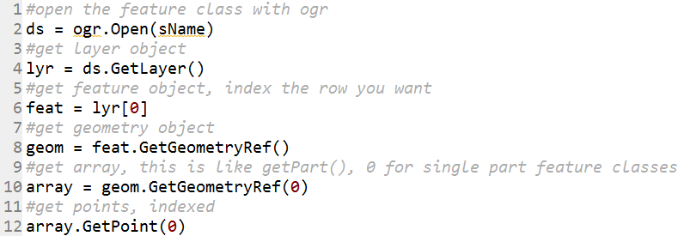
OGR Classes
GDAL/OGR are object oriented libraries. You have to work with multiple objects to complete a task, just like with arcpy.
Example:
This accesses the hierarchy of vector geometry encoding.
OGR examples

Slide 8
OGR Geometry Types
Well known binary (wkb) geometry types
wkbUnknown | unknown type, non-standard
wkbPoint | 0-dimensional geometric object, standard WKB
wkbLineString | 1-dimensional geometric object with linear interpolation between Points, standard WKB
wkbPolygon | planar 2-dimensional geometric object defined by 1 exterior boundary and 0 or more interior boundaries, standard WKB
wkbMultiPoint | GeometryCollection of Points, standard WKB
wkbMultiLineString | GeometryCollection of LineStrings, standard WKB
wkbMultiPolygon | GeometryCollection of Polygons, standard WKB
wkbGeometryCollection | geometric object that is a collection of 1 or more geometric objects, standard WKB
wkbNone | non-standard, for pure attribute records
wkbLinearRing | non-standard, just for createGeometry()
wkbPoint25D | 2.5D extension as per 99-402
wkbLineString25D | 2.5D extension as per 99-402
wkbPolygon25D | 2.5D extension as per 99-402
wkbMultiPoint25D | 2.5D extension as per 99-402
wkbMultiLineString25D | 2.5D extension as per 99-402
wkbMultiPolygon25D | 2.5D extension as per 99-402
wkbGeometryCollection25D | 2.5D extension as per 99-402
www.gdal.org/ogr

Slide 9
GDAL Raster Formats
Raster data format name | Code
Arc/Info ASCII Grid [1] | AAIGrid
ADRG/ARC Digitalized Raster Graphics (.gen/.thf) [2] | ADRG
Magellan BLX Topo (.blx, .xlb) [3] | BLX
Microsoft Windows Device Independent Bitmap (.bmp) [4] | BMP
VTP Binary Terrain Format (.bt) [5] | BT
Military Elevation Data (.dt0, .dt1, .dt2) [6] | DTED
ESRI .hdr Labelled [7] | EHdr
NASA ELAS [8] | ELAS
ENVI .hdr Labelled Raster [9] | ENVI
ERMapper (.ers) [10] | ERS
GeoTiff | GTiff
NOAA .gtx vertical datum shift | GTX
HF2/HFZ heightfield raster [11] | HF2
Erdas Imagine (.img) [12] | HFA
Image Display and Analysis (WinDisp) [13] | IDA
ILWIS Raster Map (.mpr,.mpl) [14] | ILWIS
Intergraph Raster [15] | INGR
USGS Astrogeology Isis cube (Version 2) [16] | ISIS2
KMLSUPEROVERLAY | KMLSUPEROVERLAY
In Memory Raster [17] | MEM
Vexcel MFF [18] | MFF
Vexcel MFF2 [19] | MFF2 (HKV)
NITF [20] | NITF
NTv2 Datum Grid Shift | NTv2
PCI Geomatics Database File [21] | PCIDSK
Raster Matrix Format (*.rsw, .mtw) [22] | RMF
Idrisi Raster [23] | RST
SAGA GIS Binary format [24] | SAGA
SGI Image Format [25] | SGI
SRTM HGT Format [26] | SRTMHGT
USGS ASCII DEM / CDED (.dem) [27] | USGSDEM
GDAL Virtual (.vrt) [28] | VRT
ASCII Gridded XYZ [29] | XYZ

Slide 10
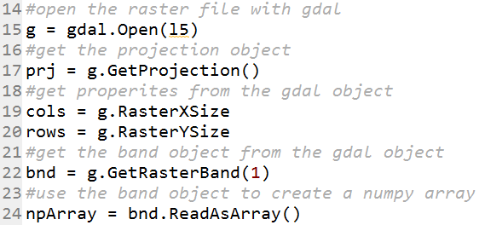
GDAL Classes
GDAL allows for multiple bands. Excellent interface with numpy is provided.
Example:
Should look familiar, working with arcpy raster objects is similar
GDAL examples

Slide 11
GDAL Data Types (GDT)
GDT Data Type and Reference #
GDT_Unknown = 0,
GDT_Byte = 1,
GDT_UInt16 = 2,
GDT_Int16 = 3,
GDT_UInt32 = 4,
GDT_Int32 = 5,
GDT_Float32 = 6,
GDT_Float64 = 7,
GDT_CInt16 = 8,
GDT_CInt32 = 9,
GDT_CFloat32 = 10,
GDT_CFloat64 = 11,
GDT_TypeCount = 12
http://www.gdal.org/gdal_8h.html

