Slide 1

Lung disease prediction from x-ray images
Anna Badalyan, Mehran Farajinegarestan
Department of Mathematics, University of Padua, 2022

Slide 2
Plan of the presentation
Introduction
Pre-processing
Models
Results
Conclusions

Slide 3
Introduction
Logistic regression
CNN 3 Layers
Problem Definition:
Classifying chest X-ray images of patients with COVID-19, non-COVID pneumonia, and normal medical conditions
To compare existing Machine Learning and Deep Learning solutions for this dataset
CNN 5 Layers
DneseNet
DenseNet with Attention
ResNet
RepVGG

Slide 4
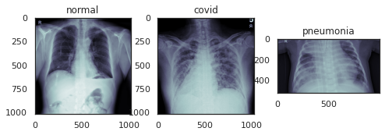
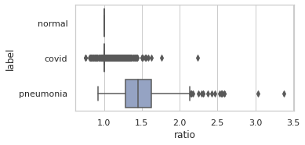
Pre-processing: Dataset
4575 images
Balanced dataset:
1525 covid
1525 normal
1525 pneumonia
Fig 1. Sample images
Fig 2. Aspect ratio distribution by label

Slide 5
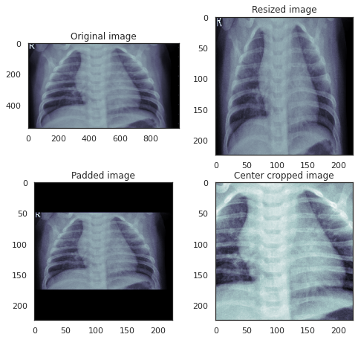
Pre-processing: Techniques
3 techniques:
Resizing
Padding
Center cropping
Resized to 224x224
Grayscale color mode
In addition, data augmentation applied on padded dataset

Slide 6
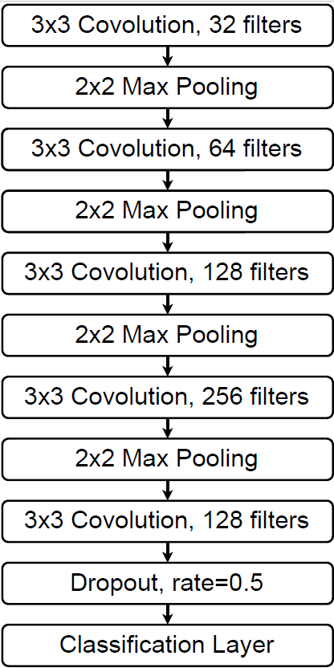
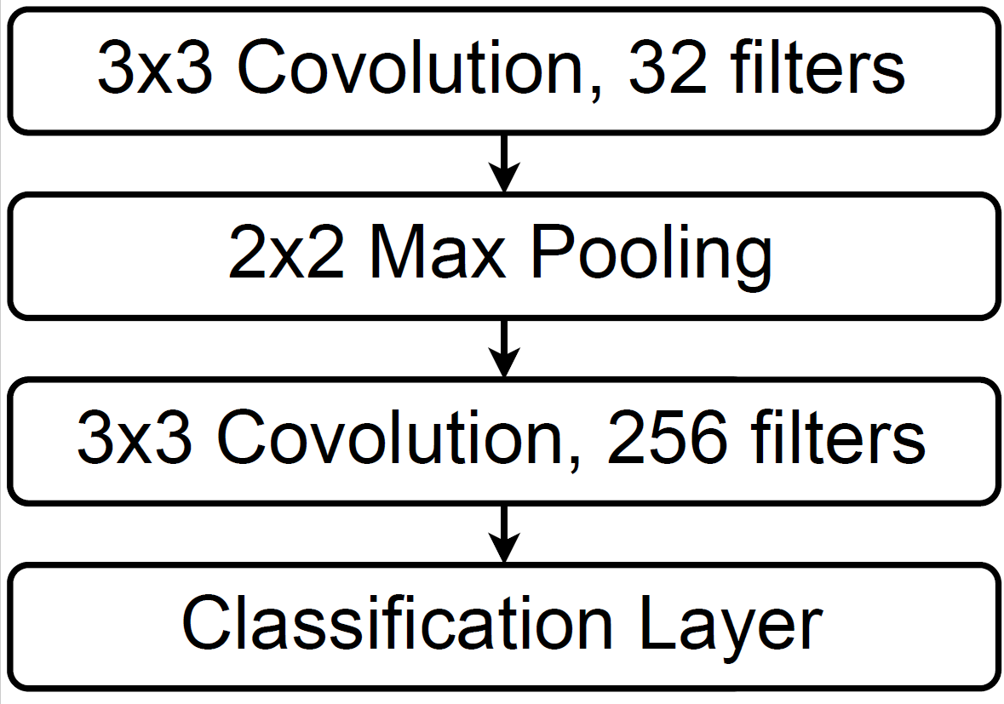
Models
CNN-5
Total parameters: 1,054,723
Dropout for regularization
Optimizer: Adam, learning rate 1e-3
CNN-2
Total parameters: 9,198,915
Optimizer: Adam, learning rate 1e-4

Slide 7
Models: Logistic Regression
Flattened 224x224 images into 50 176
Lasso regularization, C=1
One Vs Rest approach

Slide 8
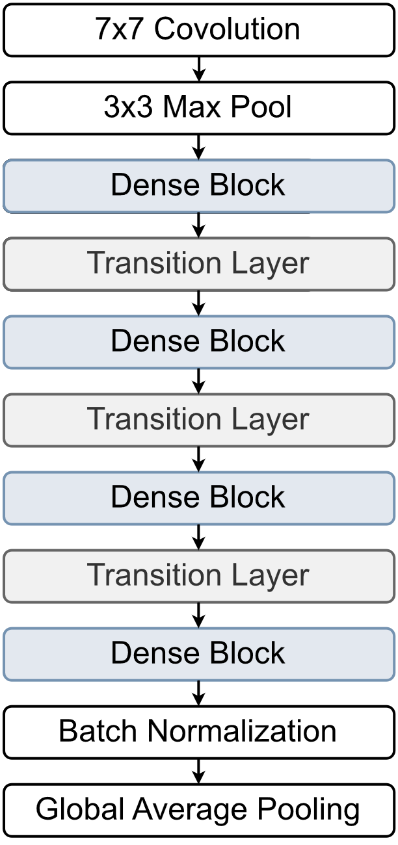
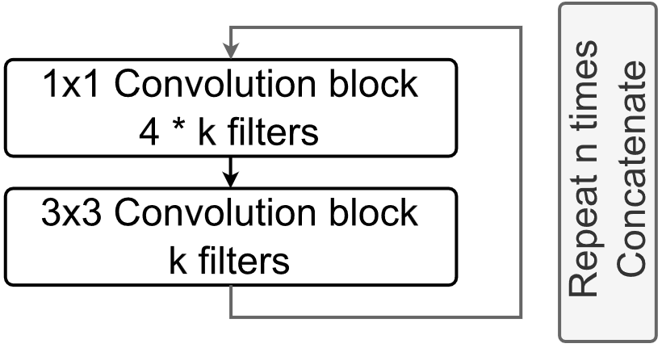
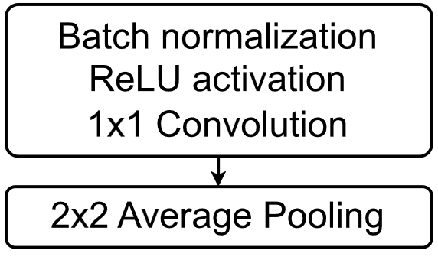
Models: DenseNet
Dense Block
Transition Layer
DenseNet-121: 6, 12, 24, 16 repetitions for each dense block
7,044,547 parameters
DenseNet-201: 6, 12, 48, 32 repetitions for each dense block
18,338,499 parameters

Slide 9
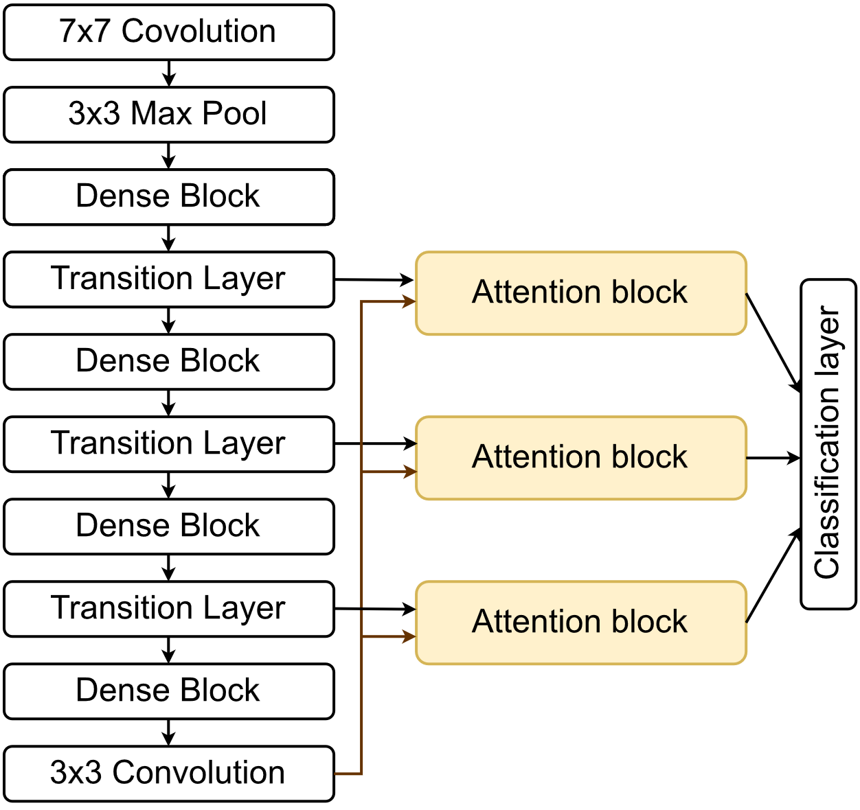
Models: DenseNet with Attention
Attention block computes the compatibility between the global output of network and the intermediate output of the transition layer.
Total parameters: 11,701,571

Slide 10
Models: ResNet
7x7 Convolution
Batch Normalization
Input
Input
3x3 Max Pooling
1x1 Convolution
Batch Normalization
Convolutional Block
1x1 Convolution
Batch Normalization
1x1 Convolution
Batch Normalization
Identity Block
3x3 Convolution
Batch Normalization
3x3 Convolution
Batch Normalization
Convolutional Block
1x1 Convolution
Batch Normalization
1x1 Convolution
Batch Normalization
Identity Block
+
Average Pooling
+
Fully Connected
Identity Block
Convolutional Block

Slide 11
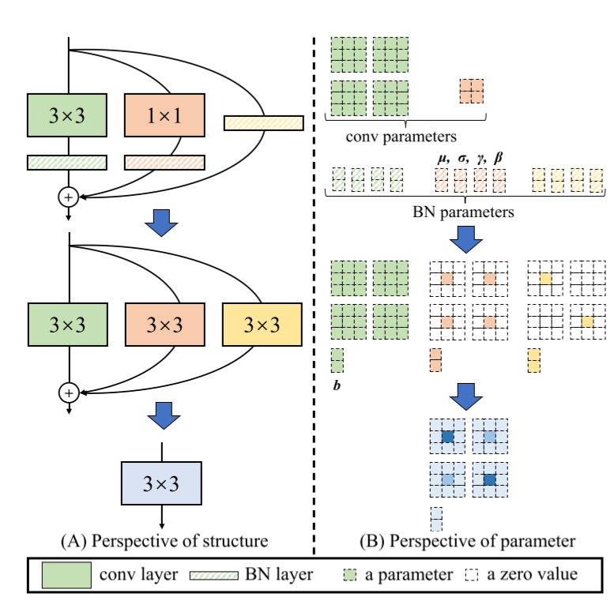


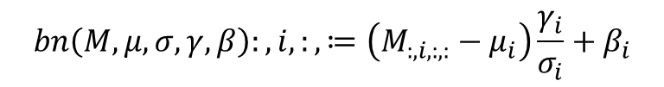
Models: RepVGG
$$M^{(2)}=bn\left(M^{\left(1\right)}∗W^{\left(3\right)},μ^{\left(3\right)},σ^{\left(3\right)},γ^{\left(3\right)},β^{\left(3\right)}\right)$$
$+bn\left(M^{\left(1\right)}∗W^{\left(1\right)},μ^{\left(1\right)},σ^{\left(1\right)},γ^{\left(1\right)},β^{\left(1\right)}\right)$
$+bn\left(M^{\left(0\right)}∗W^{\left(0\right)},μ^{\left(0\right)},σ^{\left(0\right)},γ^{\left(0\right)},β^{\left(0\right)}\right)$
$$bn\left(M,μ,σ,γ,β\right):,i,:,≔\left(M_{:,i,:,:}−μ_{i}\right)\frac{γ_{i}}{σ_{i}}+β_{i}$$
$${W′}_{i,:,:,:}=γ_{i}σ_{i}W_{i,:,:,:},{b′}_{i}=−μ_{i}\frac{γ_{i}}{σ_{i}}+β_{i}$$
$$bn{(M∗W,μ,σ,γ,β)}_{:,i,:,:}={(M∗W′)}_{:,i,:,:}+{b′}_{i}$$
[Ding et al. 2021,RepVGG: Making VGG-style ConvNets Great Again]

Slide 12
Models: RepVGG
Training-time total parameters: 786,691
Inference-time total parameters: 702,147
10% reduction in the number of parameters
[Ding et al. 2021,RepVGG: Making VGG-style ConvNets Great Again]

Slide 13
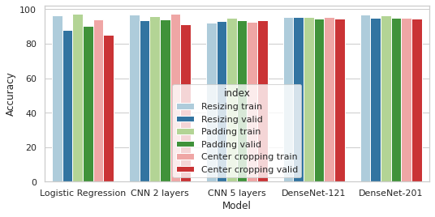
Results: Pre-processing
Train and validation results for 3 different preprocessing methods used by algorithm

Slide 14
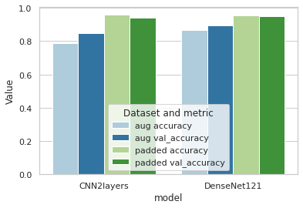
Results: Pre-processing Augmentation
After applying padding, the dataset was augmented
The validation accuracy dropped:
CNN-2 from 93.98% to 84.84% DenseNet-121 from 95.34% to 86.65%
Train and validation accuracy with and without augmentation technique

Slide 15
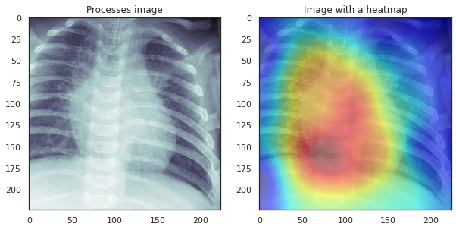
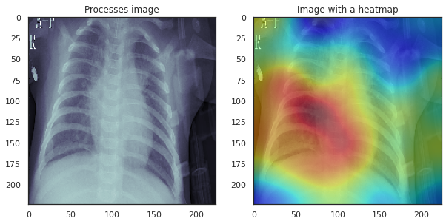
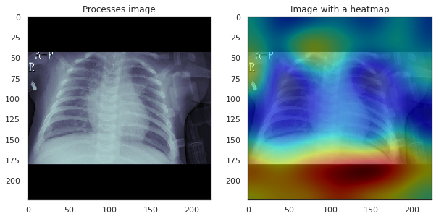
Results: Pre-processing
The heatmap of the last output layer of the model on different datasets
For padded dataset the models looks at the black spaces
Model trained on center cropped dataset.
Predicted “pneumonia”
Model trained on resized dataset.
Predicted “pneumonia”
Model trained on padded dataset.
Predicted “pneumonia”

Slide 16
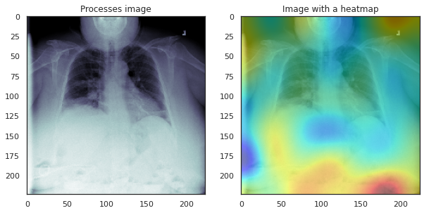
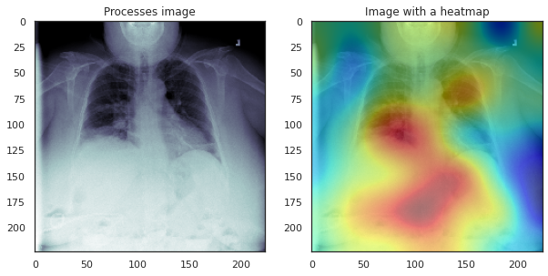
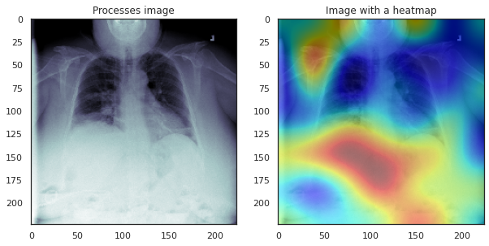
Results: Pre-processing
The heatmap of the last output layer of the model on different datasets
Image label: pneumonia
Model trained on center cropped dataset.
Predicted “normal”
Model trained on resized dataset.
Predicted “pneumonia”
Model trained on padded dataset.
Predicted “normal”

Slide 17
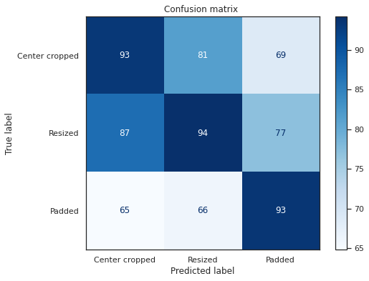
Results: Pre-processing
Accuracy on the test set pre-processed in 3 different ways
Models trained on the same pre-processing techniques
Model trained on
Test Dataset

Slide 18
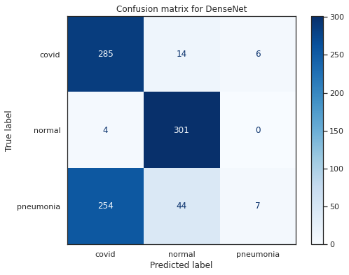
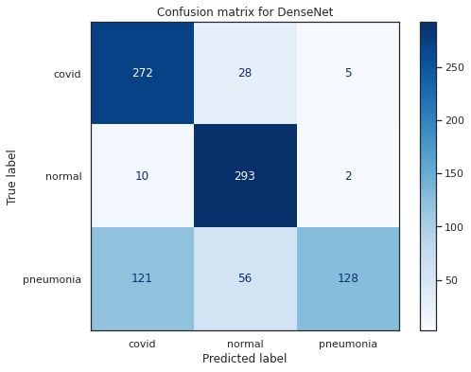
Results: Pre-processing
Confusion matrix for the model trained on the padded dataset on the resized test set.
Without augmentation
Accuracy: 66.01%
With augmentation
Accuracy: 75.74%

Slide 19
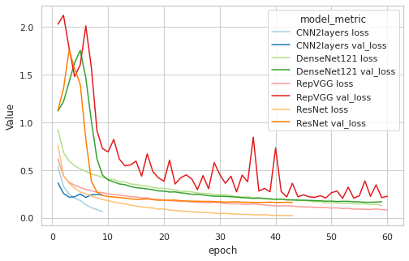
Results: Classification
Shallow networks start overfitting less than 10 epochs
Deeper networks learn poorly during the first 10 epochs
All models surpass the accuracy of 93% on validation set
DenseNet is less prone to overfitting

Slide 20
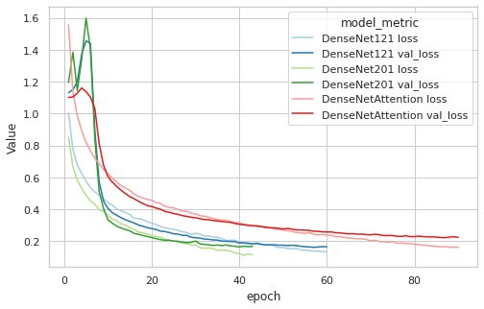
Results: Classification
Attention did not improve the performance
Validation accuracy dropped from 95.49% to 93.17%
DenseNet with attention takes more epochs to train

Slide 21
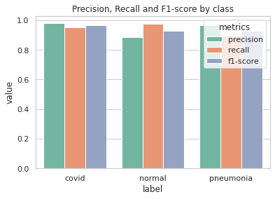
Results: Classification
DneseNet-121 on resized images got highest validation accuracy (95.49%)
With test set accuracy 94.2%
The model had the highest F1-score with covid images

Slide 22
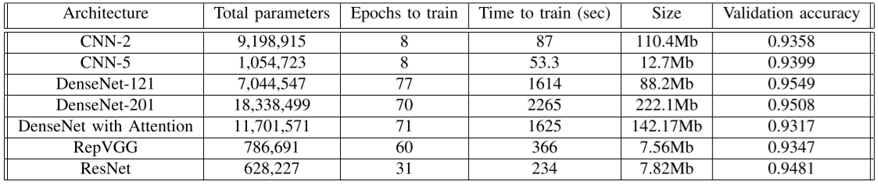
Results: Computational Efficiency
ResNet is the most efficient architecture
DenseNet architecture achieves the best performance
RepVGG and DenseNet-with-attention failed to outperform similar models

Slide 23
Conclusions
Best performing model: DenseNet (94.2% accuracy on test)
Most efficient model: ResNet
The attention didn’t work because the output of the final dense block gets almost discarded
The models didn’t learn useful representations because of the biasness of the dataset
To achieve more stable results data augmentation and mix the preprocessing techniques could be used.

