Slide 1

Canadian Immigration Trends by Province (2006-2022)
Collaborators:
Daria Riechkina
Mehr Atif
Laura Josetti
Megha Rani

Slide 2

Motivation:
The primary motivation underlying the selection of this research theme is to express the main trends of immigration process and its impact on business and society.
To present immigration data in an accessible and visually appealing manner, making it easy for stakeholders, policymakers, or the general public to understand and interpret the information.

Slide 3

Data Source:
1. Bank of Canada https://www.bankofcanada.ca
2. CMHC
https://www.cmhc-schl.gc.ca
3. Government of Canada Statistics https://www.canada.ca/en/government/statistics.html

Slide 4
ETL
Start with 57 CSV files
Cleaning process
Merging process
Getting 5 main CSV files
Creating database in Postgres

Slide 5
Used Techniques:
Flask
Pandas
Postgres
HTML
D3.js
Leaflet.js
Plotly.js
Java Script
JQuery

Slide 6
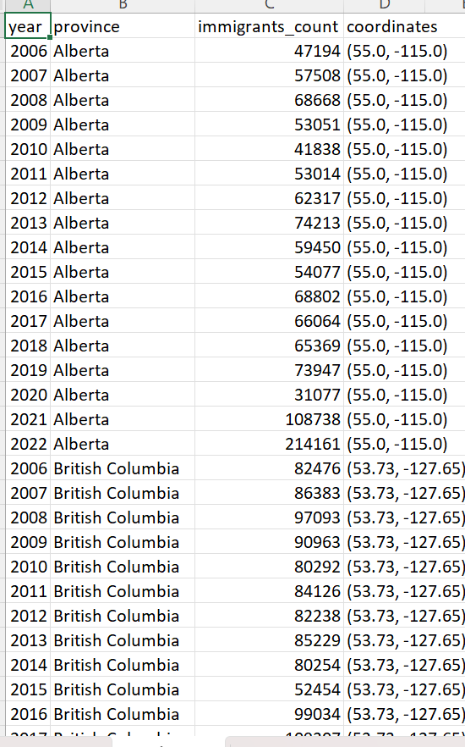
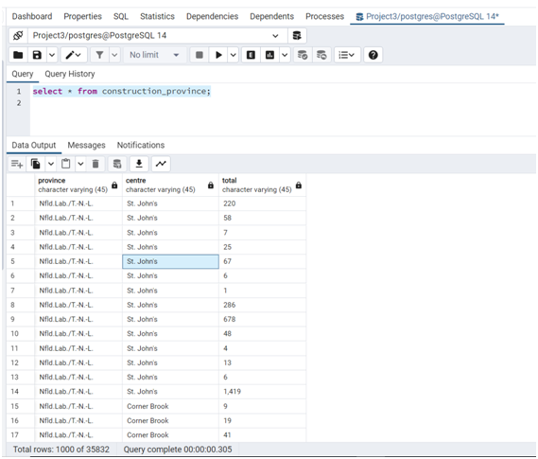
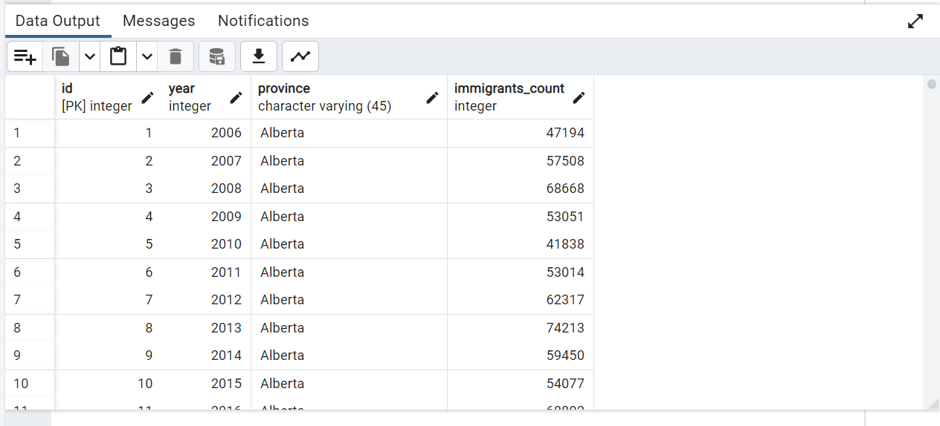
Database Project3 Postgres

Slide 7
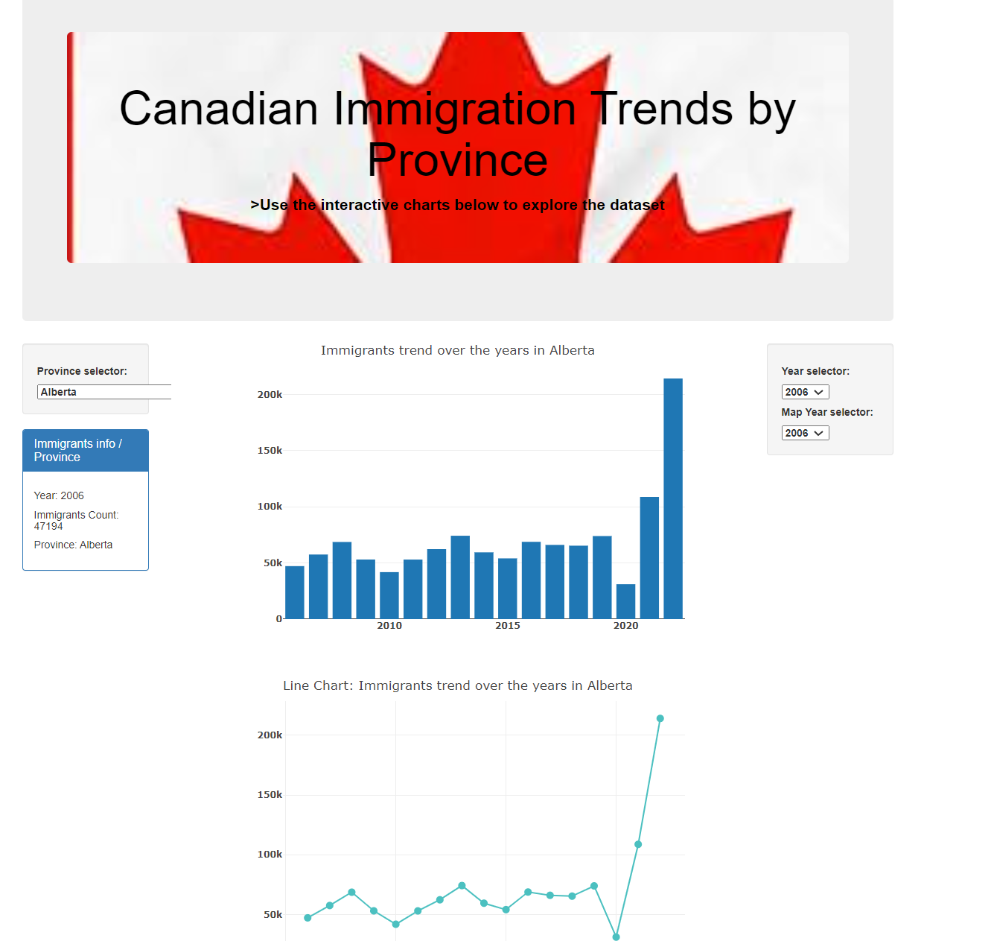

Slide 8
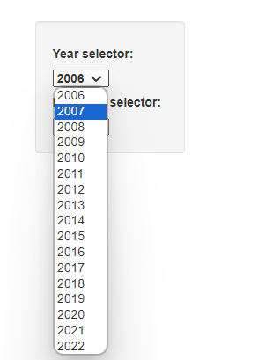
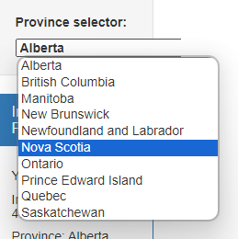
Interactivity

Slide 9
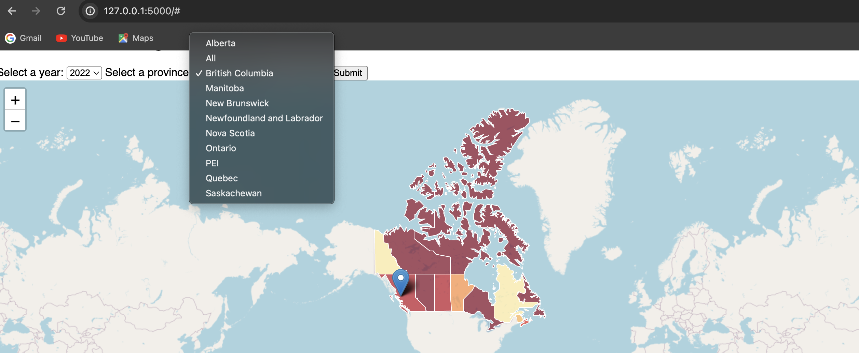

Slide 10
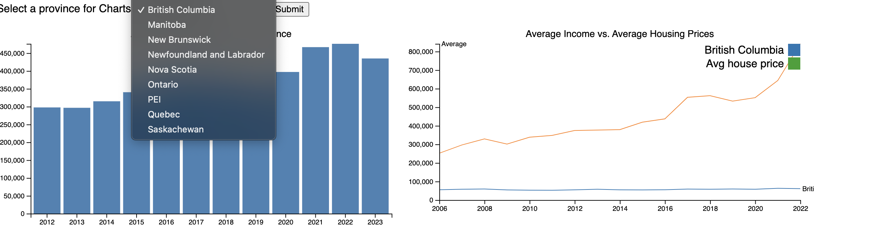

Slide 11

Conclusion:
Number of immigrants significantly has been increasing over past decade, except 2020 year due to Covid-19;
Ontario is the most popular province for immigrants however, Newfoundland and Labrador is less popular;
Good developed construction business is noted in Ontario, Alberta, Quebec, as compeared to development in Newfoundland and Labrador, PEI;
Ontario and Alberta exhibit the highest average income levels, while Newfoundland and Labrador, as well as Prince Edward Island (PEI), experience comparatively lower average incomes;
The biggest increase in mortgage prices occurred from 2020 to 2021. This phenomenon covered all provinces in Canada.
The provinces with the most expensive mortgages, ranked from highest to lowest, are British Columbia, Ontario, and Alberta. Conversely, the provinces with the most affordable mortgages, in descending order, are New Brunswick, Quebec, and Newfoundland and Labrador .

Slide 12


