Slide 1

Credit Default Risk
Mehr Atif
Daria Riechkina
Megha Rani

Slide 2
OBJECTIVE
Can you predict how capable each applicant is of repaying a loan?
The primary objective of this project is to develop a robust and accurate predictive model to assess the credit risk of loan applicants.
Specifically, the project seeks to:
Improve Decision-Making
Enhance Credit Risk Management
Optimize Loan Approval Process
Ensure Fair and Responsible Lending

Slide 3
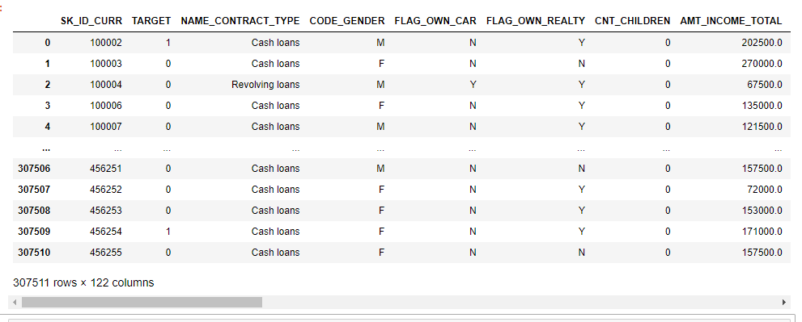
Data Overview
Application_train.csv
Includes Target variable(binary)
1- client with payment difficulties
0- client with no difficultly.
Info about lean and loan applicant at application time
https://www.kaggle.com/competitions/home-credit-default-risk/data
Static data for all applications. One row represents one loan in our data sample.

Slide 4
Analysis Process:
Understanding the purpose of analysis;
Gathering data;
Exploration data;
Wrangling data;
Features engeniering;
Machine learning model building;
Summarising results.

Slide 5

Model building with Random Forest Classifier
Problems:
Can’t deal well with categorical data;
Model have hight accurancy 92%, but very low precision and recall;
Summary:
Model doesn’t work
Need to choose another algorithm

Slide 6
LightGBM
Why?
Can deal well with categorical data;
Can deal well with big dataset;
Can deal well with umbalaced dataset.
Results:
Accuracy – 70%
Recall – 0.70, 0.63
Precision - 0.84, 0.55
Summary:
Model works well and can capture 1 (applicants potentially will have difficulties with payments)

Slide 7
Process of achivement
Changing parameters, such as learning_rate, n_estimators, num_leaves, max_depth, metric;
Imbalance TARGET in dataset using fraction of samples, SMOTE, Pipeline;
Dealing with categorical data using LabelEncoder;
Dealing with missing values;
Creating several models with different parameters;
Reducing number of features from 122 to 11 using several models and feature_importances_

Slide 8
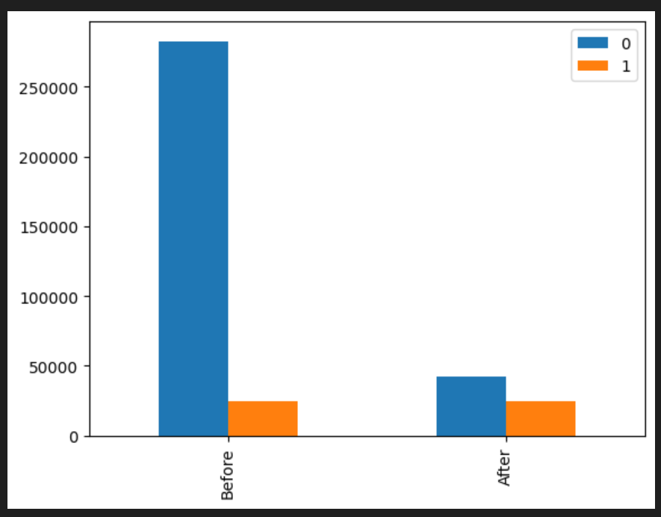
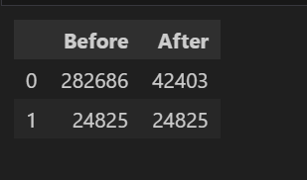
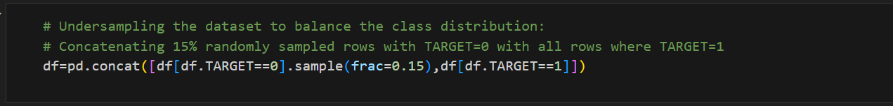
Undersampling
Value counts TARGET before and after undersampling

Slide 9
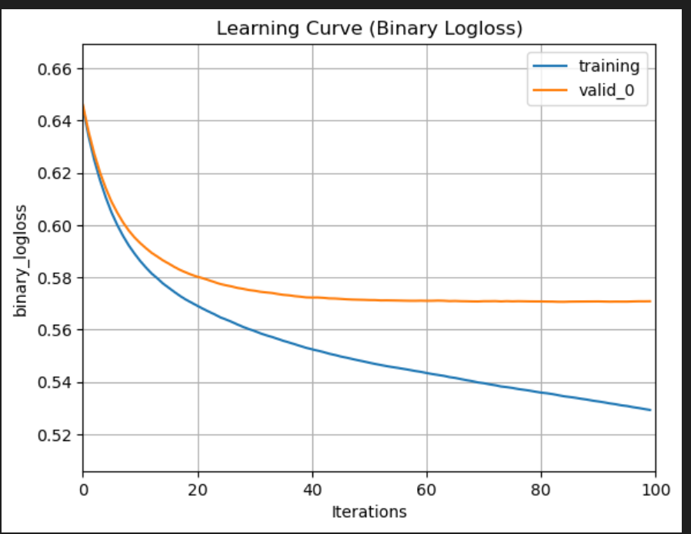
Learning Curve Analysis
1.Model Learning:
Blue training curve consistently improves, showcasing effective learning from the training data.
2.Validation Stability:
Orange validation curve stabilizes at 0.57, indicating the model's reliable performance on unseen data.

Slide 10
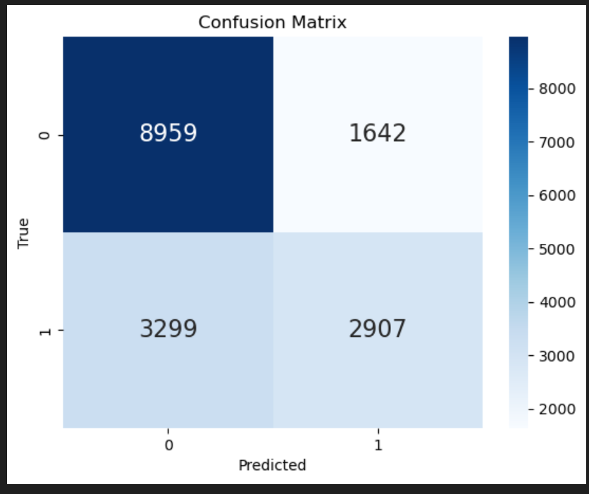
Confusion Matrix
True Negatives (TN): 8981
False Positives (FP): 1642
False Negatives (FN): 3299
True Positives(TP) : 2907
Accurately predicts (TN) and (TP)
Model needs improvement with the (FN).

Slide 11
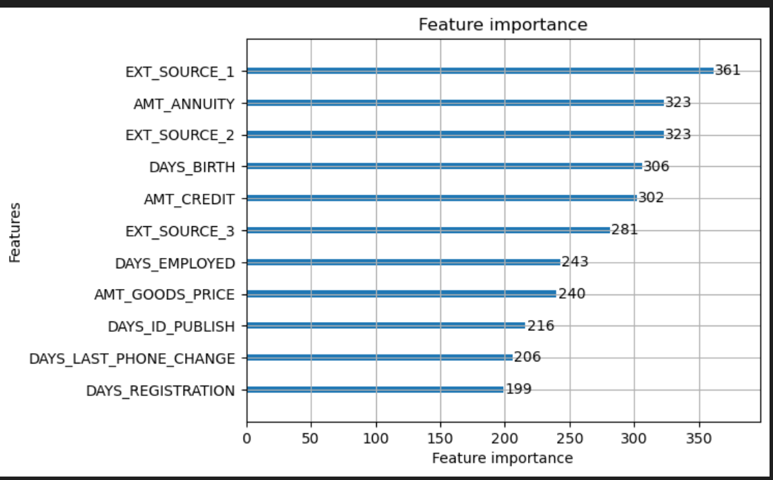
Feature Importance
Plotting the feature importance to understand which features contribute most to the model’s predictions.
The model’s performance remains unchanged with the smaller dataset .

Slide 12
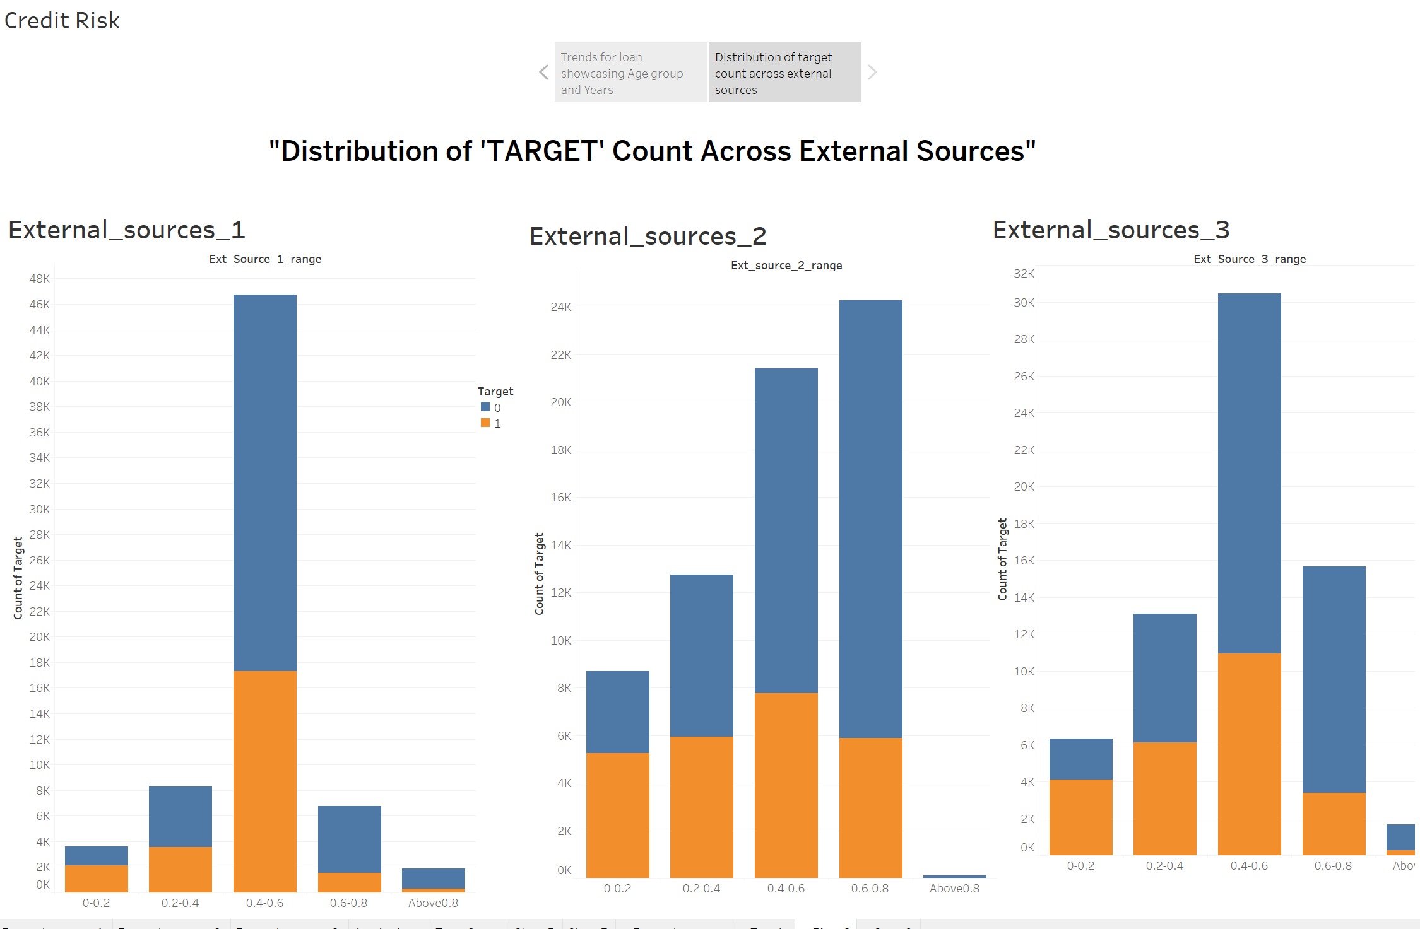
Correlation of External Sources with Loan Repayment
Clients that fall between the External source range of 0.4 -0.6 are most likely to face challenges in the loan repayment

Slide 13
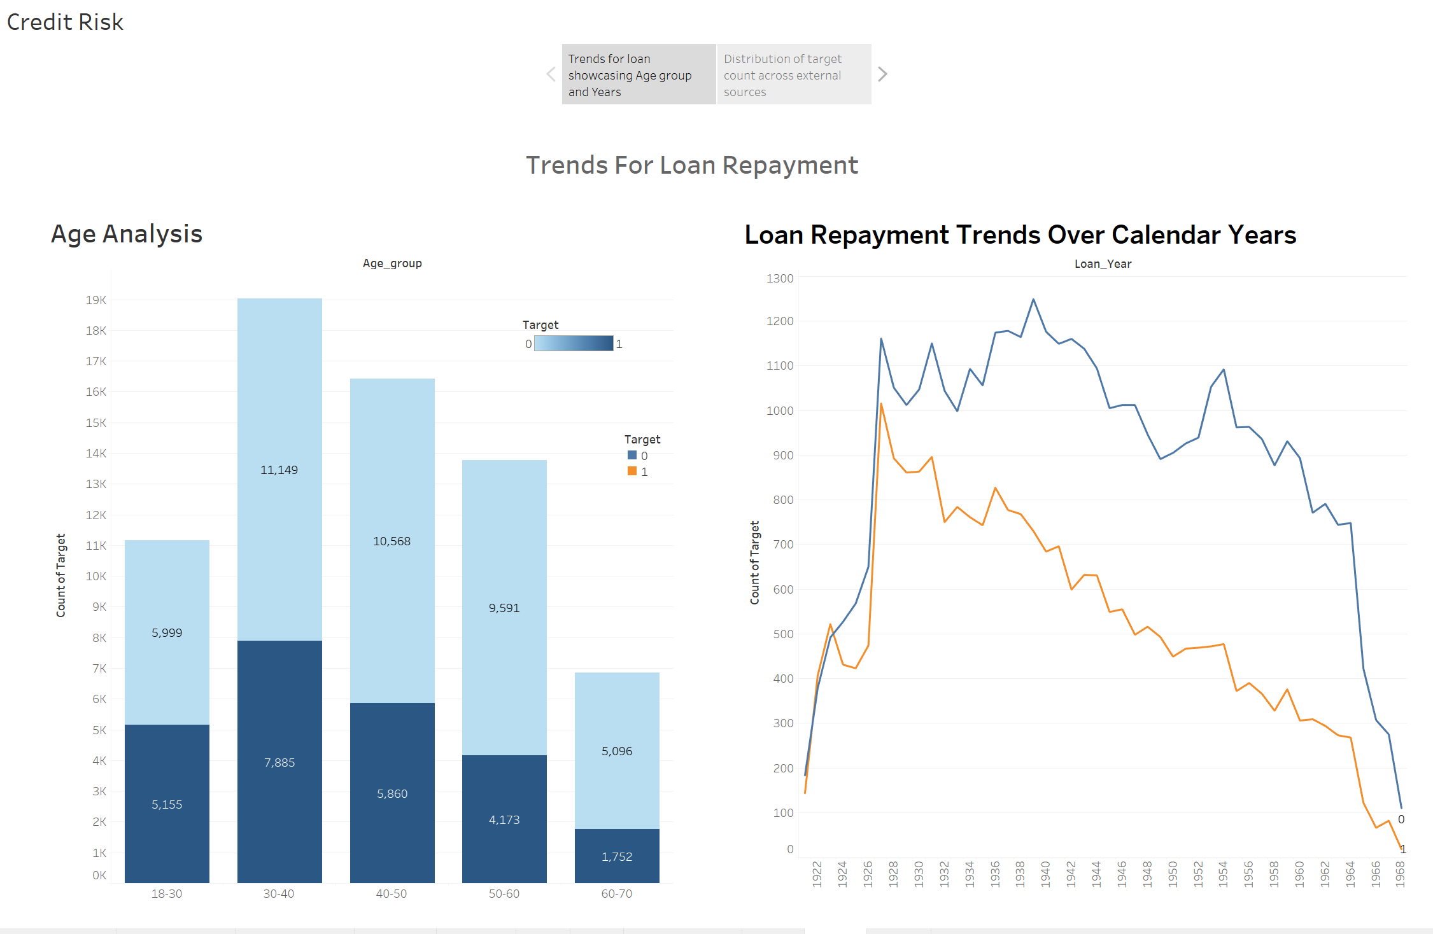
Trend Analysis
Using Tableau analyzed age-based patterns and Loan Repayment trends over the calender years to craft smart solutions for better loan repayment outcomes.

Slide 14
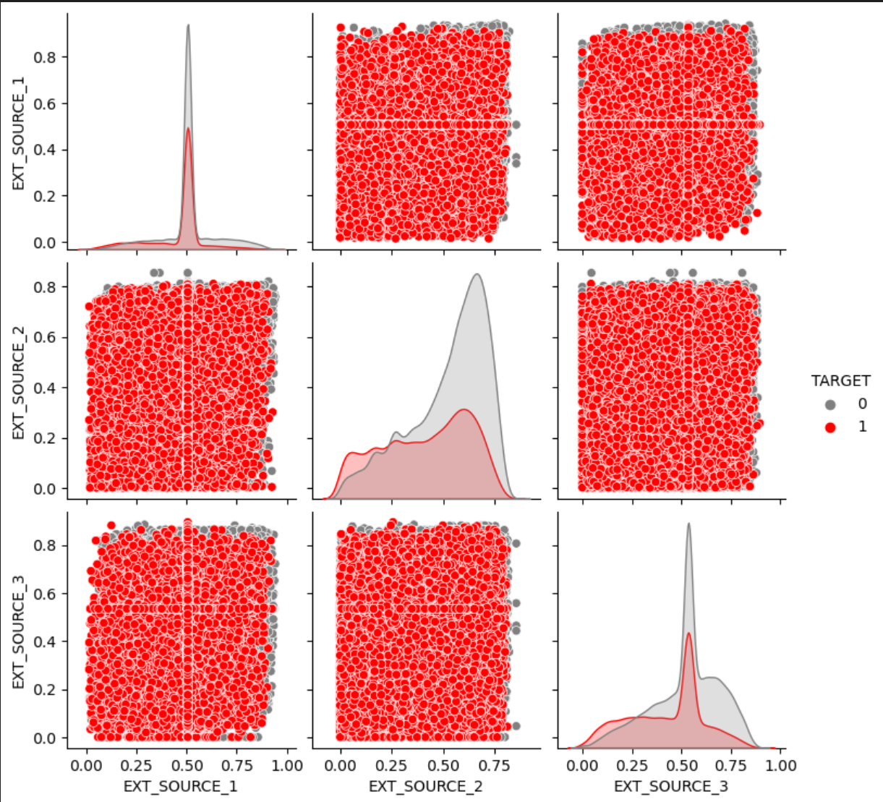
Distribution of extarnal sources
Showing the correlation between the external sources and the target using Pairplots

Slide 15

Conclusion:
Successfully developed a machine learning model aimed at predicting loan risks, which holds the potential to enhance the stability and profitability of financial institutions.
The dataset utilized for this model is characterized by an imbalance in class distribution, a substantial amount of categorical data, positively skewed numerical data, and the presence of missing values across 122 features.
The LightGBM algorithm was selected due to its exceptional ability to handle large, unbalanced datasets, efficiently manage categorical variables, and deliver rapid training speeds. Moreover, LightGBM is renowned for achieving high prediction accuracy across a diverse array of datasets.
While the model exhibits promising performance, there remains an opportunity for enhancement in terms of accuracy. Strategies such as hyperparameter tuning, feature engineering could further optimize the model's predictive capabilities. By continuing to refine the model, we can strengthen its efficacy in identifying loan risks and ultimately bolster the stability and profitability of financial institutions.

Slide 16

Questions?
Thank you for your time!

