Slide 1


Flight Price Analysis
Participants:
Daria Riechkina
Mehr Atif
Laura Josetti
Megha Rani

Slide 2
Motivation:
The primary motivation underlying the selection of this research theme is to facilitate a more streamlined and advantageous travel experience for individuals utilizing a diverse array of airline services.
The aim is to empower travelers with the tools and insights necessary for making informed decisions, resulting in both cost savings and a more efficient utilization of their time.

Slide 3
Objectives of analysis:
Does the ticket price change with the duration of flight
Does the ticket price change with season
Does the price vary with airlines
The price changes with the route
The price changes with the number of stops

Slide 4
Analysis Process:
Data Collection
Data Exploration
Data Processing
Data Statistical Analysis
Data Visualization

Slide 5
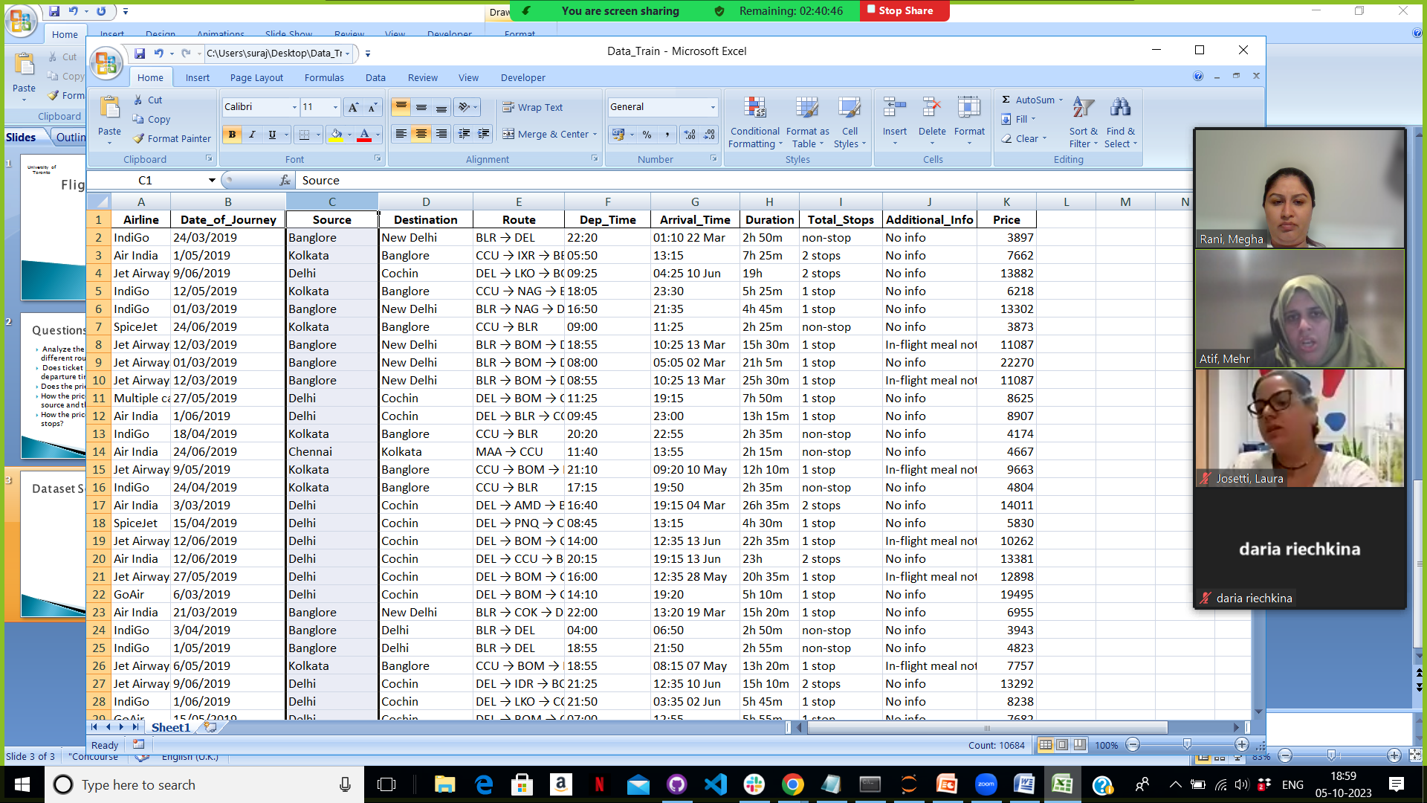
Dataset Source:
https://www.kaggle.com/code/anshigupta01/flight-price-prediction/input
Rows: 10,683
Columns: 11
Data type: String

Slide 6
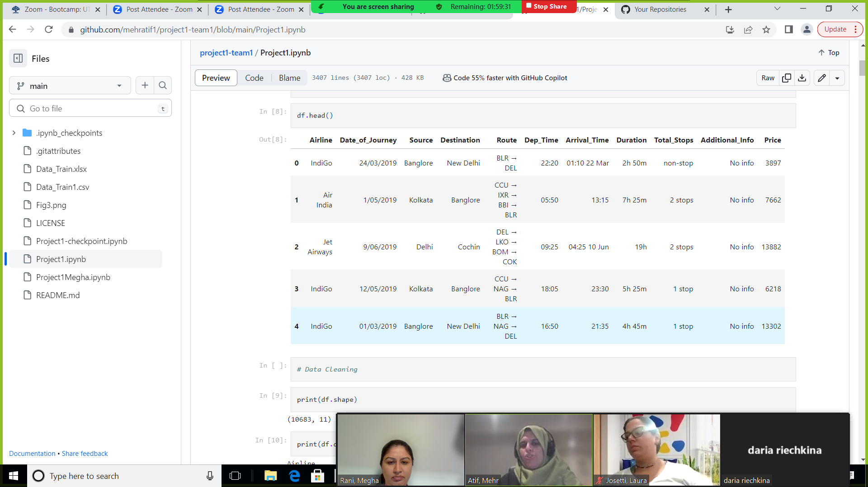
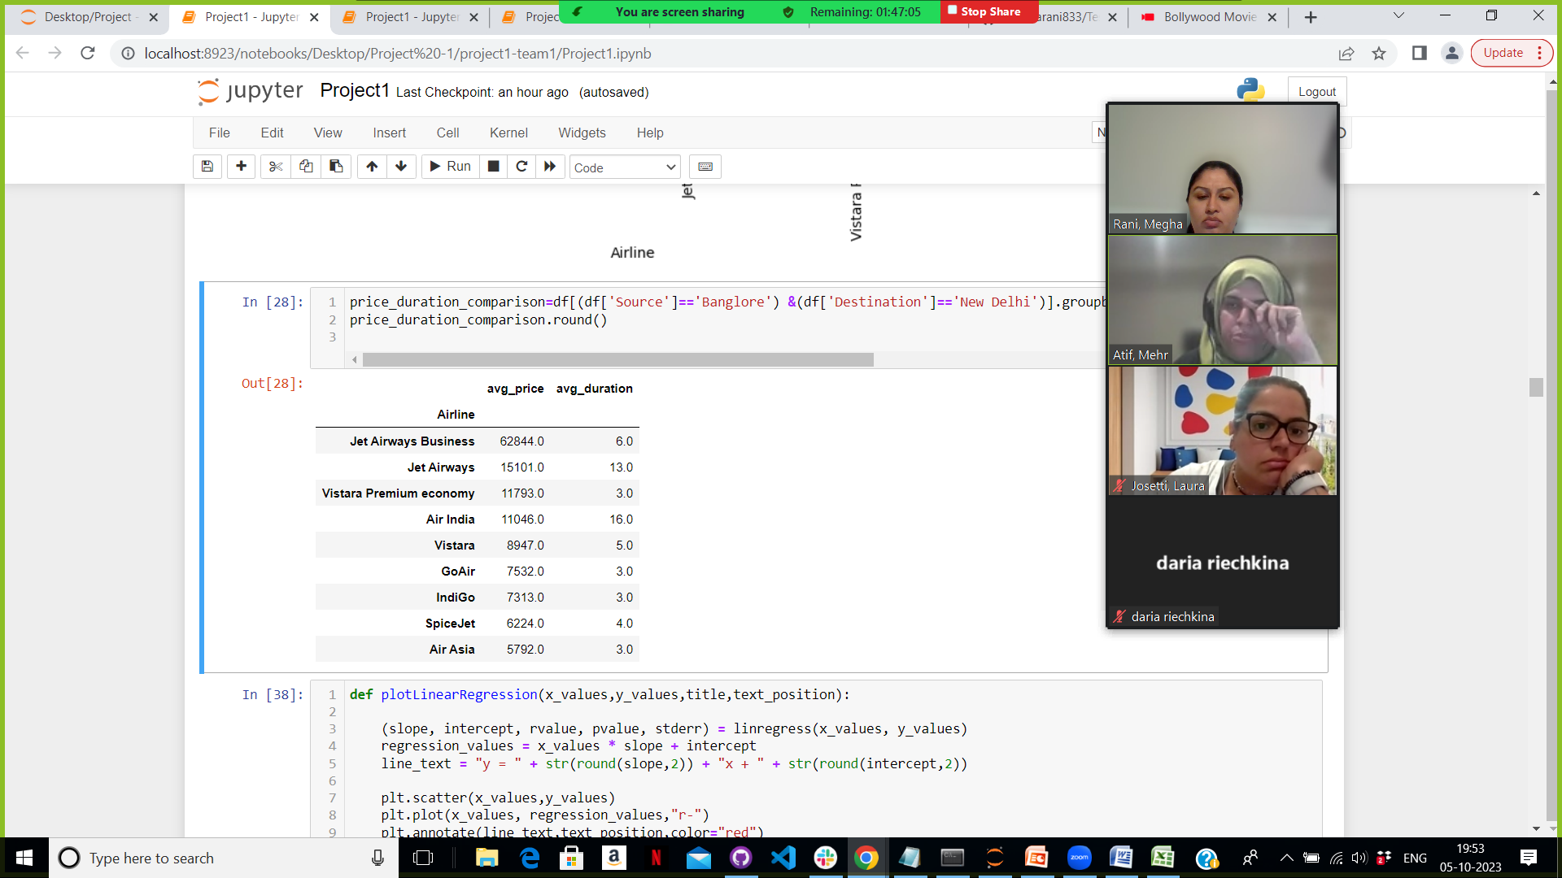
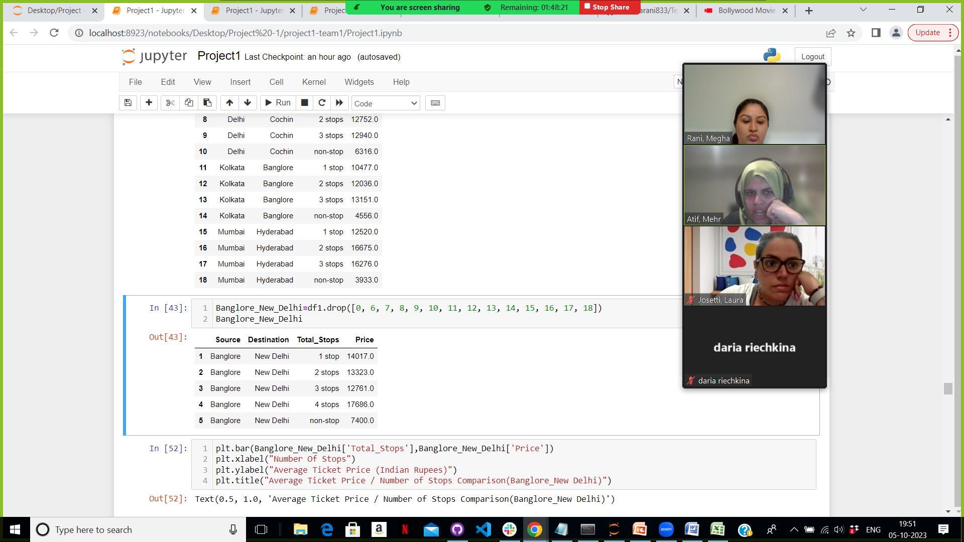
Data Processing
Cleaning, Converting Formats, Extracting Information

Slide 7
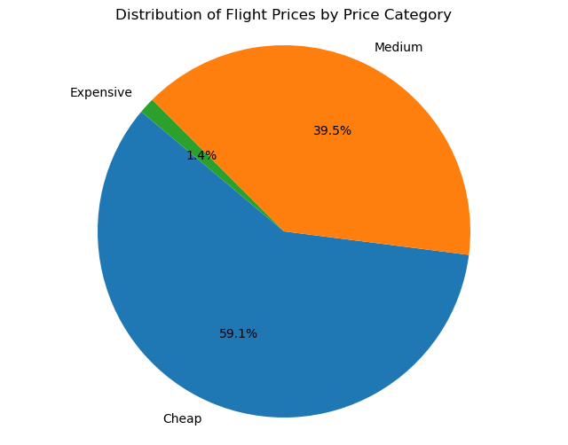
Ticket’s Price Category

Slide 8
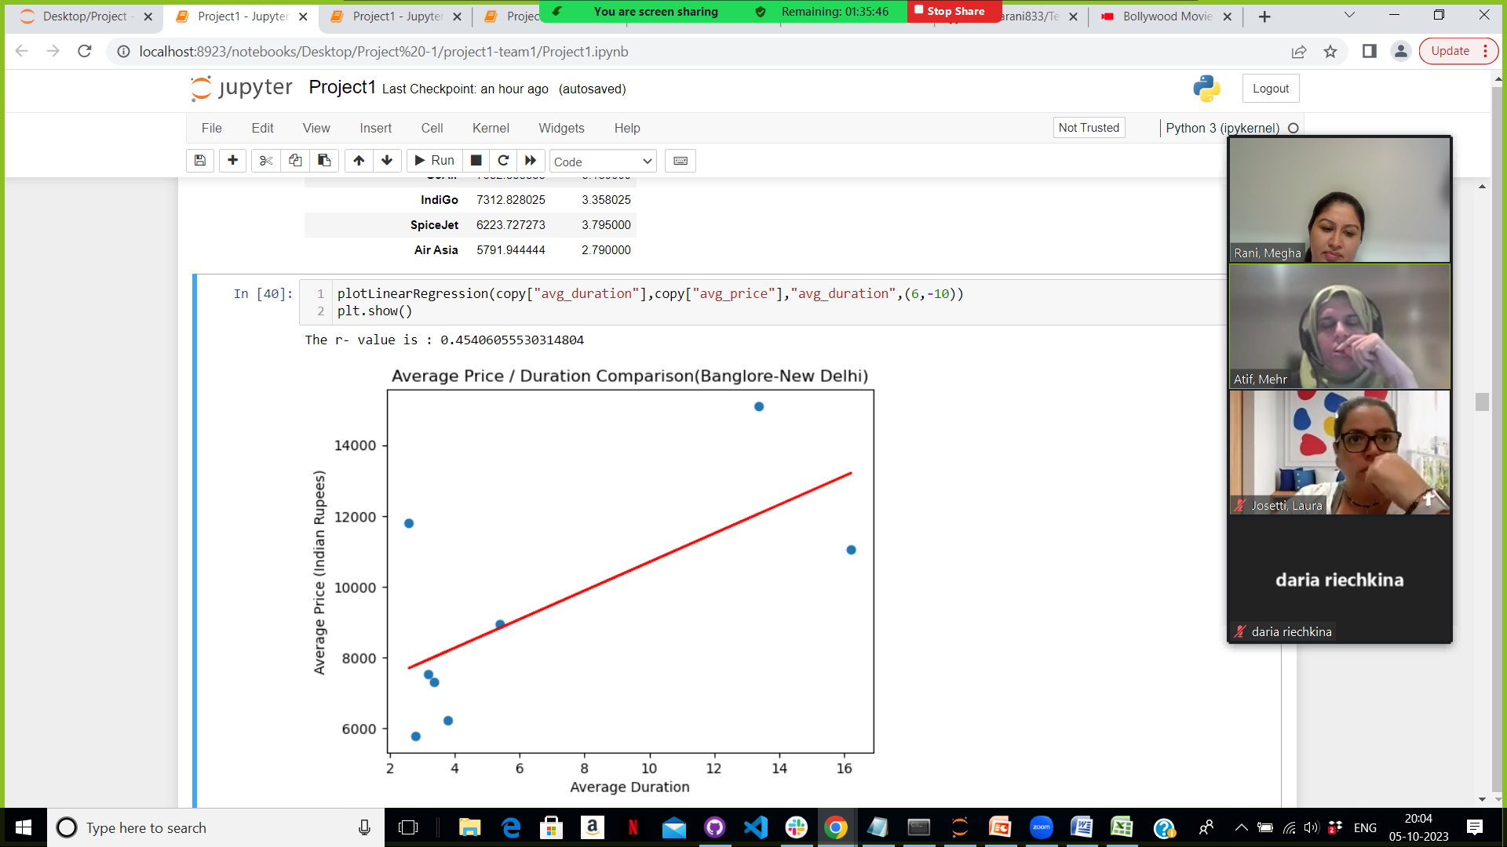
Price/ Average Duration Correlation

Slide 9
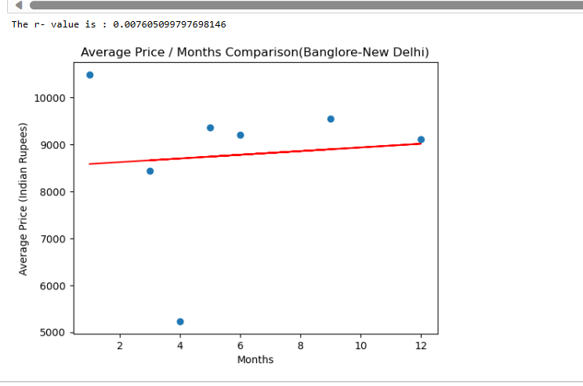
Price/season

Slide 10
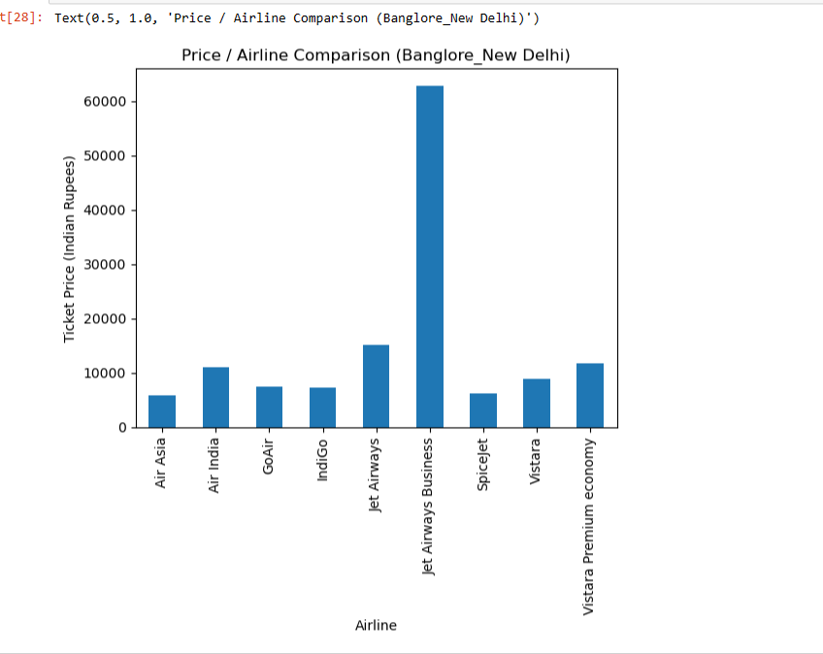
Price/Airline comparison

Slide 11
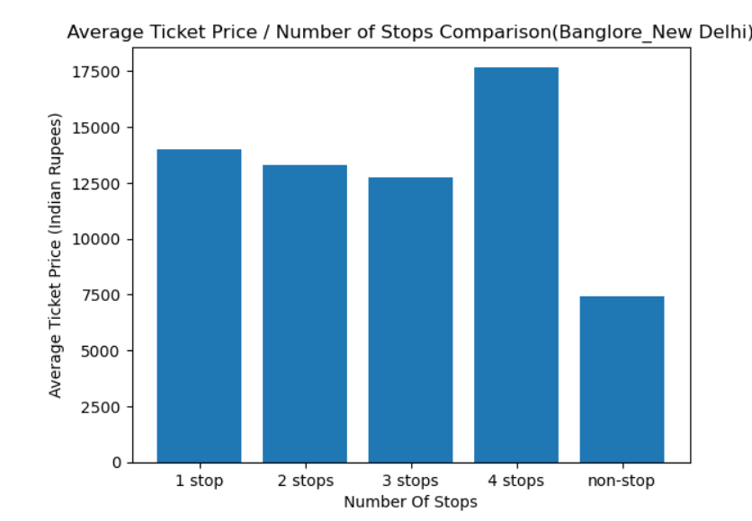
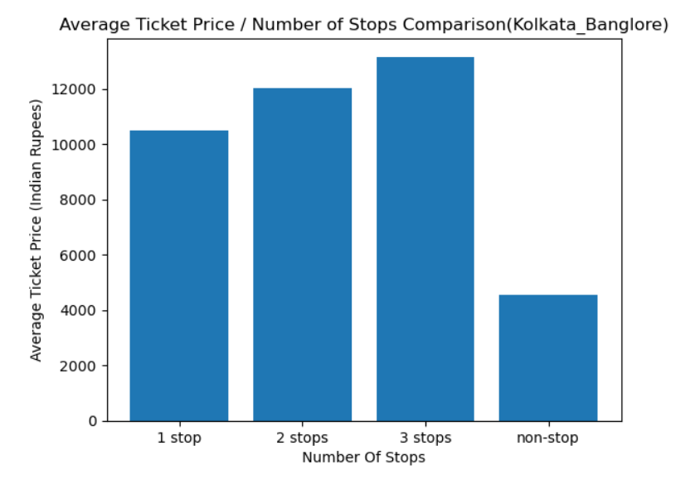
Price Analysis / Number of Stops

Slide 12

Conclusion:
Time Efficiency Matters: Shorter flights tend to correlate with lower ticket prices.
Stopovers Impact Cost: Flights with two or more stops often come with higher ticket prices.
Seasonal Consistency: Seasonal fluctuations appear to have minimal influence on ticket prices.
Budget-Friendly Prevalence: Economical ticket options dominate the market, reflecting a strong preference for affordability among travelers.
Thank You!

Slide 13

Questions?

